Slide 1

1929- PY1B
[Customer Name]
25th November, 2020

Slide 2
Contents
Ant pinch control strategy
Medtronic's video for ventilator basics
Medtronic's clinician manual overview
Requirement documentation
Alarm screen-141

Slide 3
EOL program modification for PY1B SW5.2.0 testing sequence
Cycle Time Sequence
Trigger{Down(H),Up(H)--- Down(L)+Up(L) }
Automatic current cut off
Load cell measurement
Switch based De-Initialization
TDC
Pinch Force Measurement
Inching Movements(Manual UP)
Shipping Position
?
?
Auto Down
Manual Down
Manual UP
Delay
Auto UP
?
BDC
Dead Weight Loading
Delay
Dead Weight Release and Factory Mode Verification
Delay
Trigger{Up(H) ,Down(H), --- Down(L)+Up(L) }

Slide 4
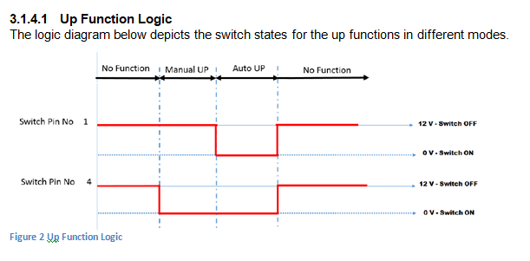
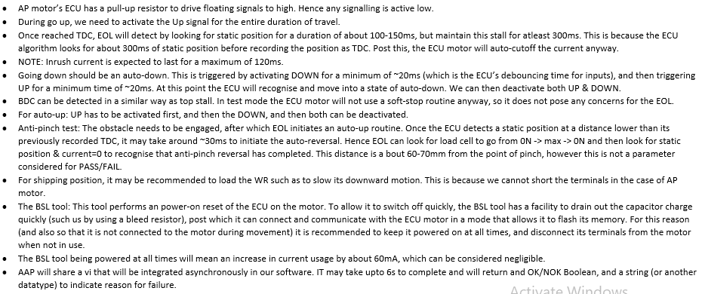
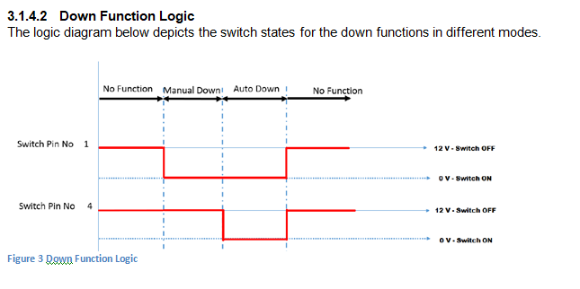
BSL flash and initialization details
DOWN pin
UP pin
DOWN pin
UP pin

Slide 5
Cycle Time Sequence for the standard WR
Load cell measurement
Delay
TDC
Go up (Loaded)
Shipping Position
Shipping posiition
Homing
BDC
Delay
Delay

Slide 6
Test sequence
Load dn
Load up

Slide 7
Test sequence

Slide 8
Test sequence

Slide 9
Test sequence

Slide 10
Test sequence

Slide 11
Test sequence

Slide 12
Test sequence

Slide 13
Test sequence

Slide 14
Test sequence

Slide 15
Test sequence

Slide 16
Test sequence

Slide 17
Shipping position

Slide 18
Shipping position
SP

Slide 19
Shipping position
SP

Slide 20
Test sequence

Slide 21
Test sequence

Slide 22
Test sequence

Slide 23
Test sequence

Slide 24
Test sequence

Slide 25
Test sequence

Slide 26
After Cycle Time Sequence 68Sec
Process Steps | Time Duration
Part loading + Connect the wiring harness + Start button | 13
Carrier plate moves from Shipping position to BDC and Dead Weight Loading | 5
Inching Movement from BDC to TDC and Calibration Cycle from TDC to BDC | 8
From BDC to Pinch force position, from pinch force position to BDC | 6
Move Up to TDC and perform Switch Based De-Initialization and Move to BDC | 6
Factory Mode Verification (Interlock) | 15
Dead Weight Release and moving from BDC to shipping position | 5
Remove wiring harness from motor, take out window regulator from fixture and place it to stand | 10
Total

Slide 27
Testing SequencE
After EOL check is complete, following steps have to be followed in order to de-initialize:
1. Take the carrier plate to the top and stall. 1 Sec
2. Once stalled in the top, give 10 manual up commands. 2 Sec
3. Followed by 10 automatic up commands. 2 Sec
4. The carrier plate will move down a short distance as an acknowledgement to the de-initialization command. 2 Sec
Note:
1. The gap between consecutive commands shall be within 30-50 ms.
2. The duration to complete the de-initialization shall be under 3 seconds.

Slide 28
BSL flash and initialization details
DOWN pin
UP pin
DOWN pin
UP pin

Slide 29
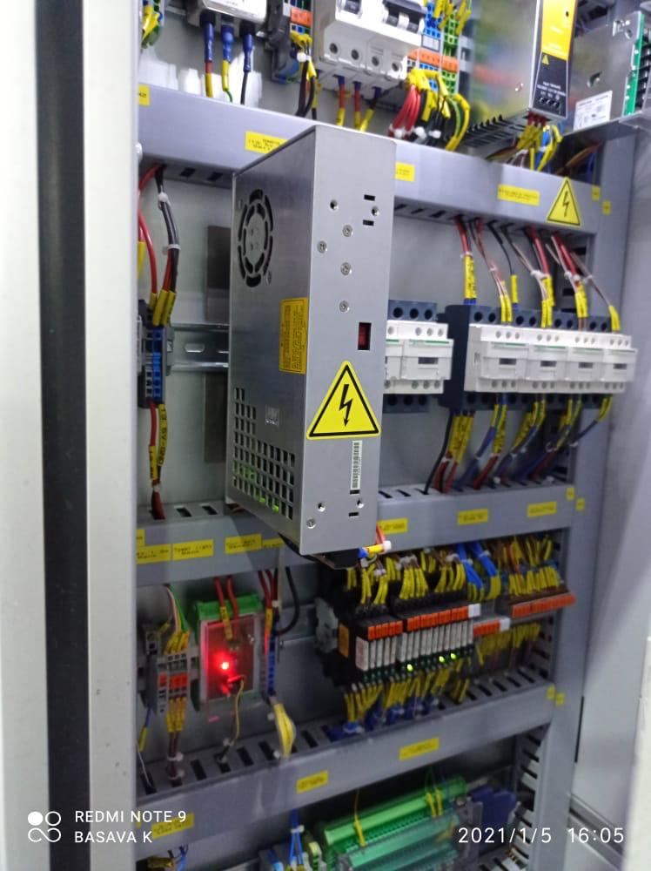
Installation diagram
24 v Banks

Slide 30
Installation diagram
24 v Banks
BSL
ECU
1
2
3
4

Slide 31
BSL flash and initialization details

Slide 32
Contents
Electronics study for the project
Station identification
Medtronic's clinician manual overview
Requirement documentation

Slide 33
I2c communication
Station 1 : Coin singling
Station 2 :
Station 3 :
Station 4 :

Slide 34
Contents
Electronics study for the project
Medtronic's video for ventilator basics
Medtronic's clinician manual overview
Requirement documentation

