Slide 1
Example Data Sets for Python Function Development

Slide 2
Example Data Sets Real Sensor Motion in Lab

Slide 3
Real Sensor Data
Resting Sensor, recorded data
RealSensorData_Restingdata.csv
Moving Sensor along a straight line (uncontrolled) for 33cm back and forth
RealSensorDatasLinearTranslation_33cm_data.csv
Moving sensor in rectangular of size 33cm x 27cm
RealSensorData_RectangularTranslation_33cmx27cm_Data.csv

Slide 4
Example Data Sets from Rigid Body Numerical Simulation

Slide 5
Motion Simulation Model
1003
Rigid Body Simulation performed
for structure shown left.
The boundary condition (prescribed motion has been applied to node 1000)
Results are reported for node 1000 and
1003.
z
1m
y
Available output:
Displacement x, y, z
Rotations rx, ry, rz
Velocities vx, vy, vz
Angular velocities vrx, vry, vrz
Acceleration ax, ay, az
Angular accelerations arx, ary, arz
x
1002
1m
1m
1000
1001

Slide 6
Set 1 – Square Path only Translation in X and Y Direction

Slide 7
Set 1 – Translation x and y – Square Path
y
x
10m
Start
10m

Slide 8
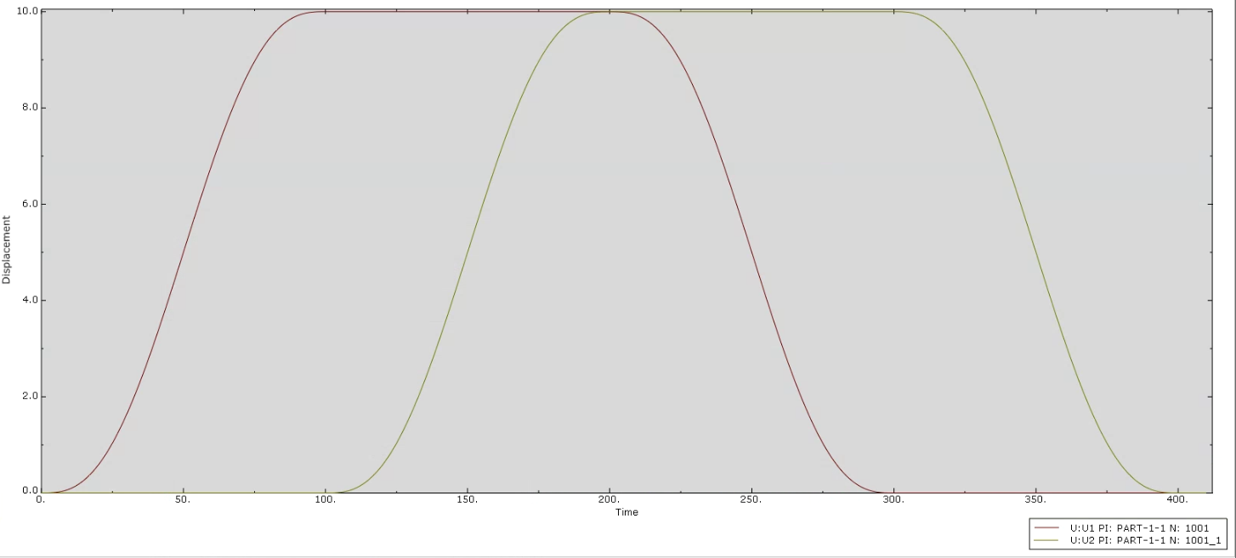
Set 1- Square Path, Displacement over Time Node 1001
Available output:
Displacement x, y, z
Rotations rx, ry, rz
Velocities vx, vy, vz
Angular velocities vrx, vry, vrz
Acceleration ax, ay, az
Angular accelerations arx, ary, arz
U1 = Displacement in X direction
U2 = Displacement in Y direction

Slide 9
Set 2 – Square Path Translation in X and Y Direction with Roll Motion

Slide 10
Set 2 – Square motion with Roll superimposed
y
x
10m
Periodic Roll (rotation around x axis) added to translation around square
Period 4s (1/4Hz)
Amplitude 2 degree
Start
10m

Slide 11
Set 3 – Square Path Translation in X and Y Direction with Pitch Motion

Slide 12
Set 3 – Square motion with Pitch superimposed
y
x
10m
Periodic Pitch (rotation around y axis) added to translation around square
Period 6s (1/6Hz)
Amplitude 3 degree
Start
10m

Slide 13
Set 4 – Square Path Translation in X and Y Direction with Roll and Pitch Motion

Slide 14
Set 4 – Square motion with Roll and Pitch superimposed
y
x
10m
Periodic Pitch (rotation around y axis) added to translation around square
Period 6s (1/6Hz)
Amplitude 3 degree
Periodic Roll (rotation around x axis) added to translation around square
Period 4s (1/4Hz)
Amplitude 2 degree
Start
10m

Slide 15
Set 5 – Square Path Translation in X and Y Direction with Roll, Pitch Motion and Heave

Slide 16
Set 5 – Square motion with Roll, Pitch and Heave superimposed
y
x
Periodic Pitch (rotation around y axis) added to translation around square
Period 6s (1/6Hz)
Amplitude 3 degree
10m
Periodic Roll (rotation around x axis) added to translation around square
Period 4s (1/4Hz)
Amplitude 2 degree
Periodic Heave (vertical translation) added to translation around square
Period 7s (1/7Hz)
Amplitude 0.2m
Start
10m

