Slide 1

Digital Project Management
From Methodology to Execution

Slide 2
Digital Project Management
Project Scenario

Slide 3
Overview
You are a project manager for Yosemite, an eCommerce company that integrates brick-and-mortar stores onto its platform for a fee. You have been assigned to work with The Stefano Shop, a family-run business that had been a local success but was struggling to stay open. The primary business goal is to digitize the store’s operations and sales and complete this project in a maximum of 12 weeks.
Integrating The Stefano Shop into Yosemite means building the following features:
A storefront on the platform,
A social media integration, and
A recommendation engine.
The Stefano family, which consists of Papa Stefano, Mama Stefano, and Junior Stefano, will also require the training and knowledge to operate their digital store once it has been developed.

Slide 4
Project Budget
The Yosemite storefront, training, and documentation can be delivered for $15,000 - a tight budget for the Stefanos. So Papa Stefano asked that you include a cost-benefit analysis in the project scope to reassure him this is a good investment.
For the cost-benefit analysis, your research shows:
The eCommerce industry discount rate is 20%
Yosemite promises a $36,000 increase in revenue
The cost of the project is $15,000

Slide 5
Yosemite teams and tasks
Aliyah - Engineering Manager
Tasks:
Build storefront
Build social media integration
Build recommendation engine.
Each task takes two weeks of work.
Each task involves design, build, test, and release.
Moe - Vendor Manager
Tasks:
Inputting all inventory data after the storefront is delivered. It takes one week to add the inventory data.
Onboarding and training Stefano's before the store goes live. It takes one week to train them.
Create a custom sales report that is automatically sent to Stefanos during or after the recommendation engine is released. It takes one week to set up the reporting.
Taylor - Marketing Manager
Tasks:
Creating social media channels and handing them off to Stefano's. It takes a week, but this task must occur before the social media integration by the Engineering team.

Slide 6
The Stefano Family
Papa Stefano has a strong presence in the family business but listens to Mama Stefano when making business decisions. He manages the floor and is averse to new technology. While he understands it’s time to modernize the shopping experience and wants to gain new customers, he’s wary of going over budget.
Mama Stefano keeps spreadsheets to track inventory and has convinced Papa to work with Yosemite. Her primary focus is on back-end administrative tasks of the business. Mama is more concerned about preparing the store for Christmas shoppers in time.
Junior Stefano is a high school student still learning about the family business. Junior creates social media posts on her own accounts for the store. Sees value in taking full advantage of Yosemite’s services.

Slide 7
Yosemite team
Moe is the Yosemite Vendor Manager; he tends to be enthusiastic about upselling customers with additional services, not mindful of budget. Moe primarily focuses on promoting and coordinating Yosemite's services, which is part of the overall project. Additionally, this project is one of many he works on.
Aliyah is the Yosemite Engineering Manager, experienced and skilled. She prefers to work in Agile sprints but understands that not all customers can keep up with that pace. Her expertise in developing and implementing technical solutions enables her to guide the project's timeline and execution strategy, making her vital in determining the project's overall direction and progress.
Taylor, the Yosemite Marketing Manager, tends to take on too many assignments and can delay completing tasks. Taylor often needs to be informed of their assignments ahead of time. His role and contributions are limited to supporting the implementation of this project's marketing plans.
Lou is the Yosemite Small Business Program Manager and oversees all accounts under the Small Business category. You report directly to Lou. Lou only keeps a high-level overview of this project and its progress. He wants to showcase your project to the entire company if all goes well and expect regular communication, especially when things go wrong.

Slide 8
Digital Project Management
Step One:
Project Scope

Slide 9
Objectives, milestones, and resources
Describe the business objectives of the project in 1-2 sentences
Digitize The Stefano Shop's operations and sales by integrating the store into Yosemite's eCommerce platform. The project will deliver an online storefront, social media integration, recommendation engine, reporting, documentation, and training within the 12-week limit.
List at least 3 project milestones
• Kickoff and scope approval • Storefront built and released • Inventory data loaded • Social channels created and integrated • Recommendation engine released • Custom sales report delivered • Stefano training, go-live, and closure completed
List the resources you have access to as the project manager, including the budget
• Budget: $15,000 • Yosemite Project Manager: Hashim Naveed • Aliyah and Engineering team • Moe and Vendor Management team • Taylor and Marketing team • Lou, Small Business Program Manager • Stefano family inventory data, business input, and user feedback • Yosemite platform, documentation templates, and reporting tools

Slide 10
Cost-Benefit Analysis
Write out the formula for the cost-benefit analysis
Cost-Benefit Ratio = Present Value of Benefits / Project Cost
Show the steps to get the cost-benefit ratio
Present Value of benefit = $36,000 / (1 + 20%) = $30,000 Cost-Benefit Ratio = $30,000 / $15,000 = 2.00
State whether the investment is positive or negative
The investment is positive. A ratio of 2.00 means the discounted expected benefit is twice the project cost, so the project provides a strong business case for the Stefanos.

Slide 11
Timing and Methodology
What are the minimum and the maximum number of weeks required to complete the project?
Minimum schedule: 8 weeks. Maximum schedule: 12 weeks. The planned Waterfall schedule uses 9 weeks, from June 8 to August 7, 2026.
What methodology do you propose to use for organizing the project: Waterfall or Agile? Explain your answer in 2-3 sentences.
I propose Waterfall. The scope, budget, major deliverables, and dependencies are defined up front, and the Stefano family needs predictable milestones because they are budget-sensitive and preparing for seasonal shoppers. Waterfall also gives Papa and Mama Stefano clear review points before go-live.
Based on your chosen methodology, list the meetings you need to schedule.
• Kickoff meeting • Weekly internal Yosemite team check-ins • Weekly customer stakeholder status meetings • Milestone review meetings after storefront, social integration, recommendation engine, and training • Risk/escalation meetings as needed • Go-live readiness meeting • Closure and lessons learned meeting

Slide 12
Digital Project Management
Step Two:
Identify Your Stakeholders and Team

Slide 13
Power-Influence Classifications
You need to classify each member of the Stefano family and Yosemite team by their power level and influence on the project. You are already provided with assumptions/risks for each person.
Take a look at the Cast of Characters in the classroom or the 6th and 7th slide to learn more about each person.
As you learned in the Setting up Your Project/Stakeholder's Power lesson, this chart has only a "High" or "Low" classification. Below is a reminder of what each term means.
Power Level: The level of authority and decision-making power that a person has over a project. You could ask: Can this person make decisions about the project?
Influence: A person's ability to influence decision-makers through their personality style, interpersonal skills, and relationship with those in authority. You could ask: Can this person influence a decision-maker?

Slide 14
Power-Influence Classification Grid
As you learned in the Setting up Your Project/Stakeholder's Power lesson, this chart has only a "High" or "Low" classification.
Stakeholder | Power Level | Influence Level | Assumptions and Risks
Papa Stefano | High | Low | Decides for the family Worries about the budget
Mama Stefano | Low | High | Influences the family decisions Concerned about timing
Junior Stefano | Low | Low | Helps out in the business Uses own account for the store
Aliyah (Engineering Manager) | High | High | Leads all development work Final decisions with engineering are hers
Moe (Vendor Manager) | Low | Low | Likes to upsell Helps out in promotions Only one of his many projects
Taylor (Marketing Manager) | Low | Low | Can delay the tasks Limited role for the project
Lou (Program Manager) | High | Low | Only high-level overview Can help when things go wrong
Me (Project Manager) | Low | High | Executes the project in a timely manner Follows the decision makers
HINT: Take a look at the Cast of Characters in the classroom or the 6th and 7th slide to learn more about each person.

Slide 15
RACI Chart
You need to fill out a RACI chart for your team, as you learned in the Setting up Your Project/Evaluating Team's Competency lesson. In the case of this project, it is usually the same person who is Responsible are Accountable for a task, since managers are working with their teams who are not part of the project.
Responsible: Stakeholders who will be responsible for executing actual tasks.
Accountable: The stakeholder - usually a manager - who has the duty of approving whether a task is truly being completed; there can only be one accountable person per task.
Consult: Anyone who has valuable insight necessary to successfully execute a task; there can be more than one consult for each task.
Informed: A stakeholder who expects to receive information and updates about a particular task. Most stakeholders will fall into this category.

Slide 16
RACI Chart Sample Solution
There are questions you can ask that help you figure out the RACI chart. Let's do that for the first task: Build storefront.
Responsible: Who in the team builds the storefront? Aliyah, as she is the engineering manager.
Accountable: Who can approve the finished storefront? Aliyah, since she is the one who knows the technical problems.
Consult: Who can provide valuable insight while building the storefront? Moe, as he is the vendor manager, and the storefront is for them.
Informed: Who needs to be kept informed about progress on this task? It can be all other people (Me, Lou, Taylor) as other tasks depend on this one.

Slide 17
RACI Chart
Take a look at the 5th slide: "Yosemite teams and tasks," for information. Each manager has a team that works with them; therefore, they are Accountable AND Responsible for the work they do. Unlike them, you have a boss who needs to approve of your work.
Tasks | Me, Project Manager | Lou, Program Manager | Taylor, Marketing Manager | Moe, Vendor Manager | Aliyah, Engineering Manager
Build storefront | I | I | I | C | A/R
Input Inventory Data | I | I | I | A/R | C
Build social media integration | I | I | C | C | A/R
Train Stefano’s on platform | I | I | I | A/R | C
Create social media channels | I | I | A/R | C | I
Build recommendation engine | I | I | C | C | A/R
Create Custom Sales Report | I | I | I | A/R | C
Engage stakeholders | R | A | I | I | I

Slide 18
Digital Project Management
Step Three:
Create a Project Plan

Slide 19
Create a Project Plan
In this step, you will reference the project scope, stakeholder analysis, and RACI chart to create a project plan for the proposed methodology.
Build a model of your plan for managing the Yosemite project. It should be a snapshot of the planning phase of the project. You can use the dates in your current year when creating the project plan.
Display this model in one of the two frameworks,
A Gantt chart for Waterfall OR
a Scrum board for Agile.
After you pick one model, be sure to include the information outlined in your project scope, stakeholder analysis, and RACI chart.

Slide 20
Instructions based on your method
Waterfall Project Plan
You need to create a Gantt chart
Implement everything from the Project Plan Details on slide 21
Follow the instructions on slide 22
Skip slides 23-25, go to slide 26 and continue the project.
Agile Project Plan
You need to create a Trello board
Implement everything from the Project Plan Details on slide 21
Skip slide 22
Follow the instructions on slide 23-25

Slide 21
Project Plan Details
In the project plan you should include at least the following tasks:
All tasks from the RACI Chart
At least 3 Status Reports - where you think it is appropriate
Follow the additional instructions for your plan depending on your method
You can assume the status reports take one day, and the documentation tasks 1-3 days.
Pay attention to:
It is a snapshot of the planning phase of the project
You can only assign tasks to Yosemite employees
The date of the tasks must correlate with the project plan
All tasks must have a start date and due date
All tasks must be assigned to the relevant person

Slide 22
Additional Instructions for the
Waterfall Project Plan
If you choose a Waterfall project plan in Step 2, you should include additional tasks related to stakeholder engagement, team management, and closure activities.
You have to include at least the following additional tasks:
A kickoff meeting
Closure meeting
Create a Gantt chart for your project by filling in the Gantt Chart Template provided in the classroom. Export or save the spreadsheet as a .xls or .xlsx file. Add this spreadsheet to your project submission folder.

Slide 23
Additional Instructions for the
Agile Project Plan
If you choose an Agile project plan in Step 2, you should organize the columns using Scrum phases:
Sprint Planning
Backlog
Work In Progress
QA
Release
Sprint Review
Include relevant tasks that occur in the initial and end phases of a Sprint. You have to include at least the following additional tasks:
Sprint planning task for each sprint
Sprint review task for each sprint

Slide 24
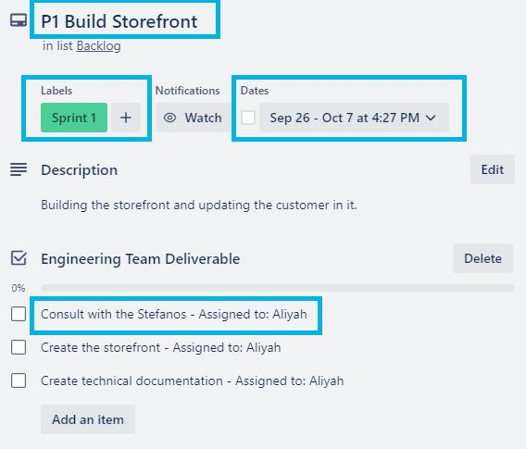
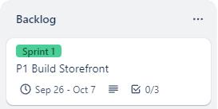
Additional Instructions for the
Agile Project Plan - Trello
Pay attention to:
The columns are based on Scrum phases
Include relevant tasks to initial and end phases of a Sprint
Label the cards according to the Sprint they belong to (e.g. Sprint 1, Sprint 2…)
Don’t forget to add dates to each card
Add assignees to each task
Trello Card Example

Slide 25
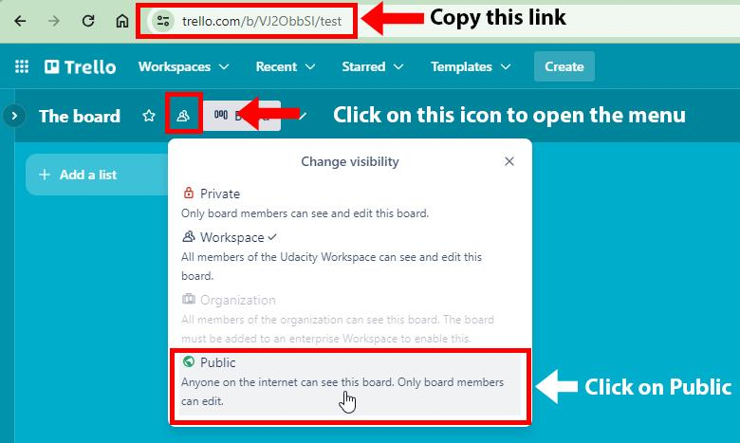
Additional Instructions for the
Agile Project Plan
Create a new Scrum board on Trello and make it public.
To make your board public, click on the Change Visibility icon and select Public > “Yes, make board public”
Copy the URL from your browser - it is the same as you are viewing the board with
N/A - Waterfall methodology selected. Completed Gantt chart is attached as yosemite_stefano_gantt_chart.xlsx.
To test your link, paste your link into an incognito browser window and open it. If it opens your board directly, your link is good.

Slide 26
Digital Project Management
Step Four:
Risk and Response

Slide 27
Risk Response Strategies
Here are the six types of response strategies you can choose from:
Avoid relates to adjusting plans so it prevents the risk from ever happening to or having an impact on your project. This strategy essentially makes the risk irrelevant to your project.
Transfer is the act of moving the risk to a different recipient by adding into the project plan a way to direct the risk in a certain direction.
Mitigate relates to proactively adjusting plans or acquiring new resources to lessen the potential consequences as much as possible or preparing for the impact of the risk.
Accept involves passively acknowledging that it will happen, or creating thresholds that trigger actions when the risk causes a certain type or level of problem.
Escalate is the act of presenting the risk to someone with the right authority or skillset to properly respond. In this case, the digital project manager cannot sufficiently do so.
Exploit involves creating an opportunity or solution out of a risk to take advantage of a problem's impact.

Slide 28
Risk Scenario 1
The Stefano Shop project relies on the customer providing Yosemite with information on all products in its inventory. The Stefanos did not deliver the inventory list by the day you planned to put inventory data into the system. They promised to deliver the inventory information in a few more days.
Your task is to:
Analyze the above risk and describe how this affects the project. Address at least two different critical points of risk, like scope, cost, schedule, quality, stakeholder relationships, etc.
Choose a risk response strategy (see the valid strategies on the "Response Strategies" slide.)
Explain how you would apply the strategy in 3-5 sentences, including how it would impact the customer.
Fill out the Status Report for this scenario

Slide 29
Risk Scenario 1 Response
How might this risk affect the project?
The missing inventory list creates a schedule risk because Moe cannot start inputting inventory data on June 22 as planned. It can also affect quality if Yosemite rushes data entry later and uploads incomplete or incorrect product information. Stakeholder trust may be affected because Mama is focused on timing and Papa is wary of surprises, even if the scope and budget remain unchanged.
Selected risk response strategy: | Mitigate
Explain below how you would apply the strategy.
I would confirm a revised delivery date for the inventory list with Mama and Papa Stefano, then ask for a partial spreadsheet or priority product list so Moe can begin with the most important items. While waiting, Moe can work on the user manual and prepare the import template to reduce lost time. I would notify Lou and the Stefanos that the overall launch is still recoverable if the list arrives within a few days, but the schedule is at risk. The customer impact is mainly faster follow-up and a possible shift in later tasks, with no added cost unless the delay grows beyond the project buffer.

Slide 30
Status Report
You need to fill out the status report on the next page. It has to be based on Risk Scenario 1, which you can find in Slide 28. You also need to use details from the project scenario, which you can find in Slide 3.
The Status Report date is when the Vendor Manager was scheduled to begin the “Input Inventory Data” task in your project plan.

Slide 31
Risk Scenario 1 - Status Report
Yosemite - The Stefano Shop Digital Transformation | Yosemite / The Stefano Shop
Hashim Naveed, Project Manager | June 22, 2026
Project Summary
This project will digitize The Stefano Shop by delivering a Yosemite storefront, social media integration, recommendation engine, inventory setup, custom sales reporting, documentation, and platform training. The project is planned within the $15,000 budget and must finish within 12 weeks, but the missing inventory list creates a schedule risk that requires immediate mitigation.
Project Highlights/Blockers
Highlights: • The project has started on schedule. • Social media channels are ready for Engineering integration. • The storefront is built and ready for inventory data. Blockers: • Stefano inventory list was not delivered by the planned inventory start date. • Inventory loading, training, and go-live could slip if the list is delayed more than a few days.
Project Health Check
Scope | On Track | Tasks: Completed/Pending
Time | At Risk | Completed: • Kickoff meeting • Stakeholder engagement started • Social media channels created • Storefront built and released • Storefront technical documentation Pending: • Inventory data input • Social media integration • Recommendation engine • Custom sales report • Platform user manual • Stefano training • Go-live and closure
Cost | On Track
Quality | On Track

Slide 32
Risk Scenario 2
When the Engineering team began designing the recommendation engine, they informed you that the task was more complicated than anticipated. The Engineering Manager said it would take four weeks and cost an additional $3,500 to upgrade the AI service that powers the recommendation engine. That fee would have to be covered by the customer.
Your task is to:
Analyze the above risk and describe how this affects the project. Address at least two different critical points of risk, like scope, cost, schedule, quality, stakeholder relationships, etc.
Choose a risk response strategy (see the valid strategies on the "Response Strategies" slide.)
Explain how you would apply the strategy in 3-5 sentences, including how it would impact the customer.

Slide 33
Risk Scenario 2 Response
How might this risk affect the project?
This risk affects cost because the project would increase from $15,000 to $18,500, which directly conflicts with Papa Stefano's budget concern. It also affects schedule because the recommendation engine would take four weeks instead of two and could push training, go-live, and closure later. Scope and stakeholder relationships are at risk because the customer expected the recommendation engine within the original package and may need to approve a change request or accept a reduced feature.
Selected risk response strategy: | Escalate
Explain below how you would apply the strategy.
I would escalate the issue to Lou because the project manager cannot approve a customer-facing $3,500 budget increase or a major schedule change alone. I would prepare a change request for Papa and Mama Stefano that compares three choices: approve the AI upgrade, reduce the recommendation engine scope, or defer that feature to a later phase. The recommendation engine work would pause until the customer approves a path forward. The customer impact is that they must choose between added cost and time or a smaller initial feature, but the decision will protect them from surprise spending.

Slide 34
Digital Project Management
Step Five:
Knowledge Documentation

Slide 35
Knowledge Documentation
Throughout the project and before its closure, you asked the team to create documentation for the company Yosemite and the customer. The documentation list is partially filled out; your task is to fill in the missing information. You can also add more documentation tasks to the list, as there are many more things that can be written down. To have a complete project plan, consider adding these tasks to your Gantt chart/Trello board.

Slide 36
Knowledge Documentation
Task | Assignee | Place in Timeline | Reason for Documenting This Task
Storefront Technical Documentation | Aliyah | After finishing Build Storefront task | Captures design, build, test, release notes, and maintenance details so Yosemite can support and update the storefront.
Platform user's manual | Moe | Before training the Stefanos | A documentation that can be given to Stefanos as a manual for operating the digital store.
Recommendation Engine Documentation | Aliyah | After finishing Build Recommendation Engine task | A comprehensive guide for end users and maintenance teams, including setup, assumptions, and support steps.
Lesson Learned Document | Project Manager | After the project is finished | Documents successes, challenges, risks, and improvements that Yosemite can reuse for future small-business integrations.

Slide 37
Waterfall Project Plan Summary
Attached file: yosemite_stefano_gantt_chart.xlsx
Schedule: June 8 - August 7, 2026 (9 weeks; within the 12-week maximum).
Major sequencing:
• Week 1-2: kickoff, stakeholder engagement, storefront build, social channels.
• Week 3-4: inventory data, platform manual, social media integration.
• Week 5-6: recommendation engine, custom sales report, engine documentation.
• Week 7-9: Stefano training, QA/readiness, go-live, lessons learned, closure.
Status reports are planned for June 19, June 22, July 17, and August 7, 2026.

