Slide 1
DATA VISUALISATION AND EXPLORATORY ANALYTICS
Regional Unemployment Trends in the UK (2010–2023)

Slide 2
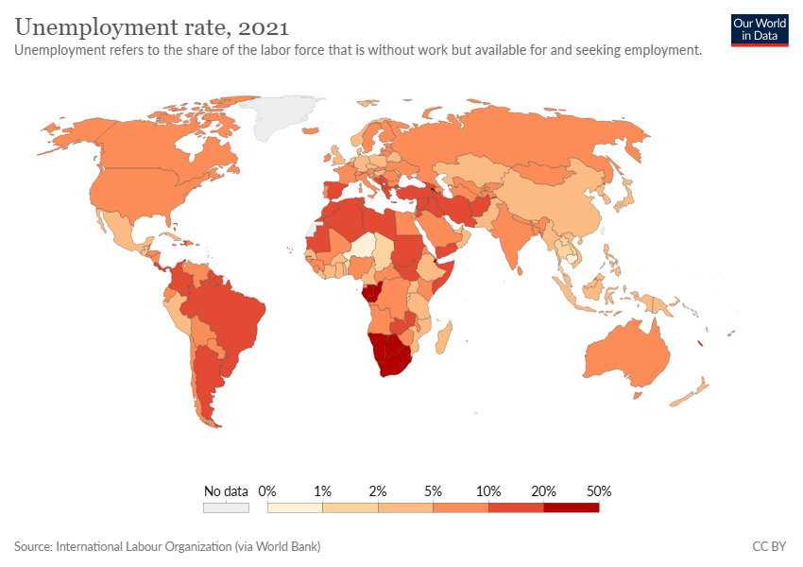
Introduction
We analyze how regional unemployment rates changed in the UK from 2010 to 2023. We make use of Tableau for visual analytics and real-world data collection to answer a main research question by observing changes and regional patterns.
Notes:
Cleaning, organising, and analyzing the data are followed by choosing the most appropriate visualisations and building a dashboard for user interaction. We describe the path followed, from obtaining the data to creating sharp visualisations, with an emphasis on best practices in visual storytelling.

Slide 3
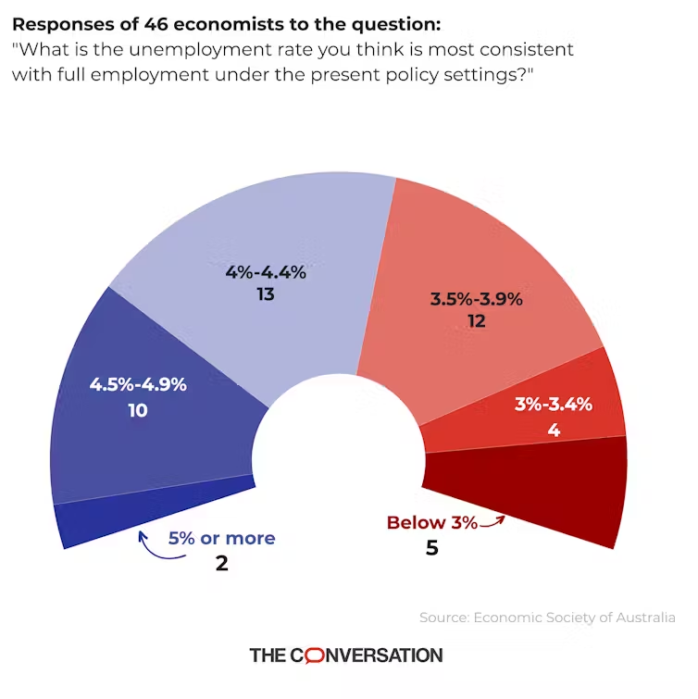
Research Question
The key research question guiding this project is:
“How has unemployment varied by region in the UK from 2010 to 2023?”
This question is important because recent economic shocks have highlighted and deepened long-standing regional economic differences.
Mapping unemployment shifts across Britain and through time provides insight into how the UK labour market behaves

Slide 4
Importance of the Question
Unemployment has a major impact on economic performance at both the individual and national levels, as well as on regional progress.
Studying patterns of regional unemployment shows structural disparities and suggests locations that may benefit from policy support.
Also, analysis of these trends provides key insights for coordinating labour force planning, formulating educational schemes, and achieving resilience in the economy.
Additionally, this research may provide useful insights for businesses and investors who assess regional performance when making decisions.

Slide 5
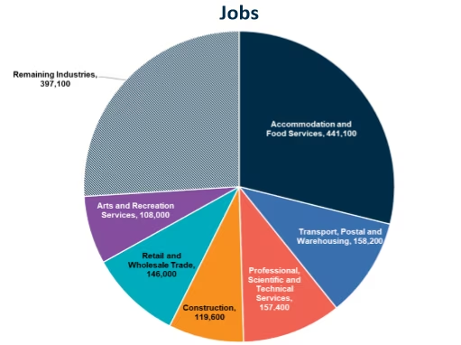
Dataset Overview
Unemployment figures for 2010 to 2023 used in this study are obtained from the UK’s Office for National Statistics (ONS). Data is presented for major geographical areas includRegion Name
Year
Unemployment Rate (%)
Population Size (optional)
Gender (optional)
This particular dataset is highly credible, freely distributed, and amenable to both time-series and geographical displays.ing the North East, London, Wales, and Scotland. Key columns include

Slide 6
Data Types
There are quantitative and qualitative variables represented in the dataset.
Quantitative:
Unemployment rate (%), population count
Time (year, treated as numeric)
Qualitative:
Categorical region, with a choice of adding gender, and type of labour market classificationFamiliarity with these types is necessary to pick the right chart format. Time series data, on the other hand, is best presented in line charts, and geographic data efficiently displayed with maps.

Slide 7
Data Preparation
Prior to importing the dataset to Tableau, the data underwent cleaning in Microsoft Excel. The key steps were:
Identified and removed both duplicate rows and any with missing values throughout the table.
We applied standard spelling to the region names to ensure correct correspondence.
All date values were reshaped so that they met the definition of a numerical time series.
Notes:
Checked to make sure all unemployment rates were given in percentages.
Made certain that the names of the columns were clear and descriptive.
The visual output was proven to be accurate and reliable as a result of this step.

Slide 8
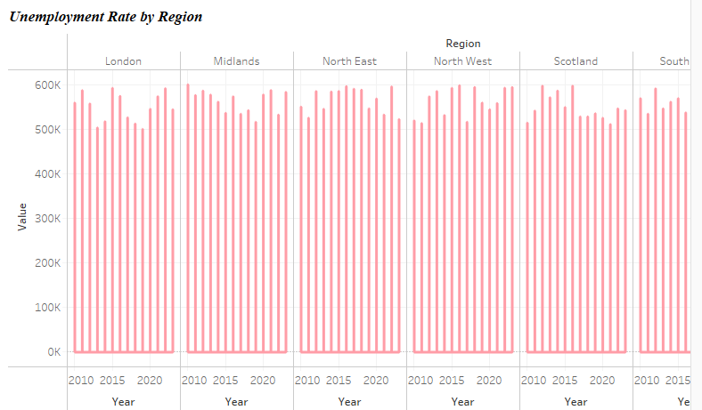
Analysis
Visual Purpose: Examine variability in regional unemployment rates on average.
Dataset Columns Used: Region, unemployment rate
Type of Variables: Qualitative (region), Quantitative (rate)
Insight: Compared to the South East and London, regions such as the North East and Northern Ireland have a tendency to have higher unemployment rates more often..
Limitation: Does not show temporal variation; only averages over time.

Slide 9
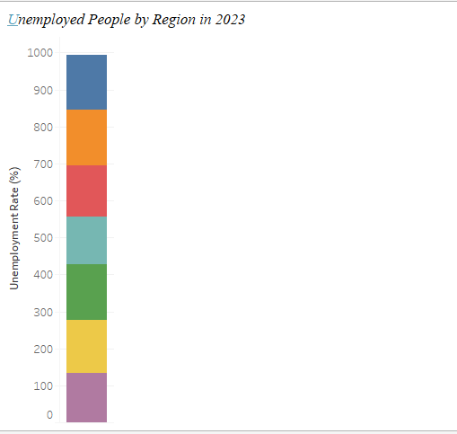
Contd.
Visual Purpose: Track unemployment trends over time
Dataset Columns Used: Year, unemployment rate
Type of Variables: Quantitative (year, rate)
Insight: Nationwide, following the financial crisis, unemployment was highest in 2011–2012 and then decreased notably in 2019. In 2020, there was a clear and substantial increase in unemployment linked to the pandemic.
Limitation: For more detailed analysis, regional patterns should be examined one area at a time.

Slide 10
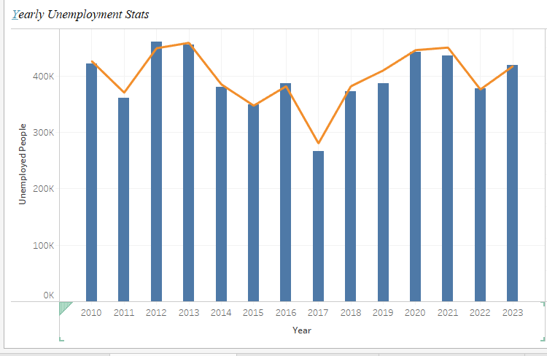
Contd.
Visual Purpose: Illustrate the pattern of unemployment rates by geographical location for a chosen year.
Dataset Columns Used: Region, unemployment rate
Type of Variables: Qualitative (region), Quantitative (rate)
Insight: The data clearly shows that the north of England and parts of Wales and Northern Ireland have systematically higher rates.
Limitation: One year of data is shown here, unless users interact with the tool.

Slide 11
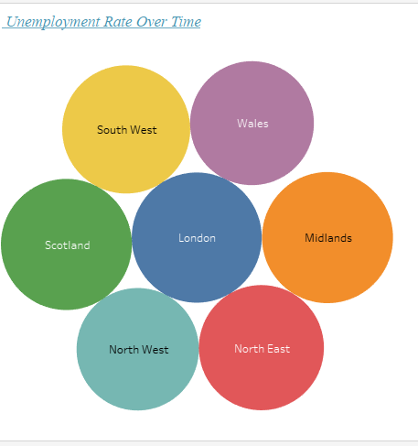
Contd.
Visual Purpose: Study the relationship between population and unemployment.
Dataset Columns Used: Region, unemployment rate, population
Type of Variables: Quantitative (both axes)
Insight: There is a lack of a strong linear relationship, yet dominant population centers, such as London, generally have low unemployment, possibly owing to diverse industrial activity.
Limitation: This plot is susceptible to both outliers and misleading scales.

Slide 12
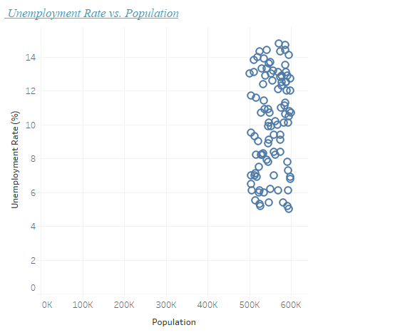
analysis
Visual Purpose: Show raw data for transparency
Dataset Columns Used: All
Insight: Provides the opportunity to analyze particular values by region and over the years. Provides direct benefits to analysts as well as policy users.
Limitation: Not arranged in a visual format, so it is usually tougher to identify patterns than with charts.

Slide 13
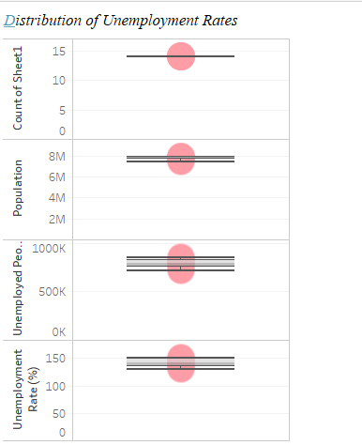
analysis
Visual Purpose: This chart illustrates both gender composition (optional) and how unemployment is spread.
Dataset Columns Used: The dataset incorporates gender as well as unemployment rate information.
Insight: When gender data is used, linear graphs may suggest modest variations between men and women in unemployment.
Limitation: In many cases, a bar or histogram provides greater accuracy than a pie chart

Slide 14
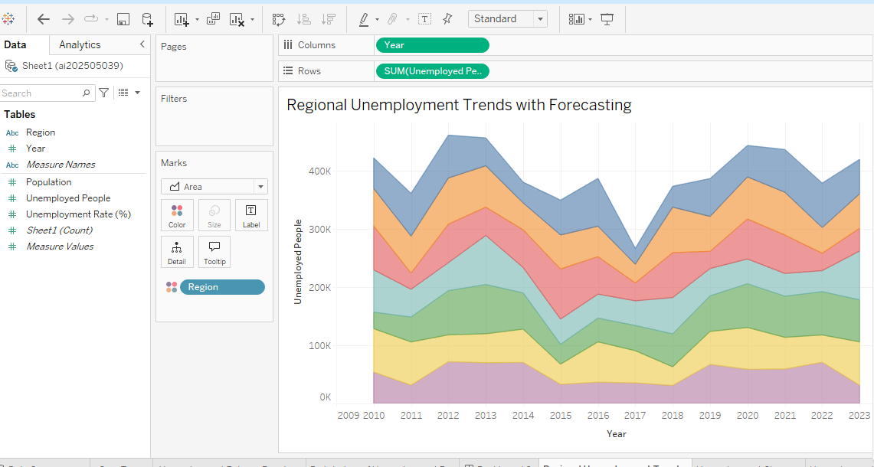
Regional Unemployment Trends with Forecasting
This Tableau sheet forecasting capabilities to project regional unemployment rates from 2024 to 2026. By analyzing historical data from 2010 to 2023, the forecasting tool identifies patterns and trends to estimate future outcomes. This visual helps predict which regions are likely to experience improvements or deteriorations in unemployment levels, offering valuable insights for policymakers, economists, and investors focused on regional economic planning.

Slide 15
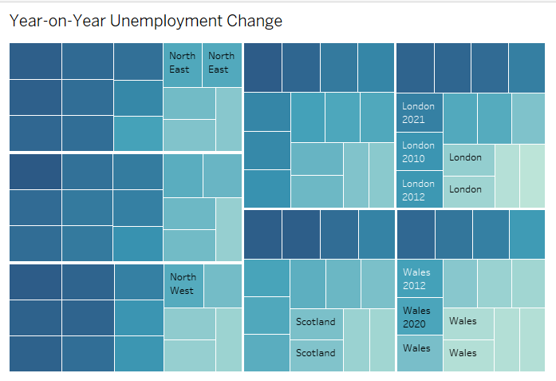
Year on year Unemployment change
Year-on-Year Change in Unemployment Rate,This Tableau sheet presents an illustration of the year-on-year change in unemployment rates across UK regions. By calculating the difference in unemployment rates from one year to the next, the visualization highlights areas and time periods of significant change. This allows users to quickly identify regions experiencing sharp improvements or declines, offering valuable context for understanding the volatility of local labour markets and informing targeted economic interventions.

Slide 16
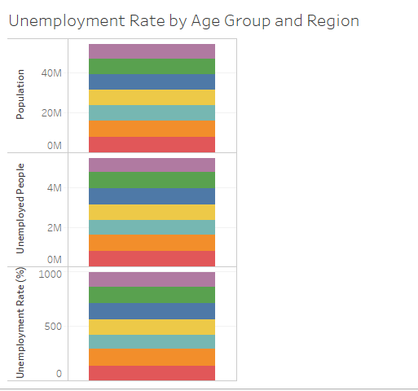
Unemployment Rate by Age Group and Region
This Tableau sheet utilizes to compare unemployment rates across different age groups and regions. If age data is available, the visualization can reveal demographic disparities in unemployment. By highlighting which age groups are most affected in specific regions, this chart offers critical insights for policymakers and educators to develop targeted employment initiatives, skills training programs, or support services tailored to the needs of vulnerable age demographics.

Slide 17
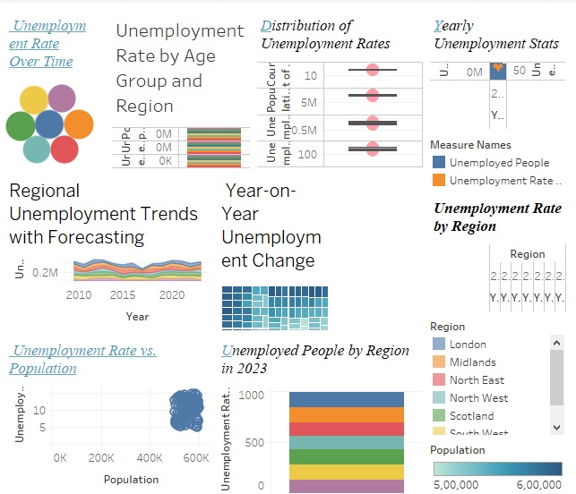
Tableau Dashboard Overview
This Tableau dashboard presents a complete overview of statistics on unemployment. You will find a circle view in the top left corner, where unemployment rates for South West, Wales, Midlands, London, and Scotland are shown. Beside the circle view, a box plot outlines the distribution of unemployment rates, and a bar chart illustrates unemployment people and rates by year.A scatter plot in the bottom left shows how unemployment rate is correlated with population. The stacked bar chart presented below the circle view gives the regional distribution of unemployed individuals in 2023. Ultimately, the bar chart at the bottom right shows the unemployment rate ordered by region. In total, the dashboard makes it possible to compare regional unemployment patterns, identify yearly changes, and assess the link between unemployment and population.

Slide 18
Interactive Features
Two key interactive features were added:
With the Year Filter, users can view and analyze data for any chosen year.
Region Dropdown – Users can select a region or view data independently of others.
Furthermore, details on each data point are displayed in tooltips when users move their cursor over them. These functionalities empower users to investigate trends interactively, thus motivating them to gain further understanding beyond rigid datasets.

Slide 19
Dashboard Design
Best design practices were followed:
Blue and orange blend into a diverging color scale that makes the visualization CUD friendly for users.
The labels at the bottom and side of the visualisation are written as clearly as possible.
All text is displayed at a size that enhances clarity.
The layout offers a top-to-bottom sequencing for users according to importance. trend ➝ map ➝ comparison
The design is created to be easily readable and accessible for anyone who views it.

Slide 20
Data Storytelling
All the visual Details fit together to make one clear and continuous story:
This line chart depicts the development of the unemployment rate since it was recorded, with important national events identified.
The presentation of regional data on a map makes it easier to see which regions faced the greatest challenges.
The bar chart allows us to observe any regions that stand out for worse unemployment results.
All these visualisations work together to provide the entire story of UK regional unemployment.

Slide 21
Limitations & Assumptions
Some challenges and limitations include:
There are years and regions where data values are unavailable.
The regional groupings or the ways in which regions are classified have changed over the years.
Policy interventions are not present as variables in the dataset.
Failing to understand the context can make simplified trend data seem oversimplified.
It is assumed that both the definitions and the procedures for reporting unemployment remained the same throughout the observed period.

Slide 22
Conclusion
The research question was successfully answered through the combination of rich data with interactive visual analytics within the project. Main results address job market changes after the financial crisis, sharp rises in unemployment during the pandemic, and the long-lasting regional differences. Users are able to continue exploring the data by using the Tableau dashboard. It was clearly shown how data storytelling can convert plain numerical data into important insights.

Slide 23
Reference
Davidescu, A.A., Apostu, S.A. and Stoica, L.A., 2021. Socioeconomic effects of COVID-19 pandemic: Exploring uncertainty in the forecast of the Romanian unemployment rate for the period 2020–2023. Sustainability, 13(13), p.7078.
Davidescu, A.A., Apostu, S.A. and Paul, A., 2021. Comparative analysis of different univariate forecasting methods in modelling and predicting the romanian unemployment rate for the period 2021–2022. Entropy, 23(3), p.325.
Jackson, S.E., Tattan-Birch, H., Buss, V., Shahab, L. and Brown, J., 2025. Trends in daily cigarette consumption among smokers: a population study in England, 2008–2023. Nicotine and Tobacco Research, 27(4), pp.722-732.
Rafiee, E., Shabani, Z.D. and Hadian, E., 2024. Driving factors on unemployment in Iran’s provinces: Do temporal and spatial dynamics matter?. Regional Science Policy & Practice, 16(2), p.12715.
Notes:
Stansbury, A., Turner, D. and Balls, E., 2023. Tackling the UK’s regional economic inequality: Binding constraints and avenues for policy intervention. Contemporary Social Science, 18(3-4), pp.318-356.
Moridian, A., Radulescu, M., Kumar, P., Radu, M.T. and Mohammad, J., 2024. New insights on immigration, fiscal policy and unemployment rate in EU countries–A quantile regression approach. Heliyon, 10(13).
Mathibe, M. and Oppong, C., 2024. Sustainable entrepreneurship: A catalyst for unemployment reduction and economic growth in Anglophone and Francophone countries. Business Strategy & Development, 7(2), p.e362.

