Slide 1


Slide 2

AI-Based crop disease detection system (Plantix app)

Slide 3
Introduction:-
Agriculture is important for food production.
Crop disease reduce quality and yield.
AI helps to detect plant disease early.
Plantix is an app that support farmers.

Slide 4
Problem faced by farmers:-
Difficult to identify disease manually
Delay in treatment
Crop loss
Need fro expert guidance

Slide 5
Objective:-
Study how AI helps to detect crop diseases.
Understand Plantix app features.
Explore benefits of digital agriculture

Slide 6
About Plantix app:-
Plantix is an AI-powered mobile application that helps farmers to identify crop diseases by analysing plant images and providing treatment recommendations.
Plantix is available on Google Playstore and also their own website.

Slide 7
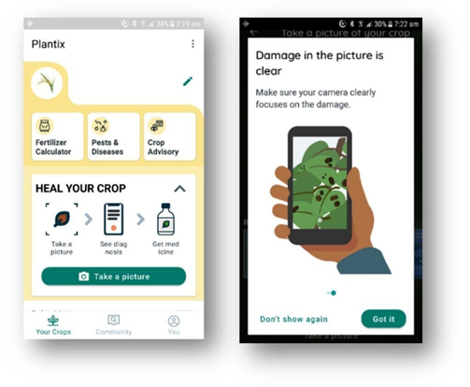
How system works:-
Process:-
Capture image
Upload
AI analysis
Disease detection
recommendation

Slide 8
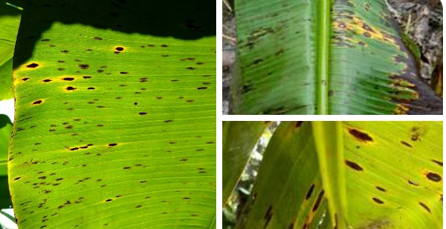
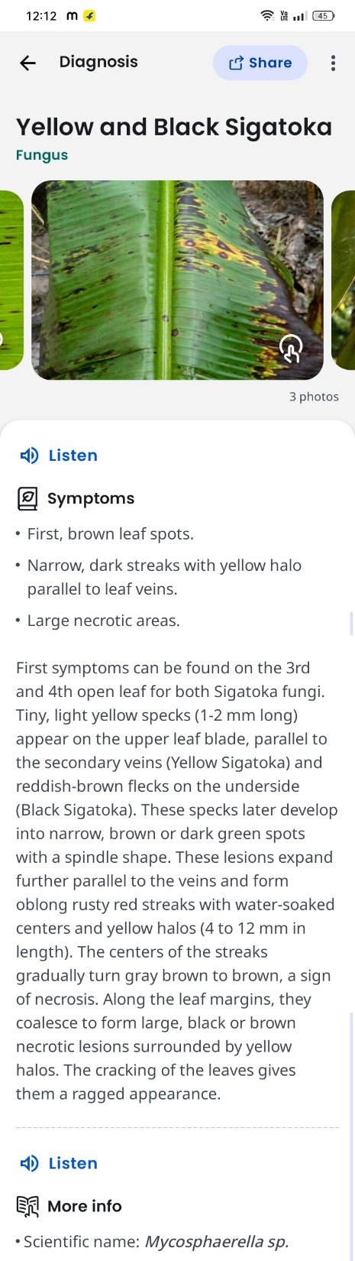
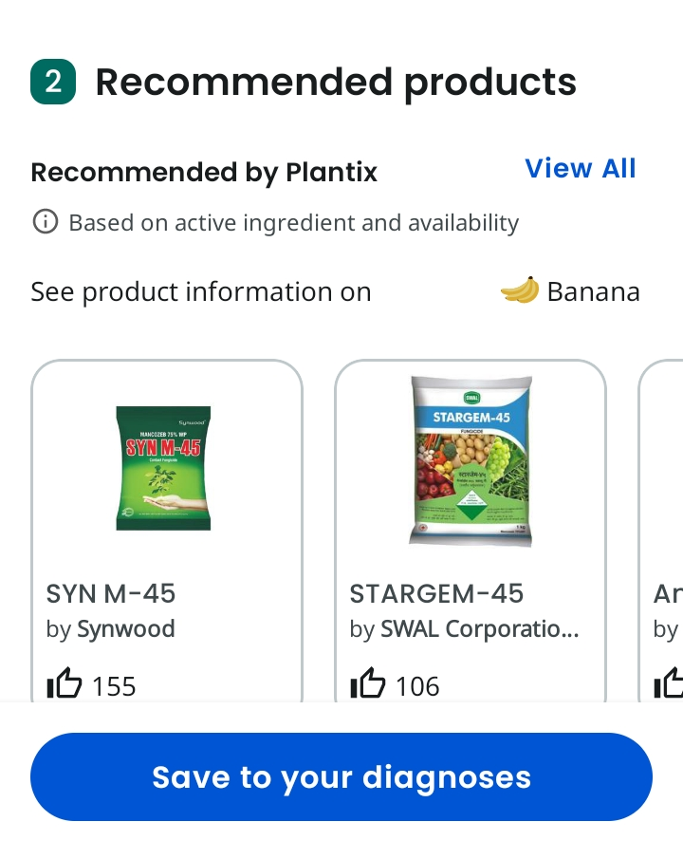


Process

Slide 9
Technologies Used:-
Artificial Intelligence (AI):- to identify crop disease.
Image Processing:-To analyse plant leaf images.
Machine Learning:- To improve detection accuracy.
Mobile Application Technologies:- For farmers access through smartphones.
Cloud Database:- To store and process agriculture data.

Slide 10
Features of Plantix:-
Disease identification
Fertilizer
Crop management tips
Farmer support

Slide 11
Advantages:-
Fast disease detection
Help increase productivity
Reduce crop damage
Cost effectiv
Easy to use

Slide 12
Limitation:-
Requires internet
Detection accuracy depends on image quality
Not a replacement for expert inspection

Slide 13
Conclusion:-
Through this study of Plantix application, I explored how Artificial intelligence and image analysis can support early crop disease detection.
This project improved my understanding of AI applications in agriculture and demonstrated how digital technologies can assist farmers in making informed decisions, improving crop management, and supporting agricultural productivity.

Slide 14
Thank you

