Slide 1
Augmented Reality (AR) Mobile App: Virtual Object Overlay on Real Scenes
DSA0202 – Computer Vision with Open CV
Presented by
Hashini S
192524035
Guided by
Dr. M. Mayuranathan

Slide 2
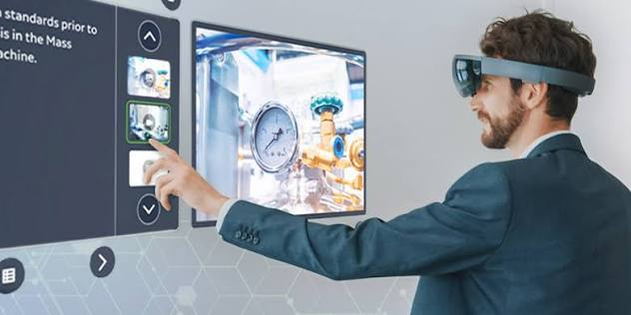
INTRODUCTION
What is Augmented Reality (AR)?
Augmented Reality (AR) combines the real world with virtual objects.
It uses a mobile camera to detect the environment.
Virtual objects (3D models, text, animations) are placed on the real scene in real time.
Examples:
Pokémon GO
Snapchat Filters
IKEA Place

Slide 3
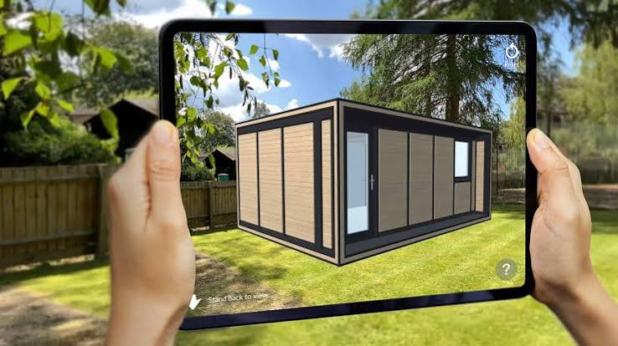
How an AR Mobile App Works
The mobile camera captures the real-world scene.
Computer Vision detects objects, surfaces, or faces.
The camera model calculates the camera's position and angle.
Computer Graphics creates virtual 3D objects.
The virtual objects are displayed on the real scene in real time.

Slide 4
Computer Graphics vs Computer Vision
Computer Graphics | Computer Vision
Creates images | Understands images
Output: Virtual objects | Output: Object information
Used for AR objects | Used for object detection
Example: 3D glasses | Example: Face detection

Slide 5

5
Camera Model Usage
Determines camera position and orientation.
Converts 3D virtual objects into the correct 2D screen position.
Ensures AR objects appear at the correct size and angle.
Makes virtual objects stay fixed while the camera moves.

Slide 6
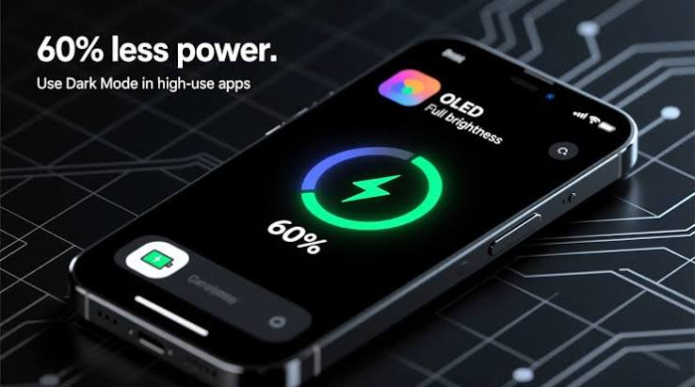
REAL-TIME CHALLENGES
Poor lighting affects object detection.
Camera movement can cause tracking errors.
Lens distortion reduces accuracy. Slow processing causes lag.
Occlusion problems.
Battery consumption is high.

Slide 7

REAL-WORLD APPLICATIONS
Pokémon GO
Snapchat & Instagram Filters
IKEA Place
Car Navigation AR
AR Education Apps
Medical Visualization

Slide 8
CONCLUSION
AR combines Computer Vision and Computer Graphics.
The Camera Model ensures correct positioning of virtual objects.
Solving real-time challenges improves AR performance and user experience.

Slide 9
THANK YOU…

