Slide 1
A#100210

Slide 2
SECTION 4: SWOT, BEHAVIORAL TRAITS & PS EXECUTION
Personalized Skill (PS) Achievement Calendar
My Skills:
Agentic Artificial Intelligence & LLM Optimization
Full-Stack Web Development
March – Basic Foundations
Skills to Learn
Basic HTML and CSS
Basics of Python Programming
Introduction to Artificial Intelligence

Slide 3
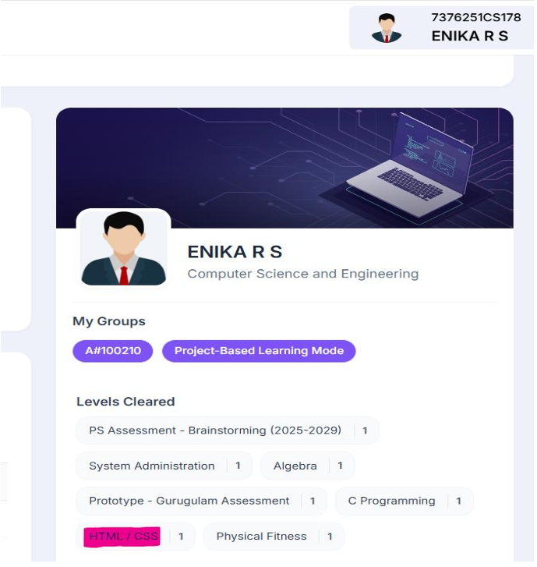
How I Will Learn
Online tutorials and AI tools
Practice coding exercises
Completed HTML CSS Proff :

Slide 4
April – Programming & Web Basics
Skills to Learn
Basic JavaScript
Frontend development basics
Understanding Large Language Models (LLMs)
May – Agentic AI & Backend Basics
Skills to Learn
Introduction to Agentic Artificial Intelligence
Basic LLM prompt design
Backend basics using Node.js
June – Full Stack Project
Skills to Learn
Connecting frontend and backend
Basic LLM optimization techniques
Building a complete web application

Slide 5
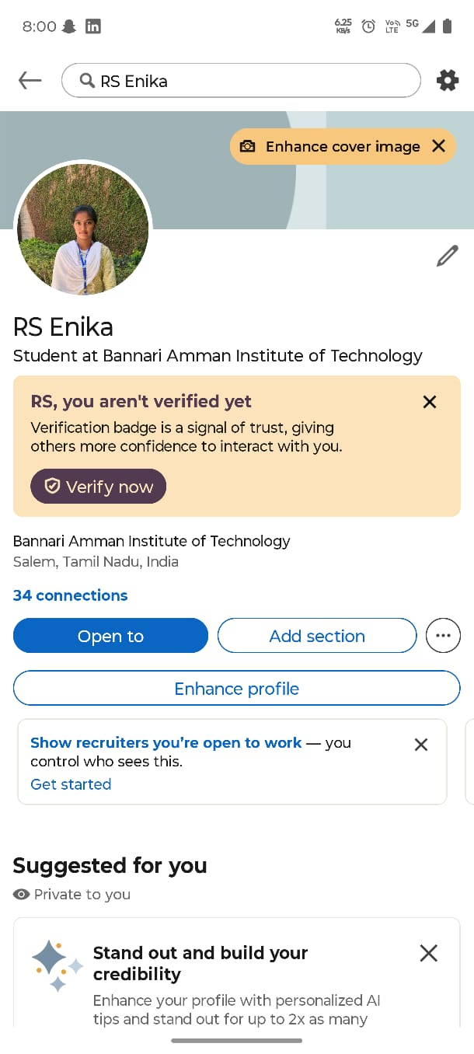
LINKEDIN
LinkedIn:
profile: linkedin profile

