Slide 1



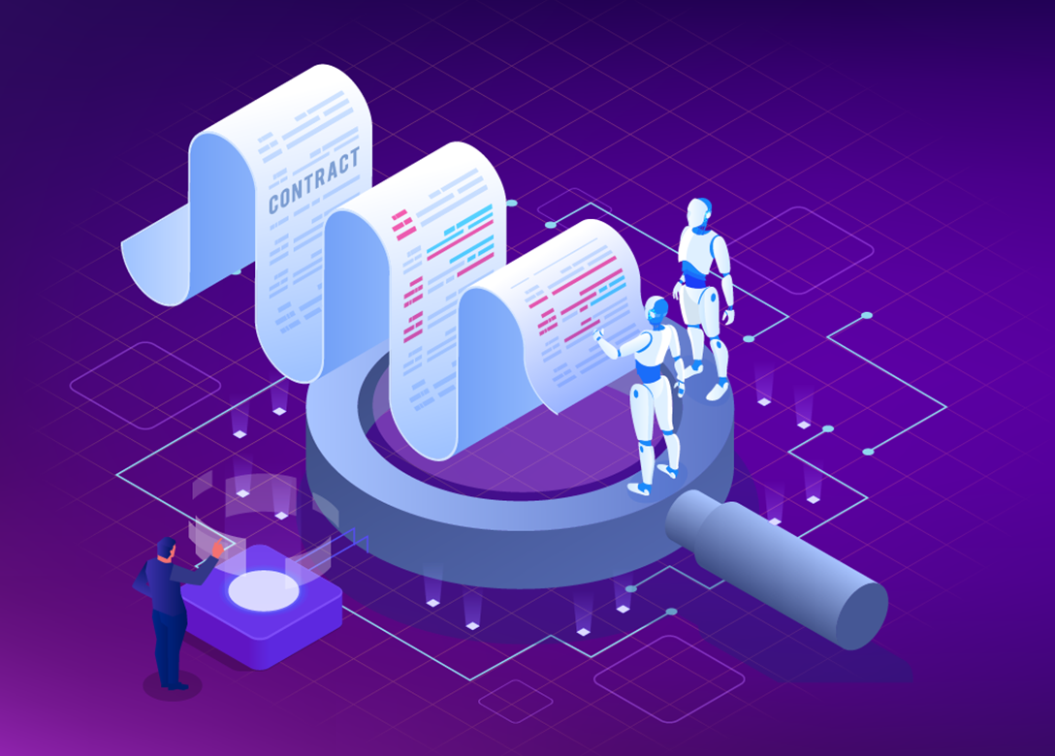


LEGAL AI ASSISTANT
Generate formatted legal contract using textual prompts
Regenerate any portion of contract using prompt
Summarize entire contract on a single click

Slide 2
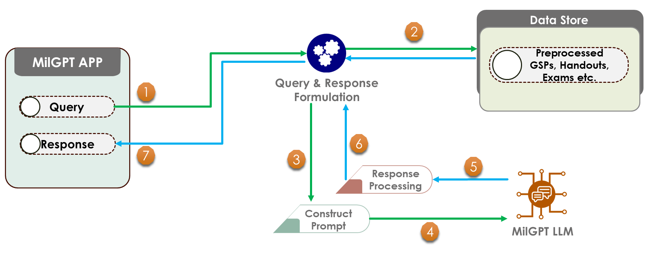
MILGPT
DOMAIN SPECIFIC LLM
Step into the future of military intelligence with cutting-edge Domain-Specific Large Language Model
Insightful information retrieval
Adaptive Learning
Completely offline
Trained on 23,000 Q&A pairs generated form just 50 books

Slide 3
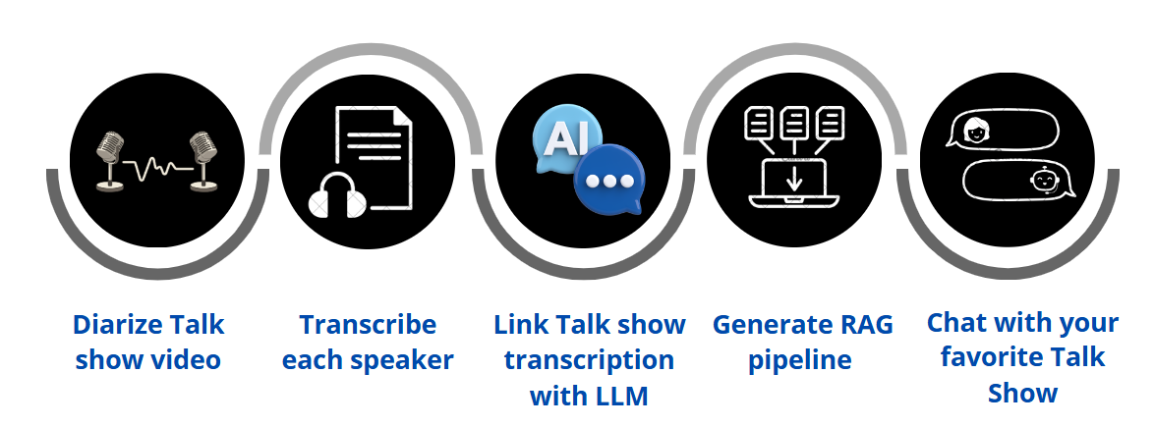
TalkShow Baithak
Talk to your host after the program is over using Talk Show Bot
Discuss topics and get more insights
Chat with your AI generated host
Never miss important details about latest news

