Slide 1

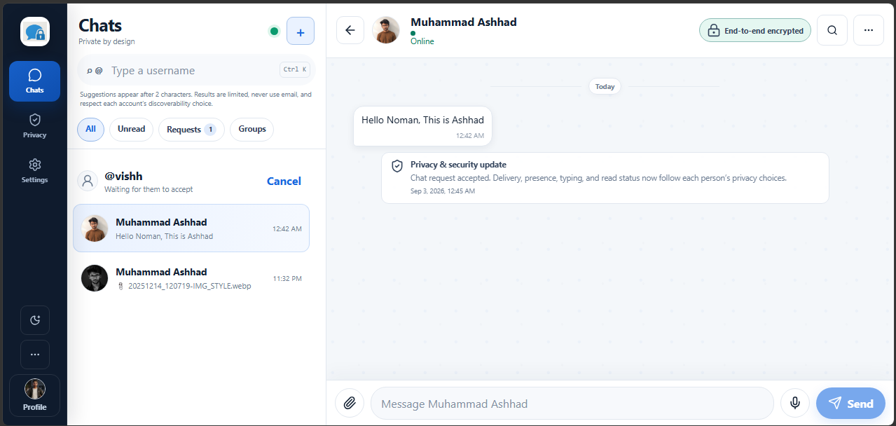
PRIVACY SHOULD
FEEL USABLE.
SecureChat
Privacy & Data Ethics in UX Design
Consent
Control
Clarity
Muhammad Ashhad . 68669
Vishaka Bharwanu · 69518
Instructor: Dr. Rizwan Munir
Human–Computer Interaction & Graphics
Notes:
[Sources]
- User-provided SecureChat interface screenshots (2026-09-03)
[/Sources]

Slide 2
THE UX PROBLEM
Security fails when people cannot understand it.
01
02
03
HIDDEN
UNCLEAR
UNCONTROLLED
What is collected?
Who can see it?
Can I reverse it?
Design goal
Make privacy visible at the exact moment of choice.
Notes:
[Sources]
- User-provided SecureChat interface screenshots (2026-09-03)
- NIST Privacy Framework — https://www.nist.gov/privacy-framework
[/Sources]

Slide 3
OUR DESIGN RESPONSE
Trust is an interaction,
not a label.
VISIBLE
MEANINGFUL
REVERSIBLE
+
+
Privacy state
Consent
Control
Privacy by Design
Integrated into the flow — not buried in legal text.
Notes:
[Sources]
- User-provided SecureChat interface screenshots (2026-09-03)
- GDPR Article 5 — https://eur-lex.europa.eu/legal-content/EN/TXT/?uri=CELEX:32016R0679
[/Sources]

Slide 4
CORE JOURNEY
Five moments. One continuous feeling of control.
1
2
3
4
5
DISCOVER
REQUEST
CONSENT
CHAT
CONTROL
Limited discovery
Intro message
Accept / decline
E2EE feedback
Export / wipe
Every step answers: “What happens next?”
Notes:
[Sources]
- User-provided SecureChat interface screenshots (2026-09-03)
[/Sources]

Slide 5
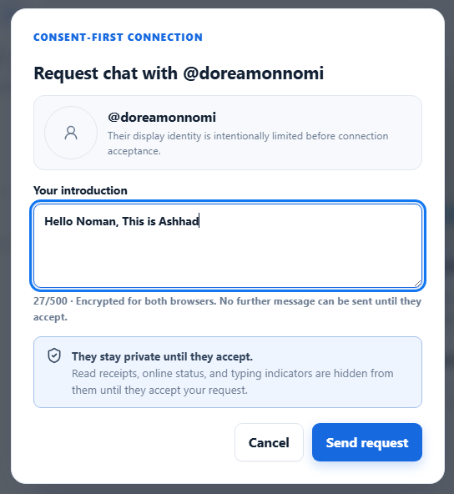
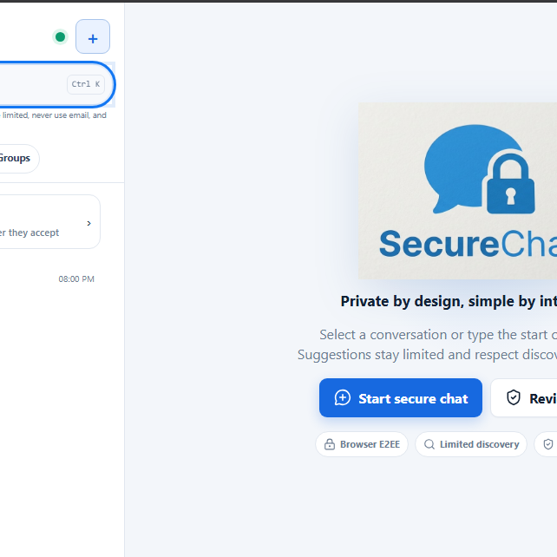
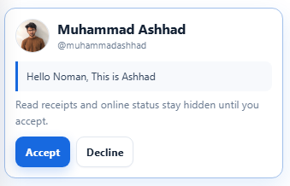
CONSENT BEFORE CONNECTION
A request is a conversation — not a dark pattern.
1
Find
2
Explain
3
Choose
Identity stays limited until acceptance.
Notes:
[Sources]
- User-provided SecureChat interface screenshots (2026-09-03)
[/Sources]

Slide 6
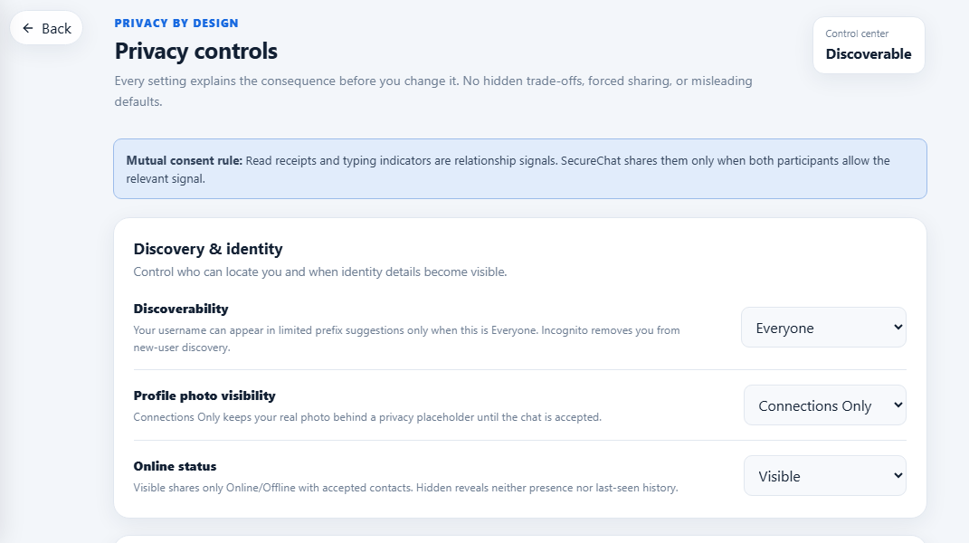
CONTROL CENTRE
Privacy settings explain consequences before change.
DISCOVERABILITY
Who can find me?
IDENTITY
When is my photo visible?
RELATIONSHIP SIGNALS
Who sees presence?
No hidden trade-offs
Notes:
[Sources]
- User-provided SecureChat interface screenshots (2026-09-03)
[/Sources]

Slide 7
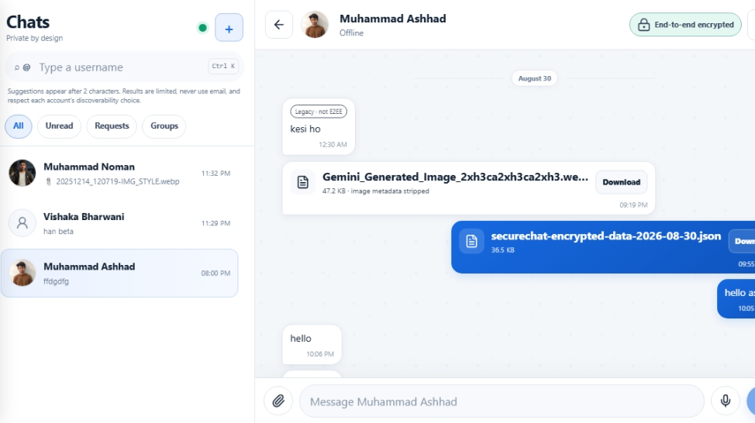
PROGRESSIVE DISCLOSURE
Show reassurance first.
Technical detail on demand.
🔒 End-to-end encrypted
Visible in the chat header
Protected
Service-visible
Advanced keys stay behind “Learn more”.
Message content
Attachments
Delivery metadata
Group membership
Less memory burden. More confidence.
Notes:
[Sources]
- User-provided SecureChat interface screenshots (2026-09-03)
[/Sources]

Slide 8
HCI FOUNDATION
Shneiderman’s 8 Golden Rules — visible in the interface.
01
02
03
04
CONSISTENCY
SHORTCUTS
FEEDBACK
CLOSURE
One design system
Search · Ctrl K
Status · toast
Accepted · sent
05
06
07
08
PREVENTION
REVERSAL
CONTROL
MEMORY
Confirm risk
Cancel · clear
User decides
Explain in context
The rules work together: clarity → confidence → control.
Notes:
[Sources]
- User-provided SecureChat interface screenshots (2026-09-03)
- Shneiderman’s Eight Golden Rules — https://www.cs.umd.edu/users/ben/goldenrules.html
[/Sources]

Slide 9
ACCESSIBLE INTERACTION
Calm motion. Clear feedback.
No layout surprises.
Aa
◐
↝
···
Readable type
High contrast
Reduced motion
Skeleton states
Transitions support orientation — never block the task.
Notes:
[Sources]
- User-provided SecureChat interface screenshots (2026-09-03)
- WCAG 2.2 — https://www.w3.org/TR/WCAG22/
[/Sources]

Slide 10
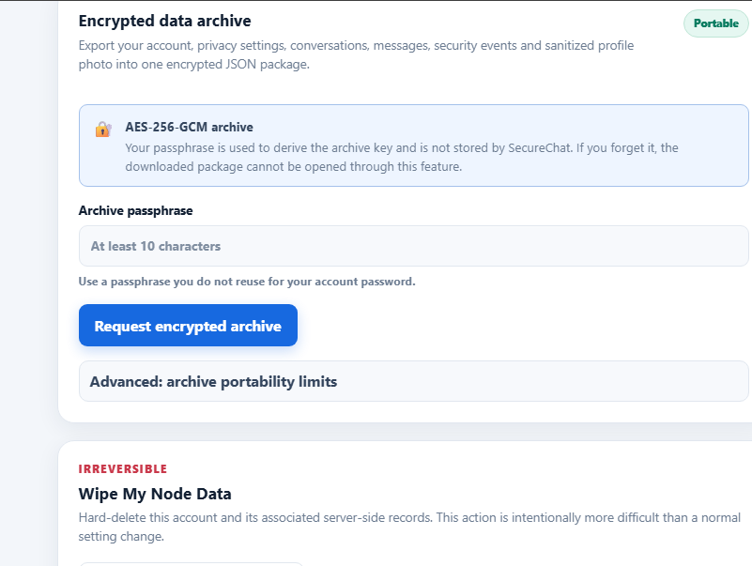
DATA ETHICS LIFECYCLE
From minimum collection to meaningful deletion.
1
MINIMIZE
Collect only what is needed
2
EXPLAIN
Show purpose and impact
3
CONSENT
Ask before sharing
4
CONTROL
Export or wipe
Portable archive
Irreversible wipe
Notes:
[Sources]
- User-provided SecureChat interface screenshots (2026-09-03)
- GDPR Article 5 — https://eur-lex.europa.eu/legal-content/EN/TXT/?uri=CELEX:32016R0679
- NIST Privacy Framework — https://www.nist.gov/privacy-framework
[/Sources]

Slide 11
EVALUATION
The interface closes the loop.
✓
Discover user
PASS
✓
Change privacy
PASS
✓
Send consent request
PASS
✓
Export data
PASS
✓
Accept / decline
PASS
✓
Wipe account
PASS
✓
Open secure chat
PASS
LIMITATION
Formal user testing with a larger sample
is the next validation step.
Heuristic + task-flow review
Notes:
[Sources]
- User-provided SecureChat interface screenshots (2026-09-03)
[/Sources]

Slide 12
A secure experience is usable
only when people understand it.
VISIBLE
CONSENSUAL
REVERSIBLE
Questions?
Dr. Rizwan Munir
Notes:
[Sources]
- User-provided SecureChat interface screenshots (2026-09-03)
[/Sources]

