Slide 1
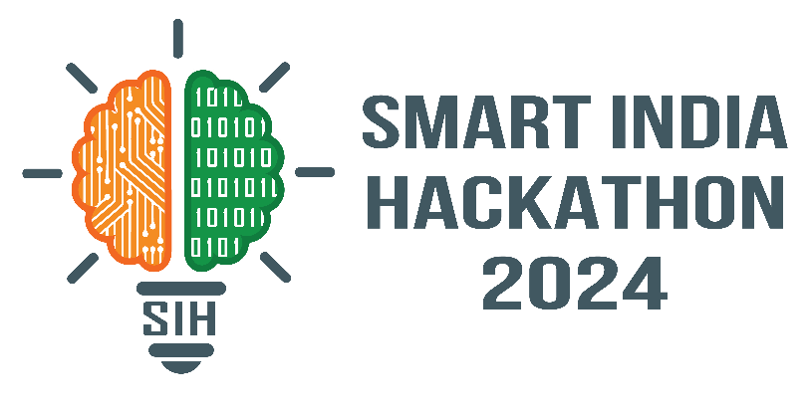
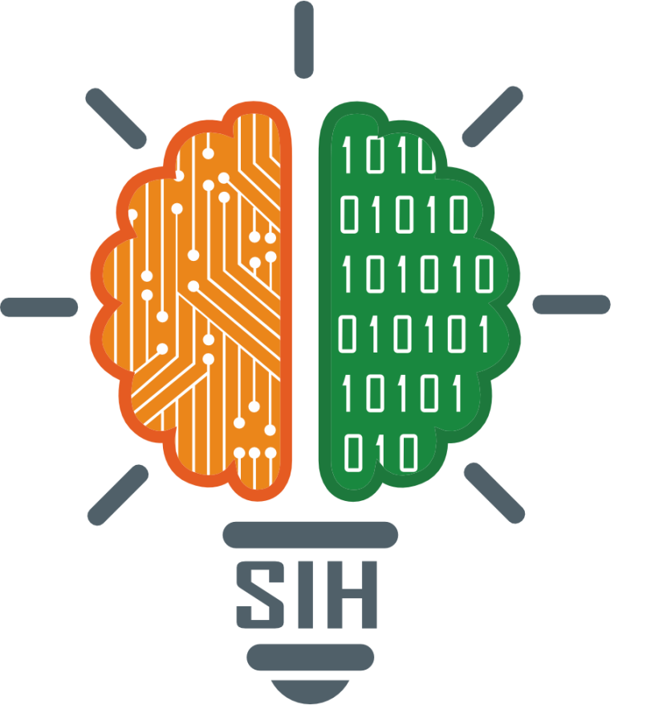
SMART INDIA HACKATHON 2024
TITLE PAGE
Problem Statement ID – 1711
Problem Statement Title- Enhancing Rail Madad with Al-powered Complaint Management.
Theme- Smart Automation
PS Category- Software
Team ID-
Team Name : Bench Markers

Slide 2
IDEA TITLE
Bench
Markers
Proposed Solution
We analyze image and video data and use BLIP(Bootstrapping Language-Image Pre-Training) and OpenCV respectively to generate captions for the given media and compare it with the text complaint entered by the user.
OCR extracts text from images, pdfs while metadata (timestamps, geolocation-geopy ) aids in faster resolution.
Using machine learning techniques like clustering to create visualizations for observed patterns in complaint data. We also use ARIMA on historical data to predict recurring issues before they occur.

Slide 3
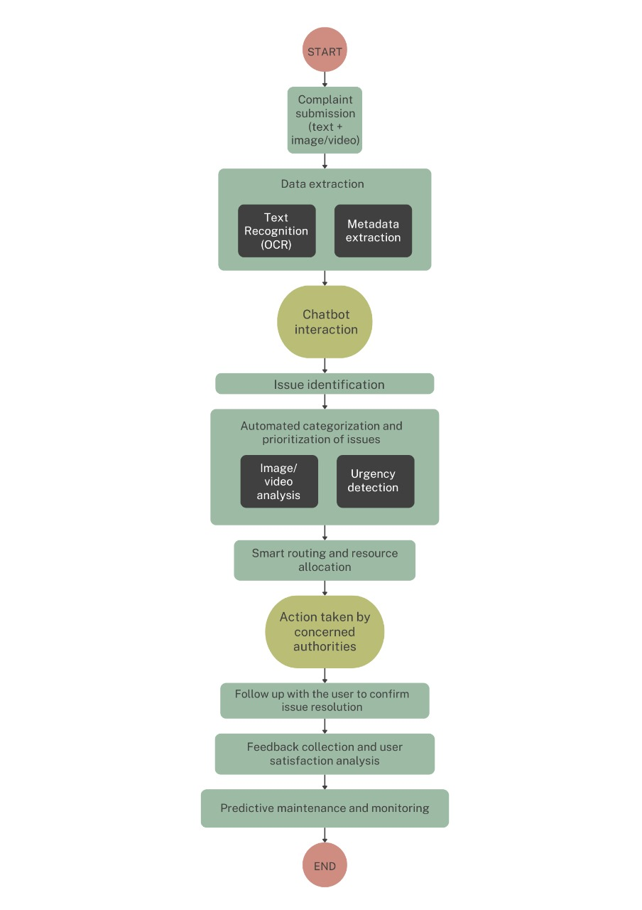









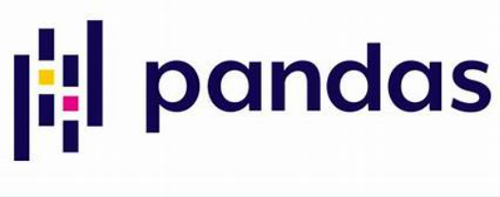






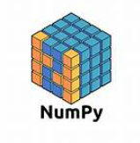
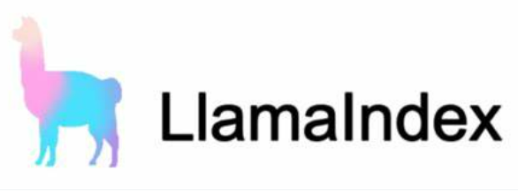




TECHNICAL APPROACH
Bench
Markers
TECH STACK
WORK FLOW
Zoom in for
Clear view

Slide 4
FEASIBILITY AND VIABILITY
Bench
Markers
Analysis of the feasibility of the idea:
The proposed AI-based Rail Madad enhancement is feasible, leveraging established technologies like groq, reAct agents, geopy, opencv, BLIP, NLP, and OCR for efficient complaint handling. With scalable cloud infrastructure and pre-trained models, it can streamline processes. Integration with existing systems and addressing challenges like data privacy ensure operational viability and long-term benefits.
Potential challenges:
Geographical location extraction from images/videos poses a challenge due to data privacy concerns. Analyzing videos that accompany complaints is also difficult. Addressing emergency complaints or urgent requirements presents another significant challenge.
Strategies for overcoming these challenges:
Geographical location can be extracted with the timestamp extracted from the image and PNR number. For video analysis, frames for every 5 seconds is captured and analyzed. Emergency complaints can be addressed by alerting the previous and next station.

Slide 5
IMPACT AND BENEFITS
Bench
Markers
The AI-driven Rail Madad system will significantly enhance passenger experience by providing faster, more efficient complaint resolution. Passengers will feel more valued with timely updates and quicker resolutions for urgent issues, increasing trust in the railway system. It also improves operational efficiency for railway staff, reducing workload and enhancing service quality.
Benefits of the Solution
Social: Enhanced passenger satisfaction through faster, transparent complaint handling and improved safety by prioritizing urgent complaints (e.g., medical emergencies).
Economic: Reduced operational costs by automating processes and leveraging predictive maintenance, which minimizes downtime and prevents costly repairs.
Environmental: By addressing issues like infrastructure degradation early, the system contributes to sustainable railway operations, reducing waste and conserving resources through efficient maintenance planning.

Slide 6
RESEARCH AND REFERENCES
Your Team Name
https://github.com/CyberArmorKnight/MetaLens_Detective/tree/main

