Slide 1
Problem Statement: Braille Learning Device For The Visually Impaired. Team Name: Digi-Vision Team Leader Name: Sahil Sirajali Kazi
The Idea Proposed Is To Develop An Intuitive And Compact Device That Helps The Visually Impaired Learn Braille.
Just like anyone, being educated and literate is essential to the well being of people who are visually impaired. Education gives the visually impaired the opportunity to thrive, contribute to society, and have a successful career. Literacy in the Braille system is so crucial to the employment of the visually impaired that 80 percent of the visually impaired who are employed can read Braille.
However, in recent years, the Braille literacy rates has been on the decline. Today, less than 10 percent of the visually impaired children can read Braille, where as the number was about 50 percent in 1950. The consequences? Over 70 percent of visually impaired adults are unemployed. Source:Internet.
One reason for this trend is the lack of access to a Braille education. There are far fewer Braille teachers and schools in India compared to the number of visually impaired students.
One survey suggests, “It is estimated that at least 200,000 children in India have severe visual impairment or blindness and approximately 15,000 are in schools for the blind. Although this represents a small percentage of the estimated 5 million blind in India, it is significant in terms of 'blind-years’ .”
The vision of our low cost embedded HID Device is to take full advantage of computer application and text-to-speech technology to aid the braille education at learners pace from anywhere in the world.
The device will produce audio instructions and output to users mechanical input, and will be capable of producing mechanical output for voice input.

Slide 2
IDEA DETAILS
Ultra-portable HID (human interface device) that serves 2 purposes: allows the visually impaired to learn and practice the Braille system independently, and makes it easy for the visually impaired to navigate and type on a computer.
Traditionally, a Braille instructor is needed to confirm that the word or letter that the student wrote is correct. With Our Device, the student will get immediate audio feedback on what Braille letter or word they just wrote, which makes it perfect for when the student is practicing Braille at home, or doesn't have access to a Braille instructor.
Low Cost Device Prototyping Cost Around INR 6000/- which can be further reduced to INR 2000/- without compromising the performance.
For the visually impaired that are familiar with Braille but have no experience with computers, there is a steep learning curve before they can use a keyboard or a traditional Braille writer. With Digi-Vision they can start typing right away, not to mention it's a far more compact than a standard keyboard, and have an additional scrolling/reading knob.
Two way functioning, the device can take mechanical input by pressing keys and produce audio output, similarly voice input can produce mechanical vibration on individual keys.
Rechargeable and works on very low power around 5-8W.
Will come with a learning application, where the user will have access to digital braille courses.

Slide 3
BLOCK DIAGRAM
Technology stack
KEYSWITCHES
RASPBERRY PI ZERO W
LED
1. RASPBERRY PI ZERO W.
2. Python.
ROTARY ENCODER
SPEAKER
MICROPHONE
USB CABLE TO HOST COMPUTER
Digi-Vision Architecture

Slide 4
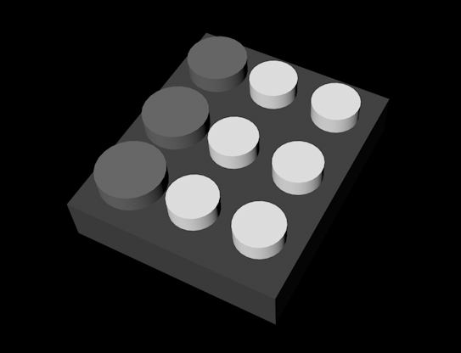
PROTOTYPE
Digi-Vision Prototype

Slide 5
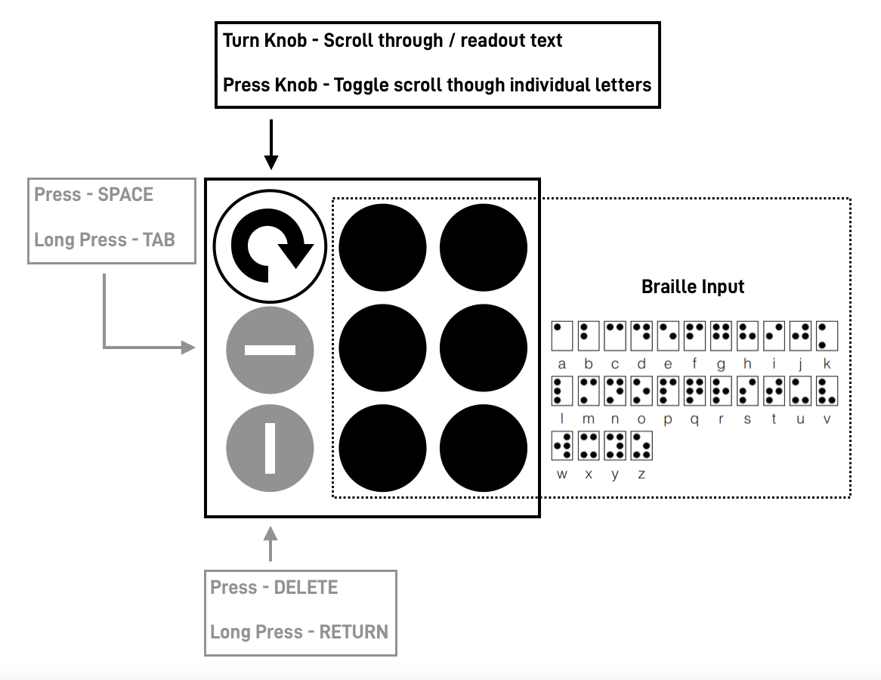
HOW IT WORKS
Figure 1: Digi – Vision

