Slide 1
CleanSense Lite
OVERCLOCK'26
24 HOURS HACKATHON | AN AI-ASSISTED HACKATHON
PS 4: CleanSense AI, adaptive cleaning
Team: [Team Name]
[Member 1] · [Member 2] · [Member 3] · [Member 4]

Slide 2
Problem Statement
The problem being addressed
Why current tools fall short
Cleaning robots use the same force on every spill. Too little leaves residue, too much damages delicate surfaces, and no one can prove the surface is actually clean.
Fixed cycles cannot adapt to the mess. LLM robots let the model declare success, and vision judges lean toward saying done.
Let the AI propose and let physics decide: a load cell weighs what is left, so clean is a measurement, not an opinion.
Key insight

Slide 3
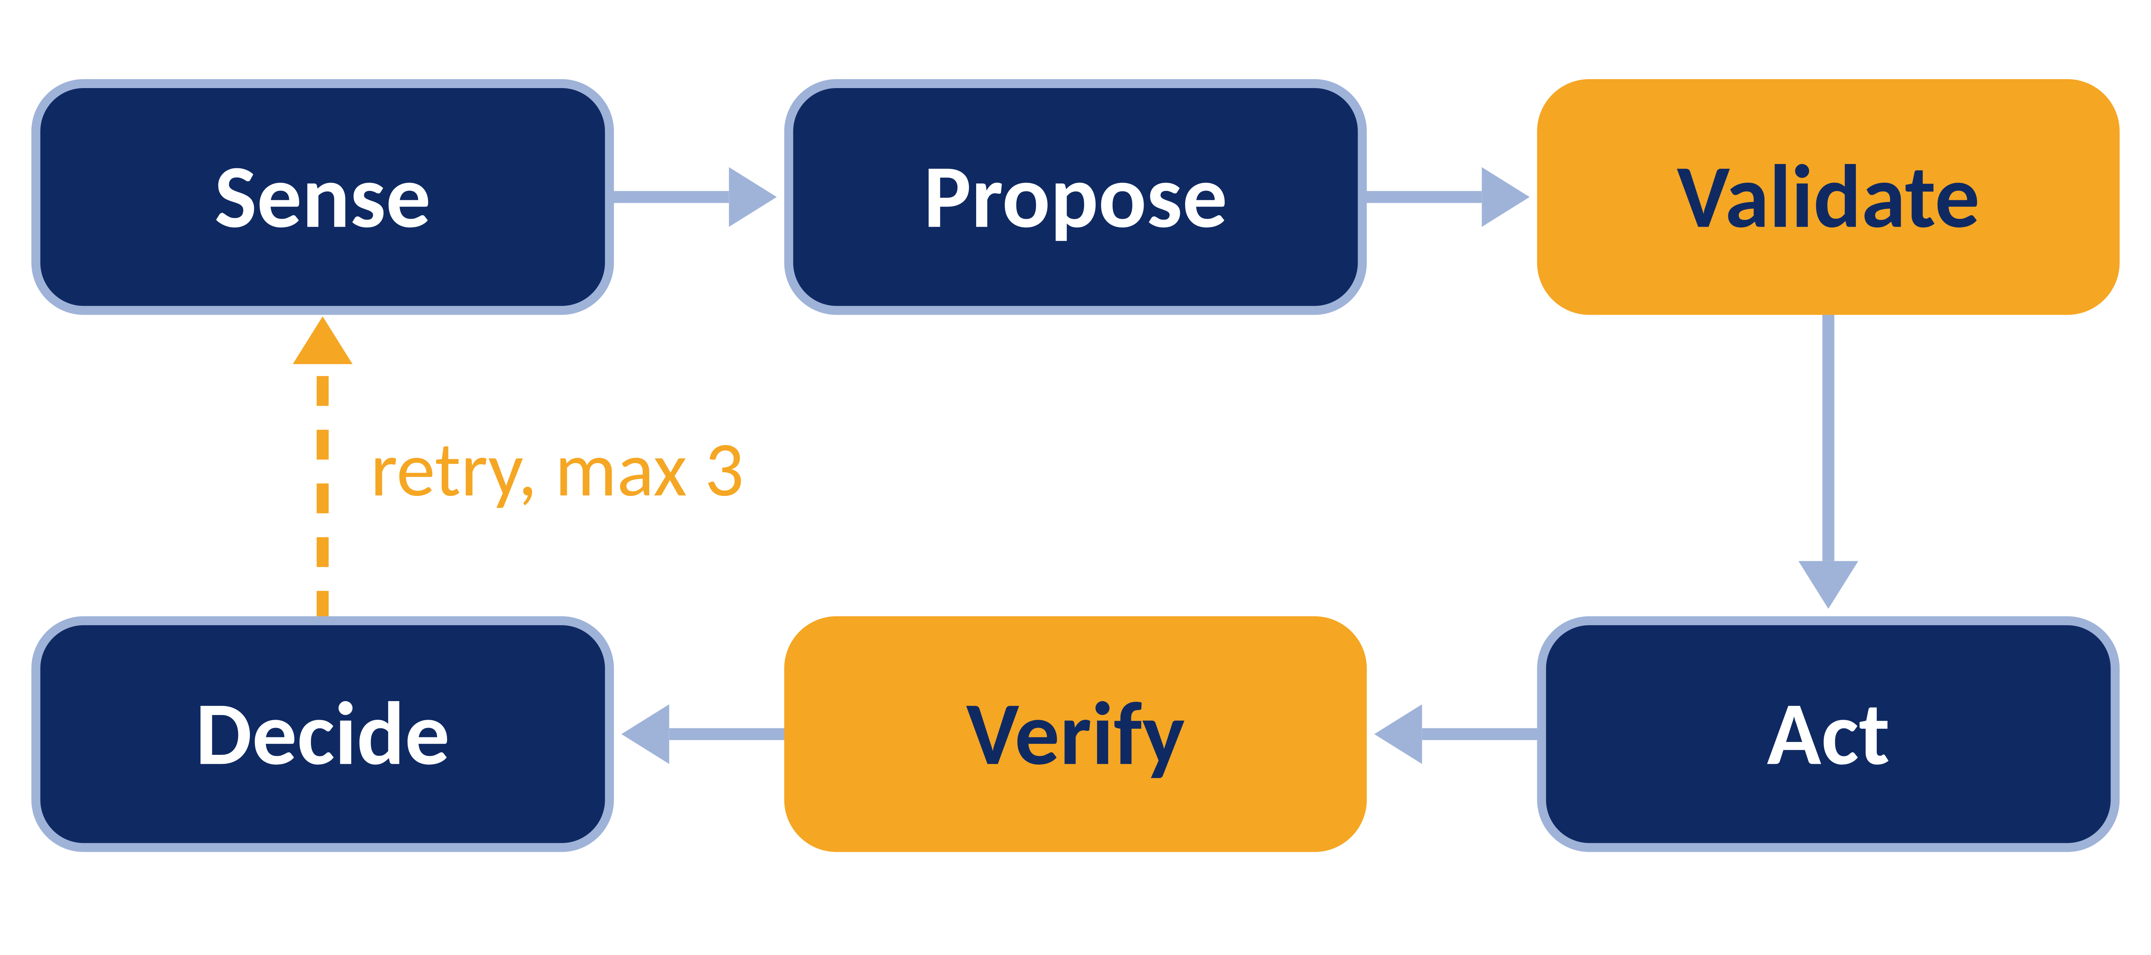
Solution Overview
1
Key features
Our solution in one sentence
AI proposes from closed options, code checks every step, the scale decides clean.
A wiper on a load-cell tile that cleans each spill with the gentlest pass the scale says is enough.
2
How it addresses the problem
Gentlest pass first, stronger only if residue stays, then a person after 3 tries.
3
Why it is different
The AI never says clean or drives a motor. An offline tier needs no network.

Slide 4
Technical Approach
Inputs
AI / Reasoning
Rules and Safety
Outputs
Load cell, camera, piezo, operator tap
Vision LLM picks from closed options
7 fail-closed checks, firmware limits, e-stop
One wiper pass, live dashboard, audit log
Technology stack
Innovations and novel techniques
Python, FastAPI, OpenCV, Claude API. ESP32 A runs servo and scale; ESP32 B runs the piezo vote.
The scale decides clean and the camera must agree. Override can only reduce. Hash-chained log.

Slide 5
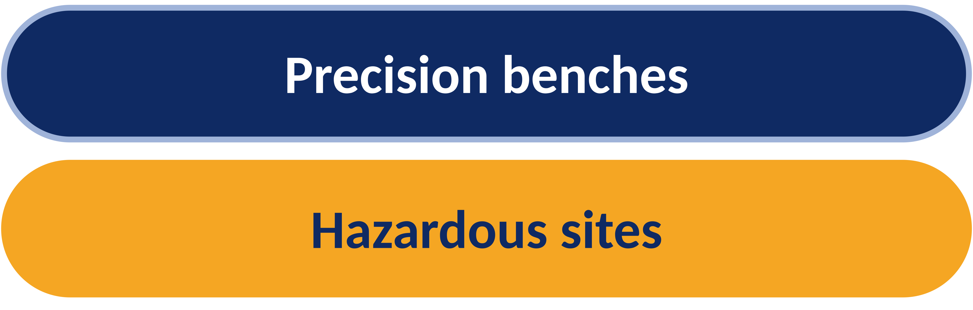
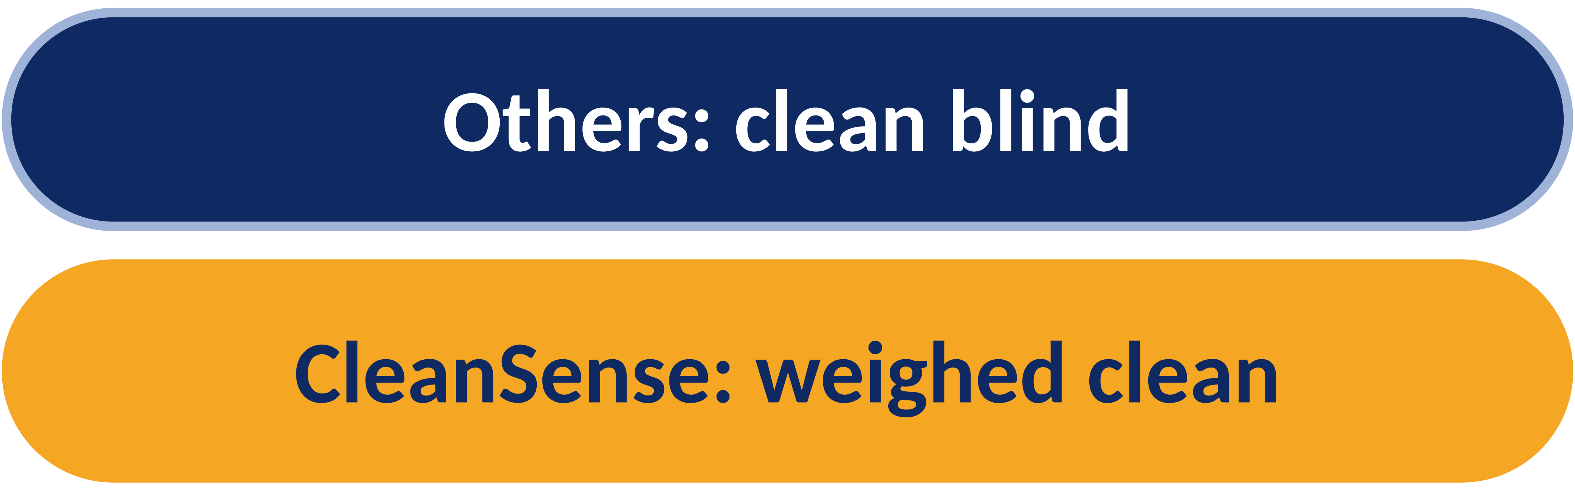
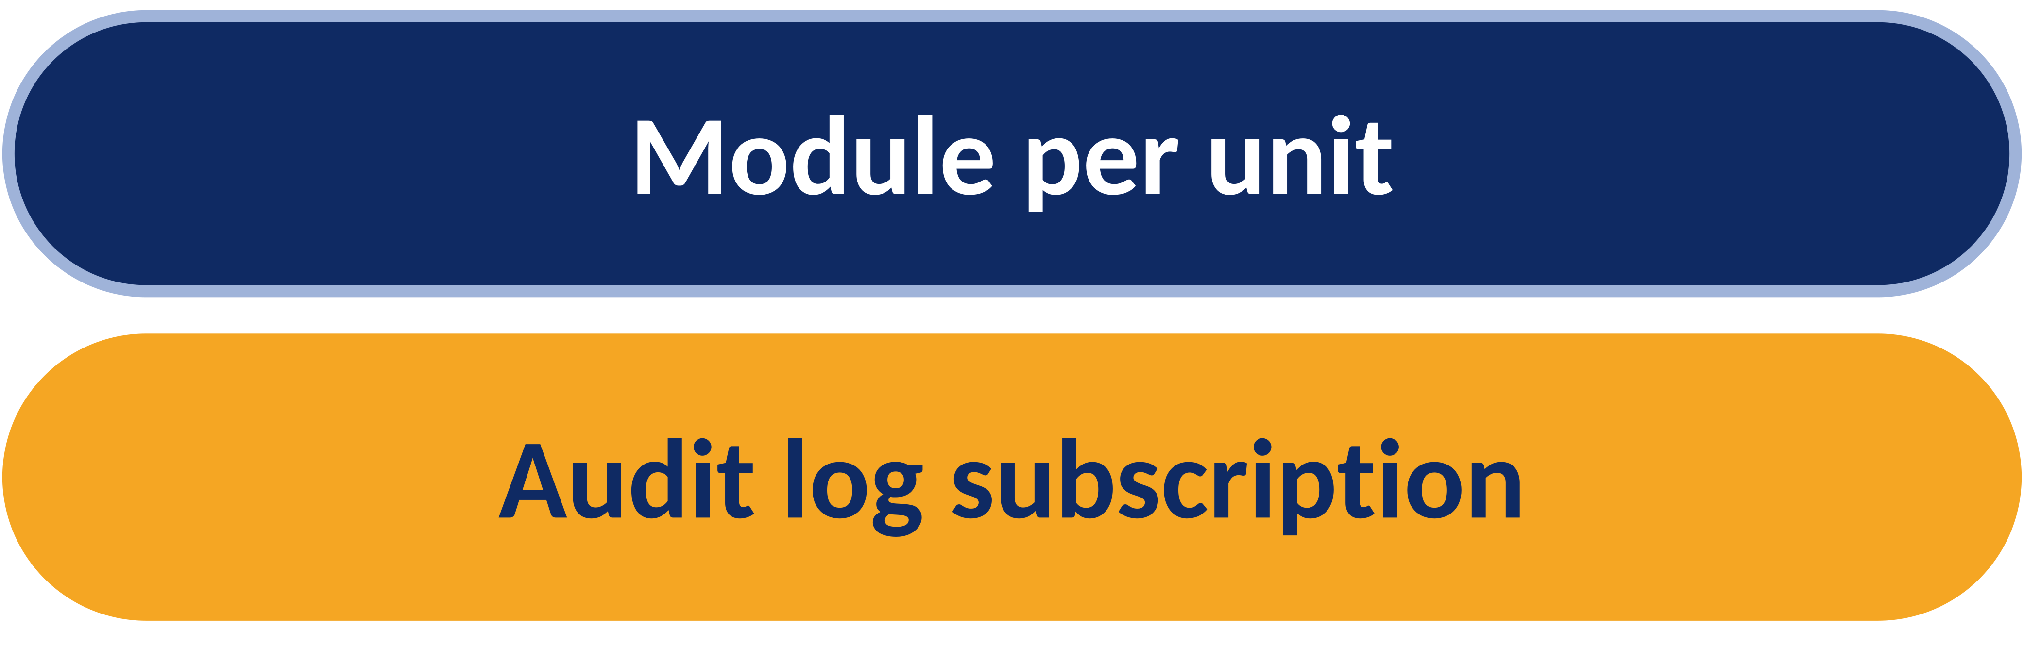
Market Potential and Business Model
Target users
Competitors and edge
Revenue and scale
Labs, food prep, clinics and electronics benches, where a wrong clean is costly. Factories and mines, where hot or hazardous spills should not meet a person first.
Robot vacuums and fixed-cycle scrubbers clean blind and cannot prove the result. CleanSense adds a measured clean, a readable safety gate and an offline mode.
Sell the verify-and-gate module to cleaning-robot makers per unit, plus a subscription for audit logs and compliance reports. The gate fits any actuator.

Slide 6
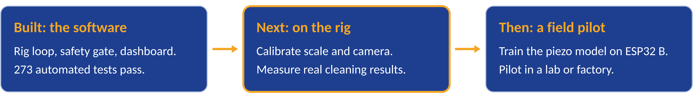
Future Scope
Next steps
Vision
Calibrate scale and camera on the rig, train the piezo model on labelled drops, wire the e-stop to fail safe, and compare AI against rules.
A verification layer for any cleaning or dispensing robot: AI that plans, physics that proves, logs anyone can audit.

