Slide 1
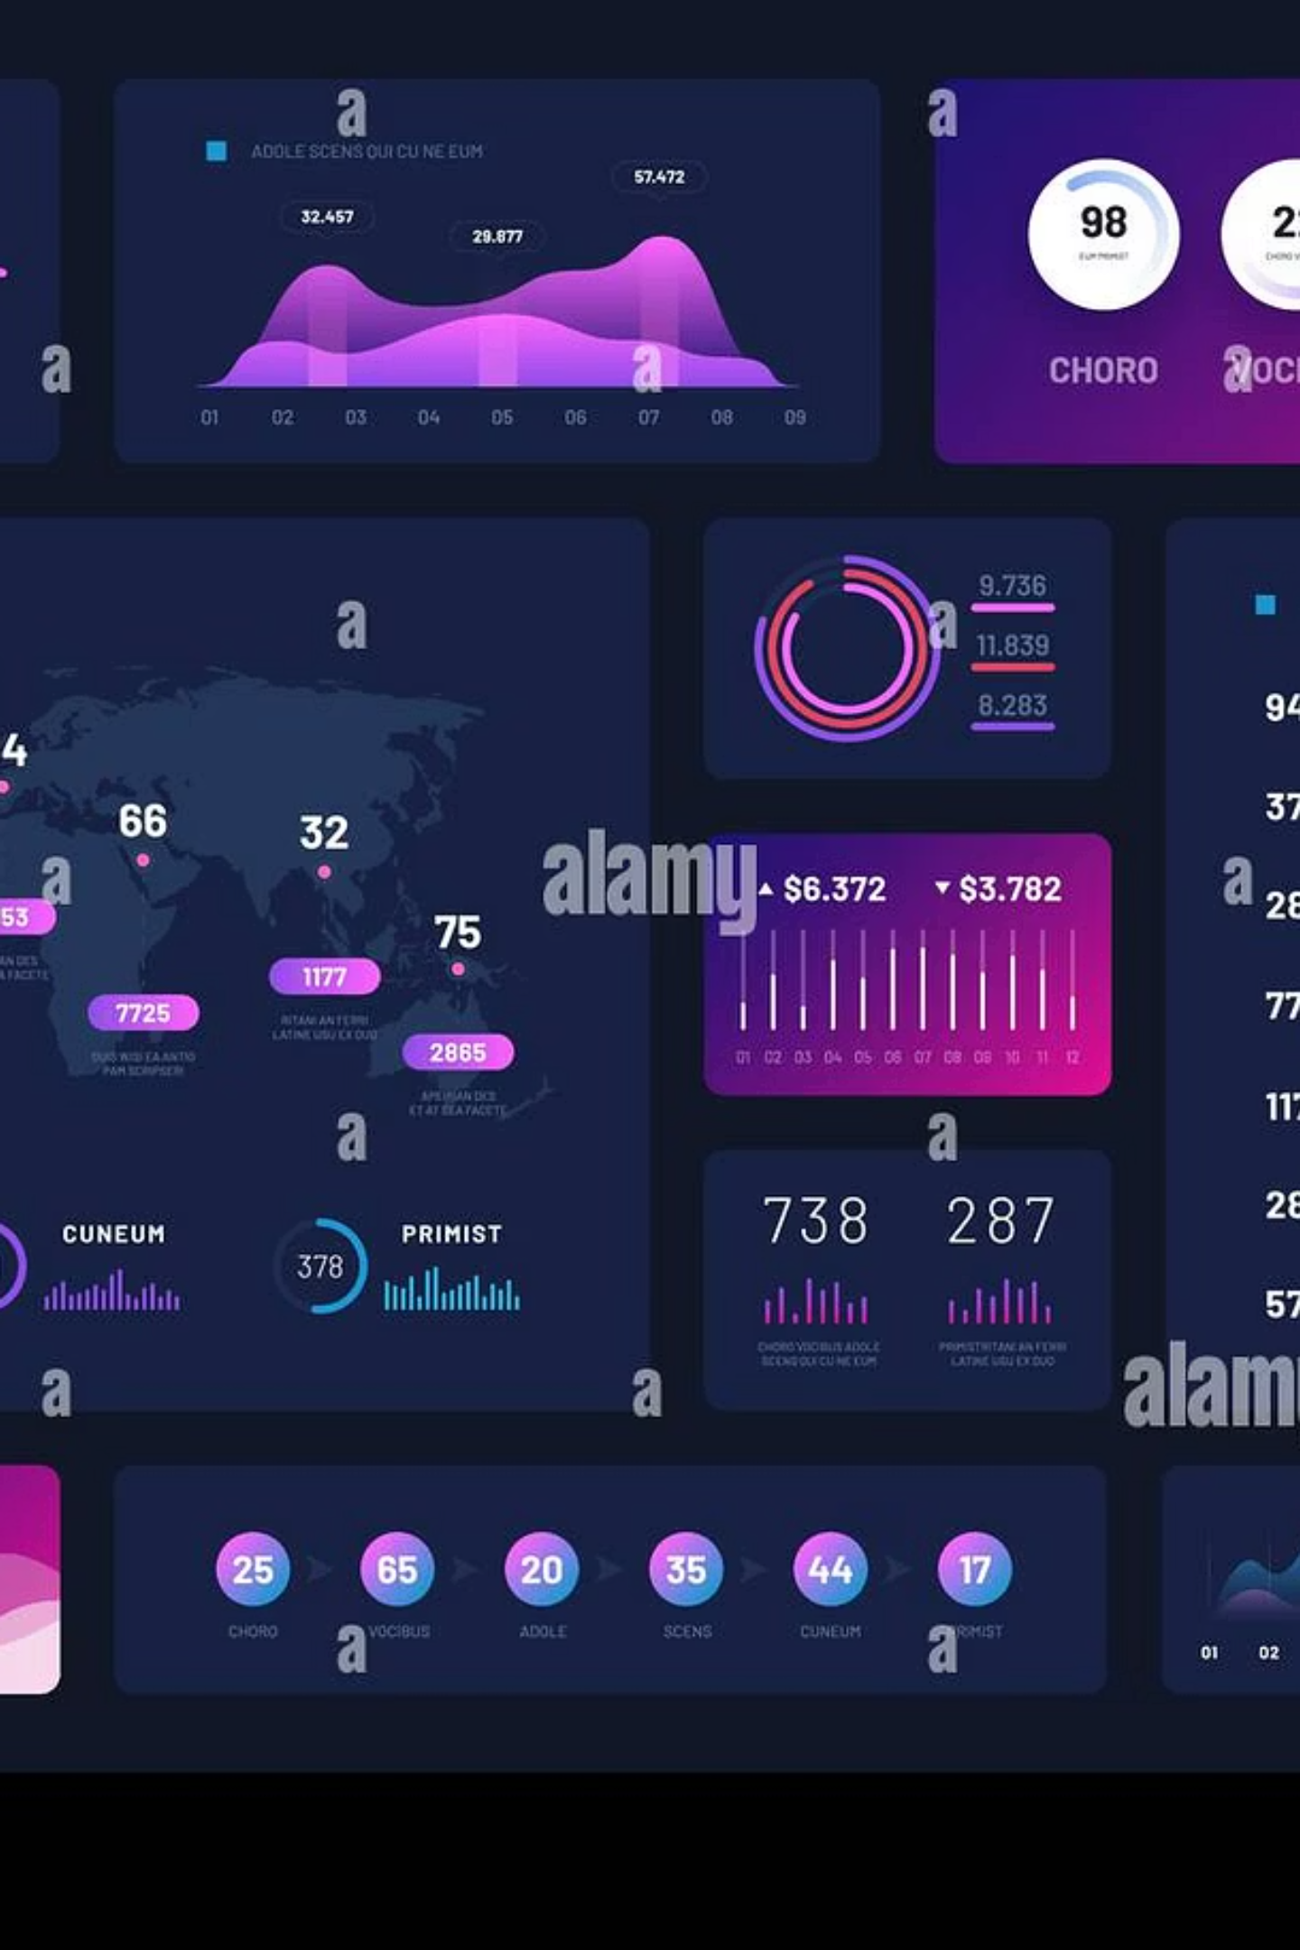
Consumer Shopping Behavior Analysis
Comprehensive insights from 3,900 customer transactions across seven dimensions: revenue performance, customer segmentation, discount effectiveness, loyalty and retention, payment behavior, product performance, and seasonal trends.

Slide 2
Executive Summary
3,900
$233,000
Total Transactions
Total Revenue
Comprehensive dataset analyzed
Across all customer segments
$59.76
43%
Avg Transaction
Discount Rate
Per customer basis
Of all transactions

Slide 3
Management Alerts
Discounts Not Driving Higher Spend
Subscriptions Not Delivering Loyalty
Young Adults Under-Represented
Discounted customers spent $59.28 vs $60.13 for non-discounted. Despite 43% of transactions involving discounts, no revenue uplift achieved.
Subscribed customers spend less ($59.49 avg) and show lower purchase frequency. Program not attracting highest-value customers.
Only 571 customers (14.6% of base) vs 1,100+ in every other age group. 18–25 segment is significant untapped growth opportunity.

Slide 4
Revenue Performance
Gender Performance
Product Categories
Male customers:
2,652 customers
$157,890 revenue
$59.54 avg spend
Clothing: $104,264 (44.7%)
Accessories: $74,200 (31.8%)
Female customers:
Footwear: $36,093 (15.5%),
1,248 customers,
$75,191 revenue,
$60.25 avg spend
Outerwear: $18,524 (7.9%)

Slide 5
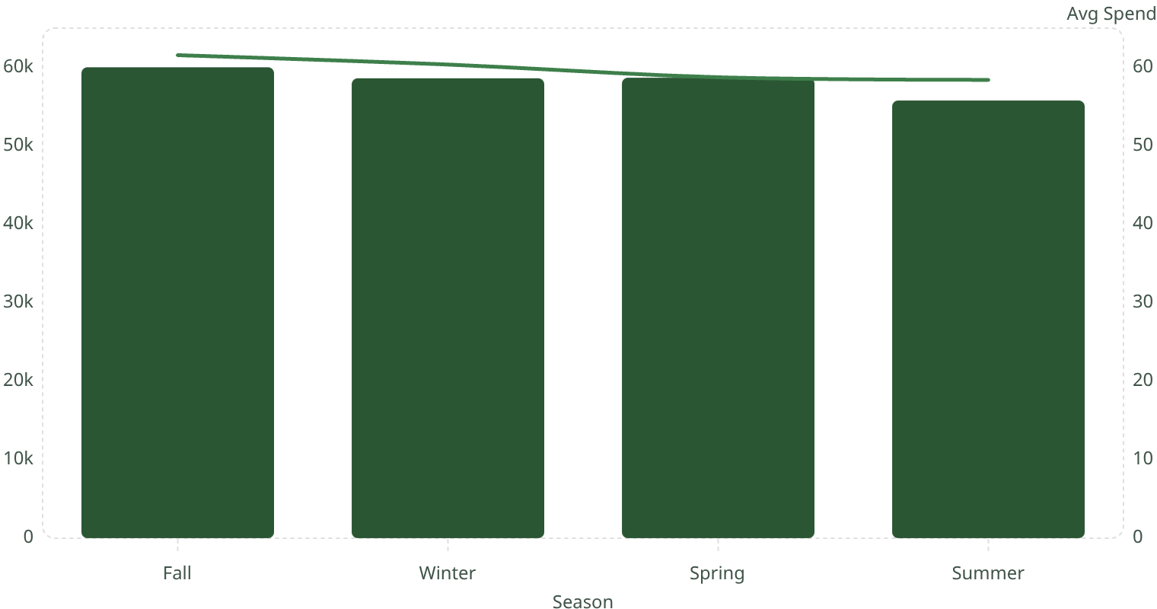
Seasonal Trends
61.6
60.4
58.7
58.4
60k
58.6k
58.7k
55.8k
Revenue
Fall
Spring
$60,018 revenue, $61.56 avg spend
$58,679 revenue, $58.74 avg spend
1
2
3
4
Winter
Summer
$58,607 revenue, $60.36 avg spend
$55,777 revenue, $58.41 avg spend
Fall is the strongest season, while Summer is the weakest and has the most room for improvement.

Slide 6
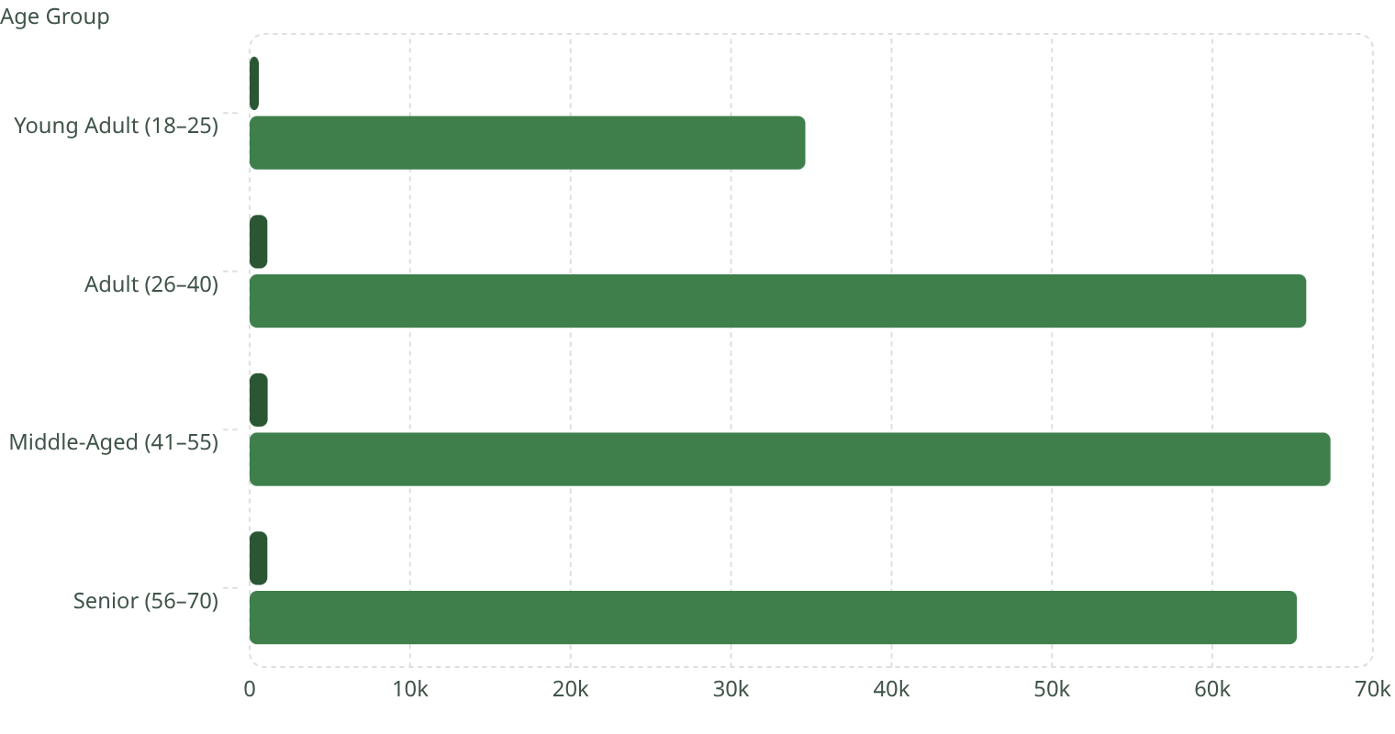
Customer Segmentation
Young Adult (18–25)
Adult (26–40)
571 customers, $34,630 revenue, $60.65 avg spend, 24.63 prev purchases
1,103 customers, $65,842 revenue, $59.69 avg spend, 25.04 prev purchases
Middle-Aged (41–55)
Senior (56–70)
1,121 customers, $67,353 revenue, $60.08 avg spend, 25.19 prev purchases
1,105 customers, $65,256 revenue, $59.06 avg spend, 26.19 prev purchases
The chart highlights customer count and revenue by age segment. Middle-Aged and Adult customers lead in revenue, while Young Adult is the smallest segment.

Slide 7
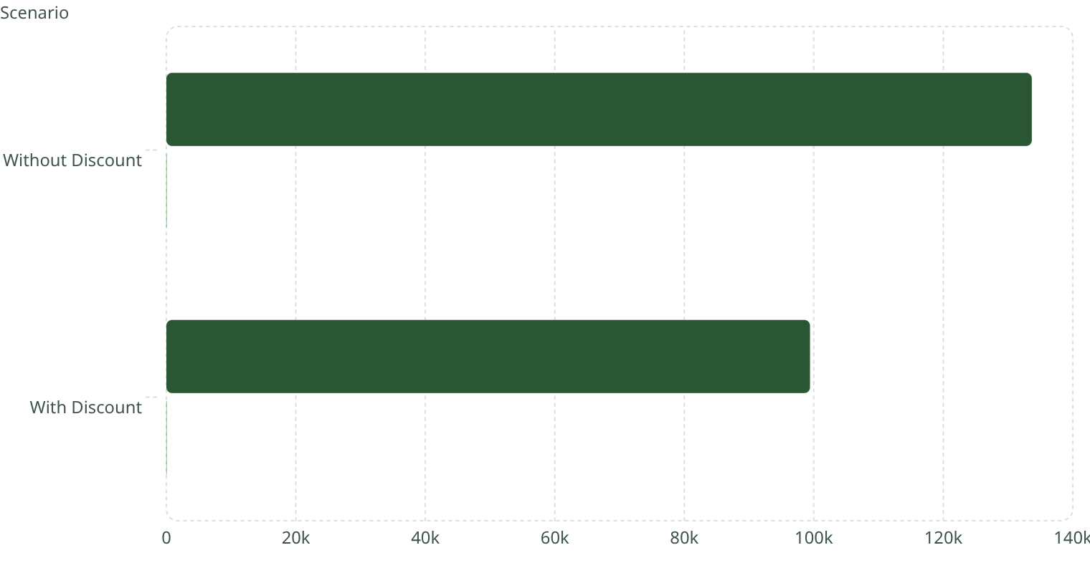
Discount Impact Analysis
Without Discount (57%)
With Discount (43%)
2,223 customers, $133,670 total revenue, $60.13 avg spend, 25.06 prev purchases
1,677 customers, $99,411 total revenue, $59.28 avg spend, 25.74 prev purchases
134k
60.1
99.4k
59.3

Slide 8
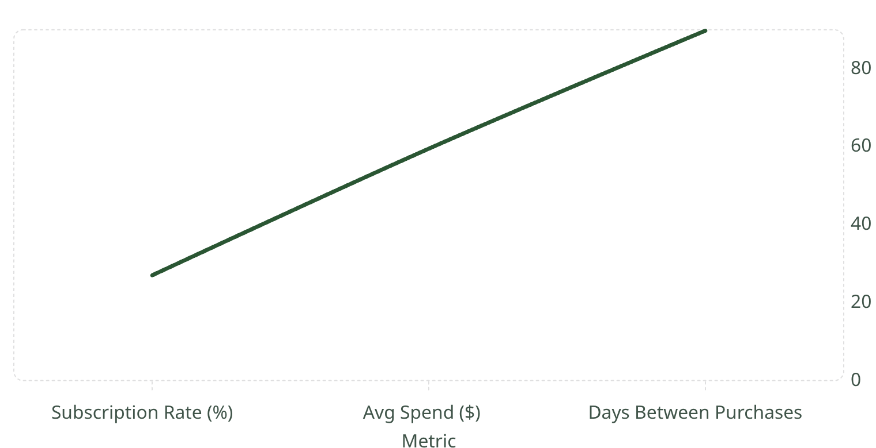
Subscription Program Performance
27%
$59.49
89.77
Subscription Rate
Avg Spend
Days Between
Purchase frequency
1,053 of 3,900 customers
Subscribed customers
89.8
59.5
27
71.8% of loyal customers (26+ purchases) have not subscribed. Program failing to attract most valuable buyers.

Slide 9
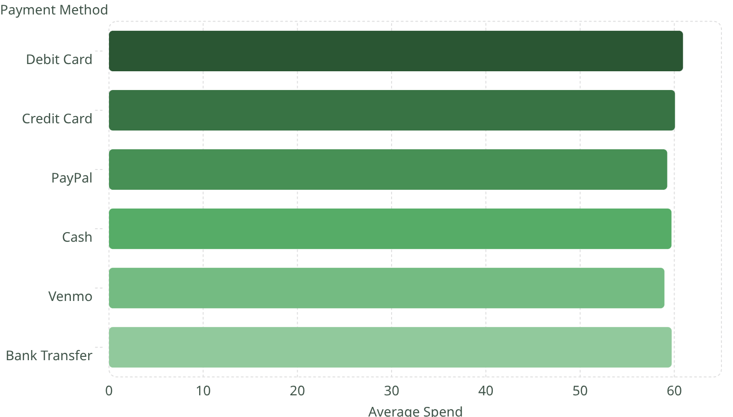
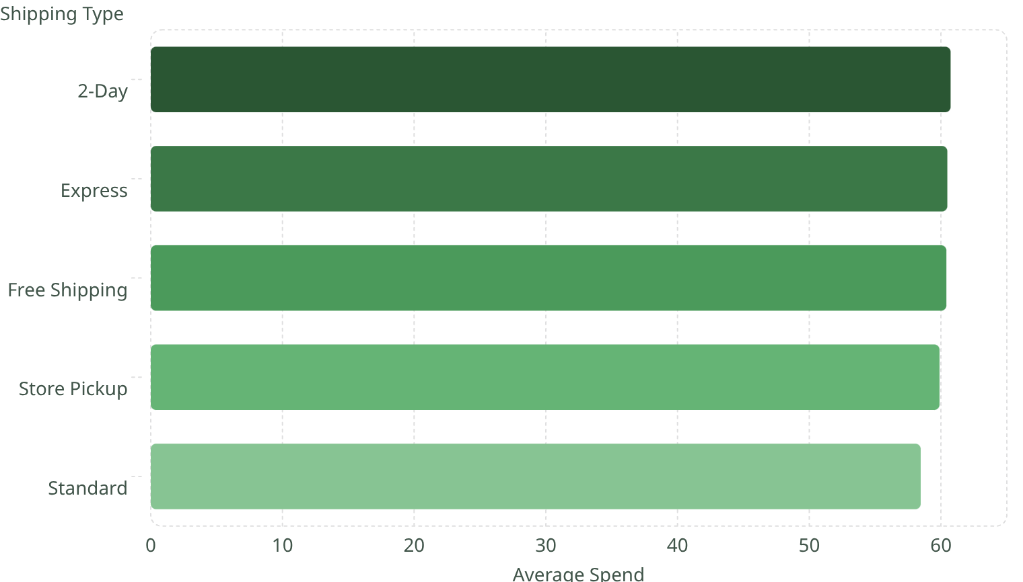
Payment & Shipping Behavior
Payment Methods
Shipping Types
60.9
60.7
60.1
60.5
59.3
60.4
59.7
59
59.9
59.7
58.5

Slide 10
Strategic Recommendations
01
02
Restructure Discount Strategy
Revamp Subscription Program
Shift to behavior-triggered discounts only. Eliminate blanket discounting on top-selling items.
Redesign value proposition with spend-linked rewards and exclusive product access.
03
04
Acquire Young Adult Customers
Summer Revenue Recovery
Targeted digital campaign across social platforms with category-relevant products.
Launch Summer-specific campaign around Accessories and product bundles.
05
06
Protect Clothing Category
Leverage Reviews
Reduce discounting on high-performing items like Blouse and Socks.
Implement post-purchase review program. Feature high-rated products prominently.

