Slide 1
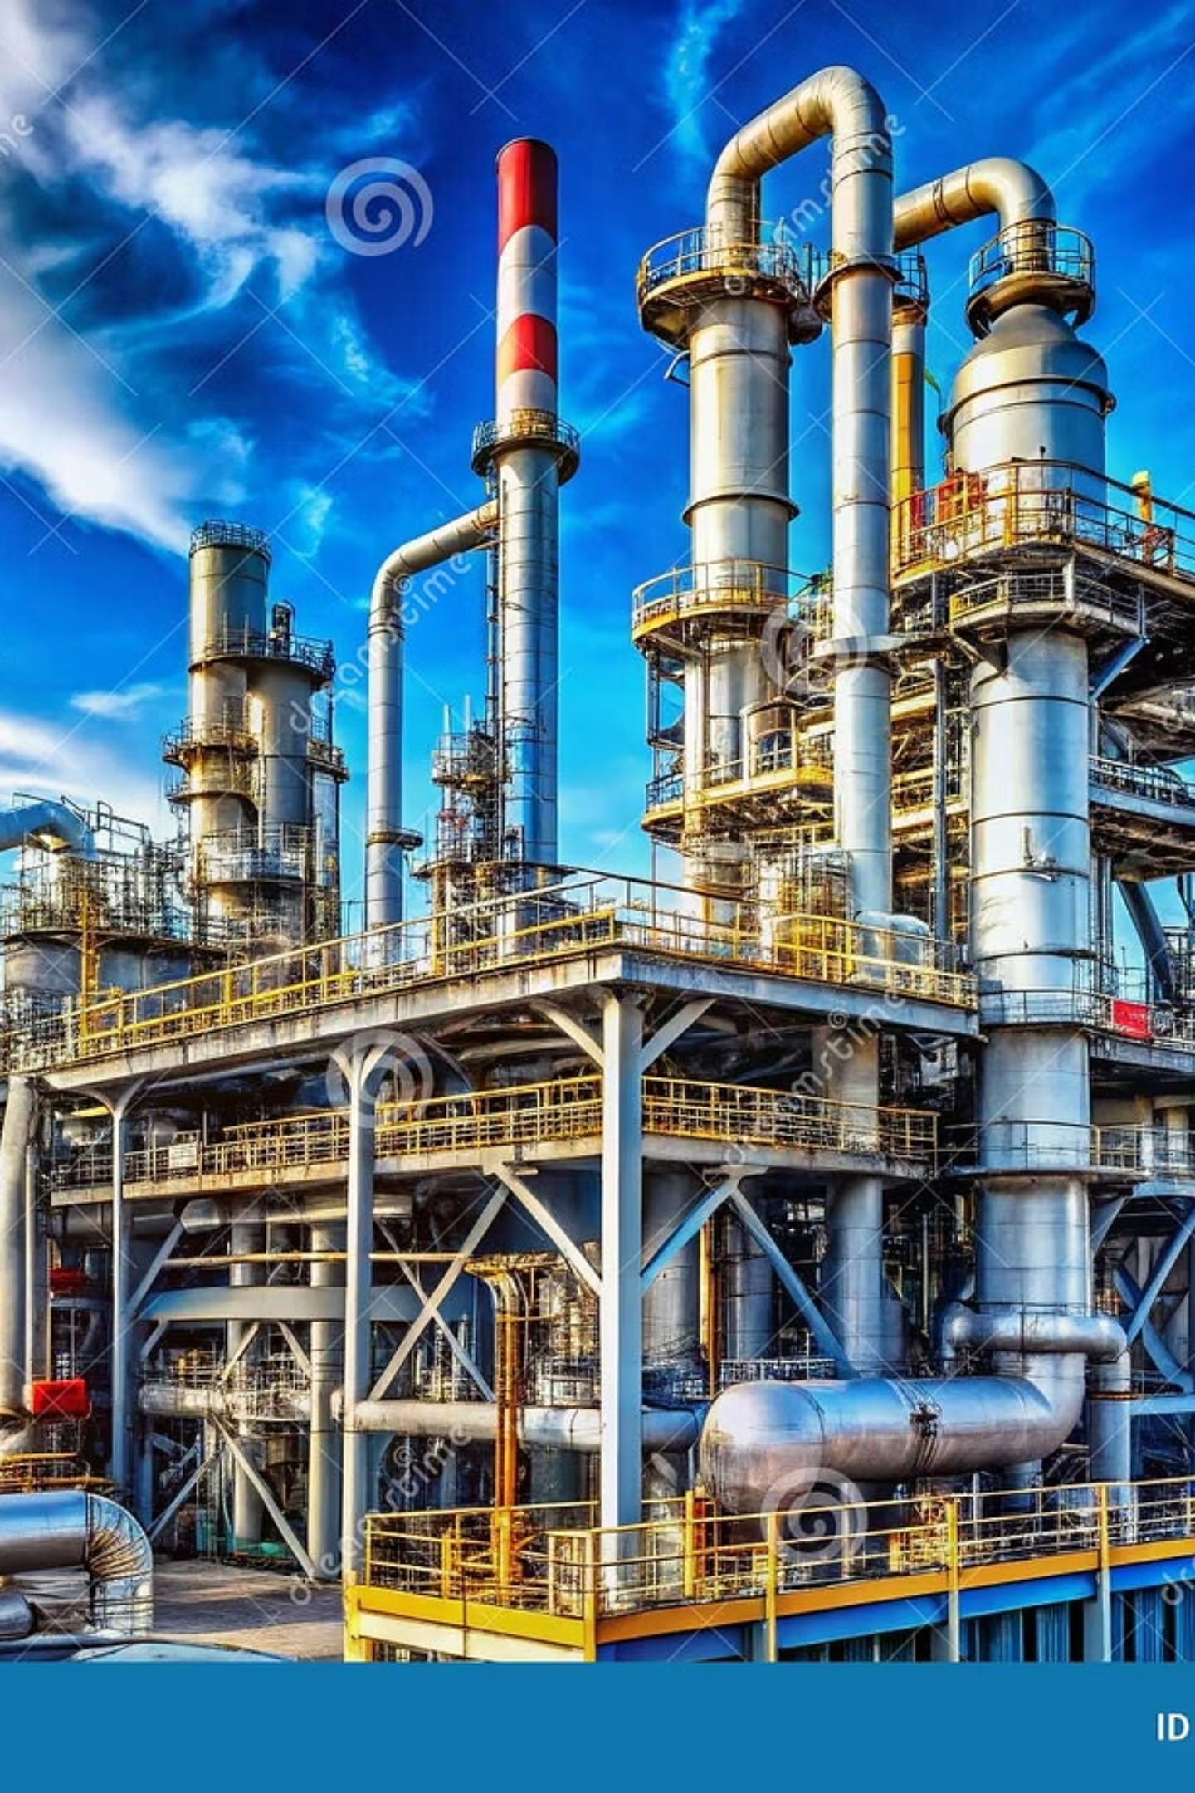
OGDCL Financial Performance
2015–2024: A Decade of Resilience
An analytical review of Pakistan’s flagship exploration and production company

Slide 2
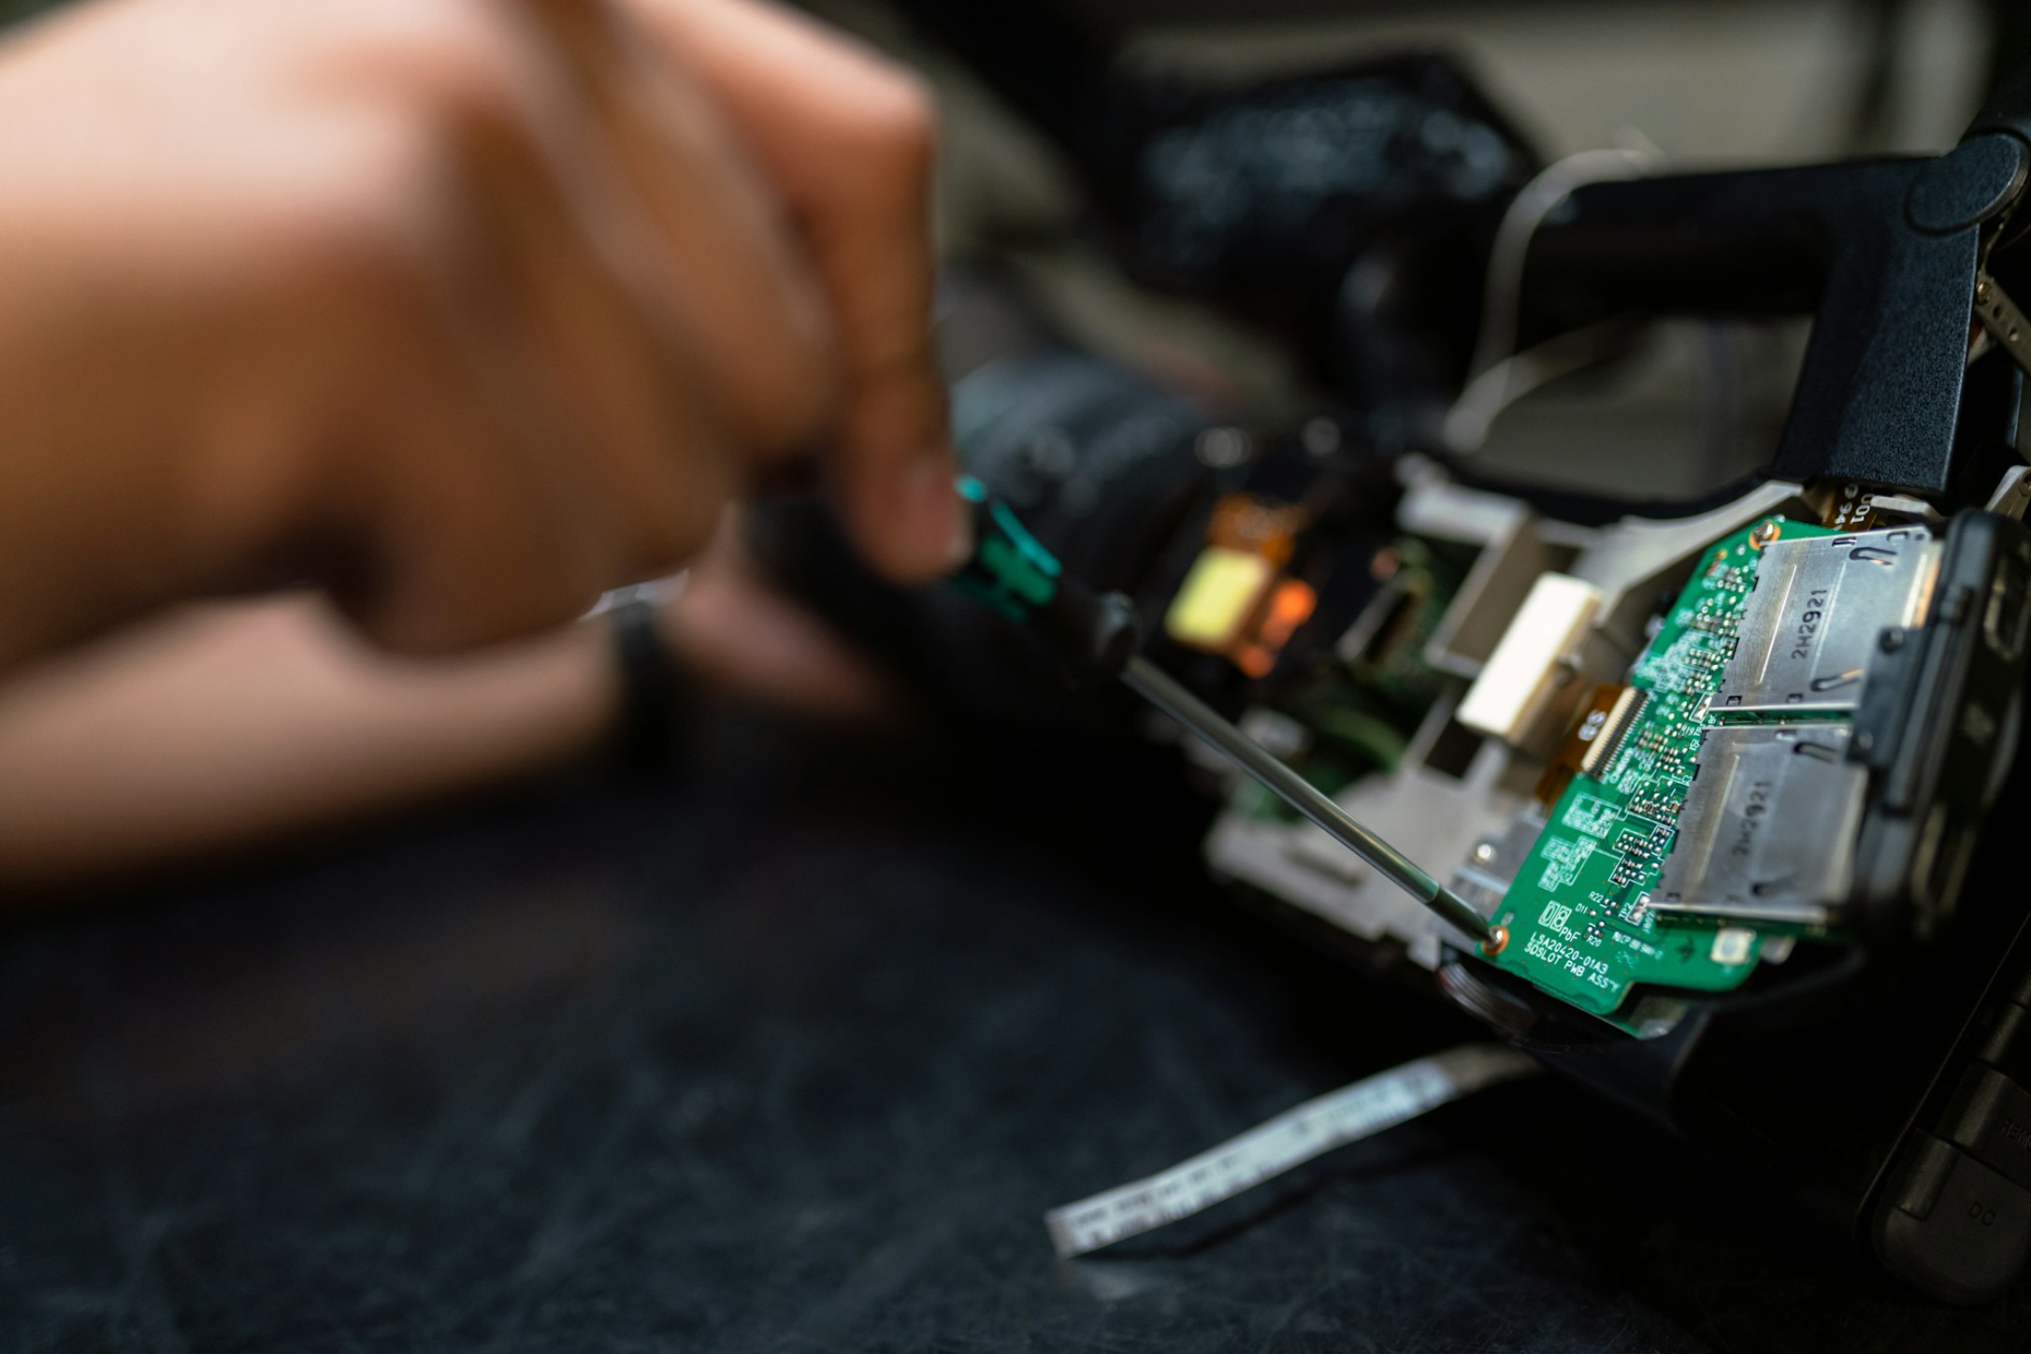
Market Position & Operations
Pakistan's Energy Flagship
Oil & Gas Development Company Limited (OGDCL) is Pakistan's largest exploration and production company, accounting for 46% of domestic oil production and 28% of natural gas output.
Founded in 1961, OGDCL operates as a public limited company with majority government ownership, focused on crude oil, natural gas, and LPG extraction.

Slide 3
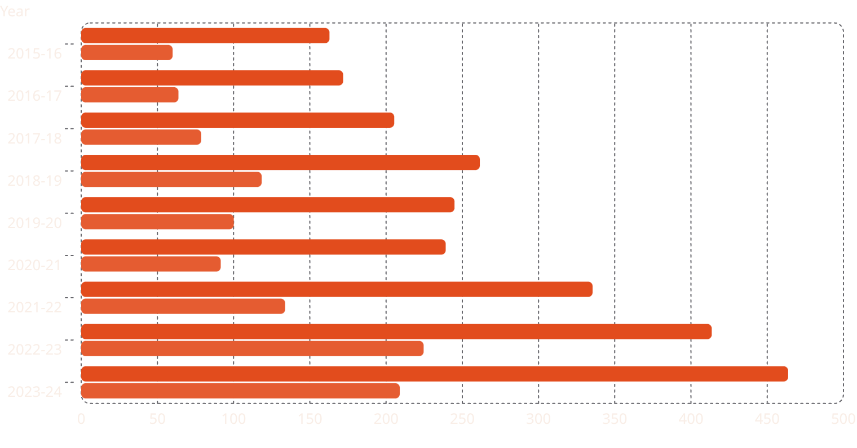
10-Year Financial Highlights
Key metrics show OGDCL's transformation from 2015 to 2024, with revenue growth exceeding 185% and net profit more than tripling.
Sales Revenue (PKR Billions)
Net Profit (PKR Billions)
Revenue and net profit trends across the decade are best read as a side-by-side comparison of annual performance. To keep the chart accurate, the year-by-year values must be provided before plotting.

Slide 4



Revenue Trajectory Analysis
2015-2017: Contraction
2018-2021: Stability
2022-2024: Accelerated Growth
Revenue declined to PKR 162.8B in 2016, reflecting the global oil price downturn and stagnant production.
Performance stabilized despite increasing circular debt pressure on the balance sheet.
Revenue rose by more than 100%, supported by PKR devaluation and USD-indexed energy prices.

Slide 5
Profitability & Efficiency Metrics
45%
3.1x
19.6%
4.67x
Net Profit Margin
Price-to-Earnings Ratio
Return on Equity
Current Ratio
Maintained near 45% over 10 years, supported by a low-cost production structure
Current valuation of 3.1x, down from 6.5x in 2015, reflecting stronger earnings performance
ROE declined from 28.2% as the equity base grew faster than net income
Liquidity improved materially, rising from 2.8x in 2018 to 4.67x in 2024

Slide 6
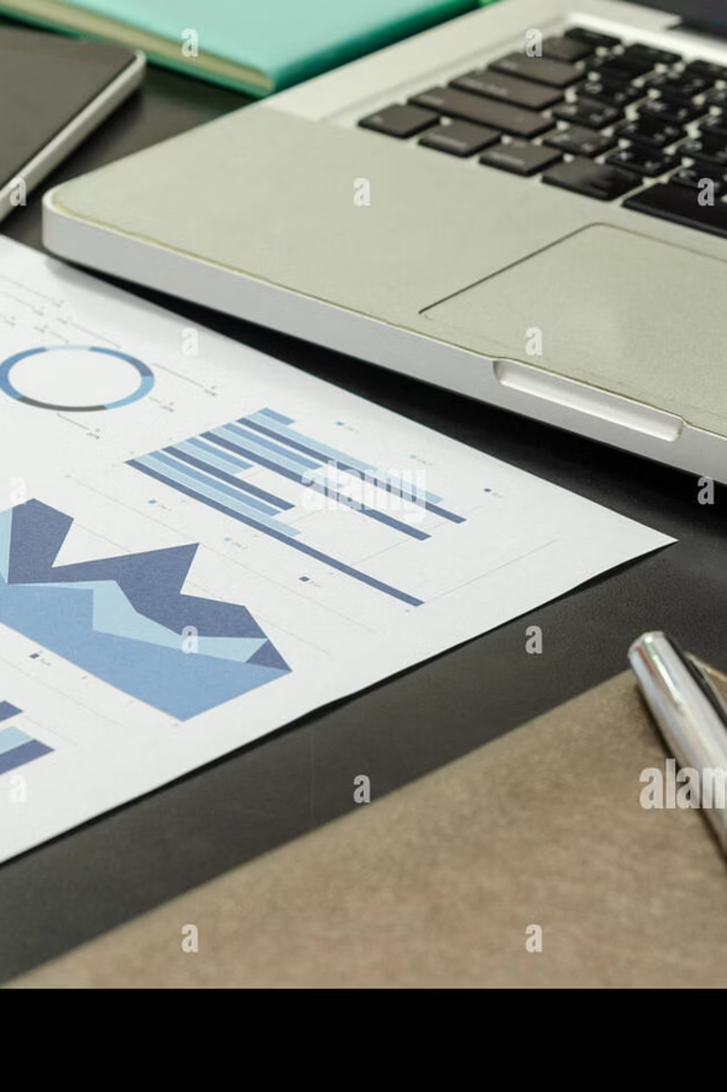
Balance Sheet Evolution
01
02
Total Assets Growth
Equity Base Expansion
Expanded from PKR 485.2B in 2015 to PKR 1,245.3B in 2024, representing 157% growth over the decade.
Shareholder equity increased from PKR 388.9B to PKR 1,065.2B, supported by retained earnings and sustained value creation.
03
Zero Long-Term Debt
Maintained a debt-free capital structure throughout the period, preserving financial flexibility and balance sheet strength.

Slide 7

Operational Excellence
Cost Leadership
OGDCL remains Pakistan's lowest-cost oil and gas producer. Success in new discoveries, including Wali and Bettani, has offset natural decline in mature fields such as Qadirpur.
Circular Debt Challenge
Trade receivables exceeding PKR 600 billion reflect amounts owed by refineries and gas companies, constraining cash conversion despite record-high paper profits.

Slide 8
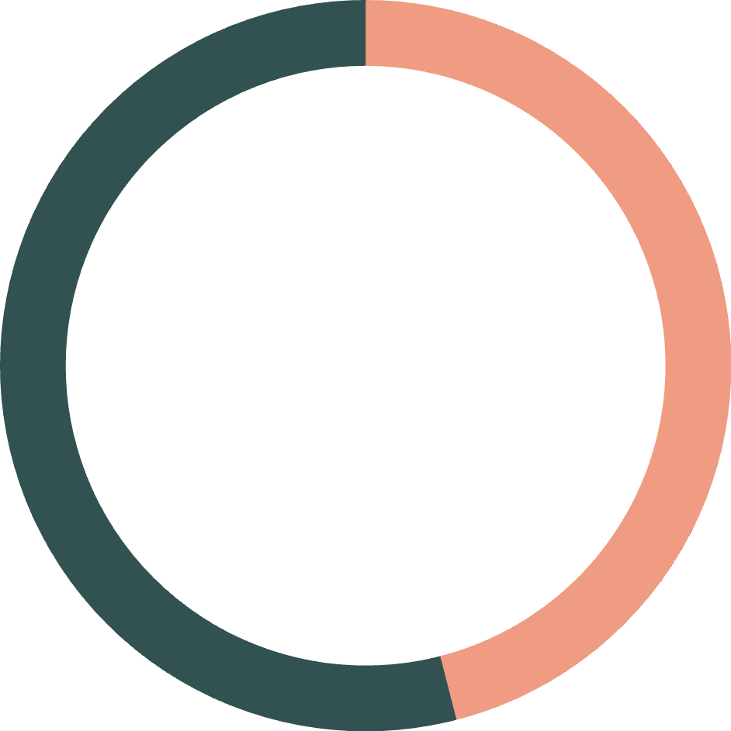
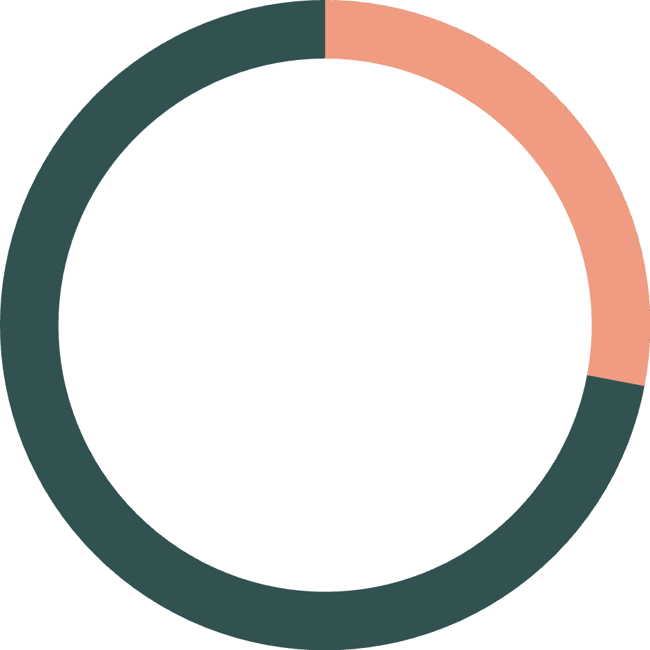
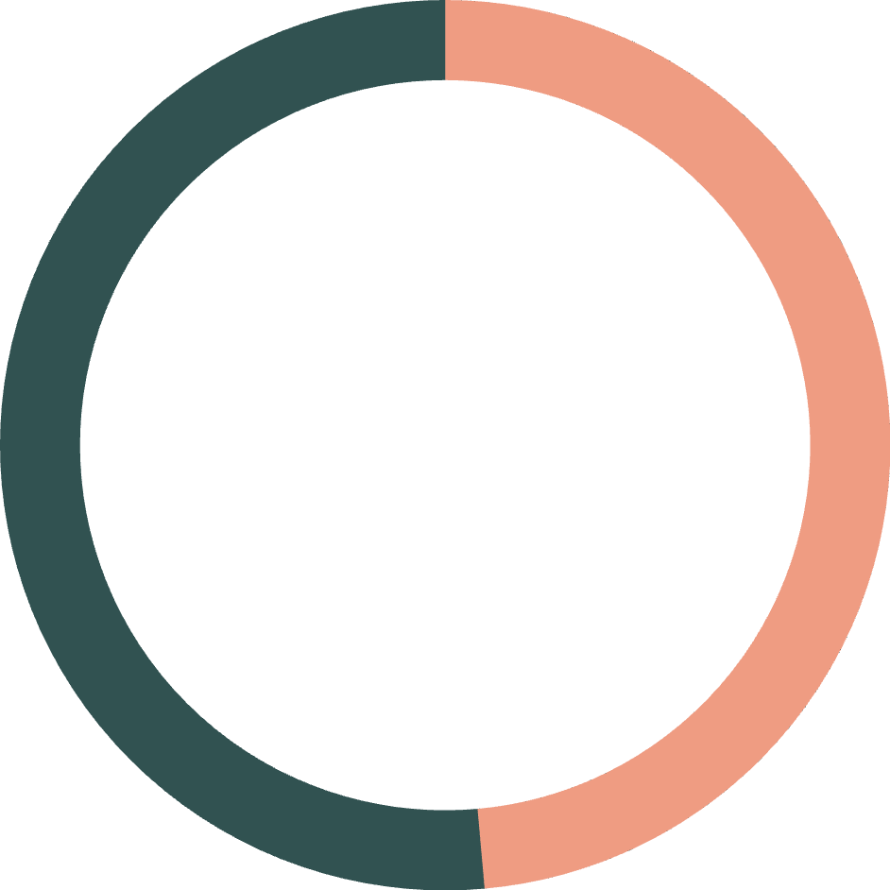
Key Performance Indicators
46%
28%
48.59
Oil Production Share
Gas Production Share
Earnings Per Share
OGDCL's contribution to national crude oil output
Company's share of domestic natural gas production
EPS reached PKR 48.59 in 2023-24, up from 13.94 in 2015-16

Slide 9
Critical Watch Metrics
Trade Debts > PKR 600B
USD-PKR Exchange Rate
New Discoveries
Circular debt continues to increase, constraining cash conversion despite strong reported profitability.
PKR depreciation supports revenue growth but introduces volatility in financial planning.
Wali and Bettani fields must offset decline in mature assets to sustain production volumes.

Slide 10

Executive Summary
Financial Strength
Operational Efficiency
Zero long-term debt, a robust equity base, and sustained profitability demonstrate financial resilience.
Industry-leading margins and a disciplined cost structure position OGDCL as Pakistan's leading E&P operator.
Cash Conversion Risk
Circular debt exceeding PKR 600 billion remains the primary constraint on converting paper profits into cash.
Analyst Recommendation: Monitor trade debt trends and circular debt resolution policies as key indicators of future cash generation potential.

