Slide 1

OPNFV DEVELOPER TOOLS

Slide 2
Agenda
Setting the Context
What we expect from you
Part I – OPNFV Developer Tools at a Glance
Part II - OPNFV Developer Workflow Quick Look
Part III - Hands on

Slide 3
Setting the Context
This presentation is about
Which developer tools we have
Frequently used terms by tools
Typical OPNFV developer workflow
How the tools fit in our workflow
This presentation will not talk about
Technical details of the tools
Relations with/workflow towards upstream projects
By following this presentation you will
Learn how to use the OPNFV Tool Set to work on projects
Be able to follow the developer workflow while working with OPNFV projects

Slide 4
What do we expect
Ask questions...
even though we can't guarantee we answer all of them on the spot – we guarantee to come back with answers though!
Give feedback...
so we can define/adjust the WOW which suits us as community and enables the smooth flow rather than becoming a blocker!
Don't just watch it like a demo...
instead, follow the steps and try them on your computer while we are doing hands on.
Notes:
WOW: Way of Working

Slide 5
Prerequisites
Read about the OPNFV Developer Tools
https://www.opnfv.org/developers/tools
Obtain an account from the Linux Foundation
https://wiki.opnfv.org/developer/getting_started
Have access to a computer with a web browser and ability to install software.
Install Git client to your computer.
Add your SSH public keys to Gerrit
https://gerrit.opnfv.org/gerrit/#/settings/ssh-keys
Notes:
https://wiki.opnfv.org/developer
https://wiki.opnfv.org/developer/projects_abc
https://wiki.opnfv.org/developer/getting_started

Slide 6
OPNFV Tools at a Glance
Jira
Gerrit
Git
Jenkins
Artifact Repository
Wiki
Etherpad
Mailing List
MeetBot

Slide 7

Issue tracking tool
proprietary
provided by Atlassian
has a simple UI and relatively simple usage comparing with other similar tools
Typical workflow
Create issue
Prioritize
Link with other issues if/as relevant
Assign
Work
Resolve
Close
Further reading/references
https://confluence.atlassian.com/display/JIRA/JIRA+Documentation
Notes:
Using Jira and creating backlog will improve overall visibility of issues/work that is left to do.
This will also make inter-project dependencies more visible.
Jira is a highly configurable tool. What is described in this and following slides reflects the default setup.

Slide 8
Issue Types – other types exist!
Epic
Story
Subtask
Bug
Create issues with clear Definition of Done (DoD).
Issue Linking – other relations exist!
Blocks/Blocked by
Depends/Depended on by
Relates to
Labeling
Attach labels for marking issues for milestones
Notes:
Main Issue Types in Jira
Epic: Epics simply are large user stories. Completion of an Epic can span to multiple sprints. Epics can also be used for grouping related stories together.
Story: Stories are main work items in Jira and expressed using non-technical words. They are written from ”user” point of view and the usual format is
As a ..., I want ... so that I can ...
As an OPNFV community member, I want Fuel build automated so that I can easily execute the build.
Estimation and prioritization are done based on stories.
Subtasks: Work unit contained in a user story. User stories can be divided 0 or more subtasks and work can be done.
Bug: Bug implements a fix.
Issue Linking
Dependencies between different issue on Jira can be made visible by linking related issues together. For example for CI to build something, it needs an input from BGS.
The stories can be created in this way.
”CI Fuel Daily Build” depends on ”BGS Fuel Build Automation”
Blocks/Blocked by can also be used for higlighting similar dependencies.
Labeling
Issues can be labelled in order to mark them for specific reasons. Labels can indicate milestones, features, and so on and can be used for creating custom Jira queries or easily finding all the issues related to ”something”.

Slide 9
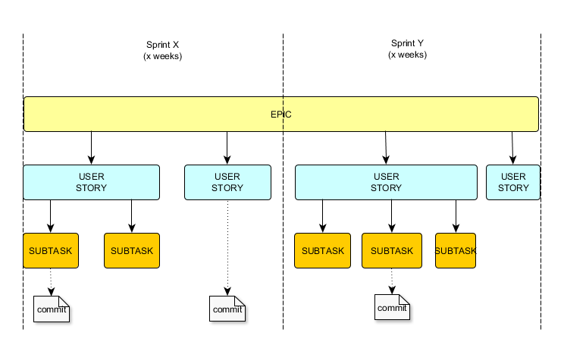

Slide 10
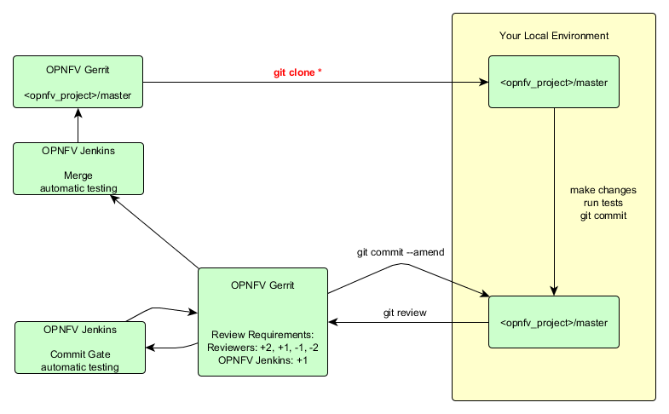
OPNFV Developer Workflow
* This is the starting point if you don’t already have a clone of the repo. Highly influenced by/stolen from OpenStack and modified for OPNFV.
Notes:
Highlight git clone in the slide
git clone is the first thing to do when starting to work on a project.
If you already cloned repo(s) you want to work with, git pull should be enough.
Many details are neglected in this flow. See below for all the steps.
Commit Flow
Steps 1 to 6 are needed once.
Registration
Create LF ID (No Special Characters in username for Gerrit compatability, Please use company email)
Email C from your company email with name of project(s) you would like to contribute to
Sign in to gerrit using LF credentials and add your keys
Sign the agreement
Set up git
Clone the repo(s) you might want/need to work with (and set up hooks if they're not set up while cloning the repo)
Install git review
Configure git review for each repo you cloned
Sign in to Jira using LF credentials
Assign yourself to a story from Jira or create a new story
[Interactive Option] An Issue of type "Story" Called onboarding_$yourname
If you think the story you're working on requires multiple patchsets, create subtasks per patchset and put subtask ID in commit message as listed in step 12.1.
[Interactive Option] Create Subtask: Add $yourname and a few goals to your_repo/Onboard.txt (better name?)
Set story to "In Progress"
Pull latest changes
Do your work in git and commit
Don't forget to add JIRA ID, this must either be the ID of a story or subtask you created/assigned yourself on step 8.1.1.
Do not add Epic IDs into commits or they will get -2 from reviewers
[Interactive Option] Add your name and a few goals you have for your project to Onboard.txt
git-review (opnfv-helpdesk@rt.linuxfoundation.org must have responded to your request for this step to work, ping aricg on freenode to expedite)
Login to Gerrit and find your change
Add reviewers
Wait for Jenkins commit gate verification
If it fails, navigate to Jenkins and check the console log
If the failure is because of the commit itself, go back to step 11 and fix the problem
If the failure is due to issues with the CI FW/environment, add a new comment to your patchset on Gerrit with either one of the keywords "recheck" or "reverify" to retrigger the verification.
If it passes, wait for reviews
Go back to Step 11 if reviewers request corrections/updates and amend your commit
Submit your change for merge when you get review +2/verified
Set the corresponding story in Jira to "Resolved" and then "Closed". (Jira-its plugin will do this automatically once its fully setup)
Reviewer Flow
Please be constructive with your reviews/comments and provide reasons clearly if you -1/-2d.
Find the commit you want to review by logging into Gerrit either using the link from the mail you received from Gerrit or by going to Gerrit directly.
If the commit gate tests have not been completed yet, please wait for their completion before starting with your review.
Checkout the patchset if you want to try yourself in your environment by copying the link from the page.
If you think the commit is good to go and
if you are the first reviewer, give +1.
If there is one or more +1(s) before and if you are a committer in the project, give +2.
If you think the commit is not good
Give -1 if it needs small changes such as not having a good commit message or code requires cosmetic changes.
Give -2 if you think it is buggy, could break stuff, or it has reference to an Epic on JIRA and so on.
Please note that -2 is blocker. The code can't get merged until the person(s) who -2d the commit amends their vote.
Workflow to Update Jenkins Jobs
The workflow is almost same as Basic Developer Workflow except the context. One must have knowledge regarding Jenkins Job Builder in order to do updates.
Please send request to Octopus Team if you want a separate session to be organized.

Slide 11

Code review tool.
open source
created by Google
fork of Rietveld
Typical workflow
If you are the committer
Push your changes to Gerrit
Add reviewers
Wait for reviews
If you are a reviewer
Do the review
Provide feedback and vote
Further reading/references
https://gerrit-documentation.storage.googleapis.com/Documentation/2.11/index.html

Slide 12
Configuring Gerrit for first use
Gerrit username is your LF username. See it from below link.
https://gerrit.opnfv.org/gerrit/#/settings/
Add your SSH public keys
https://gerrit.opnfv.org/gerrit/#/settings/ssh-keys
Configure watched projects to get notifications
https://gerrit.opnfv.org/gerrit/#/settings/projects
Get the commands to clone the repos
Go to projects page
https://gerrit.opnfv.org/gerrit/#/admin/projects/
Click the project name
Click ”clone with commit-msg hook”
Copy the command and execute it on console

Slide 13
Change
Pushing a commit with a new Change-Id
Changes could contain multiple patchsets
Patchset
Modify an existing change without pushing a new change
How Gerrit knows different patchsets are related
Change-Id
Do not add Change-Id or modify existing one manually!
Reviewing, commenting, voting
-2, -1, +1, +2, verified
-2 is blocker and sticky until the reviewer changes it
+2 means change could be submitted
Notes:
+1 + +1 != +2

Slide 14
Review/Merge Etiquette
A real review must have happened (ensure quality)
Keep a patch open for at least 1 business day (interested reviewers might not live in the same time zone as you)
If there is no real review in a couple of days - urge the team (your peers) to do a review (email, IRC, phone…)
Note that everyone can perform a review
“+2” as gateway of last resort (assuming you are a committer and very confident about your patch and the patch resolves a key issue/removes a key barrier)
Once sufficient reviews are done and issues are resolved, allow the author (in case he is a committer) to merge/submit (assume that the author knows his code the best); an experienced committer of the project is an obvious alternate

Slide 15

Distributed version control system
open source.
created by Linus Torvalds.
easy to learn and fast.
Typical workflow
Clone the repo
Do your work
Pull/fetch & rebase/merge
Add & commit
Amend
Push
Further reading/references
http://git-scm.com/book/en/v2
Notes:
Workflow shown in this and coming slides are not specific to OPNFV. They are simple Git workflows.

Slide 16
Getting ready to work
clone a repository from remote
use Gerrit to copy needed commands for repo you want to work with
everyone keeps full history of repo -> possible to work offline.
What is ”remote”
git doesn’t have central server like subversion
aliases for all the repositories that are remote to you
What is ”clone”
copy of remote repository
How to see what remotes you have
git remote –v
What is ”origin”
alias for original repository where you got your clone – set by git
Notes:
Cloning is one time operation - unless you want to have multiple clones of same repo for certain reasons.

Slide 17
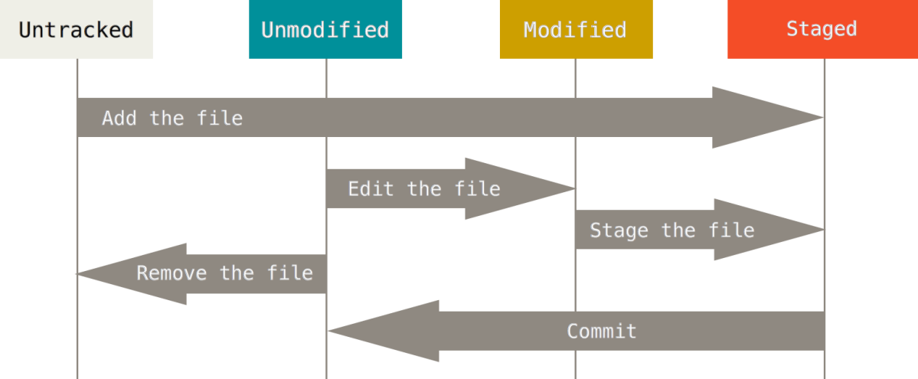
Start working
changing the state of files
modify existing files
add new files
remove existing files
File states in git repository
tracked: files that were in last snapshot – git tracks changes on them
untracked: everything else – git doesn’t track them until you want otherwise

Slide 18
When you are done with your work
Look what changes you have done
Stage your changes
How to see what changes I made
git status
What is ”staging”
prepare the conditions for committing your changes.
git add <path to file>
git add –A = git add . && git add –u
git add –A -> stage all
git add . -> stage new and modified but not deleted
git add –u -> stage modified and deleted

Slide 19
Commit your changes
git commit
So you think you are good to go, but wait, there is this whitespace here
Amend your commit then
git commit --amend
Make sure to pull latest changes from remote and rebase your changes on top of it
git pull --rebase
Share your work with others by pushing to origin
git review
Notes:
Amending is used for submitting a new patchset for an existing change that received reviews.
OPNFV uses git review so git push is not applicable to OPNFV.
commit message guidelines
Provide a brief description of the change in the first line.
Insert a single blank line after the first line.
Provide a detailed description of the change in the following lines. Use breaking paragraphs where needed.
The first line should be limited to 50 characters; should be written in present tense; and should not end with a period.
Subsequent lines should be wrapped at 72 characters.
Use present tense.
Add Jira issue no. (format JIRA: XYZ-12345)

Slide 20
Commit Message Etiquette
Brief description
Title: 50 chars max
Blank line
Adds the new base for common puppet modules
Intent of this commit is to be a common place where we can contain a common set of puppet modules that installers should leverage when installing/configuring OPNFV target system.
JIRA: BGS-23
Change-Id: I3a694b05a35a6e6025489b74c7bb38256dd84f12
Signed-off-by: Tim Rozet <trozet@redhat.com>
Detailed description
Jira reference
Sign-off with name and email
Example commit message
Commit message:
Provide a brief description of the change in the first line.
Insert a single blank line after the first line.
Provide a detailed description of the change in the following lines. Use breaking paragraphs where needed.
The first line should be limited to 50 characters; should be written in present tense; and should not end with a period.
Subsequent lines should be wrapped at 72 characters.
Use present tense.
Add Jira issue no. (format JIRA: XYZ-12345)

Slide 21
Other frequently used commands/terms
fetch
merge
log
stash
squash
branch
tag
diff
stripspace (remove trailing whitespaces etc.)
diff --check (check for obvious things to fix prior to commit)
...
Get help
git <command> --help

Slide 22

Continuous Integration Tool
open source
created by Kohsuke Kawaguchi
fork of Hudson
Typical workflow
Create jobs
Enable triggers
Let the job run
Check the console log
Further reading/references
https://wiki.jenkins-ci.org/display/JENKINS/Meet+Jenkins

Slide 23
Jobs/Projects
runnable tasks that are controlled/monitored by Jenkins
Build
result of one run of a project
Build Results
successful, stable, unstable, broken/failed, completed
Master
Basic installation of Jenkins - where the Jenkins is deployed
Slave
computers to build projects on
Trigger
when and on what conditions a job should be triggered

Slide 24
OPNFV uses Jenkins Job Builder to create/configure jobs.
You don’t need to login to Jenkins in order to modify jobs.
Read more about Jenkins Job Builder from
http://ci.openstack.org/jenkins-job-builder/
Take a look at existing OPNFV Jenkins Jobs from OPNFV Gerrit.
https://gerrit.opnfv.org/gerrit/gitweb?p=releng.git

Slide 25

General purpose storage service
provided by Google
used as artifact repository
Typical workflow
Upload artifacts
Download artifacts
Further reading/references
https://cloud.google.com/storage/docs/overview

Slide 26

DokuWiki
A wiki application to support documentation needs
Open source
Can upload images & files
Supports many plug-ins
In order to edit contents on wiki.opnfv.org, you need to have a Linux Foundation Account
Can create an account @identity.linuxfoundation.org
Content only as good as the level of community participation
Please help keep contents up-to-date!
Further reading/references
https://www.dokuwiki.org/dokuwiki#

Slide 27

Web-based collaborative real-time editor
Open source
Typical workflow
Anyone can start/create a new Pad
Share the link with team members
Anyone can update/contribute
Further reading/references
http://etherpad.org/

Slide 28

Web-based list management system
Developed by MIT
Further reading/references
http://web.mit.edu/lists/mailman/
OPNFV’ technical mailing lists are open to anyone to join. More information on OPNFV’ technical mailing lists are available at
https://wiki.opnfv.org/developer/getting_started?&#mailing_list

Slide 29
MeetBot
OPNFV uses MeetBot to create and manage meeting minutes on IRC.
See the details from
https://wiki.opnfv.org/meetings/meetbot

Slide 30
Questions &
Short Break

Slide 31
OPNFV Developer Workflow
* This is the starting point if you don’t already have a clone of the repo. Highly influenced by/stolen from OpenStack and modified for OPNFV.
Notes:
git clone is the first thing to do when starting to work on a project.
If you already cloned repo(s) you want to work with, git pull should be enough.
Many details are neglected in this flow. See below for all the steps.
Commit Flow
Steps 1 to 6 are needed once.
Registration
Create LF ID (No Special Characters in username for Gerrit compatability, Please use company email)
Email C from your company email with name of project(s) you would like to contribute to
Sign in to gerrit using LF credentials and add your keys
Sign the agreement
Set up git
Clone the repo(s) you might want/need to work with (and set up hooks if they're not set up while cloning the repo)
Install git review
Configure git review for each repo you cloned
Sign in to Jira using LF credentials
Assign yourself to a story from Jira or create a new story
[Interactive Option] An Issue of type "Story" Called onboarding_$yourname
If you think the story you're working on requires multiple patchsets, create subtasks per patchset and put subtask ID in commit message as listed in step 12.1.
[Interactive Option] Create Subtask: Add $yourname and a few goals to your_repo/Onboard.txt (better name?)
Set story to "In Progress"
Pull latest changes
Do your work in git and commit
Don't forget to add JIRA ID, this must either be the ID of a story or subtask you created/assigned yourself on step 8.1.1.
Do not add Epic IDs into commits or they will get -2 from reviewers
[Interactive Option] Add your name and a few goals you have for your project to Onboard.txt
git-review (opnfv-helpdesk@rt.linuxfoundation.org must have responded to your request for this step to work, ping aricg on freenode to expedite)
Login to Gerrit and find your change
Add reviewers
Wait for Jenkins commit gate verification
If it fails, navigate to Jenkins and check the console log
If the failure is because of the commit itself, go back to step 11 and fix the problem
If the failure is due to issues with the CI FW/environment, add a new comment to your patchset on Gerrit with either one of the keywords "recheck" or "reverify" to retrigger the verification.
If it passes, wait for reviews
Go back to Step 11 if reviewers request corrections/updates and amend your commit
Submit your change for merge when you get review +2/verified
Set the corresponding story in Jira to "Resolved" and then "Closed". (Jira-its plugin will do this automatically once its fully setup)
Reviewer Flow
Please be constructive with your reviews/comments and provide reasons clearly if you -1/-2d.
Find the commit you want to review by logging into Gerrit either using the link from the mail you received from Gerrit or by going to Gerrit directly.
If the commit gate tests have not been completed yet, please wait for their completion before starting with your review.
Checkout the patchset if you want to try yourself in your environment by copying the link from the page.
If you think the commit is good to go and
if you are the first reviewer, give +1.
If there is one or more +1(s) before and if you are a committer in the project, give +2.
If you think the commit is not good
Give -1 if it needs small changes such as not having a good commit message or code requires cosmetic changes.
Give -2 if you think it is buggy, could break stuff, or it has reference to an Epic on JIRA and so on.
Please note that -2 is blocker. The code can't get merged until the person(s) who -2d the commit amends their vote.
Workflow to Update Jenkins Jobs
The workflow is almost same as Basic Developer Workflow except the context. One must have knowledge regarding Jenkins Job Builder in order to do updates.
Please send request to Octopus Team if you want a separate session to be organized.

Slide 32
Hands on Session

Slide 33
Thank you!

