Slide 1
Enhanced Information Retrieval by Relevance Feedback Incorporation in WordSeer
INFO 256 Final Project
Yee Tung (Alice) Man & Robert (Alex) Matevish

Slide 2
Introduction
WordSeer: a text analysis environment for humanities scholars for retrieving relevant information more easily and accurately.
To overcome the problem using keyword search that being difficult to find conceptually linked passages of text, the relevance feedback method is incorporated in WordSeer.
The current relevance feedback algorithm incorporated in WordSeer is the standard Rocchio Algorithm. In this project, we incorporate some other variations of Relevance Feedback algorithms to compare the recall rates.

Slide 3
Algorithm Comparisons
Rocchio
Ide dec-chi
Ide regular

Slide 4
Rocchio
relevant
Non-relevant
Add reduced term weights to query
Normalize by dividing the number of documents used for retrieval

Slide 5
Ide dec-chi and Ide Regular
Ide dec-chi
Ide Regular
ONE Top-most Non-relevant
Compare to Rocchio:
Without Normalization
Without Weighing terms
ALL Non-relevant

Slide 6
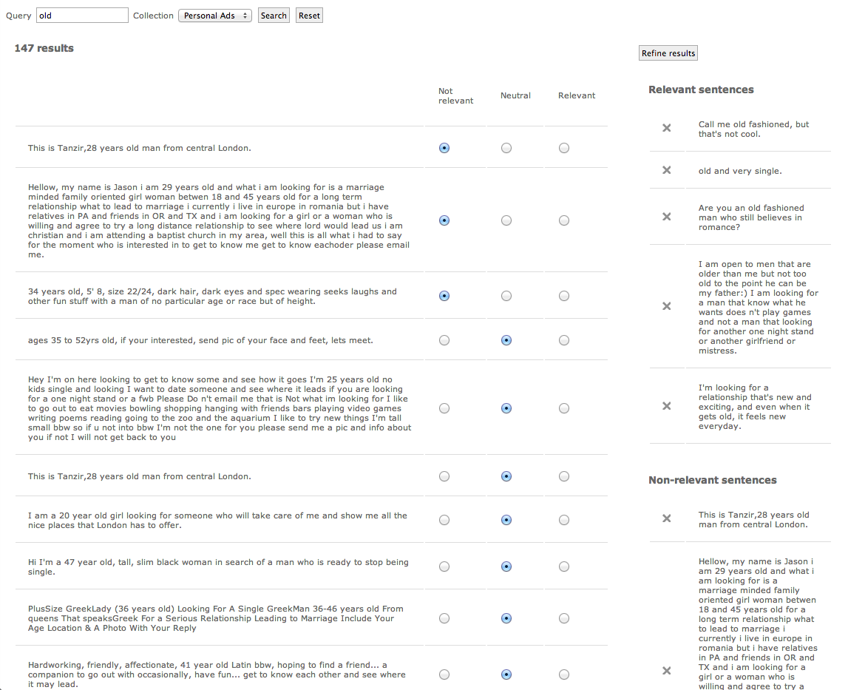
Implementation in WordSeer
Non-
Relevant
neutral
Relevant
Search term
Relevant
Sentences
Select
Non-Relevant

Slide 7
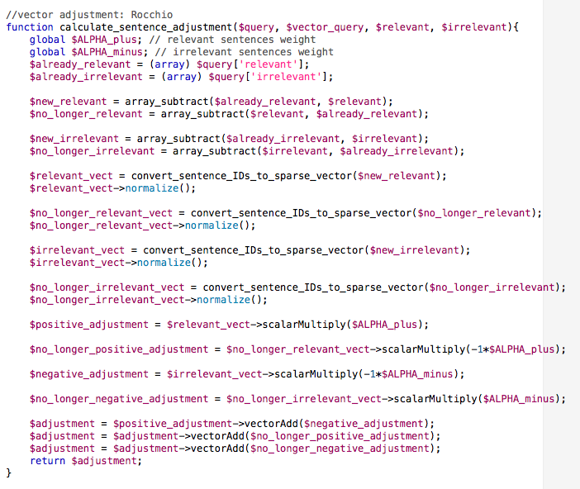
Rocchio
Normalization
Weigh terms for relevant and non-relevant sentences

Slide 8
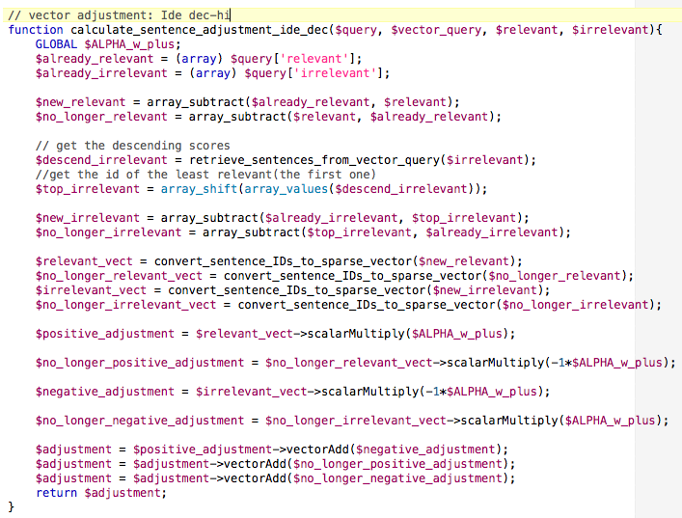
Ide dec-chi
Get Top-most irrelevant sentence
Without Normalization
No weighing terms for relevant and non-relevant sentences

Slide 9
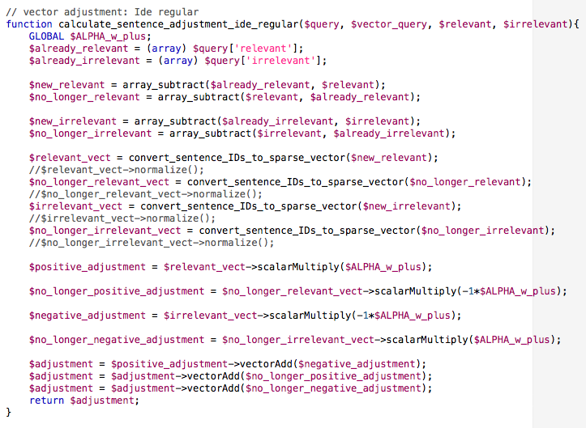
Ide Regular
Without Normalization
No weighing terms for relevant and non-relevant sentences

Slide 10
Testing Approach
Get the sentence IDs from manually selected relevant and irrelevant sentences base on a selected keyword.
Feed these sentence IDs into the relevance feedback algorithm
Run

Slide 11
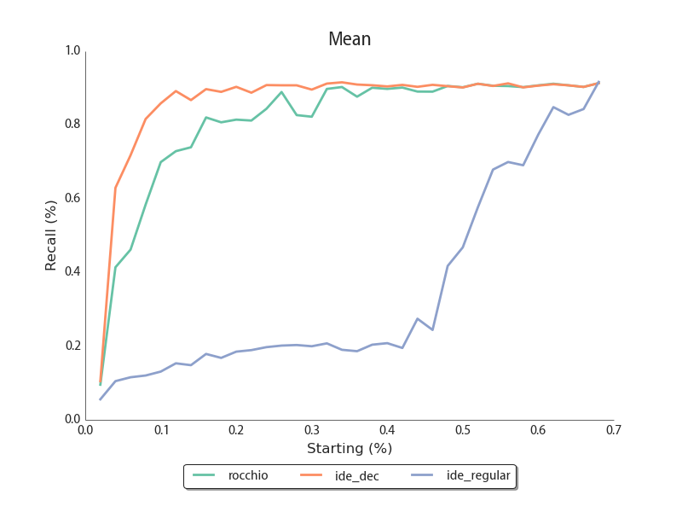
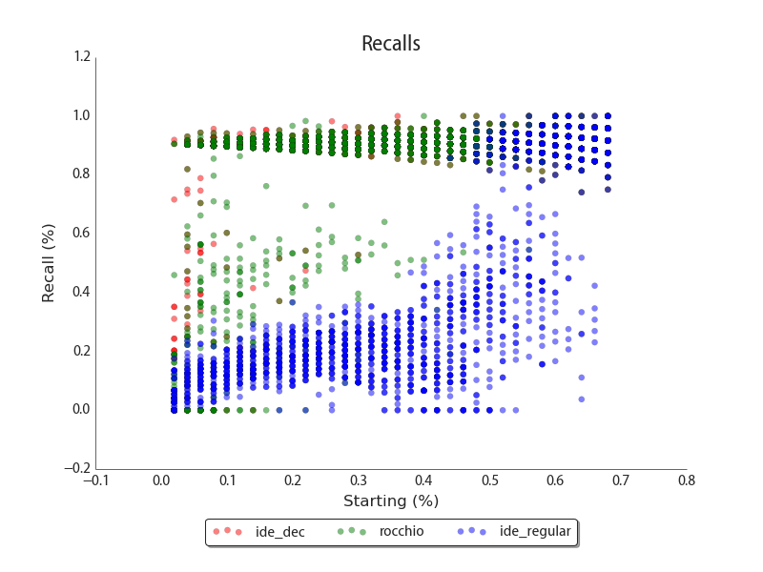
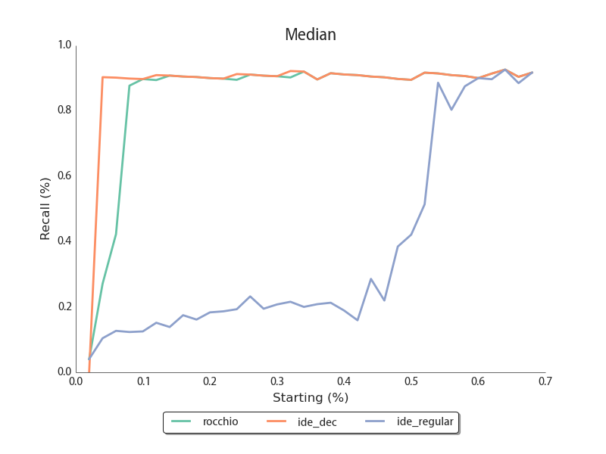
Black

Slide 12
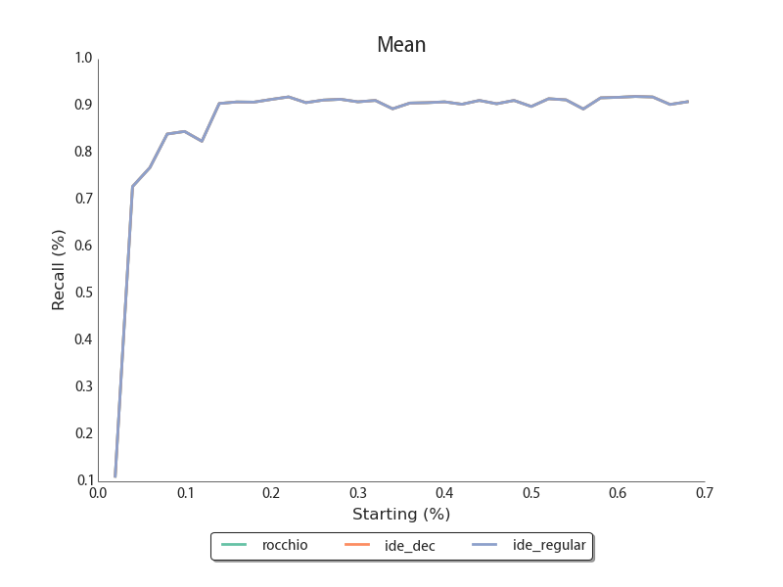
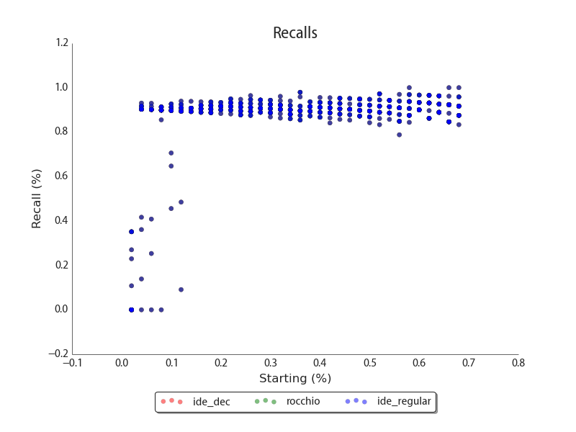
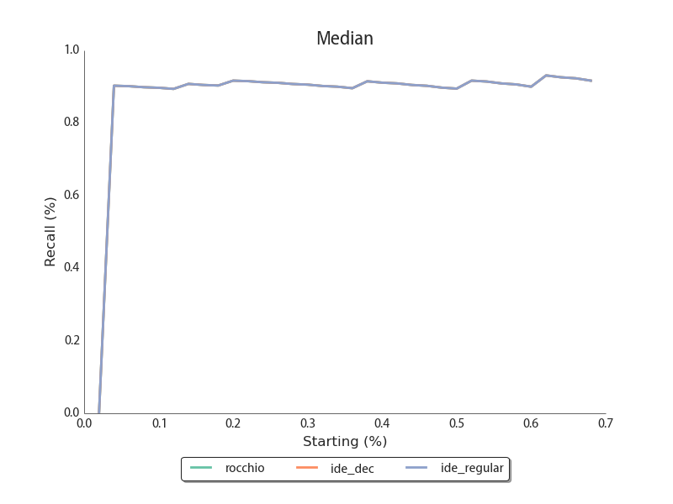
Black – No Irrelevant

Slide 13
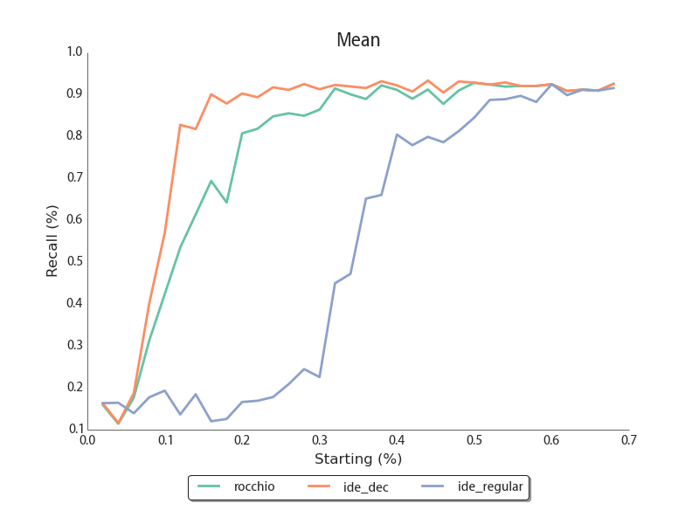
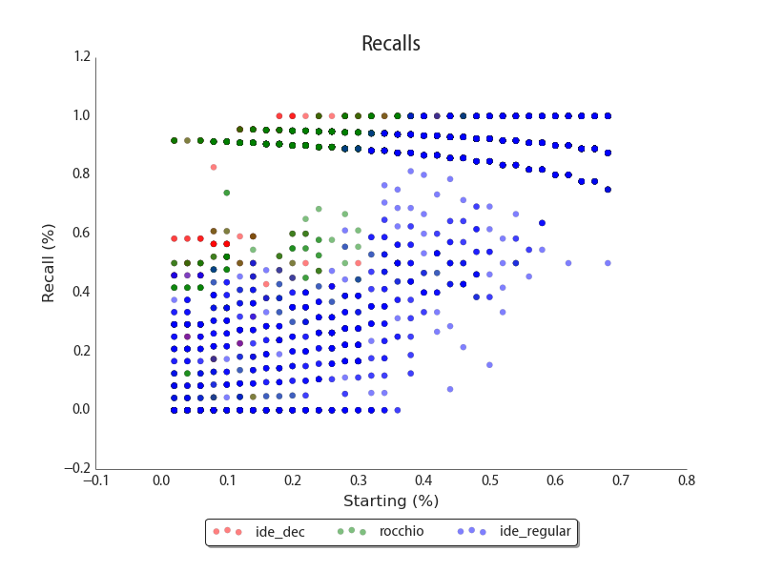
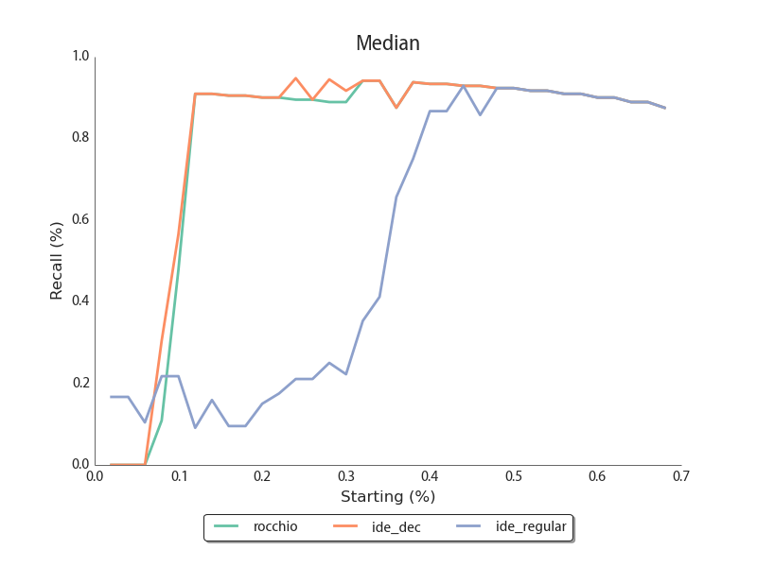
Curvy

Slide 14
References

