Slide 1
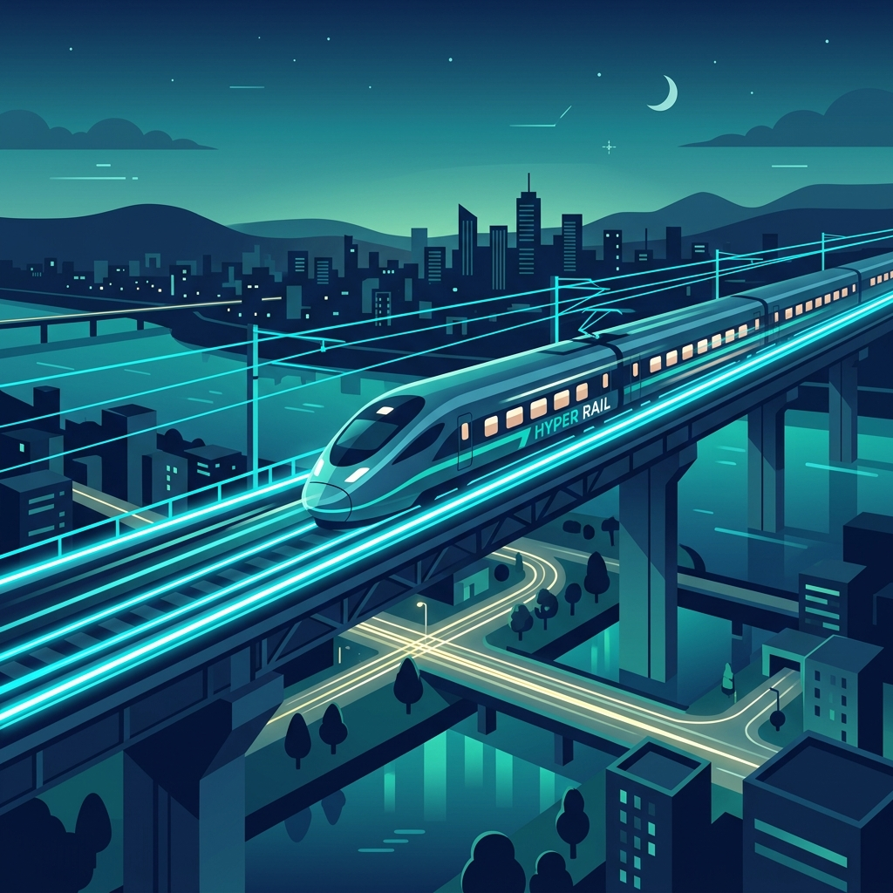
TRAINROUTER
Smart Train Route Optimization & Ticketing System
An intelligent algorithms-driven platform for seamless railway navigation, real-time seat allocation, and multi-hop route planning.
Course Project Presentation | System Analysis & Design

Slide 2



PROJECT TEAM
Project Engineering Team
ID: 00724205101098
ID: 00724205101103
ID: 00724205101123

Slide 3
OVERVIEW
Executive Summary
01. Smart Route Optimization
Uses advanced graph search algorithms (Dijkstra's & A*) to calculate optimal paths across complex rail networks with minimal transfers.
02. Real-Time Seat Management
Provides live concurrency control and dynamic seat mapping to eliminate double-booking and maximize passenger convenience.
03. Scalable Modern Architecture
Built with a decoupled modular architecture ensuring low latency, high throughput, and seamless third-party integrations.

Slide 4
PROBLEM STATEMENT
Current Challenges in Railway Ticketing
Rigid Direct Routes
Passengers struggle to find multi-train connections when direct trains are fully booked or unavailable.
Seat Conflicts & Overbooking
Legacy synchronization delays often result in duplicate bookings during high-traffic peak hours.
High System Latency
Outdated database queries lead to slow search responses and degraded user experience during rush periods.

Slide 5
PROPOSED SOLUTION
The TrainRouter Solution
Intelligent Multi-Hop Routing
Finds optimal connected routes across multiple train lines automatically.
Sub-Second Seat Locking
Atomic Redis-backed locking mechanism guarantees zero double-booking.
Interactive Seat Map
Visual coach layout allows real-time preference-based seat selection.
Automated E-Ticketing
Instant QR code ticket generation for seamless station entry and validation.

Slide 6
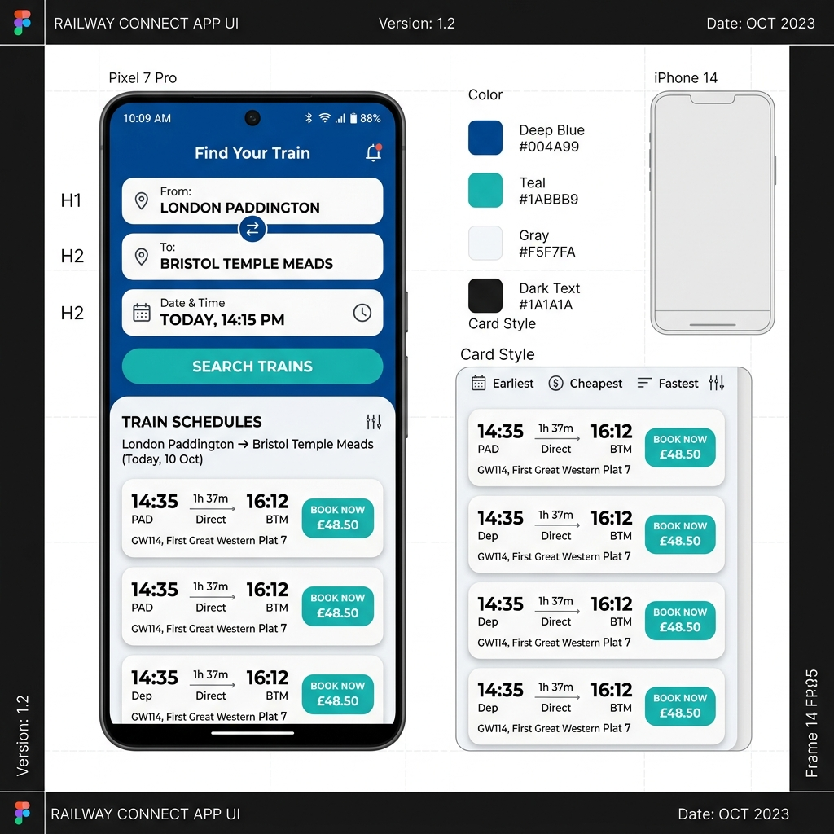
FEATURES
Key System Capabilities
• Multi-Criteria Search: Filter by travel speed, ticket cost, or transfer count.
• Live Seat Selector: Interactive graphical representation of train coaches.
• Real-Time Train Tracking: Simulated live status updates and delay alerts.
• Instant E-Tickets: Secure digital tickets with verification QR codes.
• User Dashboard: Manage active bookings, travel history, and refunds.

Slide 7
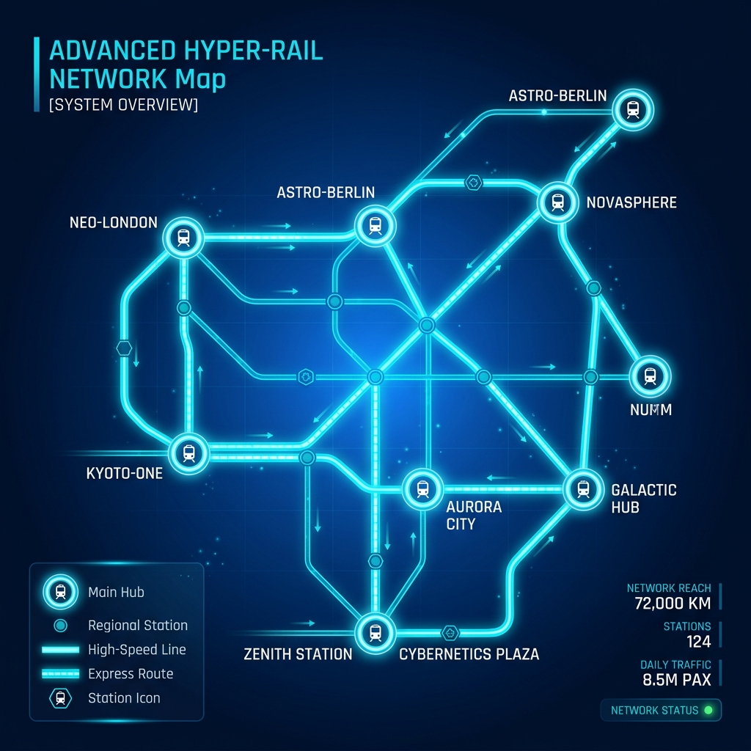
ARCHITECTURE
High-Level System Architecture
Frontend Presentation Layer
Responsive Web Portal built for desktop & mobile accessibility.
API Gateway & Authentication
Handles rate limiting, JWT validation, and CORS security.
Core Application Services
Houses the Route Engine, Seat Reservation Service, and Payment Gateway.
Data Persistence Layer
PostgreSQL database paired with Redis for ultra-fast caching.

Slide 8
ALGORITHM DESIGN
Route Optimization Algorithm
Graph Representation
• Railway Network modeled as a weighted directed graph G = (V, E). • Vertices (V): Railway stations and transit junctions. • Edges (E): Railway lines connecting stations. • Weights: Time duration, distance, and ticket price vectors.
Dijkstra's / A* Implementation
• Priority Queue based implementation for min-cost search. • Pruning heuristic minimizes station transfer wait times. • Multi-objective optimization allows user preference ranking (Fastest vs. Cheapest vs. Fewest Transfers).

Slide 9
DATA MODEL
Database Schema & Entity Model
Stations: station_id, name, code, latitude, longitude
Trains: train_id, train_number, name, total_coaches
Schedules: schedule_id, train_id, origin, destination, departure_time
Bookings: booking_id, user_id, schedule_id, total_fare, status, qr_code
Seats: seat_id, coach_num, seat_num, schedule_id, status

Slide 10
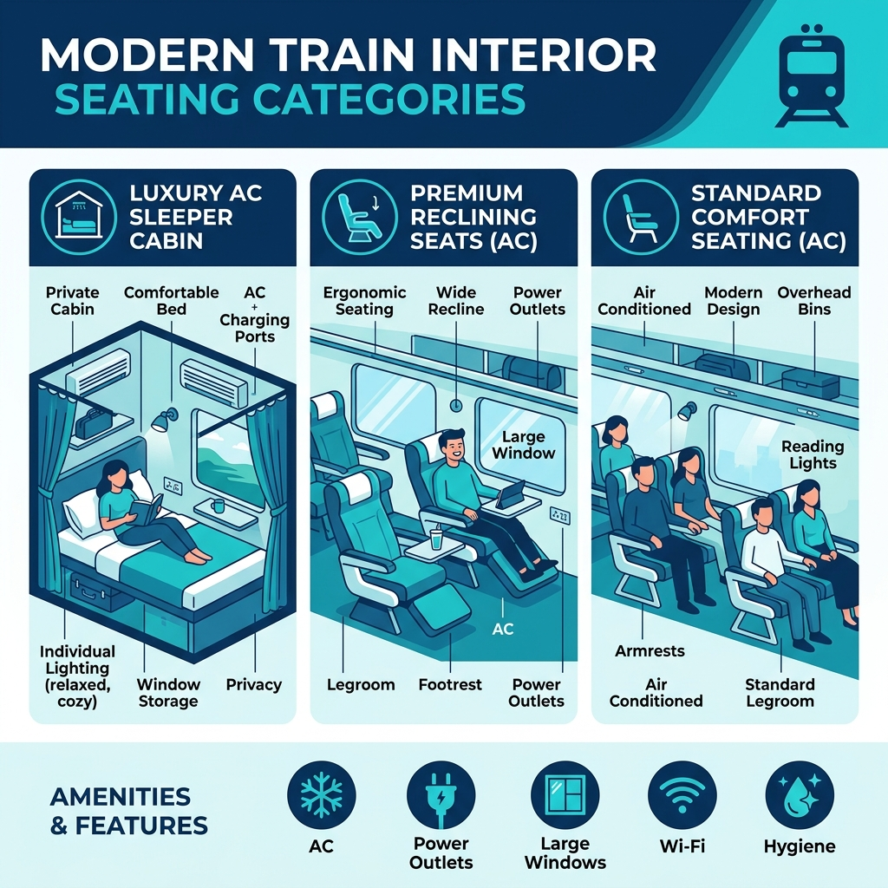
SEAT MANAGEMENT
Real-Time Seat Allocation Engine
1. Temporary Reservation Lock: 10-minute hold window during checkout.
2. Redis Distributed Locking: Prevents simultaneous lock attempts on identical seats.
3. Optimistic Concurrency Control: DB versioning handles high-throughput transactions.
4. Auto Release Trigger: Expired pending locks release seats automatically back to pool.

Slide 11
SECURITY
Security & Data Protection
Authentication
JWT tokens with short expiration & refresh token rotation.
Data Encryption
TLS 1.3 in transit and AES-256 for sensitive stored payload.
Access Control
Strict Role-Based Access Control (RBAC) for admins & commuters.
Input Validation
Comprehensive SQL injection & XSS prevention at gateway level.

Slide 12
TECH STACK
Technology Stack
Frontend
HTML5, CSS3, JavaScript (Vite), Modern UI Design
Backend Services
Node.js / Express, RESTful APIs, Routing Service
Database & Cache
PostgreSQL (Relational Data), Redis (Seat Locking)
DevOps & Hosting
Docker Containers, Cloud Hosting, GitHub Actions CI/CD

Slide 13
ROADMAP
Development Roadmap & Milestones
Phase 1: Research
Requirement gathering, ERD modeling, graph dataset preparation.
Phase 2: Core Engine
Dijkstra routing implementation, database setup, seat locker.
Phase 3: Integration
Frontend web development, API connection, UI/UX refinement.
Phase 4: Deployment
Security audit, performance testing, staging & production launch.

Slide 14
CHALLENGES
Engineering Challenges & Solutions
Challenge: Route Search Latency
Solution: Pre-computed station distance matrix & Redis caching for frequent origin-destination pairs.
Challenge: Race Conditions in Booking
Solution: Distributed atomic locks (Redlock algorithm) paired with PostgreSQL transaction isolation level.
Challenge: Multi-train Schedule Sync
Solution: Event-driven pub/sub architecture to update delay status across all active search sessions.

Slide 15
THANK YOU!
TrainRouter - Modern Railway Intelligence & Ticketing Platform
Questions & Discussion

