Slide 1

TRAINROUTER BD
BD Train Route Finder, Seat Availability & Fare Calculator
An intelligent software system engineered for Bangladesh Railway commuters to search trains by origin & destination, inspect seat classes (Shovon, Snigdha, AC Berth, AC Cabin), check live available seat counts, and calculate journey fares.
TrainRouter BD Project Presentation | CSE Software Engineering

Slide 2



• PROJECT CONTRIBUTORS
TrainRouter BD
Project Engineering Team
ID: 00724205101098
ID: 00724205101103
ID: 00724205101123

Slide 3
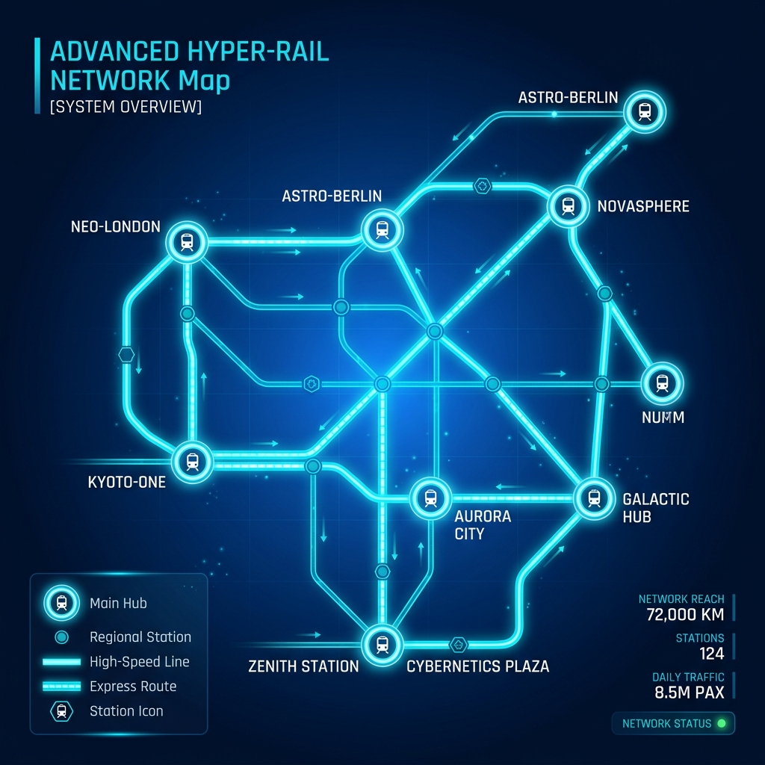
• SYSTEM VISION
TrainRouter BD
What is TrainRouter BD?
01. From-To Station Search Engine
Enables Bangladesh Railway commuters to search available intercity trains between any origin and destination (e.g. Dhaka to Cox's Bazar, Sylhet, CTG).
02. Live Seat Inventory & Category Lookup
Displays real-time available seat counts for all seat classes: Shovon (S_CHAIR), Snigdha (AC Chair), AC Berth (AC_BATH), and AC Cabin (AC_CABIN).
03. Seat-Wise Fare Calculator Engine
Computes total journey cost dynamically in BDT (৳) based on selected seat class, distance tariff matrix, and passenger quantity (No ticket purchasing).

Slide 4
• BACKGROUND CONTEXT
TrainRouter BD
Challenges in Railway Commute Planning
Uncertain Train Schedules
Passengers often lack instant visibility on how many intercity trains run between stations and their departure/arrival schedules.
Lack of Seat Class Details
Commuters struggle to inspect real-time available seat counts for specific classes (Shovon, Snigdha, AC Berth, AC Cabin) before traveling.
Complex Fare Breakdown
Calculating total journey cost for family or group travel across different seat categories requires tedious manual computations.

Slide 5
• SYSTEM ARCHITECTURE
TrainRouter BD
How TrainRouter BD Works
Step 1: From-To Input
Select origin and destination BD stations with preferred journey date.
Step 2: Database Query
Queries Bangladesh Railway schedules for active intercity trains on the route.
Step 3: Seat Inventory Lookup
Retrieves available seat counts for Shovon, Snigdha, AC Berth, and AC Cabin.
Step 4: Seat-Wise Fare Calculation
Computes fare per seat class in BDT (৳) and total journey cost for N passengers.

Slide 6
• DATA MODEL
TrainRouter BD
Bangladesh Railway Relational Schema
BD Stations Catalog: station_id, station_name (Dhaka Kamalapur, CTG, Sylhet, CXB), station_code, zone
Intercity Schedules: train_id, train_name (Suborno, Parabat, Sonar Bangla), origin, destination, off_day
Seat Inventory Pool: train_id, seat_type (Shovon, Snigdha, AC_Berth, AC_Cabin), available_seats_count
BR Fare Tariff Rules: route_km, base_tariff_rate_bdt, seat_class_multiplier, govt_vat_percentage (15%)

Slide 7
• CALCULATION RULES
TrainRouter BD
Bangladesh Railway Fare & Multiplier Engine
BD Fare Formula (BDT ৳)
• Seat Fare = (Base Tariff Rate × Route Distance KM) × Class Multiplier + 15% Govt VAT. • Total Journey Fare = Single Seat Fare × Passenger Count. • Distance matrices computed across Eastern & Western Rail Tracks.
BR Seat Class Multipliers
• Shovon Chair (S_CHAIR): 1.0x (Standard Non-AC Padded Recliner Base Tariff) • Snigdha (AC Chair): 1.8x (Air-Conditioned Premium Recliner Class) • AC Berth (AC_BATH): 2.5x (Night Sleeper Berth Class) • AC Cabin (AC_CABIN): 2.8x (Private Compartment Cabin)

Slide 8
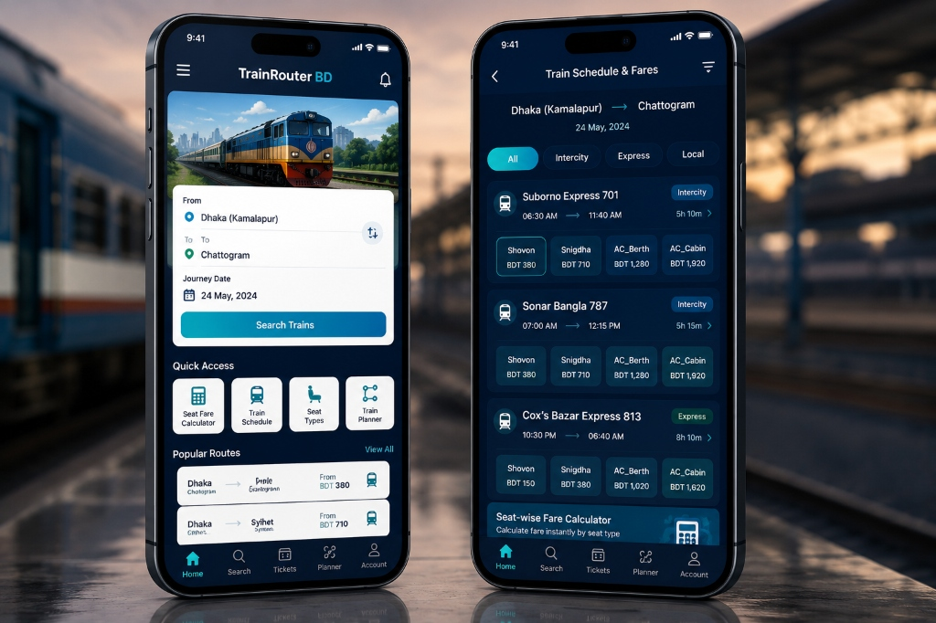
• FEATURES OVERVIEW
TrainRouter BD
System Features Showcase Overview
• From-To Station Train Search
Select origin, destination & date to view all active running trains.
• Available Seat Counts per Class
Live inventory breakdown for Shovon, Snigdha, AC Berth, and AC Cabin.
• Seat-Wise Fare Calculator (BDT ৳)
Instant cost lookup for single seat & multi-passenger journeys.
• Intermediate Stoppages & Timetables
Arrival/departure times at major junction stations.
• Pinned Ticket Store & Departure Alarm
Store offline ticket reference & set departure alert notifications.

Slide 9
• FEATURE 01
TrainRouter BD
From-To & Date-Based Train Search
• Smart Autocomplete Station Lookup: Select From (Dhaka Kamalapur) and To (Chattogram, Sylhet, Cox's Bazar, Rajshahi).
• Journey Date Picker & Off-Day Filter: Pick any travel date. System automatically checks weekly off-days (e.g. Suborno off on Wednesday) and filters non-operating trains.
• Available Train Counter Badge: Instantly shows top header summary: '4 Intercity Trains Available on Selected Date'.

Slide 10
• FEATURE 02
TrainRouter BD
Date-Wise Active Train Schedule & Seats
• Date-Wise Active Train Schedule: Displays exact running intercity trains on selected date (Suborno 701, Parabat 709, Cox's Bazar Express 813).
• Real-Time Seat Inventory per Class: Live seat count breakdown (Shovon: 120 seats, Snigdha: 45 seats, AC Berth: 12 seats).
• Train Timetable Details: Exact departure time, destination arrival time, and estimated total journey duration.

Slide 11
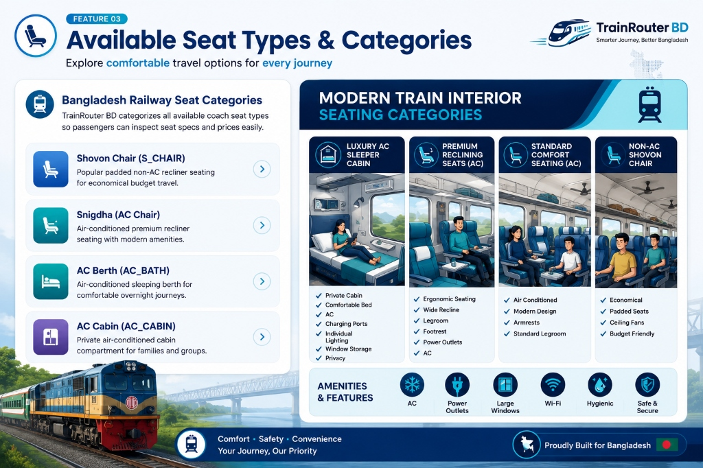
• FEATURE 03
TrainRouter BD
Available Seat Types & Categories
• Shovon Chair (S_CHAIR)
Standard non-AC padded recliner seat with 1.0x base tariff rate.
• Snigdha (AC Chair)
Premium air-conditioned recliner seating with 1.8x base tariff rate.
• AC Berth (AC_BATH)
Night sleeper berth compartment for long-distance overnight travel (2.5x tariff).
• AC Cabin (AC_CABIN)
Private lockable compartment cabin suitable for family travel (2.8x tariff).

Slide 12
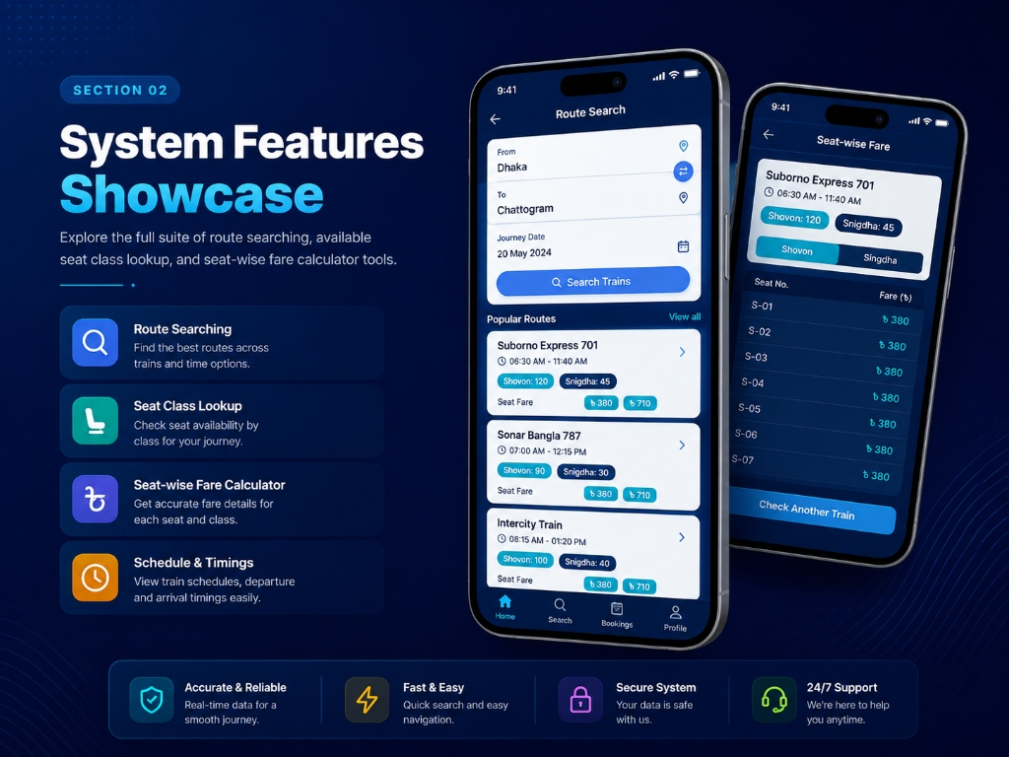
• FEATURE 04
TrainRouter BD
Seat-Wise Fare Calculator (BDT ৳)
• Dynamic Distance Fare Calculation
Automatically looks up route distance (KM) between selected stations.
• Class Multipliers & VAT Addition
Applies exact seat multiplier (1.0x to 2.8x) + 15% Bangladesh Govt VAT.
• Group / Family Trip Costing
Calculates total cost for N passengers dynamically without requiring ticket booking.

Slide 13
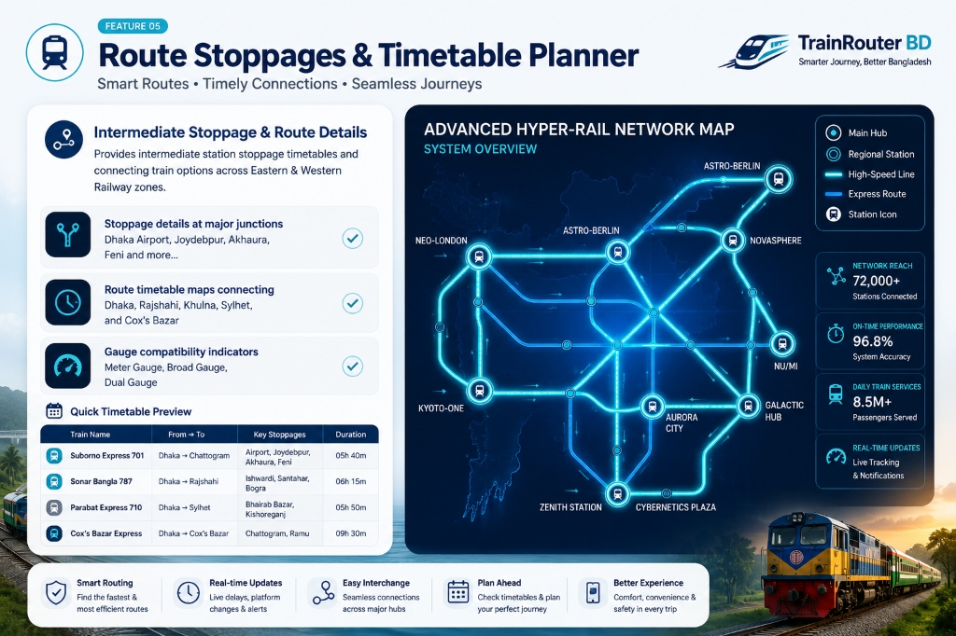
• FEATURE 05
TrainRouter BD
Intermediate Stoppages & Timetable Planner
• Stoppage Junction Timetables
Detailed arrival & departure times at intermediate stations (Airport, Joydebpur, Akhaura).
• Cross-Zone Rail Connectivity
Route mapping connecting Dhaka, Rajshahi, Khulna, Sylhet, and Cox's Bazar.
• Gauge Compatibility Indicator
Clearly demarcates Meter Gauge (MG), Broad Gauge (BG), and Dual Gauge (DG) lines.

Slide 14
• FEATURE 06
TrainRouter BD
Ticket Store & Departure Alarming Pin
• Ticket Details Pinned Storage: Store paper/online ticket photo, reference pin, train name, coach & seat info locally in app wallet.
• Journey Day Alarming Pin: Triggers sound alarms & departure notifications (e.g. 2 hours prior to departure time at Kamalapur/CTG).
• Offline Quick Pass Access: Instant offline ticket reference retrieval at station entry gates without requiring mobile data.

Slide 15
• ROADMAP: MAJOR
TrainRouter BD
Major System Updates — Multimodal Transit Hub
Dhaka Metro Rail (MRT-6 & Extension)
BusRouter BD (Inter-District Bus Schedules)
Full integration with Dhaka Metro Rail Line 6 timetables, train interval headways, Rapid Pass balance check, and seamless station transfer guide at Kamalapur Intercity Junction.
Comprehensive highway bus network integration across Bangladesh (Hanif, Shyamoli, Shohag, Ena, Green Line) with counter locations, routes, and feeder bus connections to railway stations.
Launch & Waterway Router (Sadarghat & Riverine)
Unified Multi-Modal Trip Planner
Sadarghat launch terminal riverine schedule finder, deck/cabin fare lookup, and waterway routes for Southern Bangladesh districts (Barishal, Bhola, Chandpur, Patuakhali).
Door-to-door trip planner allowing commuters to calculate combined journey routes (Local Metro ➔ Intercity Train ➔ Highway Bus / River Launch) in a single unified interface.

Slide 16
• ROADMAP: MINOR
TrainRouter BD
Minor Updates & Smart Commuter Enhancements
Live Train GPS Tracker
Seat Facilities & Coach Visualizer
Real-time GPS tracking on Google Maps showing live train position, current speed, and automated station arrival alerts.
Virtual coach layout showing seat power outlets, AC vent position, reclining angle, window view, and hygiene ratings.
Station Offline Layout Maps
AI Schedule Delay Predictor
Offline station map guides showing platforms 1-10, ticket counters, food court, parking, and luggage locker points.
Machine learning algorithm analyzing junction bottlenecks (Tongi, Joydebpur) to predict realistic delay arrival times.
Coach Crowd Density Monitor
Smart Commuter Hub
Live passenger crowding indicators for each coach (Low, Moderate, High) to help passengers find spacious seating.
Push notifications, fare change alerts & community delay reports for active passengers.

Slide 17
• FINAL REMARKS
TrainRouter BD
Conclusion & Q&A
Bangladesh Railway Impact
• 100% Transparent From-To Availability
Delivers 100% transparent From-To train availability, seat counts, and seat class rates.
• Instant Seat-wise Fare Calculator
Eliminates counter visit hassles by providing an instant seat-wise fare calculator on web/mobile.
• Smart Alerts & Ticket Management
Pinned ticket storage & departure alarm alerts ensure commuters never miss their train.
THANK YOU!
Questions & Answers Session
We welcome any questions, feedback, and suggestions regarding TrainRouter BD System.
👥 Passengers First
🛡️ Smart Travel
⏰ Save Time
📈 Better Experience

