Slide 1





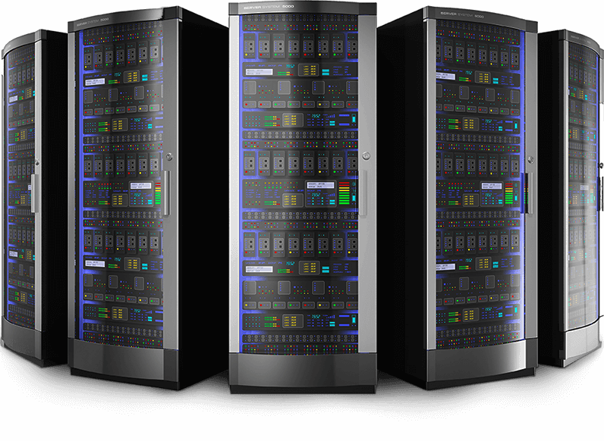
Lainotik View
Lainotik
Own Infrastructure

Slide 2
















Lainotik Bigdata Services

Slide 3


Lainotik Monitoring

