Slide 1





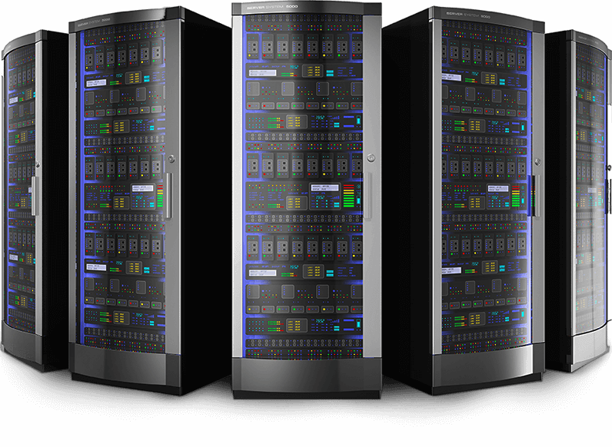
Lainotik View
Lainotik
Own Infrastructure

Slide 2


















Lainotik Bigdata Services

