Slide 1
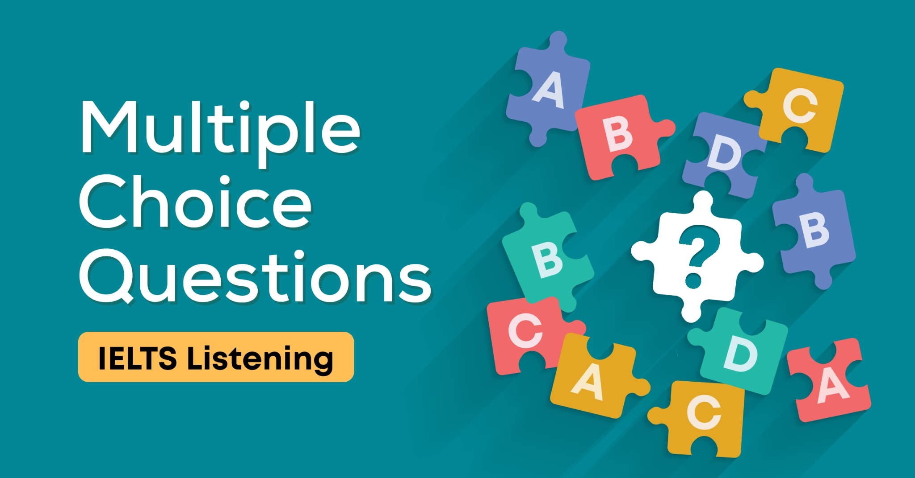

Slide 2
MCQ
In multiple choice questions, you are required to choose the correct answer from a list of options. There are two main types of question:
 | 1) Single questions with a choice of 3 answers (A, B or C). Occasionally, there may be 4 options. 2) List questions. These have a longer list of possible answers and you must select more than one as specified in the question.

Slide 3
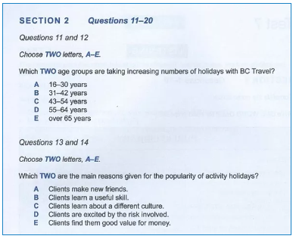
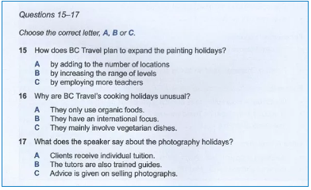
MCQ

Slide 4
Strategies
Read the Question
You will have a short time to prepare before the speaker or speakers begin talking. First, read the question very carefully to ensure that you know exactly what you have to do.
Particularly note the type of question – single with 3 options or list selection with 2 or more answers to identify. For our sample question, we must choose 3 answers. Underline or circle the 3 to remind you.

Slide 5
Look for a Title
Not every question will have a title but if there is one, it will tell you the context of the question. This will help you to understand the answers listed and give you a big clue as to what sort of information will be contained in the recording.

Slide 6
Underline the Key Word in the Question
Underline or highlight the key word in the question. For example, in this question, it is ‘recommended’.
What 3 items are you recommended to take with you to the spa?
The question is telling us that we must select 3 items that the speaker will recommend that we take with us on the spa day, that is, things we ‘should’ take.
However, don’t expect the word ‘recommend’ to be used throughout the recording. The speaker isn’t going to say, “I recommend that you take a towel and I recommend that you wear a watch.” Synonyms and paraphrasing will be used extensively, so think of some words that might be used instead, including negatives for things you should not take. For example,
“You must…”, “It’s advisable...”, “You shouldn’t…”

Slide 7
Think of Synonyms
Expect to hear all the answer options in the recording, not just the correct answers. You will have to listen very carefully to determine if each item is or is not recommended.
Synonyms will definitely be used for some of the words, so scan the list and see if you can quickly think of any synonyms or related words. An example might be some specific items of fruit for answer (c) instead of the word ‘fruit’.
So, you are not looking for the exact words but the same meaning.
Also, be aware that the answers will not be in the same order as you’ll hear them in the recording.

Slide 8
Identify the Difference
In single questions with a choice of 3 or 4 answers, the answers may be similar in some way to try and catch you out. If this is the case, underline any key words that will help you to work out the difference in meaning between them. An example for our question might be:
 | You must take a towel. You can borrow a towel. A towel will be provided.

Slide 9
Watch out for Distractors
We already know that all the answers in the list will probably be included in the text, so you need to listen carefully to identify the correct ones. Particularly listen out for distractors as the examiners love to try and trick you into picking the wrong answers.
The way they do this is to give you an answer and then take it away again.
Here are some sentences containing distractors. I’ve highlighted the relevant words.
I always recommend taking a packed lunch but the spa are providing complimentary refreshments for your visit so you won’t need to.
The coach will be returning to the hotel at 5.30 p.m. No, sorry, we’ve changed it to 6 o’clock to avoid the worst of the rush hour traffic.
I don’t usually advise taking any money as everything is included. However, they have a home pamper kit promotion on at the moment so you might like to treat yourself.

Slide 10
Watch out for Distractors
So, a distractor is a word or a phrase that changes or corrects the original piece of information given. There will almost certainly be some in the recording so beware.
The best approach to marking the correct answers is to put a tick beside an answer you think is correct but continue to listen carefully in case you find that it’s wrong after all. If it is, you can quickly change the tick to a cross and eliminate the answer from further consideration.

