Slide 1
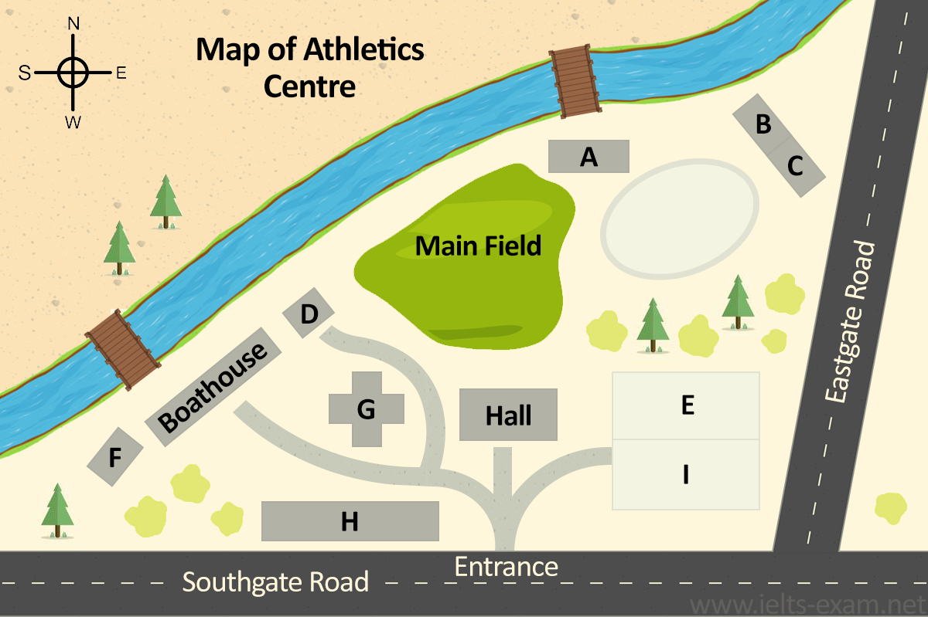
MAP TYPE

Slide 2
MAPS
You are required to match the names of the locations mentioned in the question with the unknown locations marked in the diagram (usually marked as A,B,C etc.) Strategy:
Step 1: At first familiarise yourself with the diagram given in the question. Know where all the “named” locations are before the audio plays. Step 2: While the audio plays, physically track the tour with your finger. Match the unknown locations with the named locations. Step 3: Be patient. Only go to the location that the audio tells you to go to.

Slide 3
MAPS
Be careful:
Try not to panic. Try to follow the guidelines correctly. Practice. Try not to be impatient. Do not guess & go too far away from the area the tour is telling you to go to. Learn to skip questions when you get lost. If you get lost halfway through any one question’s instructions, take a deep breath and skip it. Move on to the next question and get ready for the next set of instructions. Forget about the previous error, and try saving the score for the rest of the question.

Slide 4
Map Vocabulary
To do well in map and plan questions, you need to understand the language of location, especially prepositions of place, and direction.
Here are definitions of these two types of vocabulary to make sure that you understand the difference between them, and a few examples of each type.
Location – where something is in relation to another object or place.
Direction – the position towards which someone moves or faces.

Slide 5
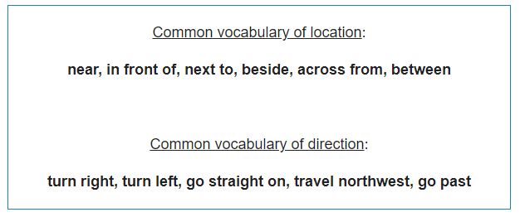

Slide 6
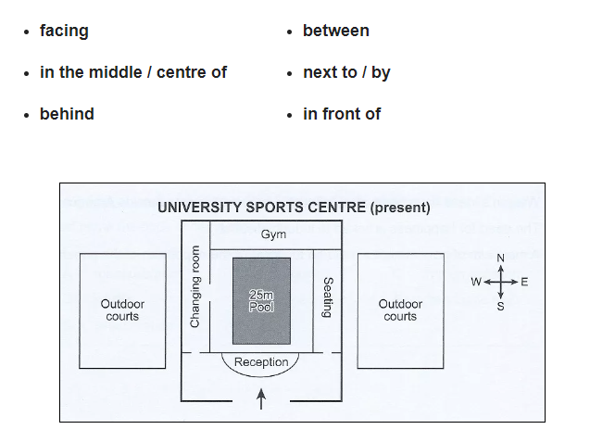
Map Vocabulary
The entrance is in front of the reception desk.
The reception desk is facing the entrance.
The pool is in the centre of / in the middle of the sport’s centre.
The gym is behind the swimming pool.
The pool is between the reception and the gym.
The seating area is next to / by the pool.

Slide 7
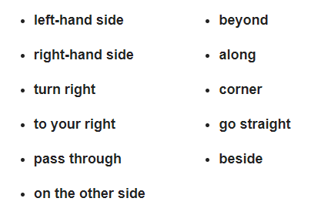
Map Vocabulary

Slide 8
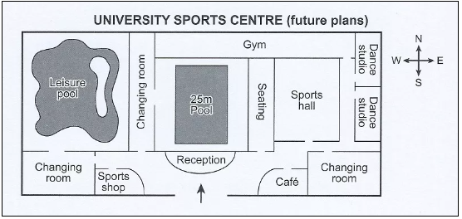
The sports shop is on the left-hand side as you enter the sports centre.
To the right-hand side of the entrance, there’s a café.
Pass through the entrance, turn right and the café is immediately in front of you.
The leisure pool is on the other side of the sports centre to the dance studios.
There is a large changing room just beyond the café.
Walk along the side of the sports hall and you’ll find the second dance studio in the far corner of the building
Go straight along the corridor beside the sports hall and to your right, you’ll see two dance studios.

Slide 9
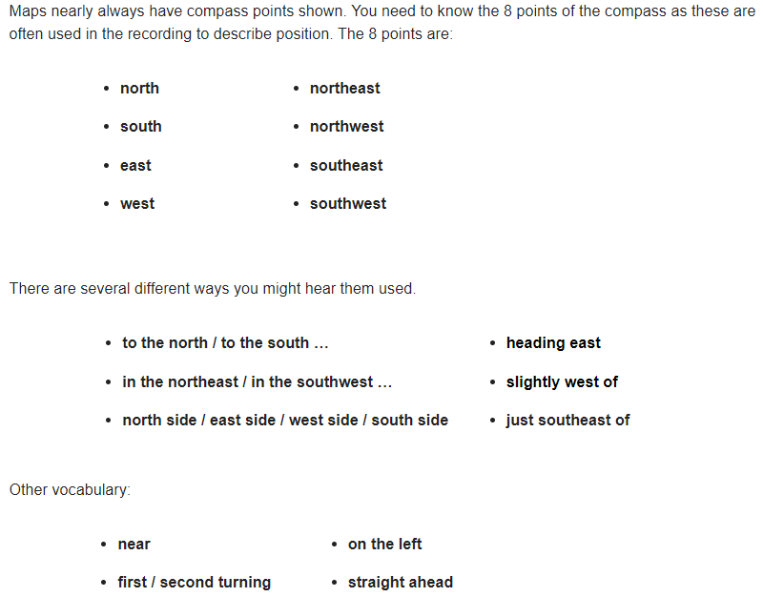

Slide 10
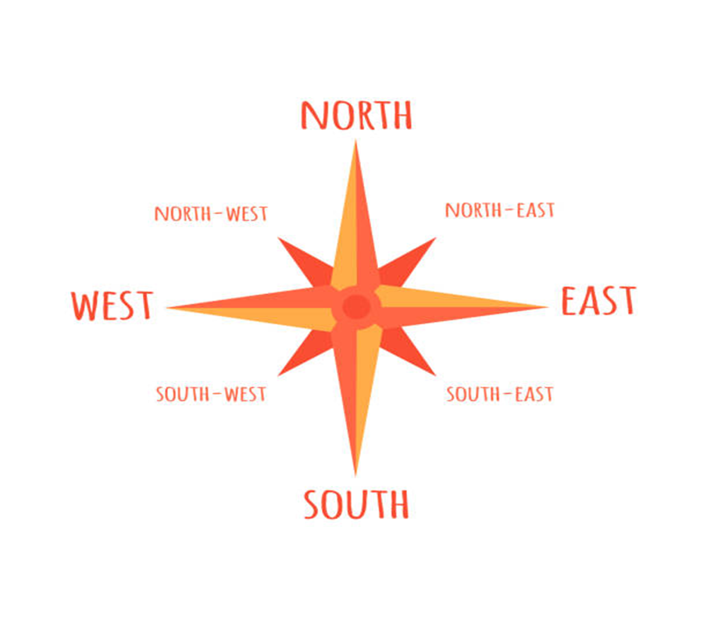
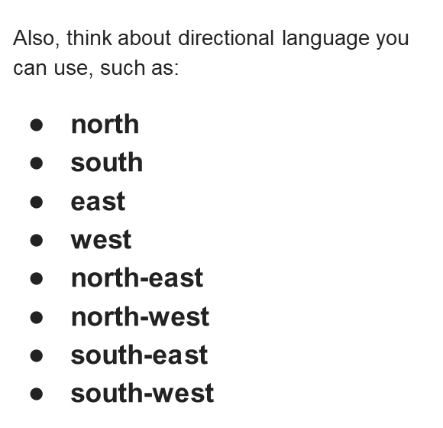

Slide 11
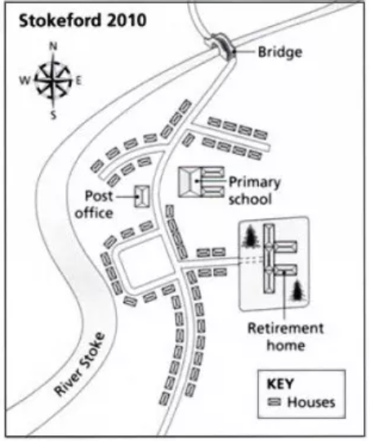
The houses immediately to the north and south of the Post Office are very near the river.
The bridge is just beyond the final row of houses heading north.
After crossing the bridge, take the second turning on the left and you’ll see the retirement home straight ahead.
The retirement home is just southeast of the primary school.
The post office is to the northwest of the retirement home.
The village of Stokeford is slightly east of the River Stoke.
There is a housing estate to the west side of the retirement home.

Slide 12
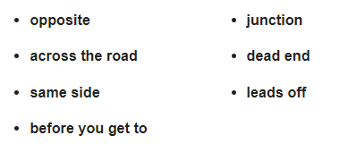
Map Vocabulary

Slide 13
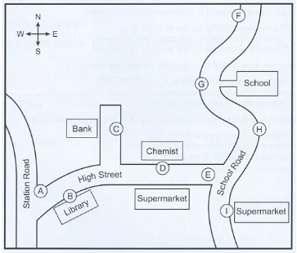
The chemist is opposite a supermarket.
They are going to build new houses across the road from the school at point G.
There is a supermarket on the same side of the road as the library.
Walk west along High Street and you’ll pass the library before you get to the junction with Station Road.
The bank is on a dead end road that leads off the High Street.

Slide 14
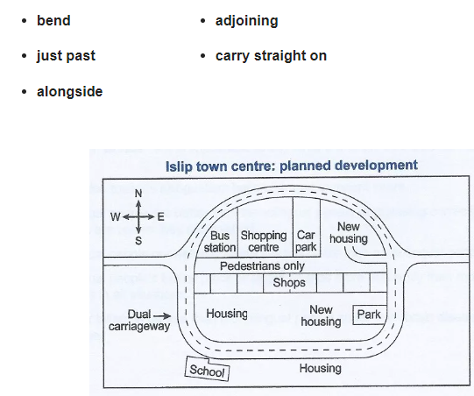
The school is situated on a bend in the dual carriageway.
The bus station is on the right just past the shopping centre.
The town centre has a pedestrian walkway running alongside a row of adjoining shops.
After passing the school on your right, carry straight on and you’ll see the park on your left around the next bend.

