Slide 1
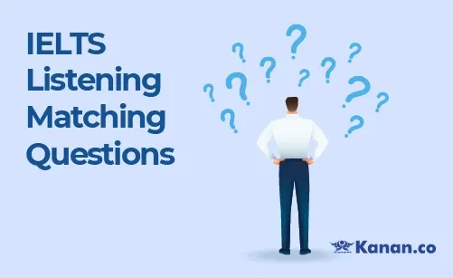

Slide 2
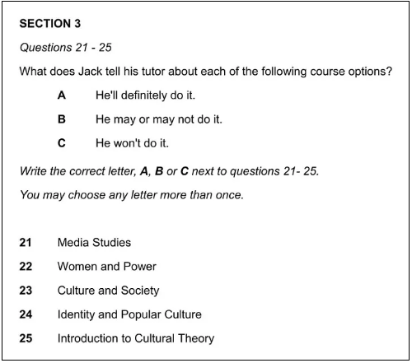
Matching Questions
This type of question usually appears in sections 1 or 3 in which the recording is a conversation between two or more people. The question will contain two sets of information and you have to match them.

Slide 3
Analyse the Question
Step 1 – First, you need to understand the relationship between the question sentence and the question options 21-25.
Highlight the key part of the question sentence and think about how it relates to the question options.

Slide 4
Answer Order
In matching questions, the questions will be mentioned in order in the recording but the answer options will appear randomly.
So, for our sample question, the speakers will first talk about Media Studies, then Women and Power, then Culture and Society, etc. The three decisions options as to whether or not to take each course could be heard in any order.

Slide 5
Synonyms and Paraphrasing
Synonyms and paraphrasing will be used extensively in the recording and another good use of your preparation time is to quickly think of some words and phrases that might be used to express the information in the question.
First, let’s think about the three answer options. Jack is not going to say,
I will definitely do the Introduction to Cultural Theory course.
I may or may not do the Culture and Society course.
I won’t do the Identity and Popular Culture course.

Slide 6
Synonyms and Paraphrasing
He will use different phrases to convey the same meaning. You will need to listen out for both positive and negative vocabulary and sentence structures. For example,
I’m very interested in Women and Power so I think I’ll go for that one.
I’ll give Media Studies a miss as I did a similar module last year.
If you can think up a few examples of what you might hear Jack say, you will be well prepared for picking out the synonyms and paraphrasing as the recording plays.

Slide 7
Watch Out for Distractors
The examiners will try and catch you out with distractors.
A distractor is a word or a phrase that changes or corrects the original piece of information given. So, you may be given an answer and then have it taken away again.
Here are some sample sentences containing distractors. I’ve highlighted the relevant words.
I’d really like to study Identity and Popular Culture but I don’t like the lecturer so I’m not going to take it.
I discounted Culture and Society. However, a friend took it last year and loved it, so I’m seriously considering it as on option.

Slide 8
Watch Out for Distractors
But’ and ‘however’ are common distractor but there are many other words and phrases that can be used to change the information given. There are several present in the recording so listen carefully for them.
You will also hear Jack changing or clarifying decisions as the conversation progresses and he’s given new information by the tutor Dr Ray.
The best approach to marking the answers is to write A, B or C next to a question as soon as you think you’ve heard the correct answer but continue to listen carefully in case you find that you’re wrong. If this happens, you can quickly cross it through and write the correct answer beside it.

Slide 9
