Slide 1
Memory Mapped
I/O
Slide by-
Md. Farhan Shakib
Lecturer, Dept. of CSE, RUET
farhan.shakib@cse.ruet.ac.bd

Slide 2
References
Embedded Systems with ARM Cortex-M Microcontrollers in Assembly Language and C 3e by Dr. Yifeng Zhu [Chapter 14]

Slide 3
I/O Operations
Typically, an on-chip peripheral device has a few registers, such as control registers, status registers, data input registers, and data output registers. A peripheral may also, have data buffers, such as the display memory of LCD controller. Input/output or I/O refers to data communication between the processor core and a peripheral device.
There are two complementary approaches to performing I/O operations: port-mapped, and memory-mapped l/O.

Slide 4
I/O Operations
Port-mapped I/O:
Port-mapped I/O uses special machine instructions, which are designed specifically for l/O operations.
The memory address space and the l/O device address space are independent of each other.
Each device is assigned one or more address space unique port numbers. For example, Intel x86 processors use IN OUT instructions to read from or write to a port.

Slide 5
I/O Operations
Memory-mapped I/O:
Memory-mapped I/O does not need any special instructions. The memory and I/O devices share the same address space.
Each peripheral register or data buffer is assigned to a memory address in the memory address space of the buffer is assigned to a memory address in the memory address space of the microprocessor.
Memory-mapped I/O is performed by the native load and store instructions of the processor. Therefore, memory-mapped l/O is a more convenient way to interface I/O devices.
The most significant disadvantage is that memory-mapped l/O has a more complex address decoding unit than port-mapped l/O.

Slide 6
I/O Operations
Memory-mapped I/O:
The address decoding process in a microcontroller involves circuitry that determines whether an address access is directed to a peripheral or to memory.

Slide 7
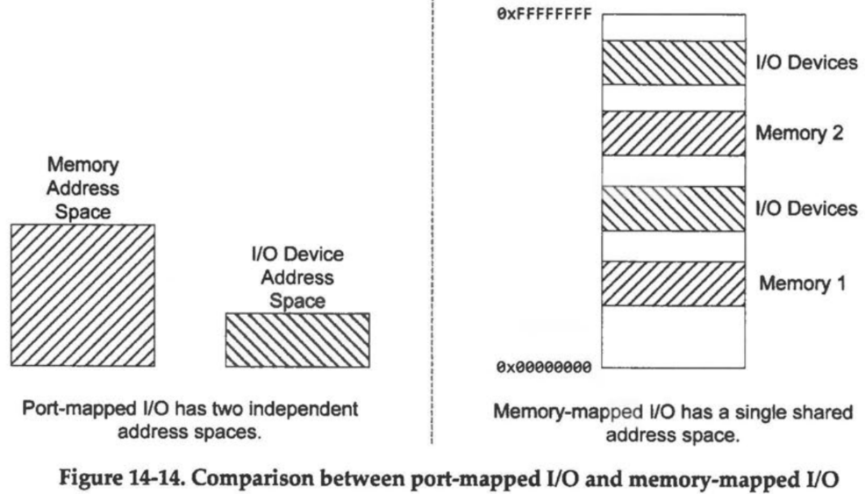
I/O Operations

Slide 8
I/O Operations
ARM Cortex-M processors use memory-mapped I/O to access peripheral registers. All peripheral registers on STM32L4 are mapped to a small memory region starting at 0x40000000.
This region includes the memory addresses of all on-chip peripherals, such as GPIO, timers, UART, SPI, and ADC. The memory address of each peripheral register is determined by chip manufacturers, and usually cannot be changed by software.
A peripheral register usually takes four bytes in memory.
For example, the output data (ODR) register of Port B on STM32L4 is mapped to memory addresses 0x48000414 to 0x48000417, with the upper halfword being reserved. Note that values stored in peripheral registers are in the format of little-endian.

Slide 9
Properties of GPIO Registers
The memory addresses of the registers are defined during the chip design stage. Software cannot change them.
Each GPIO port has up to 16 pins, and each pin may take 1, 2, or 4 bits in a control register. For example, two bits are required to specify the mode of a GPIO pin. Therefore, the size of these control registers can be either 2, 4 or 8 bytes.
Because the memory address of each register is word-aligned (is a multiple of four), dummy bytes are padded in the data structure to correctly map the fixed physical memory layout to the data structure.

Slide 10
Some Basics
Suppose we are working on a 8-bit processor. The ODR (Output Data Register) looks like this.
What if we want to change the bit at position 6 and 5 to 10?
1 | 0 | 1 | 1 | 1 | 0 | 0 | 1
7 | 6 | 5 | 4 | 3 | 2 | 1 | 0

Slide 11
Some Basics
Suppose we are working on a 8-bit processor. The ODR (Output Data Register) looks like this.
What if we want to change the bit at position 6 and 5 to 10?
Erase the bits – Perform an AND operation between ODR and 10011111.
10011111 → ~01100000 → (bin)~11<<5 → (dec)~3<<5
These summarizes to this– ODR &= ~3<<5
1 | 0 | 1 | 1 | 1 | 0 | 0 | 1
7 | 6 | 5 | 4 | 3 | 2 | 1 | 0

Slide 12
Some Basics
Suppose we are working on a 8-bit processor. The ODR (Output Data Register) looks like this.
What if we want to change the bit at position 6 and 5 to 10?
Erase the bits – Perform an AND operation between ODR and 10011111.
10011111 → ~01100000 → (bin)~11<<5 → (dec)~3<<5
These summarizes to this– ODR &= ~3<<5 [ODR → 10011001]
1 | 0 | 1 | 1 | 1 | 0 | 0 | 1
7 | 6 | 5 | 4 | 3 | 2 | 1 | 0

Slide 13
Some Basics
Suppose we are working on a 8-bit processor. The ODR (Output Data Register) looks like this.
What if we want to change the bit at position 6 and 5 to 10?
Erase the bits – Perform an AND operation between ODR and 10011111.
10011111 → ~01100000 → (bin)~11<<5 → (dec)~3<<5
These summarizes to this– ODR &= ~3<<5 [ODR → 10011001]
Change the bits – Perform an OR operation between ODR and 01000000.
01000000 → (bin)10<<5 → (dec)2<<5
These summarizes to this– ODR |= 2<<5
1 | 0 | 1 | 1 | 1 | 0 | 0 | 1
7 | 6 | 5 | 4 | 3 | 2 | 1 | 0

Slide 14
Some Basics
Suppose we are working on a 8-bit processor. The ODR (Output Data Register) looks like this.
What if we want to change the bit at position 6 and 5 to 10?
Erase the bits – Perform an AND operation between ODR and 10011111.
10011111 → ~01100000 → (bin)~11<<5 → (dec)~3<<5
These summarizes to this– ODR &= ~3<<5 [ODR → 10011001]
Change the bits – Perform an OR operation between ODR and 01000000.
01000000 → (bin)10<<5 → (dec)2<<5
These summarizes to this– ODR |= 2<<5 [ODR → 11011001]
1 | 0 | 1 | 1 | 1 | 0 | 0 | 1
7 | 6 | 5 | 4 | 3 | 2 | 1 | 0

Slide 15
Some Basics
Let’s think of a real example. In STM32L4 MCU, the ODR of GPIO port B starts from the memory address 0x48000414 and spans 32 bits. We want to set the register at position 13 (i.e., B13). How do we do that?
define a pointer that points to memory address 0x48000414.

Slide 16
Some Basics
Let’s think of a real example. In STM32L4 MCU, the ODR of GPIO port B starts from the memory address 0x48000414 and spans 32 bits. We want to set the register at position 13 (i.e., B13). How do we do that?
define a pointer that points to memory address 0x48000414.
#define GPIOB_ODR (*(volatile uint32_t *) 0x48000414)
Typically, compilers minimize the number of memory accesses, by temporally storing the memory value in a register, and then repeatedly using it without accessing the memory. The volatile qualifier on a variable prevents the compiler from making such optimization on this variable.

Slide 17
Some Basics
Let’s think of a real example. In STM32L4 MCU, the ODR of GPIO port B starts from the memory address 0x48000414 and spans 32 bits. We want to set the register at position 13 (i.e., B13). How do we do that?
define a pointer that points to memory address 0x48000414.
#define GPIOB_ODR (*(volatile uint32_t *) 0x48000414)
Dereference the address to access the value stored and set the value.

Slide 18
Some Basics
Let’s think of a real example. In STM32L4 MCU, the ODR of GPIO port B starts from the memory address 0x48000414 and spans 32 bits. We want to set the register at position 13 (i.e., B13). How do we do that?
define a pointer that points to memory address 0x48000414.
#define GPIOB_ODR (*(volatile uint32_t *) 0x48000414)
Dereference the address to access the value stored and set the value.
GPIOB_ODR |= 1UL<<13
UL = Unsigned Long Integer

Slide 19
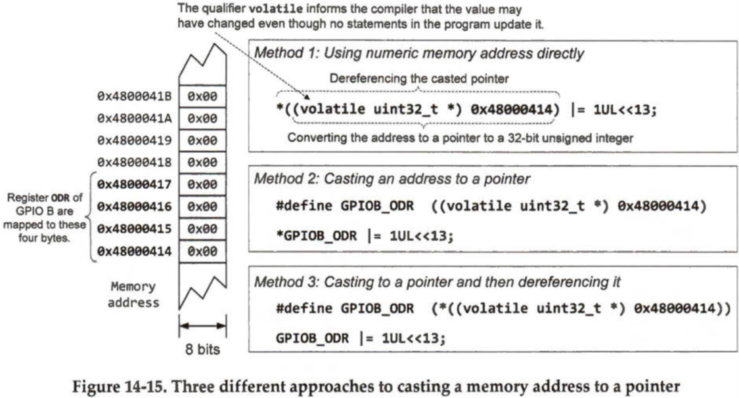
Programming Memory Mapped I/O

Slide 20
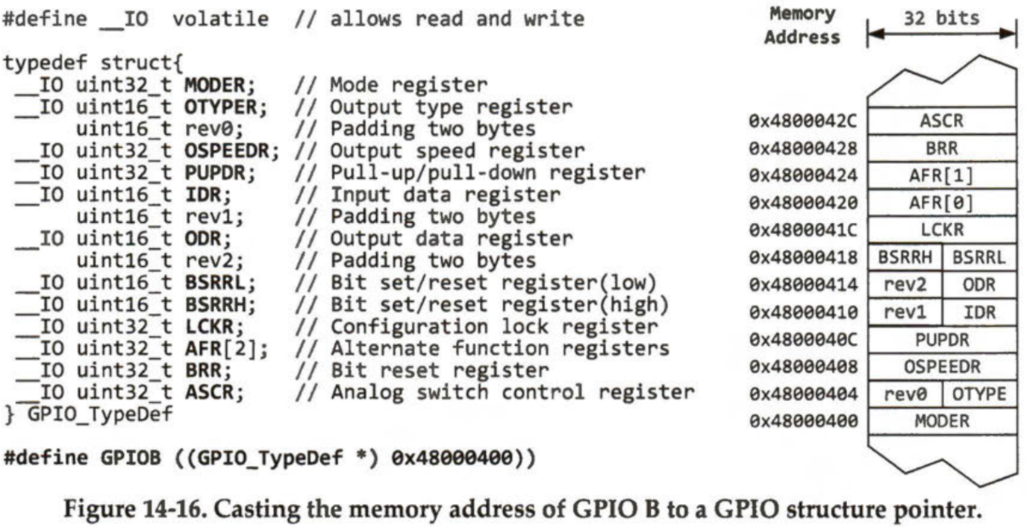
Programming Memory Mapped I/O
A better approach is to use structures and pointers. Typically, all registers of a peripheral, such as those of GPIO port B (shown in Figure 14-16), are mapped to a contiguous block of physical memory. In C, a struct encapsulates related variables into a single structure. All variables in a struct are stored contiguously in memory.

Slide 21
Programming Memory Mapped I/O
In STM32L4 MCU, GPIOB registers start from 0x48000400 and spans 48 bytes. The defined GPIO_TypeDef is also 48 bytes. So, when we are pointing GPIOB to 0x48000400, the 48 bytes/the 12 registers of 4-bytes are going to map to the 12 4-bytes blocks of the structure. So, instead of accessing ODR by it’s address, we can access it by simply GPIOB -> ODR.

Slide 22
Programming Memory Mapped I/O
To conveniently access a set of registers which are contiguous in memory, we can cast the base memory address of a GPIO port to a pointer to a data structure, as shown below.
#define GPIOB ((GPIO_TypeDef *) 0x48000400))
For example, if we want to set the output of GPIO port B pin 6 to high, we can use the following C statement. 1UL is an unsigned long integer with a value of 1. Note the pins are numbered 0-15, instead of 1-16.
GPIOB->ODR |= 1UL << 6; //Set bit 6

Slide 23

Thank You!

