Slide 1
Lighting Up An
LED (C, Assembly)
Slide by-
Md. Farhan Shakib
Lecturer, Dept. of CSE, RUET
farhan.shakib@cse.ruet.ac.bd

Slide 2
Note
Different from the book. Slide explains the concept in context of STM32f10X MCU. While the book uses different MCU. So, the addresses will also be different.

Slide 3
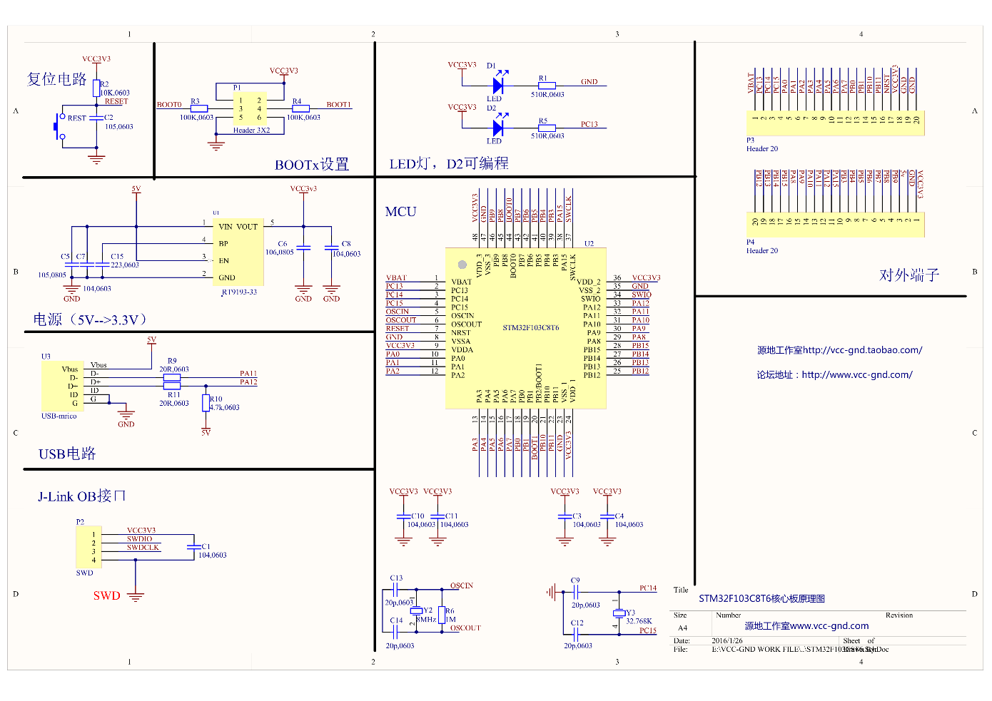
Schematics
Schematic Link: https://stm32-base.org/assets/pdf/boards/original-schematic-STM32F103C8T6-Blue_Pill.pdf

Slide 4
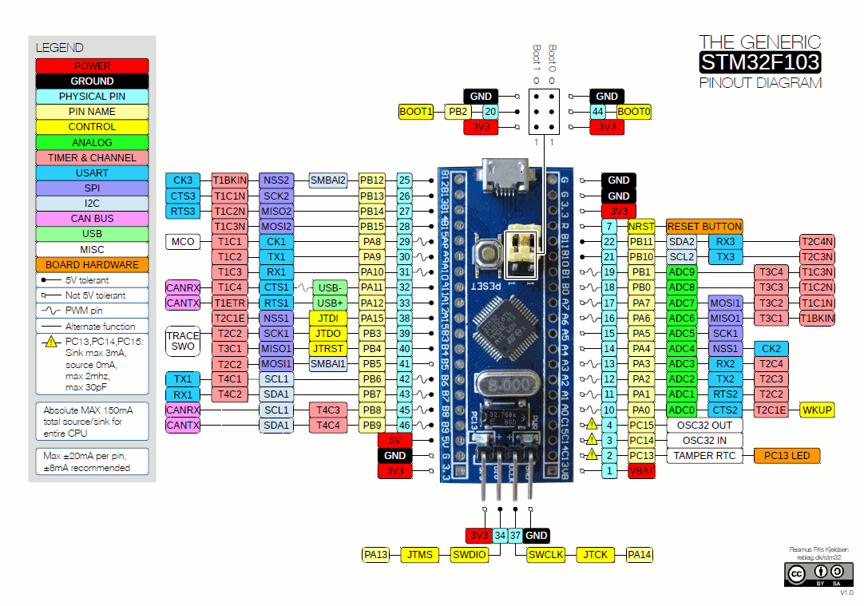
Pin Diagram

Slide 5
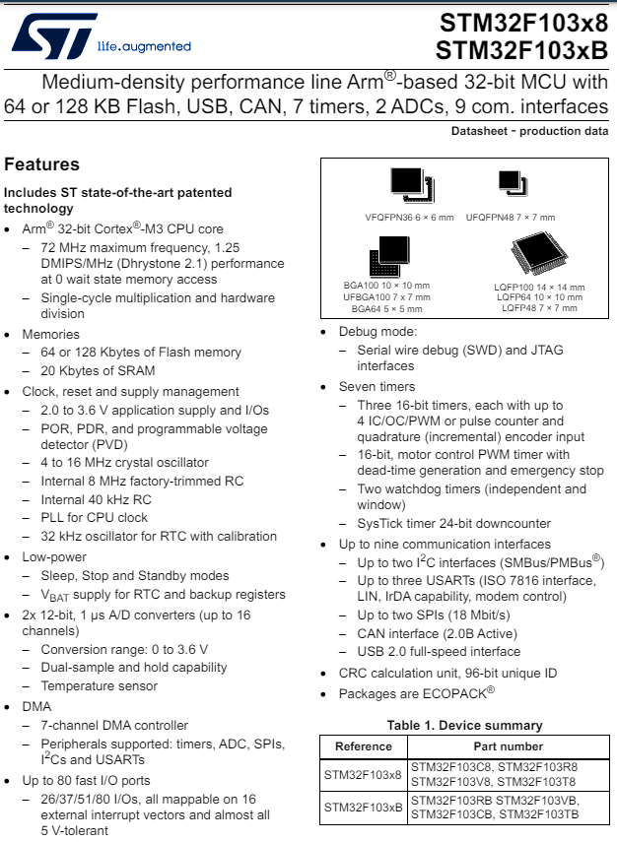
Datasheet
Datasheet: https://www.st.com/resource/en/datasheet/stm32f103c8.pdf
Figure: Page 1 of Datasheet showing features of stm32f103c8

Slide 6
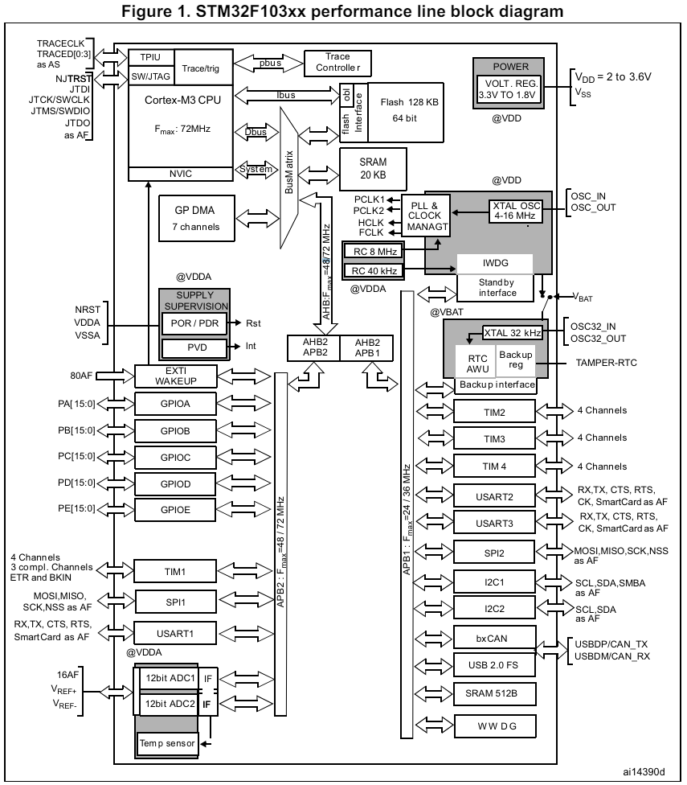
Datasheet
Figure: Page 11 of Datasheet showing STM32F103xx Block Diagram

Slide 7
Reference Manual
Reference Manual (Most Important Doc): https://www.st.com/resource/en/reference_manual/rm0008-stm32f101xx-stm32f102xx-stm32f103xx-stm32f105xx-and-stm32f107xx-advanced-armbased-32bit-mcus-stmicroelectronics.pdf

Slide 8
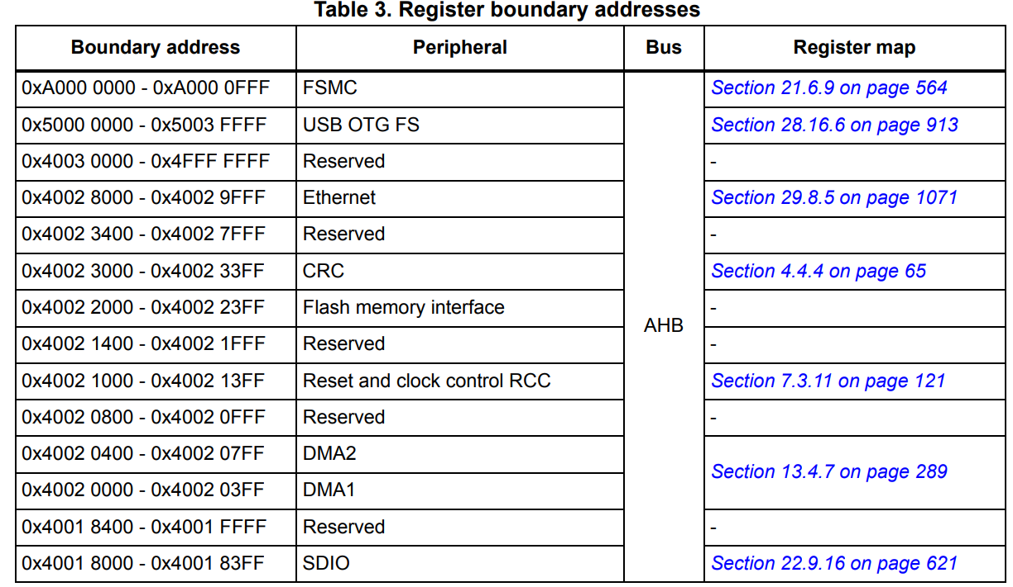
Memory Map of STM32 Blue Pill (STM32F103xx)
Figure: Memory Map of STM32 Blue Pill (STM32F103xx) (Page 50 in Reference Manual)

Slide 9
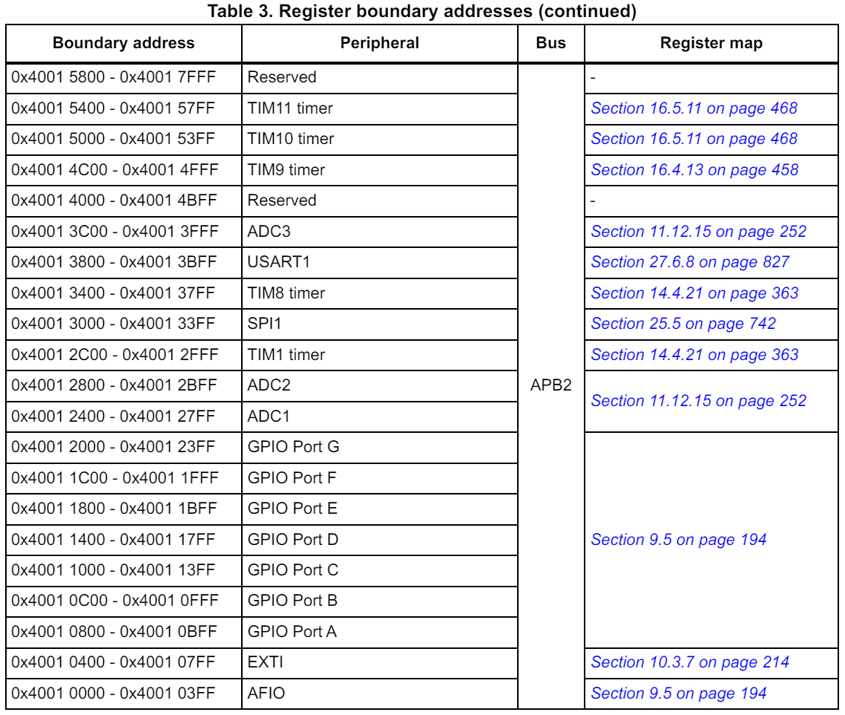
Memory Map of STM32 Blue Pill (STM32F103xx)
Figure: Memory Map of STM32 Blue Pill (STM32F103xx) (Page 51 in Reference Manual)

Slide 10
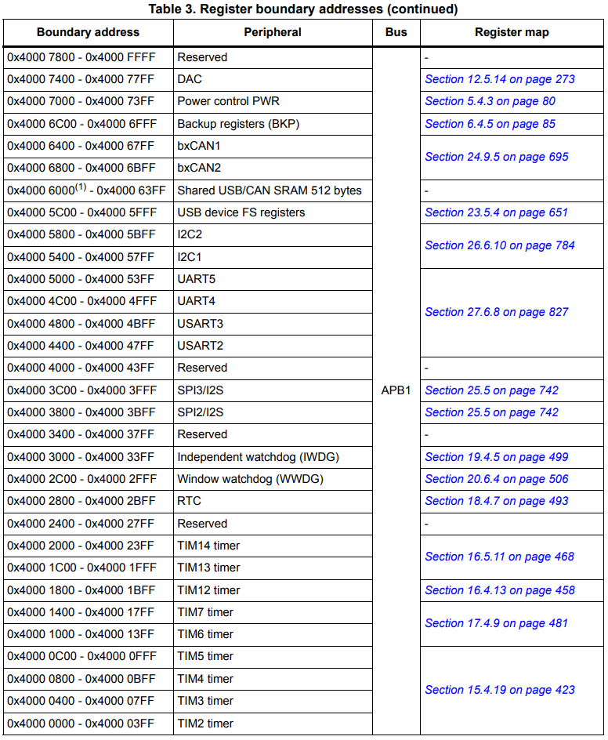
Memory Map of STM32 Blue Pill (STM32F103xx)
Figure: Memory Map of STM32 Blue Pill (STM32F103xx) (Page 52 in Reference Manual)

Slide 11
Procedure for lighting up an LED in STM32 Blue Pill
The following shows the basic procedure for lighting up an LED (Digital Output) in STM32 Bluepill. The software initialization involves three key steps.
Enabling Clock: First, it enables the clock of the GPIO port x via the RCC module by using APB2 peripheral clock enable register (RCC_APB2ENR) (Page 146 in Reference Manual). By default, clock is disabled.
Configuring Port: Second, it configures pin y of GPIO port x as a general-purpose output pin using Port configuration register high (GPIOx_CRH)/Port configuration register low (GPIOx_CRL) (Page 171 and 172 in Reference Manual)
Outputting Data: Third, it outputs data to pin y of GPIO port x using Port output data register (GPIOx_ODR) (Page 173 in Reference Manual)

Slide 12
Step 1 – Enabling Clock
GPIO Port x
(GPIOA-GPIOE)
Clock of APB2 Bus need to be enabled.

Slide 13
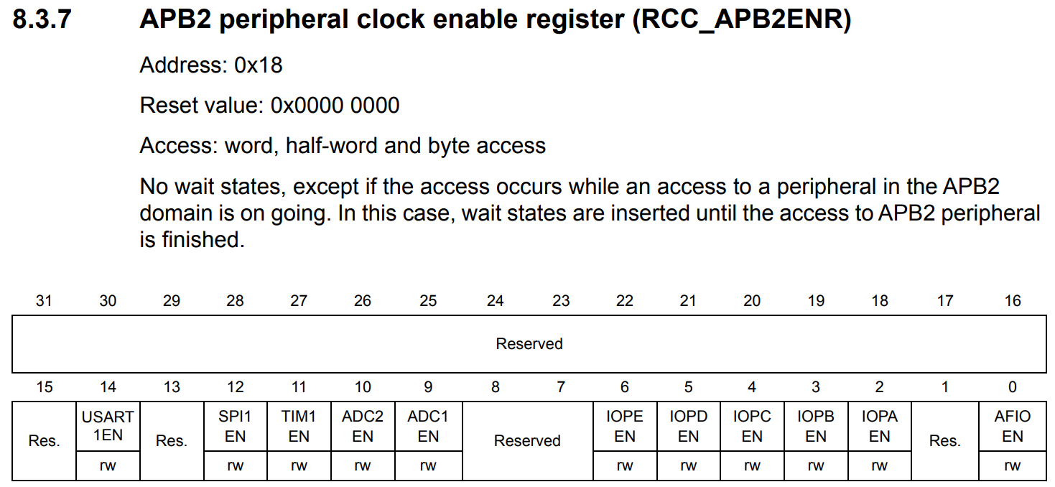
Step 1 – Enabling Clock
Figure: RCC_APB2ENR Register Details (Page 146 in Reference Manual)

Slide 14
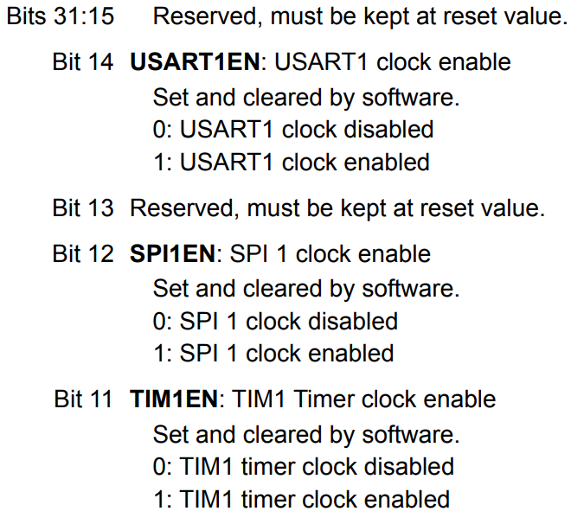
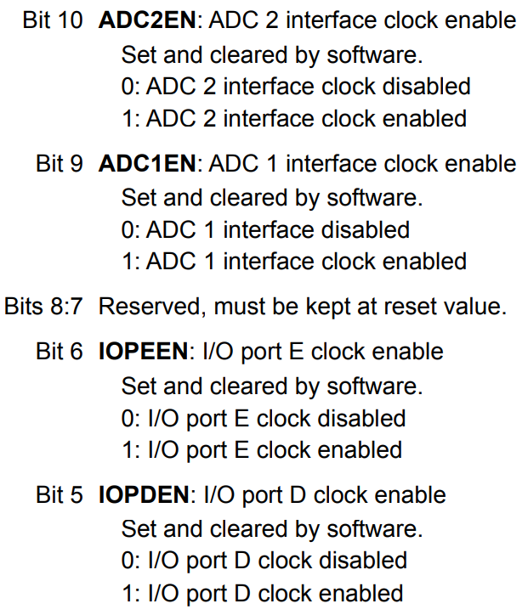
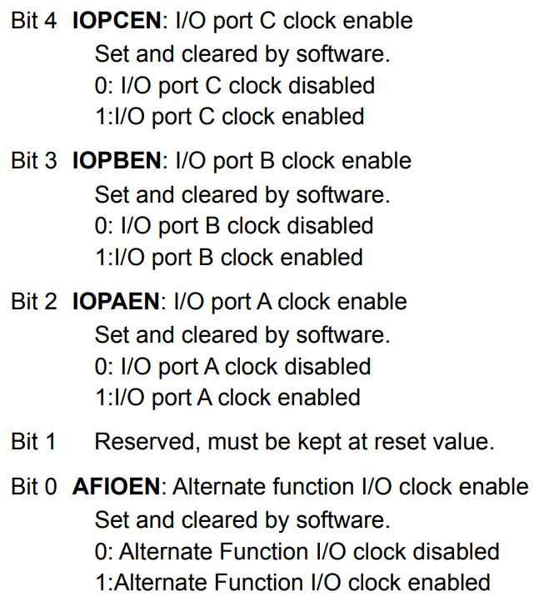
Step 1 – Enabling Clock
Figure: RCC_APB2ENR Register Details (Page 146 in Reference Manual)

Slide 15
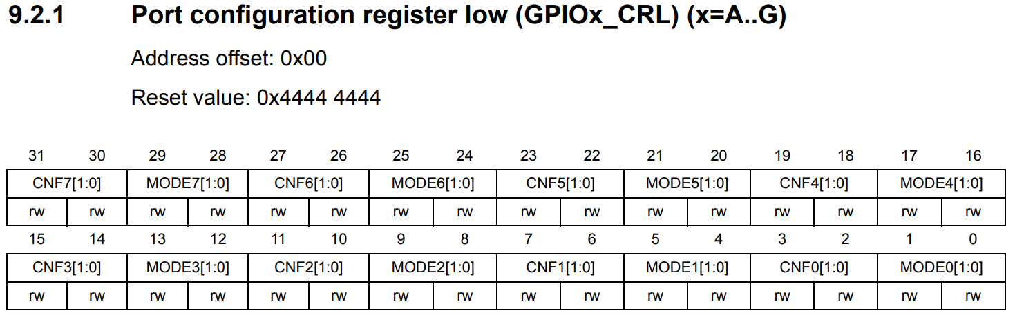
Step 2 – Configuring Port
Figure: GPIOx_CRL Register Details (Page 171 in Reference Manual)

Slide 16
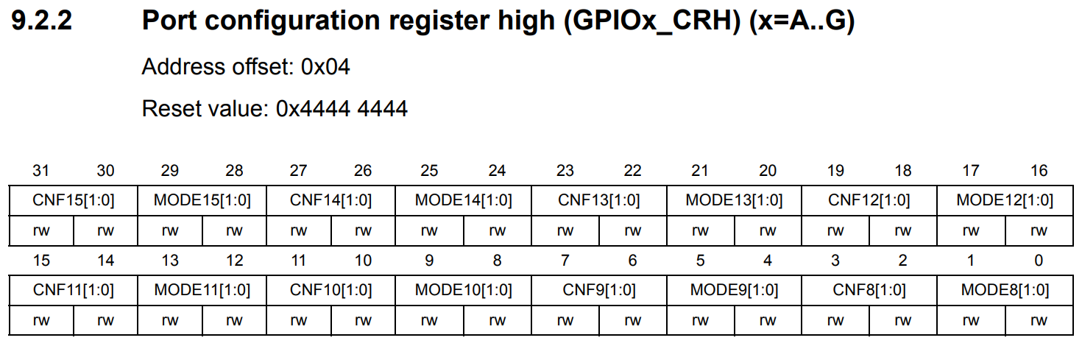
Step 2 – Configuring Port
Figure: GPIOx_CRH Register Details (Page 172 in Reference Manual)

Slide 17
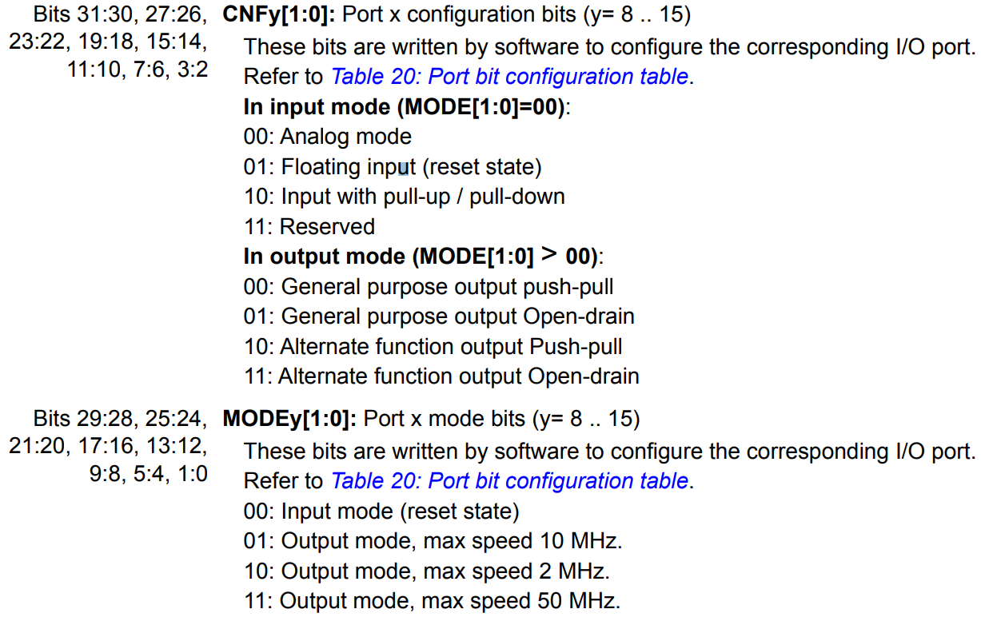
Step 2 – Configuring Port
Figure: GPIOx_CRL/GPIOx_CRL Register Details (Page 171 and 172 in Reference Manual)

Slide 18
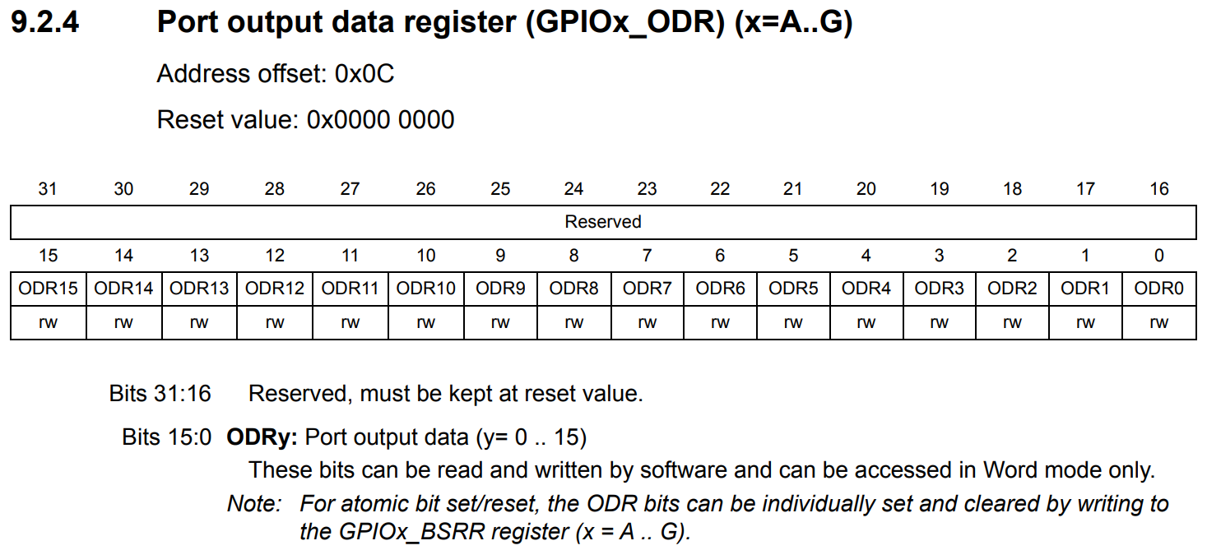
Step 3 - Outputting Data
Figure: GPIOx_ODR Register Details (Page 173 in Reference Manual)

Slide 19
Lighting up LED in PA5 Pin
Step 1 (Enabling Clock):
Since we want to light up LED in PA5, PA5 pin belongs to GPIO Port A peripheral. GPIO Port A belongs to APB2 bus. So, clock of APB2 bus need to enabled.
Clock of APB2 Bus need to be enabled.
PA5 pin belongs to GPIO A Port

Slide 20
Lighting up LED in PA5 Pin
Step 1 (Enabling Clock):
First find address of RCC_APB2ENR register by adding base address of RCC in memory map and offset of RCC_APB2ENR register.
Base address of RCC is 0x40021000
Figure: Base address of RCC in Memory

Slide 21
Lighting up LED in PA5 Pin
Step 1 (Enabling Clock):
First find address of RCC_APB2ENR register by adding base address of RCC and offset of RCC_APB2ENR register.
Offset of RCC_APB2ENR register is 0x18
Address of RCC_APB2ENR register in memory map is 0x40021000+ 0x18 = 0x40021018
Figure: Address of RCC_APB2ENR register in memory map

Slide 22
Lighting up LED in PA5 Pin
Step 1 (Enabling Clock):
First find address of RCC_APB2ENR register by adding base address of RCC and offset of RCC_APB2ENR register.
Enable clock of GPIO A (PA5 Pin belongs to GPIO A) by enabling (bit 1) IOPAEN bit of RCC_APB2ENR Register
#define RCC_APB2ENR (*(volatile uint32_t *) 0x40021018)
RCC_APB2ENR |= 1UL<<2; //0x0100
Figure: Enabling clock by enabling (bit 1) IOPAEN bit of RCC_APB2ENR Register

Slide 23
Lighting up LED in PA5 Pin
Step 2 (Configuring Port):
To configure pin 5 of GPIO port A as a general-purpose output pin, we have to find address of GPIOA_CRL because PA5 belongs to Port configuration register low GPIOA_CRL register of GPIO Port A.
We can find address of GPIOA_CRL register by adding base address of GPIO Port A in memory map and offset of GPIOA_CRL register.
Base address of GPIO Port A is 0x40010800
Figure: Base address of GPIO Port A in Memory

Slide 24
Lighting up LED in PA5 Pin
Step 2 (Configuring Port):
We can find address of GPIOA_CRL register by adding base address of GPIO Port A in memory map and offset of GPIOA_CRL register.
Offset of GPIOA_CRL register is 0x00
Address of GPIOA_CRL register in memory map is 0x40010800+ 0x00 = 0x40010800
Figure: Address of GPIOA_CRL register in memory map

Slide 25
Lighting up LED in PA5 Pin
Step 2 (Configuring Port):
We can find address of GPIOA_CRL register by adding base address of GPIO Port A in memory map and offset of GPIOA_CRL register.
Clear CNF5[1:0] and MODE5[1:0] bits of GPIOA_CRL Register using AND op.
#define GPIOA_CRL (*(volatile uint32_t *) 0x40010800)
Figure: Clear CNF5[1:0] and MODE5[1:0] bits of GPIOA_CRL Register using AND (&) operations.
GPIOA_CRL &= ~(15UL<<20);//~(0x1111) = 0x0000

Slide 26
Lighting up LED in PA5 Pin
Step 2 (Configuring Port):
To set PA5 pin as output pin, Set MODE5[1:0] to 11 (Output mode with max speed of 50 MHz and set CNF5[1:0] to 00 (General Purpose Output with Push-Pull settings).
GPIOA_CRL |= 3UL<<20; //0x0011
Figure: Enabling clock by enabling (bit 1) IOPAEN bit of RCC_APB2ENR Register

Slide 27
Lighting up LED in PA5 Pin
Step 3 (Outputting Data):
To output data to PA5 (pin 5 of GPIO Port A), find address of GPIOA_ODR register by adding base address of RCC in memory map and offset of GPIOA_ODR register.
Base address of GPIO Port A is 0x40010800
Figure: Base address of GPIO Port A in Memory

Slide 28
Lighting up LED in PA5 Pin
Step 3 (Outputting Data):
To output data to PA5 (pin 5 of GPIO Port A), find address of GPIOA_ODR register by adding base address of RCC in memory map and offset of GPIOA_ODR register.
Offset of GPIOA_CRL register is 0x0C
Address of GPIOA_CRL register in memory map is 0x40010800+ 0x0C = 0x4001080C
Figure: Address of GPIOA_ODR register in memory map

Slide 29
Lighting up LED in PA5 Pin
Step 3 (Outputting Data):
To output data to PA5 (pin 5 of GPIO Port A), find address of GPIOA_ODR register by adding base address of RCC in memory map and offset of GPIOA_ODR register.
Set ODR5 bit to 1 in GPIOA_ODR Register using OR op.
#define GPIOA_ODR (*(volatile uint32_t *) 0x4001080C)
Figure: Set ODR5 bit to 1 in GPIOA_ODR Register using OR operations.
GPIOA_ODR |= 1UL<<5;

Slide 30
Lighting up LED in PA5 Pin
Program 1
#include <stdint.h> #define RCC_BASE 0x40021000 #define APB2ENR_OFFSET 0x18 #define GPIOA_BASE 0x40010800 #define GPIOA_CRL_OFFSET 0x00 #define GPIOA_ODR_OFFSET 0x0C #define RCC_APB2ENR (*(volatile uint32_t *) (RCC_BASE+APB2ENR_OFFSET)) #define GPIOA_CRL (*(volatile uint32_t *) (GPIOA_BASE+GPIOA_CRL_OFFSET)) #define GPIOA_ODR (*(volatile uint32_t *) (GPIOA_BASE+GPIOA_ODR_OFFSET)) void GPIO_Clock_Enable(void); void GPIO_Pin_Init(void);

Slide 31
Lighting up LED in PA5 Pin
Program 1 (Cont’d)
void GPIO_Clock_Enable(void) { RCC_APB2ENR |= 1UL<<2; //0x0100 } void GPIO_Pin_Init(void) { GPIOA_CRL &= ~(15UL<<20); GPIOA_CRL |= 3UL<<20; } int main(void) { GPIO_Clock_Enable(); GPIO_Pin_Init(); GPIOA_ODR |= 1UL<<5; while(1); }

Slide 32
Lighting up LED in PA5 Pin
Program 2 (using stm32f10x.h header which includes all addresses of registers):
#include "stm32f10x.h" // Device header void GPIO_Clock_Enable(void); void GPIO_Pin_Init(void); int main(void) { GPIO_Clock_Enable(); GPIO_Pin_Init(); GPIOA->ODR |= 1UL<<5; while(1); } | void GPIO_Clock_Enable(void) { RCC->APB2ENR |= 1UL<<2; //0x0100 } void GPIO_Pin_Init(void) { GPIOA->CRL &= ~(15UL<<20); GPIOA->CRL |= 3UL<<20; }

Slide 33
Lighting up LED in PA5 Pin
Program 3 (Assembly Code):
; Memory addresses of GPIO port A and RCC (reset and clock control) data structure GPIOA_BASE EQU 0x40010800 RCC_BASE EQU 0x40021000 ; Byte offset of each register in GPIO and RCC RCC_APB2ENR EQU 0x18 GPIO_CRL EQU 0x00 GPIO_ODR EQU 0x0C AREA main, CODE, READONLY EXPORT _main ; make _main visible to Linker ENTRY _main PROC ; Enable the clock to GPIO port A ; Load address of reset and clock control (RCC) LDR r2, =RCC_BASE ; Load base address of RCC into r2 LDR r1, [r2, #RCC_APB2ENR] ; Load the value of RCC_APB2ENR into r1 ORR r1, r1, #(1 << 2) ; Set bit 2 (IOPAEN) to enable GPIOA clock STR r1, [r2, #RCC_APB2ENR] ; Store the updated value back into RCC_APB2ENR

Slide 34
Lighting up LED in PA5 Pin
Program 3 (Cont’d) (Assembly Code):
; Load GPIO port A base address LDR r3, =GPIOA_BASE ; Load the base address of GPIOA into r3 ; Configure pin PA5 as general-purpose output push-pull ; with max speed of 50 MHz LDR r1, [r3, #GPIO_CRL] ; Load the value of GPIOA_CRL into r1 BIC r1, r1, #(15 << 20) ; Clear bits 23:20 belonging to pin 5 ORR r1, r1, #(3 << 20) ; Set bits 23:20 to 0011, configuring PA5 ; as output with max speed 50 MHz STR r1, [r3, #GPIO_CRL] ; Store the updated value back into GPIOA_CRL ; Set PA5 high to turn on the LED LDR r1, [r3, #GPIO_ODR] ; Load the value of GPIOA_ODR into r1 ORR r1, r1, #(1 << 5) ; Set bit 5 to 1, which sets PA5 high STR r1, [r3, #GPIO_ODR] ; Store the updated value back into GPIOA_ODR stop B stop ; Infinite loop to keep the program running ENDP END

Slide 35
Sample Questions
Question 1
Write a program in C Language to turn on/enable GPIO pin PA5/turn on LED connected to GPIO pin PA5 by using addresses to access the registers.
Given–
GPIOA base address 0x40010800
RCC base address 0x40021000
RCC_APB2ENR offset 0x18
GPIOA_CRL offset 0x00
GPIOA_ODR offset 0x0C
Solution is in the 1st Program.
* Question can include any GPIO pin.
* Question can also include disabling/turning off.

Slide 36
Sample Questions
Question 2
Write a program in Assembly Language to turn on/enable GPIO pin PA5/turn on LED connected to GPIO pin PA5 by using addresses to access the registers.
Given–
GPIOA base address 0x40010800
RCC base address 0x40021000
RCC_APB2ENR offset 0x18
GPIOA_CRL offset 0x00
GPIOA_ODR offset 0x0C
Solution is in the 3rd Program.
* Question can include any GPIO pin.
* Question can also include disabling/turning off.

Slide 37
Sample Questions
Question 3
Write a program in C Language to turn on/enable GPIO pin PA5/turn on LED connected to GPIO pin PA5 by using stm32f10x.h header to access the registers.
Solution is in the 2nd Program.
* Question can include any GPIO pin.
* Question can also include disabling/turning off.

Slide 38

Thank You!

