Slide 1
Push Button
(C Code)
Slide by-
Md. Farhan Shakib
Lecturer, Dept. of CSE, RUET
farhan.shakib@cse.ruet.ac.bd

Slide 2
Note
Different from the book. Slide explains the concept in context of STM32f10X MCU. While the book uses different MCU. So, the addresses will also be different.

Slide 3
References
Embedded Systems with ARM Cortex-M Microcontrollers in Assembly Language and C 3e by Dr. Yifeng Zhu [Chapter 14]

Slide 4
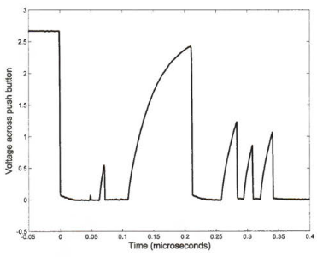
Push Button
When a mechanical button is pressed, two metal contacts bang together and immediately rebound a couple of times before setting. These rebounds produce multiple signals within a few milliseconds due to the bounce effects.
Because the processor runs at a fast speed,
the processor can observe these falling and
rising transitions and mistakenly thinks the
push button has been pressed multiple
times.

Slide 5
Push Button
There are both hardware and software solutions to eliminate the bouncing effects. These solutions are called debouncing

Slide 6
Push Button
Hardware Debouncing - RC Filter
The hardware debouncing usually uses a simple RC circuit, which includes a capacitor connected in parallel with the pushbutton to filter out any high-frequency signals.
When the switch is open, this capacitor is fully charged. Therefore, there is no current on these resistors, and the voltage on the processor pin is zero. As soon as the button is pressed, the capacitor is quickly discharged. If the button rebounds and the switch is open briefly, the capacitor cannot be recharged fast enough to pull the processor pin low.

Slide 7
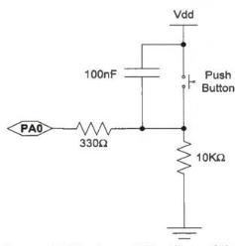
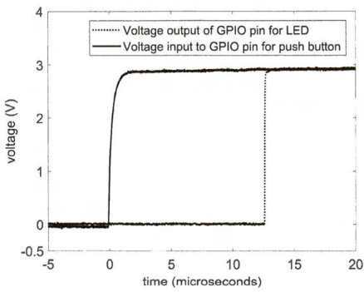
Push Button
Hardware Debouncing - RC Filter

Slide 8
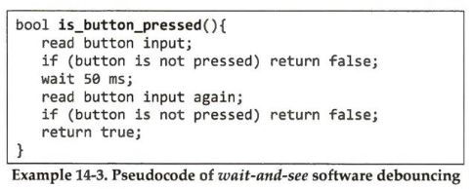
Push Button
Software Debouncing - Wait-and-See
The easiest software debouncing technique is wait-and-see. When the program detects that a button is pressed, it re-examines the input signal after a short delay, typically between 20 and 50 ms. If the input signal still shows the button is pressed, the program then reports that the button has been pressed indeed.

Slide 9
Push Button
Software Debouncing - Wait-and-See
However, the response time of the wait-and-see technique is significant and is not acceptable in many applications, such as gaming or mission- critical systems. A better software debouncing technique is counter debouncer.

Slide 10
Push Button
Software Debouncing - Counter Debouncer
It polls the button input at regular intervals and requires a few consecutive positive readings to confirm the button has been pressed.
In given pseudocode, the pin is polled every 5 ms during the debounce period 50 ms, and it requires 4 consecutive positive readings. If a button is pressed, this approach has less response time than the wait-and-see method.

Slide 11
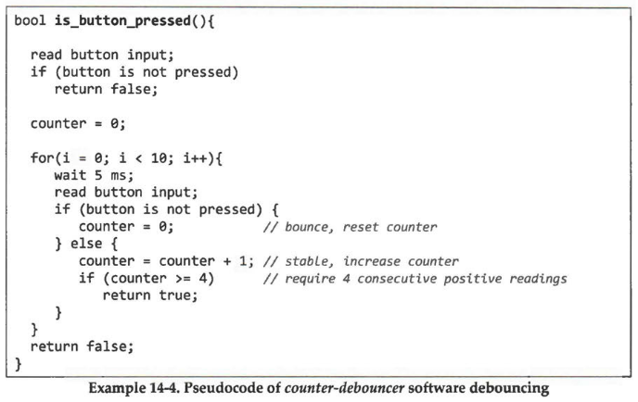
Push Button
Software Debouncing - Counter Debouncer

Slide 12
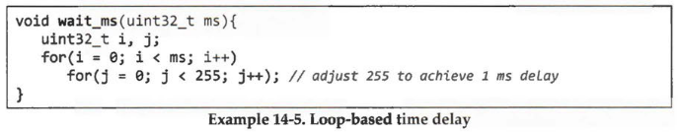
Push Button
Time Delay - Loop Based
One issue in software debouncing methods is how to implement the time delay. Many new programmers use a large for or while loop to achieve the delay, as shown below.

Slide 13
Push Button
Time Delay - Loop Based
The loop-based time delay is not recommended for real-time embedded systems.
First, these busy loops tie up the processor and prevent other tasks from running, wasting processor time and energy.
Second, the timing may change dramatically based on compiler versions, compiler optimization levels, and processor speed.

Slide 14
Push Button
Time Delay - Timer Interrupts
A better implementation is to use timer interrupts.
(Will be explained in lectures related to Interrupts. InshaaAllah.)

Slide 15
Push Button
Polling/Busy-Wait
The following shows a polling I/0 method (busy waiting) to constantly query the input of external devices. Software repeatedly checks whether the push button is pressed or not.
Although the polling method is simple, it is inherently inefficient because the CPU wastes many cycles on querying or waiting for input. A method based on interrupts is more efficient than polling.

Slide 16
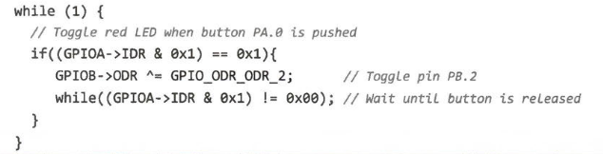
Push Button
Polling/Busy-Wait

Slide 17
Push Button
Detecting button press at PC15 and controlling LED connected to PB0.

Slide 18
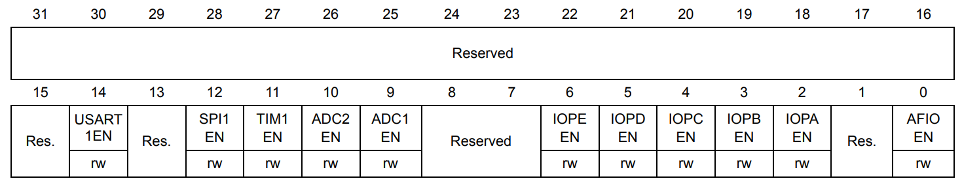
Push Button
Step 1 (Enabling Clock):
Enable clock for both Port B and Port C
#define RCC_APB2ENR (*(volatile uint32_t *)0x40021018) RCC_APB2ENR |= 1UL<<3; RCC_APB2ENR |= 1UL<<4;

Slide 19
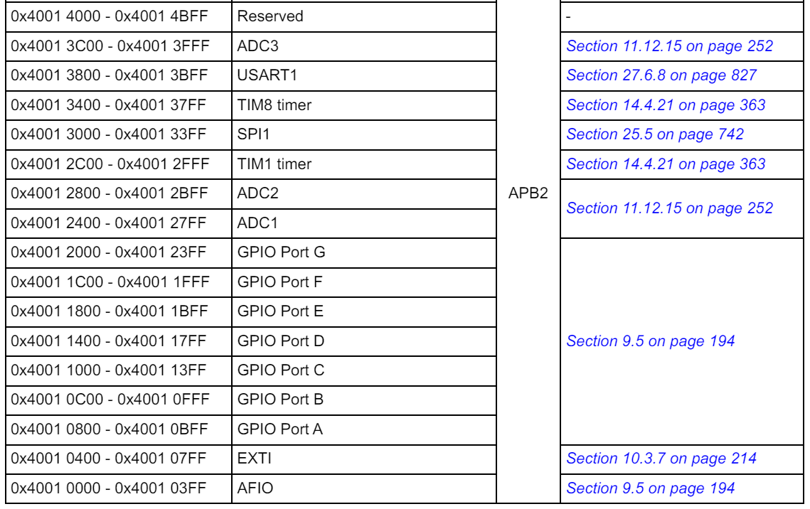
Push Button
Step 2 (Configuring Port):
Set PB0 as Output
Base address of GPIO Port B is 0x40010C00

Slide 20
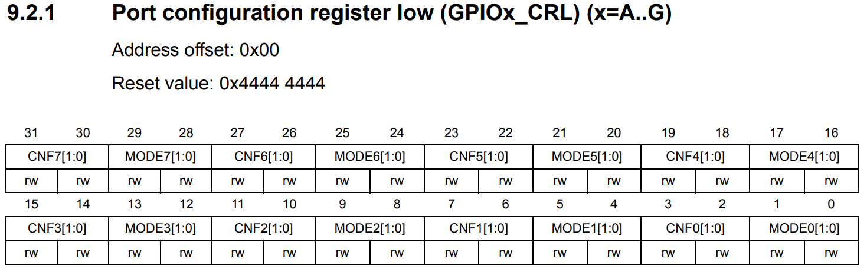
Push Button
Step 2 (Configuring Port):
Set PB0 as Output
Offset of GPIOB_CRL register is 0x00
Address of GPIOB_CRL register in memory map is 0x40010C00+ 0x00 = 0x40010C00

Slide 21
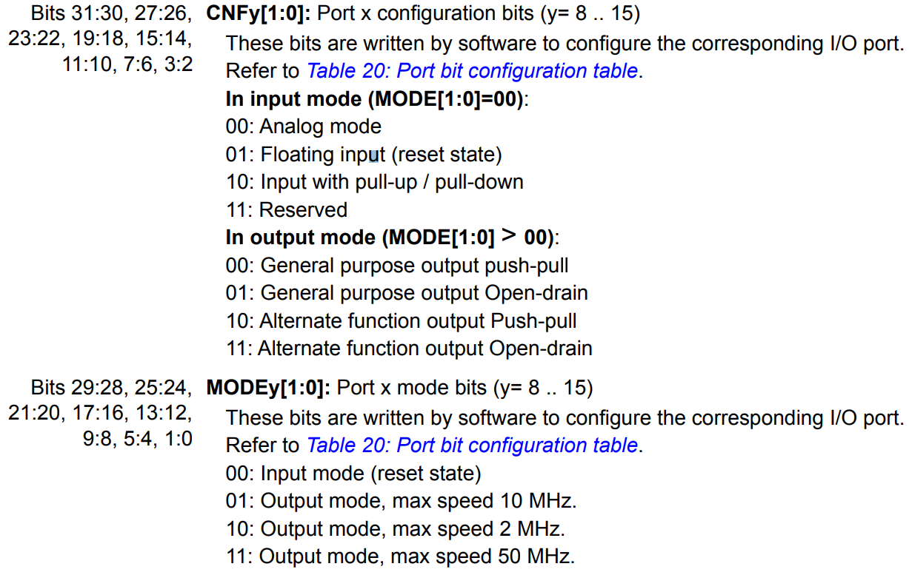
Push Button
Step 2 (Configuring Port):
Set PB0 as Output
#define GPIOB_CRL (*(volatile uint32_t *)0x40010C00) GPIOB_CRL &= ~(15UL<<0); GPIOB_CRL |= 3UL<<0;

Slide 22
Push Button
Step 3 (Configuring Port):
Set PC15 as Input
Base address of GPIO Port C is 0x40011000

Slide 23
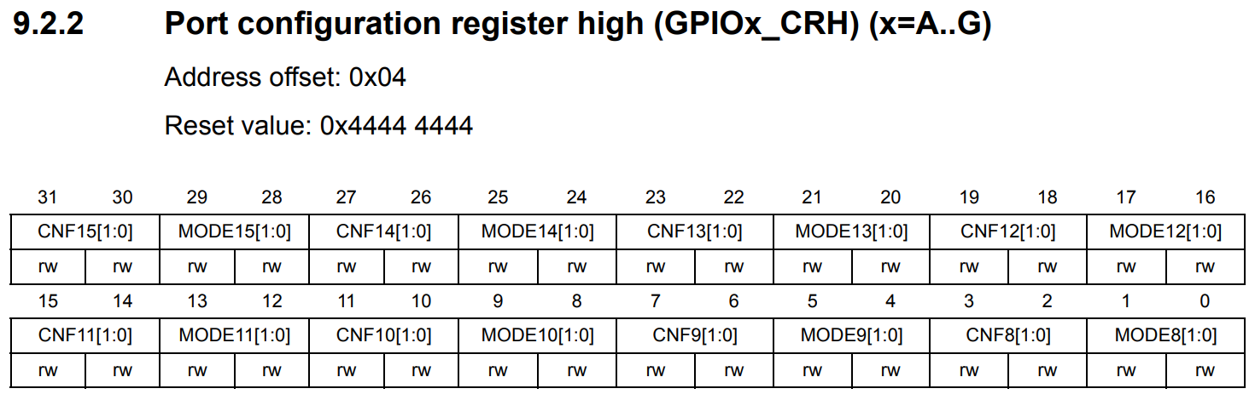
Push Button
Step 3 (Configuring Port):
Set PC15 as Input
Offset of GPIOC_CRH register is 0x04
Address of GPIOC_CRH register in memory map is 0x40011000+ 0x04 = 0x40011004

Slide 24
Push Button
Step 3 (Configuring Port):
Set PC15 as Input
#define GPIOC_CRH (*(volatile uint32_t *)0x40011004) GPIOC_CRH &= ~(15UL<<28); GPIOC_CRH |= 4UL<<28;

Slide 25
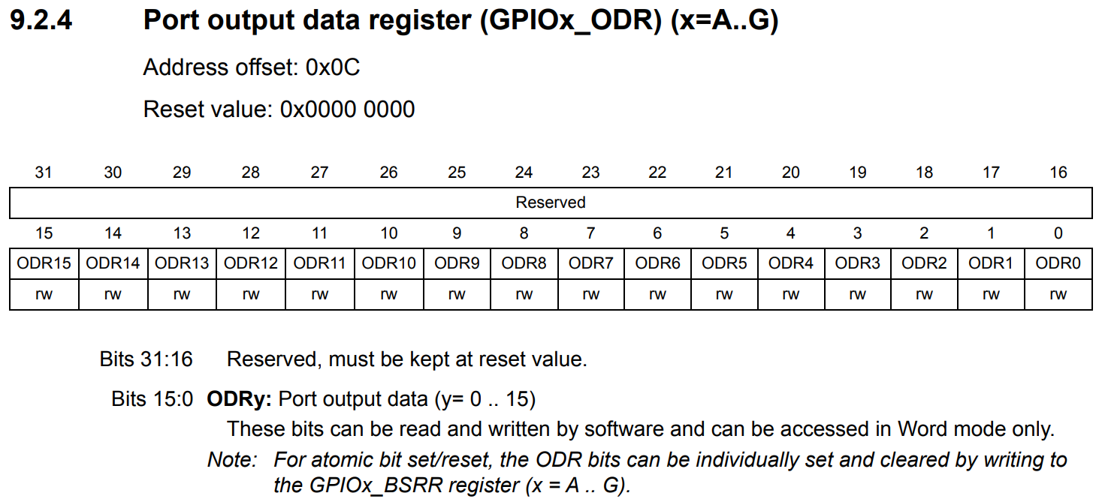
Push Button
Outputting Data (Not part of the setup phase)
Setting PB0 in ODR high when button is pressed.
Offset of GPIOB_ODR register is 0x0C
Address of GPIOB_ODR register in memory map is 0x40010C00+ 0x0C = 0x40010C0C

Slide 26
Push Button
Outputting Data (Not part of the setup phase)
Setting PB0 in ODR high when button is pressed.
#define GPIOB_ODR (*(volatile uint32_t *)0x40010C0C) GPIOB_ODR |= (1<<0);

Slide 27
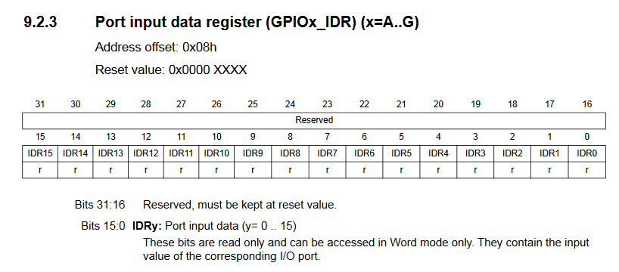
Push Button
Inputting Data (Not part of the setup phase)
Reading PC15
Offset of GPIOC_IDR register is 0x08
Address of GPIOC_IDR register in memory map is 0x40011000+ 0x08 = 0x40011008

Slide 28
Push Button
Inputting Data (Not part of the setup phase)
Reading PC15
#define GPIOC_IDR (*(volatile uint32_t *)0x40011008) GPIOC_IDR |= (1<<15);

Slide 29
Push Button
/*
* Debouncing Function
* Pass it the previous button state,
* and get back the current debounced button state.
*/
boolean debounce(boolean last)
{
boolean current = digitalRead(BUTTON); // Read the button state
if (last != current) // if it's different...
{
delay(5); //Wait 5ms
current = digitalRead(BUTTON); //Read it again
}
return current; //Return the current value
}

Slide 30
Push Button
Program 1
#define RCC_APB2ENR (*(volatile uint32_t *)0x40021018) #define GPIOB_CRL (*(volatile uint32_t *)0x40010C00) #define GPIOC_CRH (*(volatile uint32_t *)0x40011004) #define GPIOB_ODR (*(volatile uint32_t *)0x40010C0C) #define GPIOC_IDR (*(volatile uint32_t *)0x40011008)

Slide 31
Push Button
Program 1 (cont’d)
void delay(uint32_t count) { for(uint32_t i = 0; i < count; ++i) { // NOP } } void setup() { // Enable clocks for GPIOB and GPIOC RCC_APB2ENR |= (1<<3); // GPIOB RCC_APB2ENR |= (1<<4); // GPIOC // Set PB0 as output (push-pull, max speed 50 MHz) GPIOB_CRL &= ~(15UL<<0); GPIOB_CRL |= 3UL<<0; // Set PC15 as input GPIOC_CRH &= ~(15UL<<28); GPIOC_CRH |= 4UL<<28; }

Slide 32
Push Button
Program 1 (cont’d)
uint8_t debounce(uint8_t last) { uint8_t current = (GPIOC_IDR & (1<<15)) ? 1 : 0; if (last != current) { delay(50000); current = (GPIOC_IDR & (1<<15)) ? 1 : 0; } return current; }

Slide 33
Push Button
Program 1 (cont’d)
int main() { uint8_t lastButton = 0; uint8_t currentButton = 0; uint8_t ledOn = 0; setup(); while (1) { currentButton = debounce(lastButton); if (lastButton == 0 && currentButton == 1) { ledOn = !ledOn; } lastButton = currentButton; if (ledOn) { GPIOB_ODR |= (1<<0); } else { GPIOB_ODR &= ~(1<<0); } } }

Slide 34
Push Button
Program 2 (using stm32f10x.h header):
#include "stm32f10x.h" // Device header void delay(uint32_t count) { for(uint32_t i = 0; i < count; ++i) { // NOP } } void setup() { // Enable clocks for GPIOB and GPIOC RCC->APB2ENR |= (1<<3); // GPIOB RCC->APB2ENR |= (1<<4); // GPIOC // Set PB0 as output (push-pull, max speed 50 MHz) GPIOB->CRL &= ~(15UL<<0); GPIOB->CRL |= 3UL<<0; // Set PC15 as input GPIOC->CRH &= ~(15UL<<28); GPIOC->CRH |= 4UL<<28; }

Slide 35
Push Button
Program 2 (Cont’d) (using stm32f10x.h header):
uint8_t debounce(uint8_t last) { uint8_t current = (GPIOC->IDR & (1<<15)) ? 1 : 0; if (last != current) { delay(50000); current = (GPIOC->IDR & (1<<15)) ? 1 : 0; } return current; }

Slide 36
Push Button
Program 2 (Cont’d) (using stm32f10x.h header):
int main() { uint8_t lastButton = 0; uint8_t currentButton = 0; uint8_t ledOn = 0; setup(); while (1) { currentButton = debounce(lastButton); if (lastButton == 0 && currentButton == 1) { ledOn = !ledOn; } lastButton = currentButton; if (ledOn) { GPIOB->ODR |= (1<<0); } else { GPIOB->ODR &= ~(1<<0); } } }

Slide 37
Sample Questions
Question 1
Write a program in C Language to detect key press on GPIO pin PC13 and turn on/enable GPIO pin PB0/turn on LED connected to GPIO pin PB0 by using addresses to access the registers.
Given–
GPIOB_CRL address 0x40010C00
GPIOC_CRH address 0x40011004
RCC_APB2ENR address 0x40021018
GPIOB_ODR address 0x40010C0C
GPIOC_IDR address 0x40011008
Solution is in the 1st Program.
* Question can include any GPIO pin.
* Question can also include disabling/turning off.

Slide 38
Sample Questions
Question 2
Write a program in C Language to detect key press on GPIO pin PC13 and turn on/enable GPIO pin PB0/turn on LED connected to GPIO pin PB0 by using stm32f10x.h header to access the registers.
Solution is in the 2nd Program.
* Question can include any GPIO pin.
* Question can also include disabling/turning off.

Slide 39

Thank You!

