Slide 1
4x3 Keypad Scan
(C Code)
Slide by-
Md. Farhan Shakib
Lecturer, Dept. of CSE, RUET
farhan.shakib@cse.ruet.ac.bd

Slide 2
Note
Different from the book. Slide explains the concept in context of STM32f10X MCU. While the book uses different MCU. So, the addresses will also be different.

Slide 3
References
Embedded Systems with ARM Cortex-M Microcontrollers in Assembly Language and C 3e by Dr. Yifeng Zhu [Chapter 14]

Slide 4
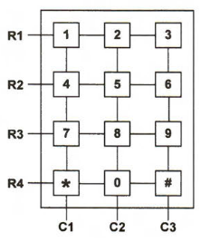
Keypad Scan
Suppose we have a keypad that has 12 keys, as shown in figure. One simple way is to interface each key in the same approach as a push button, with each key having a dedicated pin to detect whether it is pressed or not. However, this would require 12 I/0 pins, which is not desirable for many applications because the total number of pins available for use on a microcontroller is limited.

Slide 5
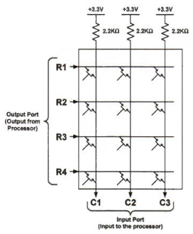
Keypad Scan
To reduce the number of pins required, a keypad usually organizes its keys in a matrix, as shown in figure. This matrix scheme decreases the number of I/0 pins from 12 to 7 in this example.

Slide 6
Keypad Scan
The columns are connected in a pull-up fashion. So, C1, C2 & C3 initially read high, when no button is pressed. Because, rows and columns are only connected via switch and no switch is pressed.

Slide 7
Keypad Scan
When any button is pressed, Columns read the lower resistive path. So, corresponding column reads 0.

Slide 8
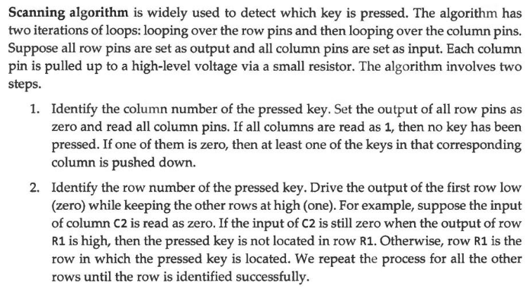
Keypad Scan

Slide 9
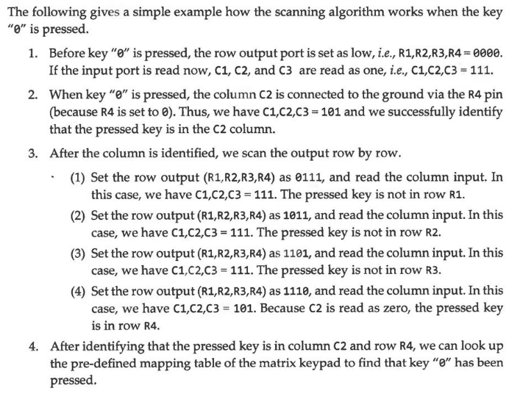
Keypad Scan

Slide 10
Keypad Scan

Slide 11
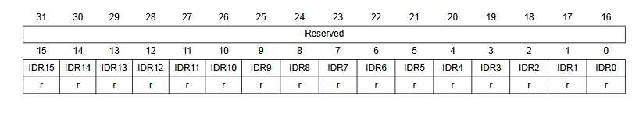
Keypad Scan
Check whether if C1 is 0 or not.
0 0 0 0 0 0 0 0 0 0 0 1 0 0 0 0
#define GPIOA_IDR (*(volatile uint32_t *) 0x40010808) if((GPIOA_IDR & 1UL<<4) == 0) { col = 0; }

Slide 12
Keypad Scan
Check whether if C2 is 0 or not.
0 0 0 0 0 0 0 0 0 0 1 0 0 0 0 0
#define GPIOA_IDR (*(volatile uint32_t *) 0x40010808) if((GPIOA_IDR & 1UL<<4) == 0) { col = 0; } else if((GPIOA_IDR & 1UL<<5) == 0) { col = 1; }

Slide 13
Keypad Scan
Check whether if C3 is 0 or not.
0 0 0 0 0 0 0 0 0 1 0 0 0 0 0 0
#define GPIOA_IDR (*(volatile uint32_t *) 0x40010808) if((GPIOA_IDR & 1UL<<4) == 0) { col = 0; } else if((GPIOA_IDR & 1UL<<5) == 0) { col = 1; } else if((GPIOA_IDR & 1UL<<6) == 0) { col = 2; } else { col = -1; }

Slide 14
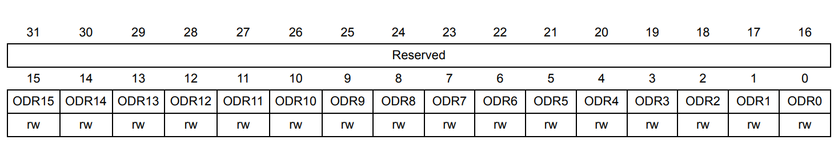
Keypad Scan
Set Rows=1110 and check whether columns=111 or not
0 0 0 0 0 0 0 0 0 0 0 0 1 1 1 0
#define GPIOA_ODR (*(volatile uint32_t *) 0x4001080C) GPIOA_ODR &= ~(15UL<<0); GPIOA_ODR |= (14UL<<0); if(GPIOA_IDR & (7UL<<4) != 112) {row = 0;} //b1110000 = 112

Slide 15
Keypad Scan
Set Rows=1101 and check whether columns=111 or not
0 0 0 0 0 0 0 0 0 0 0 0 1 1 0 1
#define GPIOA_ODR (*(volatile uint32_t *) 0x4001080C) GPIOA_ODR &= ~(15UL<<0); GPIOA_ODR |= (14UL<<0); if(GPIOA_IDR & (7UL<<4) != 112) {row = 0;} GPIOA_ODR &= ~(15UL<<0); GPIOA_ODR |= (13UL<<0); if(GPIOA_IDR & (7UL<<4) != 112) {row = 1;}

Slide 16
Keypad Scan
Set Rows=1011 and check whether columns=111 or not
0 0 0 0 0 0 0 0 0 0 0 0 1 0 1 1
#define GPIOA_ODR (*(volatile uint32_t *) 0x4001080C) GPIOA_ODR &= ~(15UL<<0); GPIOA_ODR |= (14UL<<0); if(GPIOA_IDR & (7UL<<4) != 112) {row = 0;} GPIOA_ODR &= ~(15UL<<0); GPIOA_ODR |= (13UL<<0); if(GPIOA_IDR & (7UL<<4) != 112) {row = 1;} GPIOA_ODR &= ~(15UL<<0); GPIOA_ODR |= (11UL<<0); if(GPIOA_IDR & (7UL<<4) != 112) {row = 2;}

Slide 17
Keypad Scan
Set Rows=0111 and check whether columns=111 or not
0 0 0 0 0 0 0 0 0 0 0 0 0 1 1 1
GPIOA_ODR &= ~(15UL<<0); GPIOA_ODR |= (14UL<<0); if(GPIOA_IDR & (7UL<<4) != 112) {row = 0;} GPIOA_ODR &= ~(15UL<<0); GPIOA_ODR |= (13UL<<0); if(GPIOA_IDR & (7UL<<4) != 112) {row = 1;} GPIOA_ODR &= ~(15UL<<0); GPIOA_ODR |= (11UL<<0); if(GPIOA_IDR & (7UL<<4) != 112) {row = 2;} GPIOA_ODR &= ~(15UL<<0); GPIOA_ODR |= (7UL<<0); if(GPIOA_IDR & (7UL<<4) != 112) {row = 3;}

Slide 18
Keypad Scan
Full Code:
#define RCC_APB2ENR (*(volatile uint32_t *) 0x40021018) #define GPIOA_CRL (*(volatile uint32_t *) 0x40010800) #define GPIOA_IDR (*(volatile uint32_t *) 0x40010808) #define GPIOA_ODR (*(volatile uint32_t *) 0x4001080C) int row, col; unsigned char key_map [4][3] = { {'1', '2', '3'}, {'4', '5', '6'}, {'7', '8', '9'}, {'*', '0', '#'}, }; void enable_clock() { // Enable port A clock RCC_APB2ENR |= 1UL<<2; }

Slide 19
Keypad Scan
Full Code:
char input_string[100] = {0}; // Initialize input string int input_index = 0; // Initialize input index void add_to_string(char c) { // Ensure there is space for the new character and the null terminator if (input_index < sizeof(input_string) - 1) { input_string[input_index] = c; // Add character at the current index input_index++; // Move to the next position input_string[input_index] = '\0'; // Null terminate the string } }

Slide 20
Keypad Scan
Full Code:
void set_output_pins() { // Set PA0, PA1, PA2, PA3 as output (R1, R2, R3, R4) GPIOA_CRL &= ~(15UL<<0); // Erase PA0 CNF and MODE GPIOA_CRL |= (3UL<<0); // Set PA0 as Output GPIOA_CRL &= ~(15UL<<4); // Erase PA1 CNF and MODE GPIOA_CRL |= (3UL<<4); // Set PA1 as Output GPIOA_CRL &= ~(15UL<<8); // Erase PA2 CNF and MODE GPIOA_CRL |= (3UL<<8); // Set PA2 as Output GPIOA_CRL &= ~(15UL<<12); // Erase PA3 CNF and MODE GPIOA_CRL |= (3UL<<12); // Set PA3 as Output }

Slide 21
Keypad Scan
Full Code:
void set_input_pins() { // Set PA4, PA5, PA6 as Input (C1, C2, C3) GPIOA_CRL &= ~(15UL<<16); // Erase PA4 CNF and MODE GPIOA_CRL |= (4UL<<16); // Set PA4 as Input GPIOA_CRL &= ~(15UL<<20); // Erase PA5 CNF and MODE GPIOA_CRL |= (4UL<<20); // Set PA5 as Input GPIOA_CRL &= ~(15UL<<24); // Erase PA6 CNF and MODE GPIOA_CRL |= (4UL<<24); // Set PA6 as Input }

Slide 22
Keypad Scan
Full Code:
void get_column() { // Check whether PA4 is 0 or not if((GPIOA_IDR & 1UL<<4) == 0) { col = 0; } // Check whether PA5 is 0 or not else if((GPIOA_IDR & 1UL<<5) == 0) { col = 1; } // Check whether PA6 is 0 or not else if((GPIOA_IDR & 1UL<<6) == 0) { col = 2; } // PA4, PA5, PA6 are all 1. No button pressed. else { col = -1; } }

Slide 23
Keypad Scan
Full Code:
void get_row() { // Set PA0 as 0 and check if all columns are 1 GPIOA_ODR &= ~(15UL<<0); GPIOA_ODR |= (14UL<<0); if(GPIOA_IDR & (7UL<<4) != 112) {row = 0;} // Set PA0 as 0 and check if all columns are 1 GPIOA_ODR &= ~(15UL<<0); GPIOA_ODR |= (13UL<<0); if(GPIOA_IDR & (7UL<<4) != 112) {row = 1;} // Set PA0 as 0 and check if all columns are 1 GPIOA_ODR &= ~(15UL<<0); GPIOA_ODR |= (11UL<<0); if(GPIOA_IDR & (7UL<<4) != 112) {row = 2;} // Set PA0 as 0 and check if all columns are 1 GPIOA_ODR &= ~(15UL<<0); GPIOA_ODR |= (7UL<<0); if(GPIOA_IDR & (7UL<<4) != 112) {row = 3;} }

Slide 24
Keypad Scan
Full Code:
int main() { enable_clock(); set_output_pins(); set_input_pins(); while(1) { get_column(); if (col == -1) { continue; } get_row(); add_to_string(key_map[row][col]); } }

Slide 25
Sample Questions
Question 1
Write a program in C to scan/interface a 4x3 keypad with STM32 Blue Pill using PA0-PA6 by using addresses to access the registers.
Given–
GPIOA_CRL address 0x40010800
RCC_APB2ENR address 0x40021018
GPIOA_ODR address 0x4001080C
GPIOA_IDR address 0x40010808
Solution is in the given program in slide.

Slide 26

Sample Questions
Question 2
Write a program in C to scan/interface a 4x3 keypad with STM32 Blue Pill using PA0-PA6 by using stm32f10x.h header to access the registers.
Try yourself. I trust in your capabilities.

Slide 27

Thank You!

