Slide 1
Interrupts
Slide by-
Md. Farhan Shakib
Lecturer, Dept. of CSE, RUET
farhan.shakib@cse.ruet.ac.bd

Slide 2
Different from the book. Slide explains the concept in context of
STM32f103xx MCU. While the book uses different MCU. So, the
addresses and implementation will also be different.

Slide 3
References
Embedded Systems with ARM Cortex-M Microcontrollers in Assembly Language and C 3e by Dr. Yifeng Zhu [Chapter 11]
STM32f103xx Datasheet https://www.st.com/resource/en/datasheet/stm32f103c8.pdf
STM32f103xx Programming Manual https://www.st.com/resource/en/programming_manual/pm0056-stm32f10xxx20xxx21xxxl1xxxx-cortexm3-programming-manual-stmicroelectronics.pdf

Slide 4
Introduction to Interrupts
An interrupt is a signal to the processor indicating an event that needs immediate attention, causing the processor to temporarily halt its current execution and jump to execute an Interrupt Service Routine (ISR) before returning to its previous activity.
The halted process continues as if nothing had happened.

Slide 5
Introduction to Interrupts
Interrupts are widely used to respond to both internal and external hardware requests efficiently. For example, interrupts can inform a program of some timely external events(such as pushing a button and receiving a message in a communication port). Interrupts allow a processor to gracefully shutdown when there are critical errors(such as memory access violations, and detection of undefined instructions).

Slide 6
Introduction to Interrupts
Interrupts also allow a processor to perform multiple tasks simultaneously. At any given time, the microcontroller is serving only one program activity. However, interrupts enable the processor to serve multiple computation tasks alternately in a multiplexing fashion. Multiple tasks can be handled in a preemptive or non-preemptive manner.

Slide 7
Preemptive Interrupt
A preemptive interrupt allows a higher-priority task to interrupt and temporarily halt a lower-priority task so that the higher-priority task can be executed immediately.
Example: In a microcontroller managing both a temperature sensor and a motor control, if the temperature sensor's reading indicates a critical condition, a preemptive interrupt can halt the motor control task to immediately process the temperature data and take necessary actions to prevent overheating.

Slide 8
Non-preemptive Interrupt
A non-preemptive interrupt allows the processor to complete the current task before switching to handle the interrupt, ensuring that tasks are executed sequentially without interruption.
Example: If a microcontroller is executing a routine to read a sensor value and a non-preemptive interrupt occurs to log data to memory, the microcontroller will finish reading the sensor value before logging the data.

Slide 9
Interrupt vs Polling/Busy Wait
Consider a microcontroller tasked with detecting when a push button is pressed. In a polling (busy wait) scenario, the microcontroller continuously checks the button's state in a loop, consuming processing time and resources even when the button is not pressed. This inefficiently uses the microcontroller's capacity, limiting its ability to perform other tasks simultaneously. In contrast, with an interrupt-based approach, the microcontroller performs other tasks and only temporarily halts them when the button press triggers an interrupt. This allows the microcontroller to respond immediately to the button press without constantly checking its state, freeing up processing power for other operations and improving overall efficiency.

Slide 10
Interrupt Numbers
Cortex-M processors support up to 256 types of interrupts. Each interrupt type, excluding the reset interrupt, is identified by a unique number, ranging from -15 to 240.
Interrupt numbers are defined by ARM and chip manufacturers collectively. These numbers are fixed and software cannot re-define them

Slide 11
Interrupt Numbers
Cortex-M processors support up to 256 types of interrupts. Each interrupt type, excluding the reset interrupt, is identified by a unique number, ranging from -15 to 240. Blue Pill has 43 interrupts (Excluding 16 system interrupts.)
Interrupt numbers are defined by ARM and chip manufacturers collectively. These numbers are fixed and software cannot re-define them.
Interrupt numbers are divided into two groups– System Interrupts and Peripheral Interrupts.

Slide 12
System Interrupts
The first 16 interrupts are system interrupts, also called system exceptions. Exceptions are the interrupts that come from the processor core.
These interrupt numbers are defined by ARM. Specifically, the ARM CMSIS library defines all system exceptions by using negative values.
CMSIS stands for Cortex Microcontroller Software Interface Standard

Slide 13

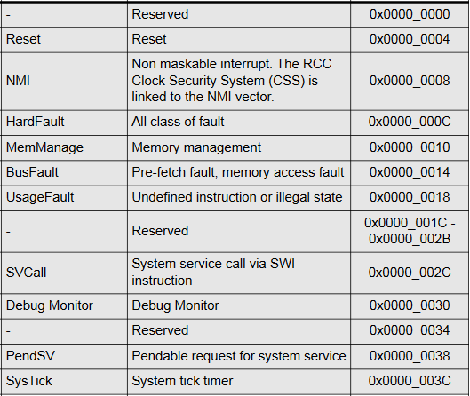
System Interrupts

Slide 14
Peripheral Interrupts
The remaining 240 interrupts are peripheral interrupts, also called non-system exceptions. Blue Pill has 43 peripheral interrupts.
The peripheral interrupt numbers start at 0. Peripheral interrupts are defined by chip manufacturers.
The total number of peripheral interrupts supported varies among chips.

Slide 15
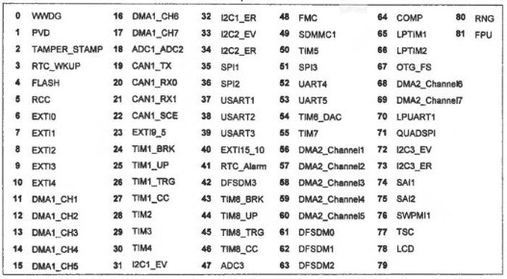
Peripheral Interrupts

Slide 16
Interrupt Numbers
When an interrupt is processed, the interrupt number is stored in the program status register (PSR).
However, ARM Cortex-M does not store interrupt numbers in two's complement. Instead, the interrupt number in PSR adds a positive offset of 15 to the CMSIS interrupt number.
Interrupt number in PSR = CMSIS interrupt number + 15

Slide 17
Interrupt Service Routines
An Interrupt Service Routine (ISR) is a function that is called in response to an interrupt. It handles the specific event that caused the interrupt and typically performs tasks such as updating variables, processing data, or interacting with peripherals.

Slide 18
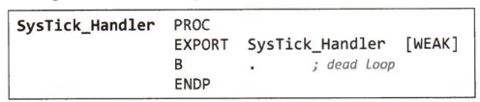
Interrupt Service Routines
The default implementation of most ISRs is simply a dead loop.
void SysTick_Handler(void) {
while (1) {
// Do nothing, just stall the processor
}
}
In assembly language

Slide 19
Interrupt Service Routines
All ISRs are declared as weak in the system startup code. The keyword weak means that another non-weak subroutine with the same name defined elsewhere can override this one.
void SysTick_Handler(void) {
GPIOC->ODR |= 1UL<<13; // Turn on PC13
}

Slide 20
Interrupt Vector Table
There is an interrupt service routine (ISR) associated with each type of interrupt.
Cortex-M stores the starting memory address of every ISR in a special array called the interrupt vector table.

Slide 21
Interrupt Vector Table
An interrupt number is used as an index into the interrupt vector table to locate the corresponding interrupt service routine.
For a given interrupt number i defined in CMSIS, the memory address of its corresponding ISR is located at the (i + 16)^{th} entry in the interrupt vector table.
The interrupt vector table is stored at the memory address 0x00000004. Because each entry in the table represents a memory address, each entry takes four bytes in memory.

Slide 22
Interrupt Vector Table
Address of ISR = lnterruptVectorTable[i + 15]
For example, the interrupt number of SysTick is -1, the memory address of SysTick_Handler can be founding by reading the word stored at the following address.
Address of SysTick_Handler
= 0x00000004 + 4 x ( -1 + 15)
= 0x0000003C

Slide 23
Interrupt Vector Table
Address of ISR = lnterruptVectorTable[i + 15]
The interrupt number of reset is -15. Thus, the memory address of Reset_Handler is
Address of Reset_Handler
= 0x00000004 + 4 x ( -15 + 15)
= 0x00000004

Slide 24
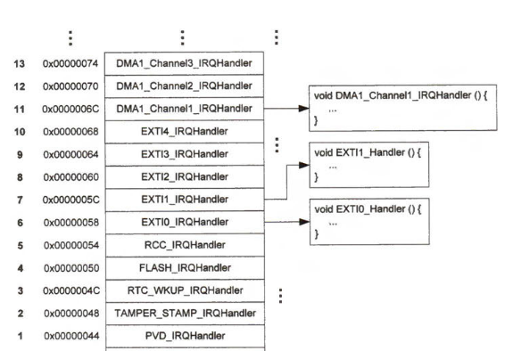
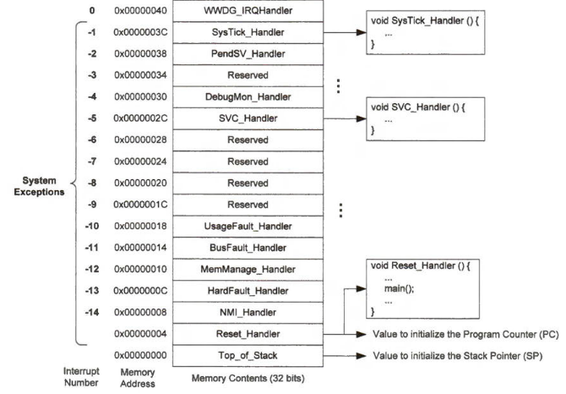
Interrupt Vector Table

Slide 25
The Booting Process Of Cortex-M
When an ARM Cortex processor is turned on or reset, the processor fetches two words located at 0x00000000 and 0x00000004 in memory.
The processor uses the word located at 0x00000000 to initialize the main stack pointer (MSP), and the other one at 0x00000004 to set up the program counter (PC).
The word stored at 0x00000004 is the memory address of the Reset_Handler(). Typically, Reset_Handler calls main(), which is the user's application code. After PC is initialized, the program begins execution.

Slide 26
Interrupt Stacking and Unstacking
Interrupt Stacking
When an interrupt occurs, the processor saves the current context, which includes registers, program counter, and status register, onto the stack, ensuring that the system can return to the exact state it was in before the interrupt. This process is known as stacking.
Before executing the interrupt handler, the stacking process automatically pushes eight registers to preserve the running environment. These eight registers include the lowest four registers (r0, r1, r2, and r3) and four other registers (r12, LR, PSR, and PC).

Slide 27
Interrupt Stacking and Unstacking
Interrupt Untacking
Once the interrupt service routine (ISR) completes, the unstacking process restores the saved context from the stack, allowing the processor to resume normal operation seamlessly.
After the interrupt handler completes, the unstacking process automatically pops the values of these eight registers off the stack.
At the same time, the processor clears the corresponding active bits in the NVIC status registers.

Slide 28
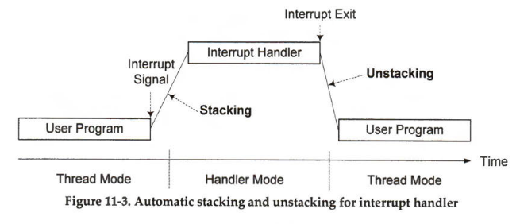
Interrupt Stacking and Unstacking

Slide 29
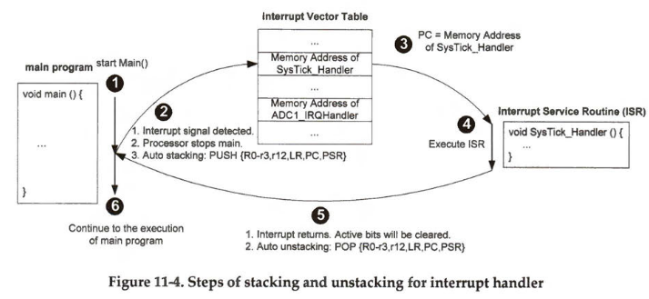
Interrupt Stacking and Unstacking

Slide 30
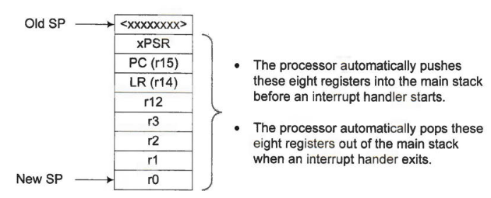
Interrupt Stacking and Unstacking
Since an interrupt may occur at any time, the program counter (PC) is preserved during interrupt stacking and then is recovered during interrupt unstacking. Thus, the processor can successfully continue executing the computation that had been interrupted.

Slide 31
Interrupt Stacking and Unstacking
The interrupt service routine exits by running "BX LR". Note that LR in an interrupt service routine has a meaning different from LR in a normal subroutine.
LR in a regular subroutine represents the return address to the caller. When a regular subroutine is called, LR holds the memory address of the instruction to be processed after exiting the subroutine. The value of LR is copied to PC when a regular service routine exits.

Slide 32
Interrupt Stacking and Unstacking
The interrupt service routine exits by running "BX LR". Note that LR in an interrupt service routine has a meaning different from LR in a normal subroutine.
LR in an interrupt service routine indicates whether the processor uses the main stack or the process stack in the push and pop operations. Since the interrupt service routine preserves and recovers PC via stacking and unstacking, the LR register is not copied to set PC when an interrupt service routine exits. Instead, the LR register shall be fixed to a special value, to indicate whether the processor should unstack data out of the main stack (MSP) or the process stack (PSP).

Slide 33
Nested Vectored Interrupt Controller (NVIC)
The nested vectored interrupt controller (NVIC) is built into Cortex-M cores to manage all interrupts. It offers three key functions:
Enable and disable interrupts.
Configure the preemption priority and subpriority of a specific interrupt.
Set and clear the handing bit of a specific interrupt.

Slide 34
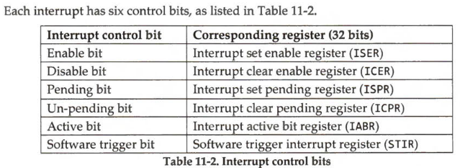
Nested Vectored Interrupt Controller (NVIC)

Slide 35
Nested Vectored Interrupt Controller (NVIC)
The nested vectored interrupt controller (NVIC) is built into Cortex-M cores to manage all interrupts. It offers three key functions:
Enable and disable interrupts.
Configure the preemption priority and subpriority of a specific interrupt.
Set and clear the handing bit of a specific interrupt.
NVIC does not handle System Interrupts (-16 to -1)

Slide 36
Nested Vectored Interrupt Controller (NVIC)
Enable and disable an interrupt
Writing an enable bit to 1 can enable the corresponding interrupt. Writing an enable bit to 0 does not turn off the corresponding interrupt. Write a disable bit to 1 can disable the interrupt. Writing a disable bit to e has no impacts on the related interrupt. Separating enable bits and disable bits allows us to disable an interrupt conveniently without affecting the other interrupts.
ISER = Interrupt Set Enable Register
ICER = Interrupt Clear Enable Register

Slide 37
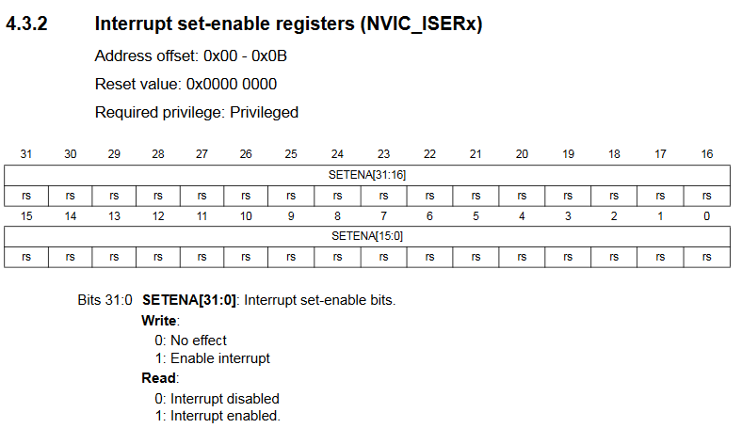

Nested Vectored Interrupt Controller (NVIC)
Enable and disable an interrupt

Slide 38
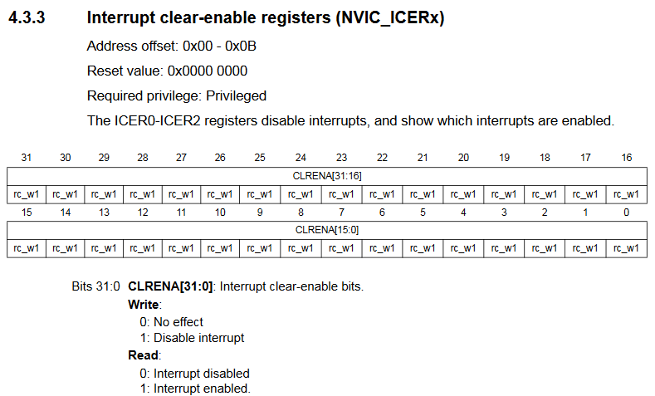
Nested Vectored Interrupt Controller (NVIC)
Enable and disable an interrupt

Slide 39
Nested Vectored Interrupt Controller (NVIC)
Pend and clear an interrupt
If an interrupt occurs, the corresponding pending bit is set if the microcontroller cannot process this interrupt immediately. Writing the clear pending bit to 1 removes the corresponding interrupt from the pending list. When an interrupt is disabled but its pending bit has already been set, this interrupt instance remains active, and it is serviced before it is disabled.
ISPR = Interrupt Set Pending Register
ICPR = Interrupt Clear Pending Register

Slide 40
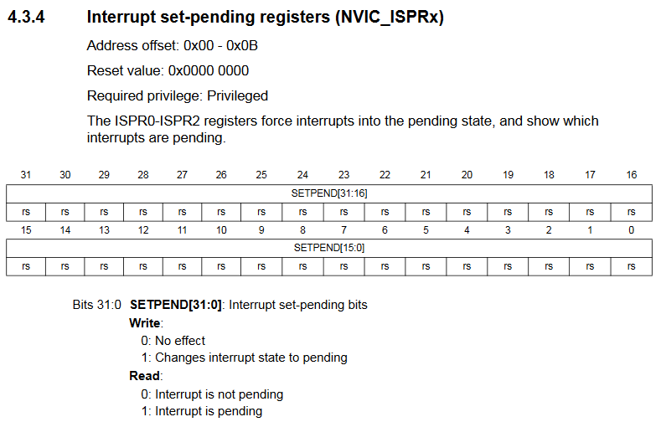
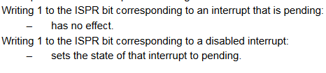
Nested Vectored Interrupt Controller (NVIC)
Pend and clear an interrupt

Slide 41
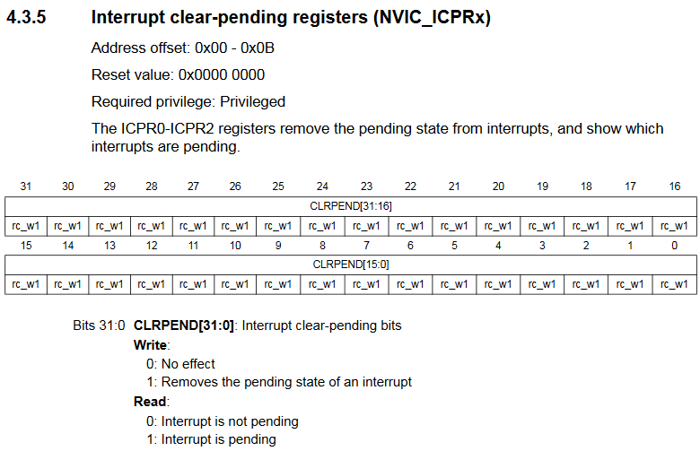
Nested Vectored Interrupt Controller (NVIC)
Pend and clear an interrupt

Slide 42
Nested Vectored Interrupt Controller (NVIC)
Trigger an interrupt
Setting an active bit by software or hardware activates the related interrupt, and the microcontroller starts the corresponding interrupt handler. If software writes a trigger bit of the software trigger interrupt register (STIR) to 1, the related interrupt is also activated. Most system exceptions can only be activated by hardware.
IABR = Interrupt Active Bit Register

Slide 43
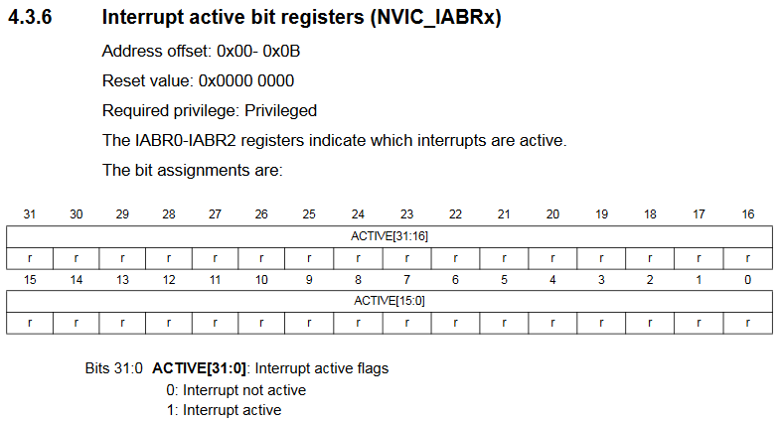
Nested Vectored Interrupt Controller (NVIC)
Trigger an interrupt

Slide 44
Nested Vectored Interrupt Controller (NVIC)
Cortex-M processors can have up to 240 Peripheral Interrupts. It can have up to–
Eight 32-bit Interrupt Set-Enable Registers (ISER), ISER0 - ISER7.
ISER[0] - ISER[7]
Eight 32-bit Interrupt Clear-enable Register (ICER), ICER0 - ICER7.
ICER[0] - ICER[7]
Eight 32-bit Interrupt Set-Pending Registers (ISPR), ISPR0 - ISPR7.
ISPR[0] - ISPR[7]
Eight 32-bit Interrupt Clear-Pending Register (ICPR), ICPR0 - ICPR7.
ICPR[0] - ICPR[7]
Eight 32-bit Interrupt Active Bit Register (IABR), IABR0 - IABR7.
IABR[0] - IABR[7]

Slide 45
Nested Vectored Interrupt Controller (NVIC)
STM32 Blue Pill has 43 Peripheral Interrupts. It has–
Two 32-bit Interrupt Set-Enable Registers (ISER), ISER0 - ISER1.
ISER[0] - ISER[1]
Two 32-bit Interrupt Clear-enable Register (ICER), ICER0 - ICER1.
ICER[0] - ICER[1]
Two 32-bit Interrupt Set-Pending Registers (ISPR), ISPR0 - ISPR1.
ISPR[0] - ISPR[1]
Two 32-bit Interrupt Clear-Pending Register (ICPR), ICPR0 - ICPR1.
ICPR[0] - ICPR[1]
Two 32-bit Interrupt Active Bit Register (IABR), IABR0 - IABR1.
IABR[0] - IABR[1]

Slide 46
Enable and Disable Peripheral Interrupts
Given interrupt number IRQn = 40. Enable this interrupt.
Step-1: Find the wordOffset.
wordOffset = IRQn / 32
= 40 / 32
= 1
So, this interrupt is in ISER1
In code–
wordOffset = IRQn >> 5 //2⁵ = 32
If the divisor is of form 2^{n},
the quotient is equivalent to
right shifting dividend n times.
quotient = dividend >> n

Slide 47
Enable and Disable Peripheral Interrupts
Given interrupt number IRQn = 40. Enable this interrupt.
Step-2: Find bitOffset.
bitOffset = IRQn mod 32
= 40 mod 32
= 8
So, this interrupt is the 8th bit in ISER1
In code–
bitOffset = IRQn & 0x1F //0x1F = 31
If the divisor is of form 2^{n},
the remainder is equivalent to
bitwise and of dividend and (divisor - 1)
remainder = dividend & (2^{n}-1)

Slide 48
Enable and Disable Peripheral Interrupts
Given interrupt number IRQn = 40. Enable this interrupt.
Step-3: Set bit
In Code–
NVIC->ISER[wordOffset] = 1UL<<bitOffset;

Slide 49
Enable and Disable Peripheral Interrupts
Given interrupt number IRQn = 40. Enable this interrupt.
Full Code–
int wordOffset = 40 >> 5 //2⁵ = 32
int bitOffset = 40 & 0x1F //0x1F = 31
NVIC->ISER[wordOffset] = 1UL<<bitOffset;
Or,
NVIC->ISER[1] = 1UL<<8;

Slide 50
Enable and Disable Peripheral Interrupts
Similarly, the given code can disable this interrupt.
int wordOffset = 40 >> 5 //2⁵ = 32
int bitOffset = 40 & 0x1F //0x1F = 31
NVIC->ICER[wordOffset] = 1UL<<bitOffset;

Slide 51
Interrupt Priority
The processor serves all interrupts based on their priority levels. The processor stops the currently running interrupt handler if a new interrupt with a higher priority occurs. The new interrupt task preempts the current lower-priority task, and the processor resumes the low-priority task when the handler of the new interrupt completes.
A higher value of the interrupt priority number represents a lower priority (or urgency). The Reset_Handler() has top priority, and its priority number is -3.

Slide 52
Interrupt Priority
Usually, the peripheral interrupts have a positive interrupt level while a microcontroller core interrupt can have negative priority numbers, not changeable by software.
When there are multiple pending interrupts, the interrupt that has the lowest interrupt number is serviced first by the processor.

Slide 53
Interrupt Priority
While Cortex-M processors use eight bits to store the priority number, STM32 Blue Pill processors only implement four bits. Thus, the STM32 Blue Pill microcontroller only supports 16 interrupt priority levels, ranging from e to 15.
For a different Cortex-M processor, the interrupt priority byte might be different

Slide 54
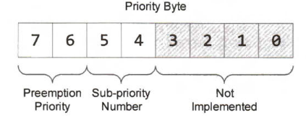
Interrupt Priority
STM32 Blue Pill allows five different schemes to split the four-bit priority number. If we use n bits for the preempt priority number, then the sub-priority number has 4- n bits, where n = 0, 1, 2, 3, or 4. By default, two bits are used for the preempt priority number, and two bits are used for the sub-priority number, as shown in Figure.

Slide 55
Sample Questions
Question-1
The starting address of Interrupt Vector Table is 0x00000004. Find the address of the SysTick interrupt. The interrupt number of SysTick interrupt is -1.
Address of SysTick_Handler
= 0x00000004 + 4 x ( -1 + 15)
= 0x0000003C

Slide 56
Sample Questions
Question-2
Write a code snippet to enable* interrupt 40.
int wordOffset = 40 >> 5;
int bitOffset = 40 & 0x1F;
NVIC->ISER[wordOffset] = 1UL<<bitOffset;
*Can be any of these- Enable, Disable, Set Pending, Clear Pending, Trigger

Slide 57

Thank You!

