Slide 1
System Timer
(SysTick)
Slide by-
Md. Farhan Shakib
Lecturer, Dept. of CSE, RUET
farhan.shakib@cse.ruet.ac.bd

Slide 2
Different from the book. Slide explains the concept in context of
STM32f103xx MCU. While the book uses different MCU. So, the
addresses and implementation will also be different.

Slide 3
References
Embedded Systems with ARM Cortex-M Microcontrollers in Assembly Language and C 3e by Dr. Yifeng Zhu [Chapter 11]
STM32f103xx Datasheet https://www.st.com/resource/en/datasheet/stm32f103c8.pdf
STM32f103xx Programming Manual https://www.st.com/resource/en/programming_manual/pm0056-stm32f10xxx20xxx21xxxl1xxxx-cortexm3-programming-manual-stmicroelectronics.pdf

Slide 4
System Timer
The system tick timer (SysTick) is a simple 24-bit down counter to produce a small fixed time quantum. Software uses SysTick to create time delays or generate periodic interrupts to execute a task repeatedly.
• The timer counts down from N-1 to 0, and the processor generates a SysTick interrupt once the counter reaches zero.
• After reaching zero, the SysTick counter loads the value held in a speCial register named the SysTick Reload register and counts down again.
• The SysTick timer does not stop counting down when the processor is halted. The processor still generates SysTick interrupts during the process of debugging.

Slide 5
System Timer
Another usage of SysTick timer is to create a useful hardware timer for the CPU scheduler in real-time operating systems (RTOS).
When multiple tasks run concurrently, the processor allocates a time slot to each task according to some scheduling policy, such as the round robin. To achieve that, the processor utilizes a hardware timer to generate interrupts at regular time intervals. These interrupts inform the processor to stop the current task, save the context registers of the present task to the stack, and then select a new task in the job waiting queue to serve.

Slide 6
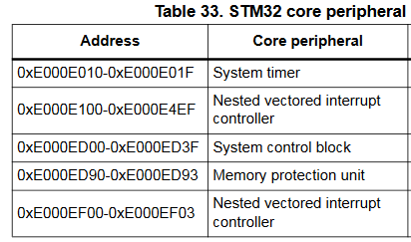
System Timer
The starting address of SysTick is
0xE000E010

Slide 7
System Timer
There are four 32-bit registers for configuring system timers. Chip manufacturers may have different names for these registers, but their memory addresses are the same for each ARM Cortex-M family.
Their memory addresses are–
SysTick_CTRL 0xE000E010
SysTick_LOAD 0xE000E014
SysTick_VAL 0xE000E018
SysTick_CALIB 0xE000E01C

Slide 8
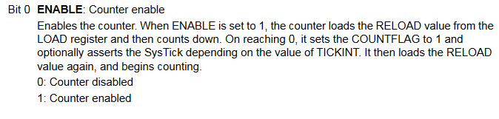
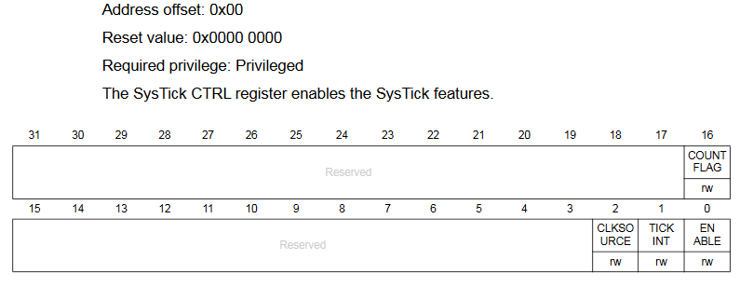
SysTick Control And Status Register (STK_CTRL)

Slide 9

SysTick Control And Status Register (STK_CTRL)

Slide 10

SysTick Control And Status Register (STK_CTRL)

Slide 11
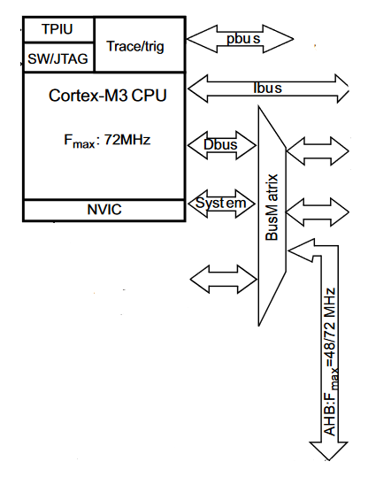
SysTick Control And Status Register (STK_CTRL)

Slide 12

SysTick Control And Status Register (STK_CTRL)

Slide 13
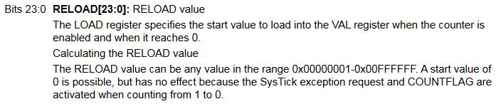
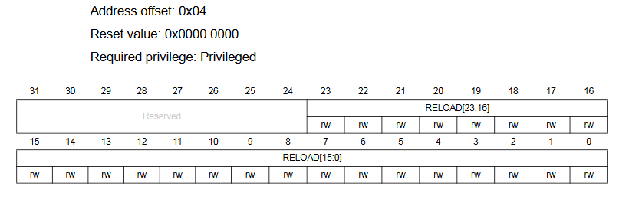
SysTick Reload Value Register (STK_LOAD)

Slide 14
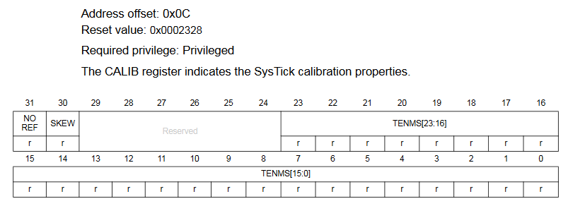
SysTick Calibration Value Register (STK_CALIB)
The SysTick calibration value is set to 9000, which gives a reference time base of 1 ms with the SysTick clock set to 9 MHz (max HCLK/8).

Slide 15
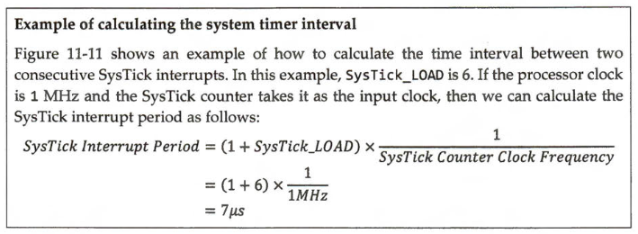
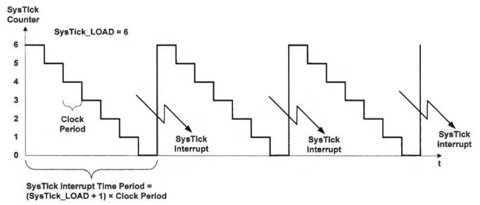
Calculating The System Timer Interval

Slide 16
Calculating The System Timer Interval
Calculate the SysTick Interrupt Period. Given that the SysTick Counter Clock Frequency is 72MHz and SysTick_LOAD is 71,999.

Slide 17
Calculating The System Timer Interval
Calculate the SysTick Interrupt Period. Given that the SysTick Counter Clock Frequency is 72MHz and SysTick_LOAD is 71,999.

Slide 18
Calculating The System Timer Interval
Calculate the SysTick Interrupt Period. Given that the SysTick Counter Clock Frequency is 72MHz and SysTick_LOAD is 71,999.
This is how we are going to implement 1 ms delay in our code.

Slide 19
Creating an 1ms Delay
void systick_init(void) {
SysTick->LOAD = 72000 - 1; // Set reload register for 1 ms
SysTick->VAL = 0; // Clear current value register
SysTick->CTRL = 5; // Enable SysTick with processor clock
}

Slide 20
Creating an 1ms Delay
void systick_init(void) {
SysTick->LOAD = 72000 - 1; // Set reload register for 1 ms
SysTick->VAL = 0; // Clear current value register
SysTick->CTRL = 5; // Enable SysTick with processor clock
}
You can also break down SysTick->CTRL = 5 like this–
SysTick->CTRL = 1<<0; // Enable SysTick
SysTick->CTRL = 1<<2; // Enable processor clock

Slide 21
Creating an 1ms Delay
void systick_init(void) {
SysTick->LOAD = 72000 - 1; // Set reload register for 1 ms
SysTick->VAL = 0; // Clear current value register
SysTick->CTRL = 5; // Enable SysTick with processor clock
}
void delay_ms(void) {
while (!(SysTick->CTRL & (1 << 16))); // Wait for COUNTFLAG to be 1
}

Slide 22
Creating an 1ms Delay
void systick_init(void) {
SysTick->LOAD = 72000 - 1; // Set reload register for 1 ms
SysTick->VAL = 0; // Clear current value register
SysTick->CTRL = 5; // Enable SysTick with processor clock
}
void delay_ms(void) {
while (!(SysTick->CTRL & (1 << 16))); // Wait for COUNTFLAG to be 1
}
void delay_t(unsigned long t) {
while (t--) { delay_ms();}
}

Slide 23
Blinking LED on PC15 using SysTick Delay
#include "stm32f10x.h" void systick_init(void) { SysTick->LOAD = 72000 - 1; // Set reload register for 1 ms SysTick->VAL = 0; // Clear current value register SysTick->CTRL = 5; // Enable SysTick with processor clock } void delay_ms(void) { while (!(SysTick->CTRL & (1 << 16))); // Wait for COUNTFLAG to be 1 } void delay_t(unsigned long t) { while (t--) { delay_ms();} }

Slide 24
Blinking LED on PC15 using SysTick Delay
void GPIO_config(void) { // Enable GPIOC clock RCC->APB2ENR |= (1 << 4); // Configure PC15 as output push-pull // Clear mode and configuration bits for PC15 GPIOC->CRH &= ~(0xF << 28); // MODE15[1:0] = 10 (Output mode, max speed 2 MHz) GPIOC->CRH |= (2 << 28); }

Slide 25
Blinking LED on PC15 using SysTick Delay
int main(void) { systick_init(); // Initialize SysTick GPIO_config(); // Configure GPIO while (1) { GPIOC->ODR = (1 << 15); // Enable PC15 delay_t(500); // Delay for 500 ms GPIOC->ODR = (0 << 15); // Disable PC15 delay_t(500); // Delay for 500 ms } }

Slide 26
Sample Questions
Question-1
Calculate the SysTick Interrupt Period. Given that the SysTick Counter Clock Frequency is 72MHz and SysTick_LOAD is 71,999.

Slide 27



Sample Questions
Question-2
Calculate the SysTick_LOAD for 1ms SysTick Interrupt Period. Given that the SysTick Counter Clock Frequency is 72MHz.

Slide 28
Sample Questions
Question-3
Write a function to make 1ms delay using SysTick. Bits 0, 2 and 16 of SysTick->CTRL register are Enable SysTick, Clock Source and Count Flag respectively.
void delay_ms(void) {
SysTick->LOAD = 72000 - 1;
SysTick->VAL = 0;
SysTick->CTRL = 5;
while (!(SysTick->CTRL & (1 << 16)));
}

Slide 29
Sample Questions
Question-4
Write a function to make 4 ms delay using SysTick. Bits 0, 2 and 16 of SysTick->CTRL register are Enable SysTick, Clock Source and Count Flag respectively.
void delay_t(unsigned long t) {
SysTick->LOAD = 72000 - 1;
SysTick->VAL = 0;
SysTick->CTRL = 5;
while (t--) {
while (!(SysTick->CTRL & (1 << 16)));
}
}

Slide 30

Thank You!

