Slide 1
External
Interrupts
Slide by-
Md. Farhan Shakib
Lecturer, Dept. of CSE, RUET
farhan.shakib@cse.ruet.ac.bd

Slide 2
Different from the book. Slide explains the concept in context of
STM32f103xx MCU. While the book uses different MCU. So, the
addresses and implementation will also be different.

Slide 3
References
Embedded Systems with ARM Cortex-M Microcontrollers in Assembly Language and C 3e by Dr. Yifeng Zhu [Chapter 11]
STM32f103xx Datasheet https://www.st.com/resource/en/datasheet/stm32f103c8.pdf
STM32f103xx Programming Manual https://www.st.com/resource/en/programming_manual/pm0056-stm32f10xxx20xxx21xxxl1xxxx-cortexm3-programming-manual-stmicroelectronics.pdf

Slide 4
External Interrupt
External interrupts are interrupts triggered by peripherals or devices, external to the microprocessor core, such as push buttons and keypads.
External interrupts are very useful because they allow the microcontroller to monitor external signals efficiently and promptly response to external events.

Slide 5
External Interrupt
The external interrupt controller supports 16 external interrupts, named EXTI0, EXTI1, ... , EXTI15. Each of these interrupts is only associated with one specific GPIO pin.
The GPIO pins with the same pin number in all GPIO ports are assigned to the same external interrupt. In other words, only pins with the pin number k can be the source of external interrupt EXTIk. For example, the processor can map GPIO pin PA0 to EXTI0, PA1 to EXTI1, PA2 to EXTI2, and so on.

Slide 6
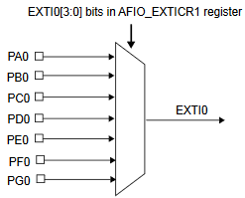
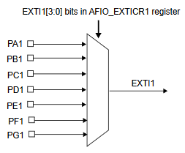
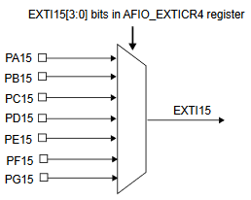
External Interrupt
0000
0001
0010
0011
0100
0101
0110
0000
0001
0010
0011
0100
0101
0110
0000
0001
0010
0011
0100
0101
0110
……
EXTICR[0] EXTICR[1] …… EXTICR[15]

Slide 7
External Interrupt
Also, there is only one external interrupt on all pins with the same number out of all GPIO ports. For example, if the pin PA3 has an external interrupt on it, we cannot use the pins PB3, PC3, PD3, or PE3 as the external interrupt source.
The external interrupt controller has a voltage monitor module that has a programmable edge detector. This hardware monitor module can monitor the voltage signal on GPIO pins. Software can select the rising edge, the falling edge, or both edges of the voltage signal to trigger an interrupt request.

Slide 8
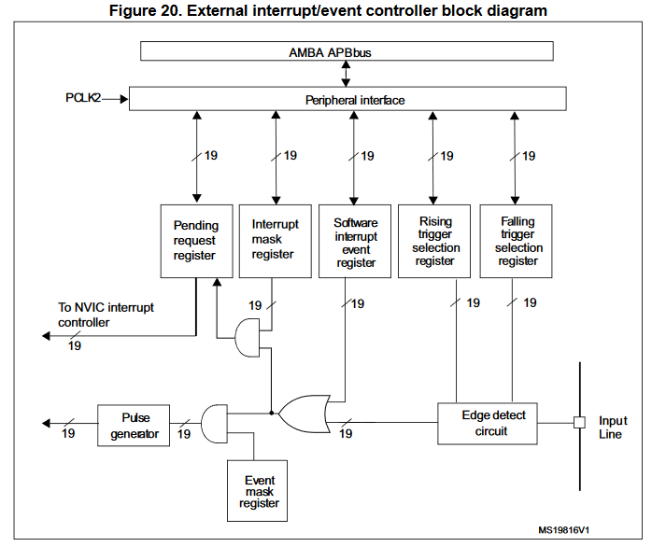
External Interrupt

Slide 9
Handling An External Interrupt on PA0
Step-1: Enabling AFIO
Step-2: Configure EXTICR registers
Step-3: Unmask EXTI
Step-4: Select Rising/Falling edge that triggers the exception
Step-5: Enable interrupt EXTI k on NVIC controller
Step-6: Disable pending register if in pending state
Step-7: Write the interrupt handler

Slide 10
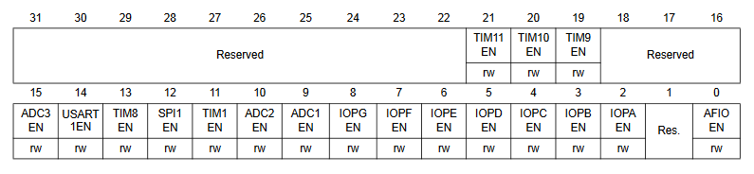
Handling An External Interrupt on PA0
Step-1: Enabling AFIO
Because External Interrupt is an Alternate function (AFIO) of the GPIO, first we need to enable alternate function from APB2ENR just like enabling any GPIO port.
RCC->APB2ENR |= 1UL<<0;
RCC->APB2ENR |= 1UL<<2;

Slide 11
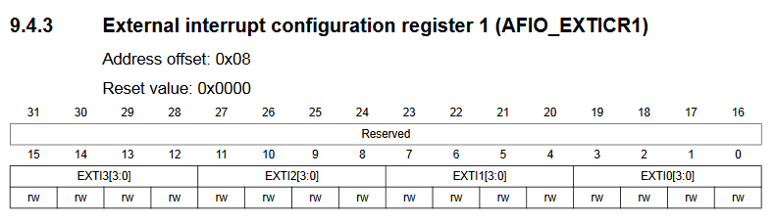
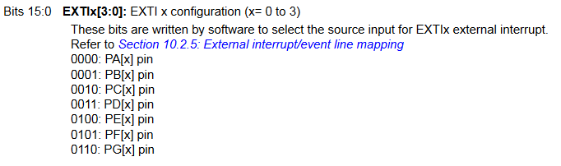
Handling An External Interrupt on PA0
Step-2: Configure EXTICR registers
Each EXTICR registers can configure up to four EXTIs, four bits for each of them. These bits configure which pin we are connecting to the EXTI.

Slide 12
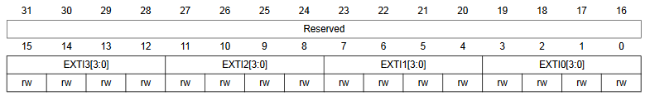
Handling An External Interrupt on PA0
Step-2: Configure EXTICR registers
In this example, we are connecting PA0 to EXTI0. So, we need to configure EXTICR[0] and set its value to 0000.
AFIO->EXTICR[0] &= ~(15UL<<0); //Clear EXTI0 bits
AFIO->EXTICR[0] |= (0UL<<0); //Set EXTI0 to PA0

Slide 13
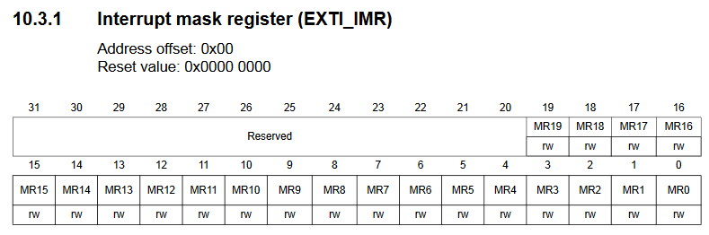

Handling An External Interrupt on PA0
Step-3: Unmask EXTI
An interrupt can only be generated if the corresponding bit in the interrupt mask register is 1 (or unmasked).

Slide 14
Handling An External Interrupt on PA0
Step-3: Unmask EXTI
In this example, we need to unmask EXTI0
EXTI->IMR |= (1UL<<0); //Unmask EXTI0

Slide 15
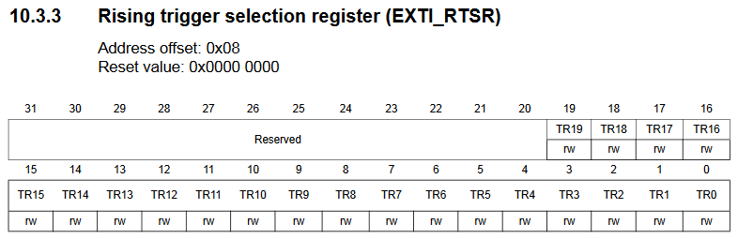

Handling An External Interrupt on PA0
Step-4: Select Rising/Falling edge that triggers the exception
Select the active edge that can trigger EXTI. The signal can be a rising edge, a falling edge or both.

Slide 16


Handling An External Interrupt on PA0
Step-4: Select Rising/Falling edge that triggers the exception
Select the active edge that can trigger EXTI. The signal can be a rising edge, a falling edge or both.

Slide 17
Handling An External Interrupt on PA0
Step-4: Select Rising/Falling edge that triggers the exception
In this example we will be using both edges.
EXTI->RTSR |= (1UL<<0); // Trigger on rising edge
EXTI->FTSR |= (1UL<<0); // Trigger on falling edge

Slide 18
Handling An External Interrupt on PA0
Step-5: Enable interrupt EXTI k on NVIC controller
Enable interrupt EXTI on NVIC controller via NVIC_EnableiRQ.
For any EXTI number x, you need to use EXTIx_IRQn
NVIC_EnableIRQ(EXTI0_IRQn); // Enable EXTI0 interrupt in NVIC

Slide 19
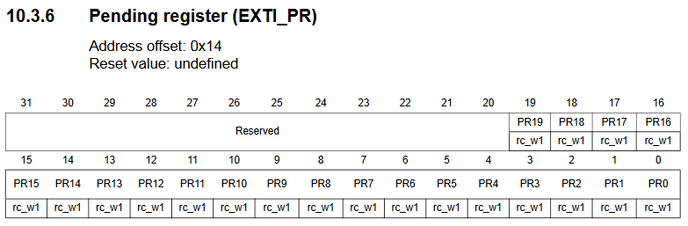
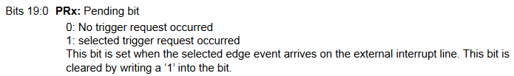
Handling An External Interrupt on PA0
Step-6: Disable pending register if in pending state

Slide 20
Handling An External Interrupt on PA0
Step-6: Disable pending register if in pending state
if (EXTI->PR & (1UL<<0)) { // Check if EXTI0 interrupt pending
EXTI->PR |= (1UL<<0); // Clear the interrupt pending bit
}

Slide 21
Handling An External Interrupt on PA0
Step-7: Write the interrupt handler
We are actually overriding EXTI0_IRQHandler
void EXTI0_IRQHandler(void) {
// Contains code you want to run when the interrupt has occurred
// For example- turn on/off LED
}

Slide 22
Handling An External Interrupt on PA0
Step-7: Write the interrupt handler
List of IRQHandlers–
PIN # | EXTI # | IRQHandler Function
PA0, PB0 | 0 | EXTI0_IRQHandler
PA1, PB1 | 1 | EXTI1_IRQHandler
PA2, PB2 | 2 | EXTI2_IRQHandler
PA3, PB3 | 3 | EXTI3_IRQHandler
PA4, PB4 | 4 | EXTI4_IRQHandler
PA5 - PA9 PB5 - PB9 | 5 - 9 | EXTI9_5_IRQHandler
PA10 - PA15 PB10 - PB15 PC13 - PC15 | 10 - 15 | EXTI15_10_IRQHandler

Slide 23
Detect Button Press on PA0 and control LED Connected to PC15
#include "stm32f10x.h" // Device header
void GPIO_Config(void) {
// Enable clock for GPIOA, GPIOC, and AFIO
RCC->APB2ENR |= (1UL<<2) | (1UL<<4) | (1UL<<0); // You can enable separately
// Configure PA0 as input floating
GPIOA->CRL &= ~(15UL<<0); // Clear mode and configuration bits for PA0
GPIOA->CRL |= (4UL<<0); // Set configuration to input floating
// Configure PC15 as output push-pull
GPIOC->CRH &= ~(15UL<<28); // Clear mode and configuration bits for PC15
GPIOC->CRH |= (3UL<<28); // Set mode to 50 MHz output push-pull
}

Slide 24
Detect Button Press on PA0 and control LED Connected to PC15
void EXTI_Config(void) {
// Configure EXTI line 0 to be triggered by PA0
AFIO->EXTICR[0] &= ~(15UL<<0); // Clear EXTI0 bits
AFIO->EXTICR[0] |= (0UL<<0); // Set EXTI0 to PA0
// Configure EXTI0 line to trigger on rising edge
EXTI->IMR |= (1UL<<0); // Unmask EXTI0
EXTI->RTSR |= (1UL<<0); // Trigger on rising edge
EXTI->FTSR |= (1UL<<0); // Trigger on falling edge
}
void NVIC_Config(void) {
NVIC_EnableIRQ(EXTI0_IRQn); // Enable EXTI0 interrupt in NVIC
}

Slide 25
Detect Button Press on PA0 and control LED Connected to PC15
void EXTI0_IRQHandler(void) {
if (EXTI->PR & (1UL<<0)) { // Check if EXTI0 interrupt pending
EXTI->PR |= (1UL<<0); // Clear the interrupt pending bit
// Toggle PC15 based on PA0 input state
if (GPIOA->IDR & (1UL<<0)) {
GPIOC->ODR |= (1UL<<15); // Turn on PC15
}
else {
GPIOC->ODR &= ~(1UL<<15); // Turn off PC15
}
}
}

Slide 26
Detect Button Press on PA0 and control LED Connected to PC15
int main(void) {
GPIO_Config();
EXTI_Config();
NVIC_Config();
while(1)
{
// Main loop does nothing, waiting for interrupt
}
}

Slide 27
Sample Questions
Question-1
Write a code snippet to handle External Interrupt 0 (EXTI0)* on an STM32F103xx microcontroller. When the interrupt occurs, the code should set GPIO pin PA13 to high. Assume that the necessary configurations for EXTI0 and GPIO PA13 have already been completed.
void EXTI0_IRQHandler(void) {
GPIOC->ODR |= 1UL<<13;
}
* Can be any External Interrupt from 0-15.

Slide 28

Thank You!

