Slide 1

Shyamoli Engineering College
AI-Based Facial Emotion Analysis System Using Deep Learning
Presented By :
Rayhan Hussain
Hasibul Islam Niloy
Session: 2020–2021
Shyamoli Engineering College

Slide 2
Presentation Outline
Introduction & Motivation
Problem Statement & Objectives
Background & Literature Review
System Design
Methodology
Implementation & Deployment
Results & Evaluation
Limitations
Applications
Conclusion & Future Work
References
Q&A

Slide 3
Introduction & Motivation
Facial expressions: Universal way to communicate emotions
Key research area: AI + Computer Vision + Psychology
Machines lack emotional intelligence
Demand for affective computing growing rapidly
Benefits:
Natural, adaptive, personalized interactions
Early detection of stress/anxiety/depression
Improved learning outcomes & customer satisfaction
Goal: Bridge gap between human emotions & machine understanding

Slide 4
Problem Statement & Objectives
Challenges
Lighting, head pose, occlusions (masks, glasses)
Individual differences (age, ethnicity)
Cloud-based systems → latency
Objectives
Develop CNN model on FER2013 dataset
Improve accuracy via preprocessing & augmentation
Deploy real-time online/offline Streamlit app
Evaluate with standard metrics

Slide 5
Background & Literature Review
Traditional methods: Gabor, LBP → limited performance
Deep Learning: CNNs learn features automatically
Key works:
Goodfellow et al. (2013): ~79% on FER2013
Recent studies: Up to 89–90% on benchmarks
Our target: Higher accuracy + fully online/offline + real-time

Slide 6
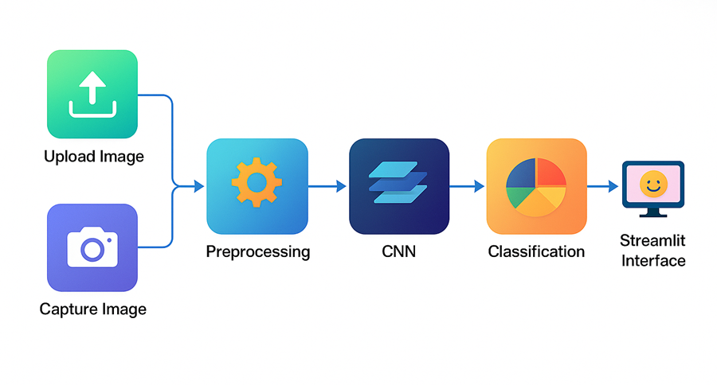
System Design
Modular architecture Inputs: Image upload or live webcam
Core flow: Preprocessing → CNN Classification
Output: Emotion + confidence via Streamlit
Optional: SQLite for emotion history logging

Slide 7
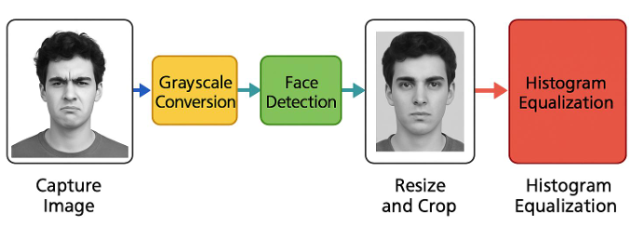
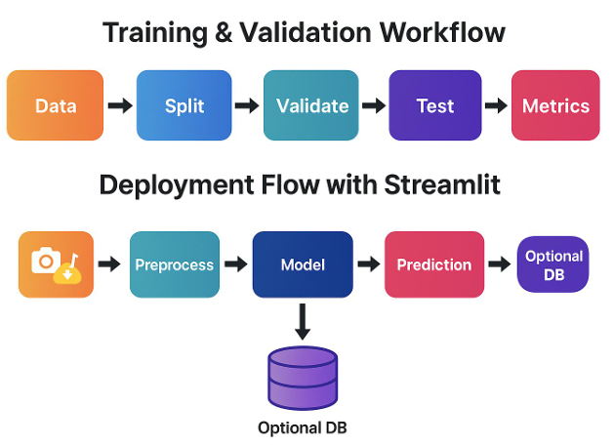
Methodology
Dataset: FER2013 (~35,887 grayscale 48×48 images)
→ 80/10/10 split
Preprocessing: Face detection, resize, normalize, augmentation
Model: Custom CNN
  Conv layers (32→64→128) + MaxPool
  Dropout (0.5) + Dense → Softmax (5 classes)

Slide 8
Implementation
Tools:
Python, TensorFlow/Keras, OpenCV, Streamlit
Features:
  Live webcam detection and direct image upload
  Real-time predicted emotion with confidence score
  Session emotion-history log
  Live Analytics dashboard

Slide 9
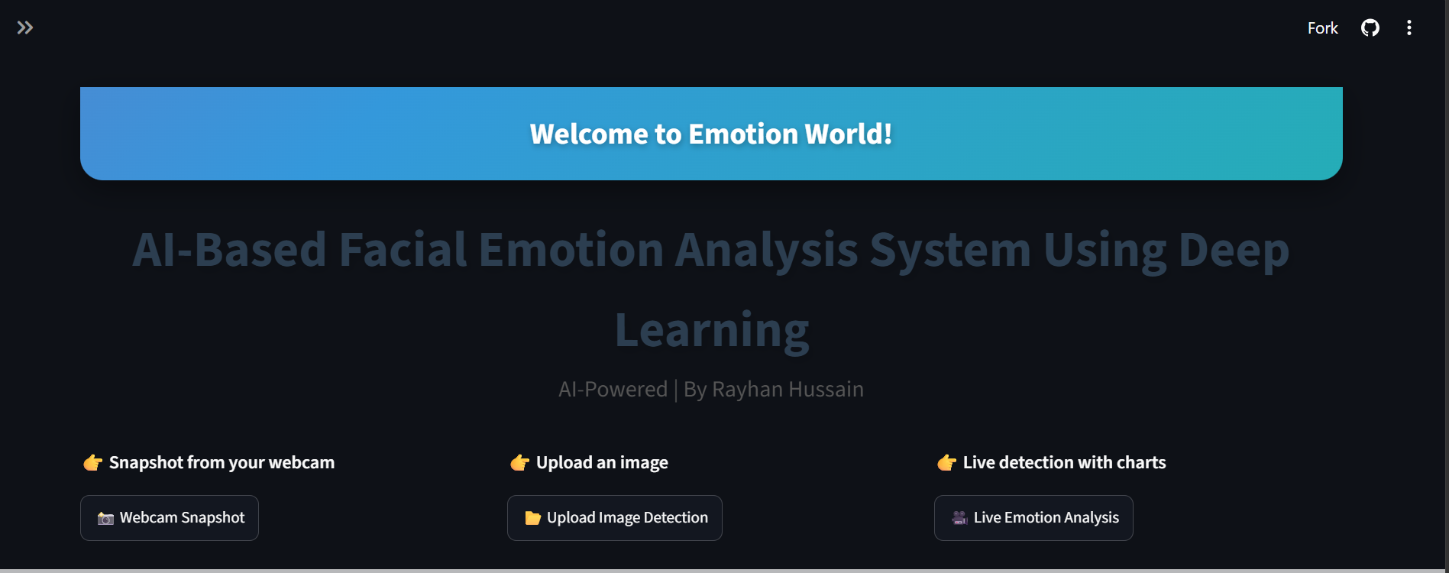
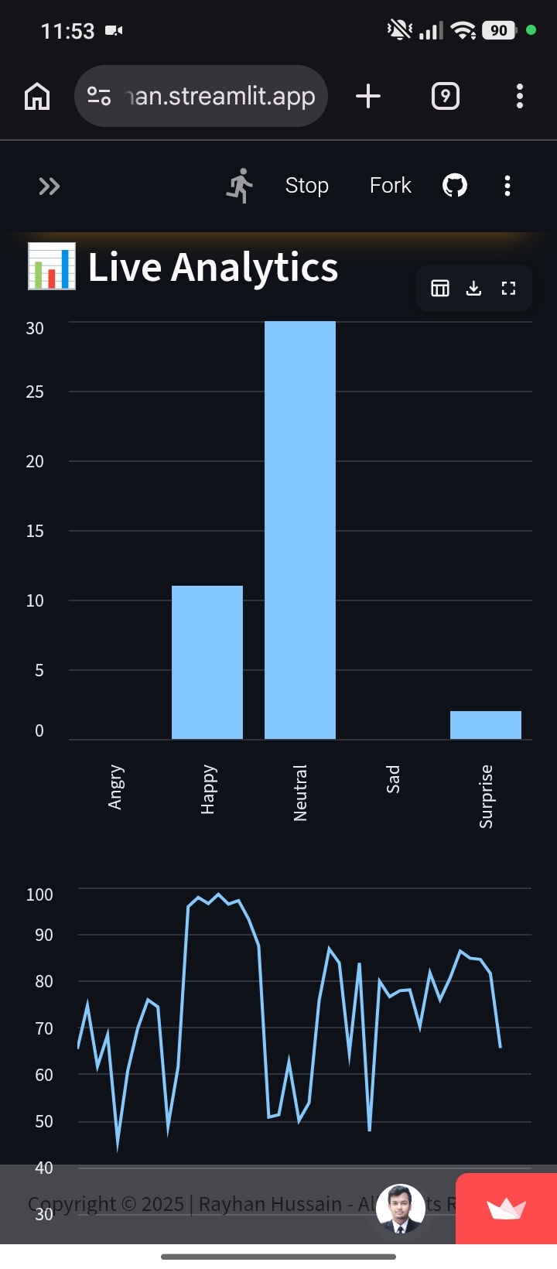
Deployment
Verified On The Live
Deployment — Mobile
Live Deployment
emotion-rayhan.streamlit.app

Slide 10
Results & Evaluation
Final Test Accuracy: 92.4%
Smooth training curves (minimal overfitting)
Clean confusion matrix
Outperforms several commercial APIs
Emotion | Precision | Recall | F1-Score
Happy | 95.2% | 93.8% | 94.5%
Sad | 91.0% | 89.3% | 90.1%
Angry | 89.1% | 87.7% | 88.4%
Surprise | 96.7% | 94.9% | 95.8%
Neutral | 93.0% | 91.5% | 92.2%

Slide 11
Limitations
Dataset issues: Low-res (48×48), noisy labels, imbalance
Model constraints: 5 emotions only, may struggle with diverse faces
Real-world: Webcam quality, lighting affect accuracy
No advanced mechanisms (attention/transformers)
Ethical/privacy concerns in applications

Slide 12
Applications
Healthcare: Mental health monitoring, telemedicine
Education: Adaptive learning based on engagement
HCI & Robotics: Empathetic interactions
Other:
Customer service, driver monitoring, VR/AR

Slide 13
Conclusion & Future Work
Built lightweight, online/offline, real-time FER system
Achieved 92.4% accuracy on FER2013
User-friendly Streamlit deployment
Future Work
  Add more emotion
  Use MobileNet/EfficientNet for edge devices
  Multimodal (face + voice)
  Real-world testing in healthcare/education

Slide 14
References
Goodfellow et al. (2013). Challenges in representation learning...
Khaireddin & Chen (2021). Facial Emotion Recognition...
FER2013Bhagat et al. (2024).
Facial Emotion Recognition using CNN...Aly et al. (2025). Deep learning for real-time emotion in online learning...(Full list in report – 30+ sources)

Slide 15
Thank You
Any Questions?

