Slide 1

Bangladesh Army University of Science and Technology (BAUST), Saidpur
Department Computer Science and Engineering (CSE)
Course Tittle: Information System Design Sessional
Course Code: CSE 3210
Project Title: BAUST ALUMNI MANAGEMENT SYSTEM
Project Type: Web Based Information System
Presented By:
Name: Mst. Jugnu Khatun
ID: 0802410105101072
Name: Most. Arifa Akter Allo
ID: 0802410105101073
Name: Hasibul Hasib
ID: 0802410205101079
Presented To:
Teacher Name: AKZ Rasel Rahman
Designation: Lecturer, CSE, BAUST.
Teacher Name: MD. Rabby Hossain
Designation: Lecturer, CSE, BAUST.
1

Slide 2





Project Overview
Name, type, organization, location, and stakeholders at a glance
PROJECT NAME
Alumni Management System (AMS)
Key Stakeholders
PROJECT TYPE
University Administration
Web-based Information System (Academic)
Alumni Affairs Office
ORGANIZATION
Bangladesh Army University of Science and Technology (BAUST), Saidpur
Alumni (Graduates)
Current Students
LOCATION
University Campus – Alumni Affairs Department
Faculty Members
2

Slide 3



THE CASE FOR THIS PROJECT
Project Motivation
Why the Alumni Management System was selected
→
→
PROBLEM
NEED
SOLUTION
Fragmented Alumni Data
A Reliable Engagement Tool
Alumni Management System
• No centralized database
• Track alumni across batches
• Centralized alumni profiles
• Records scattered across sheets & social media
• Support mentorship & referrals
• Role-based web portal
• No structured student-alumni link
• Coordinate events and donations
• Analytics for engagement & giving
3

Slide 4



INSTITUTIONAL CONTEXT
Organization Structure
Department and sub-department this system belongs to
UNIVERSITY ADMINISTRATION
Bangladesh Army University of Science and Technology
MAIN DEPARTMENT
Student Affairs / Registrar's Office
SUB-DEPARTMENT (ALUMNI RELATIONS CELL)
Alumni Affairs Office
The Alumni Affairs Office operates under Student Affairs and is the direct owner of the proposed system.
4

Slide 5




WHO USES THE SYSTEM
User Identification
Primary users and how each interacts with the system
Admin
Alumni
Current Students
University Administration
Alumni Affairs staff who manage records, events, and content.
Graduates who update profiles, network, and join events.
Students seeking mentorship, referrals, and alumni contacts.
Leadership viewing engagement analytics and reports.
5

Slide 6
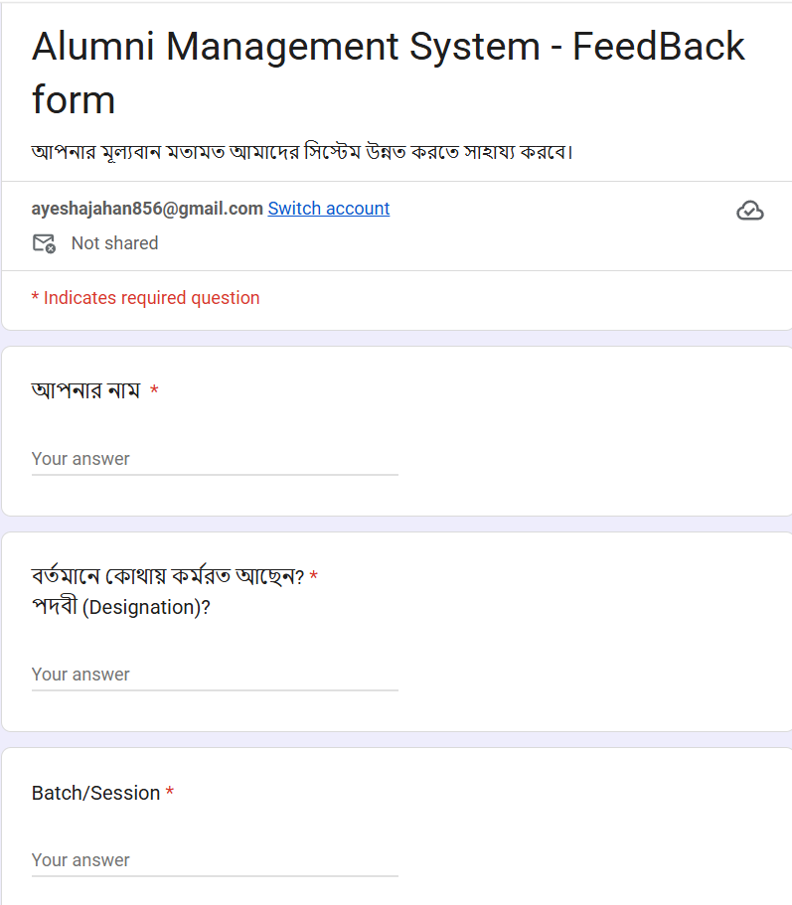
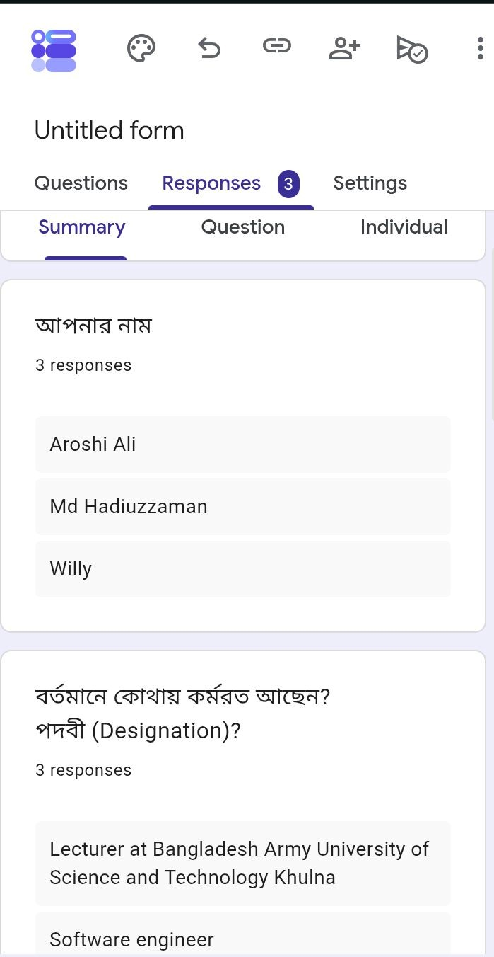
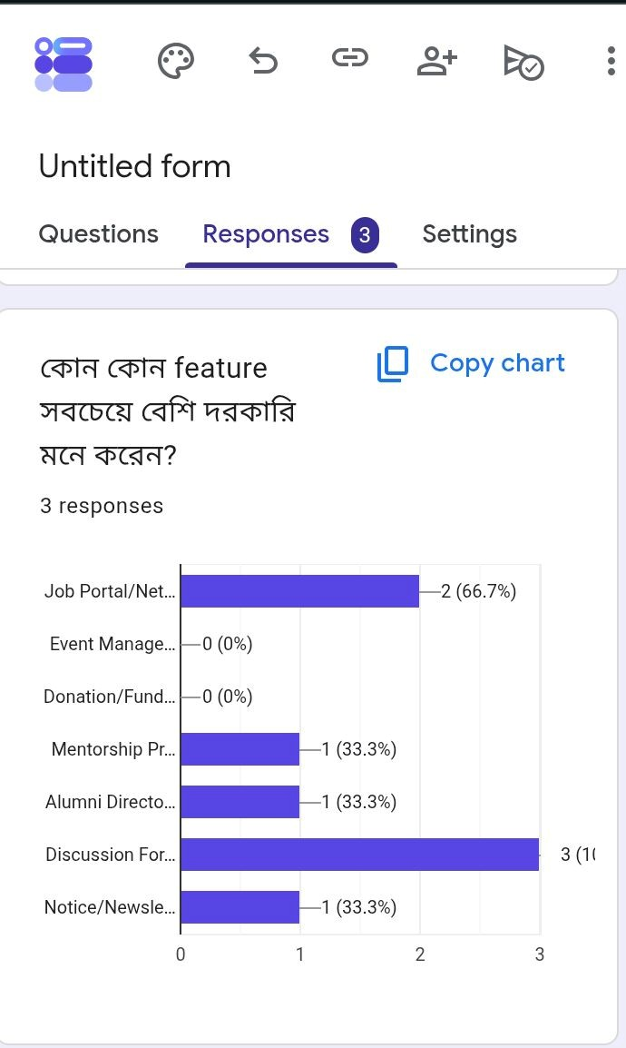
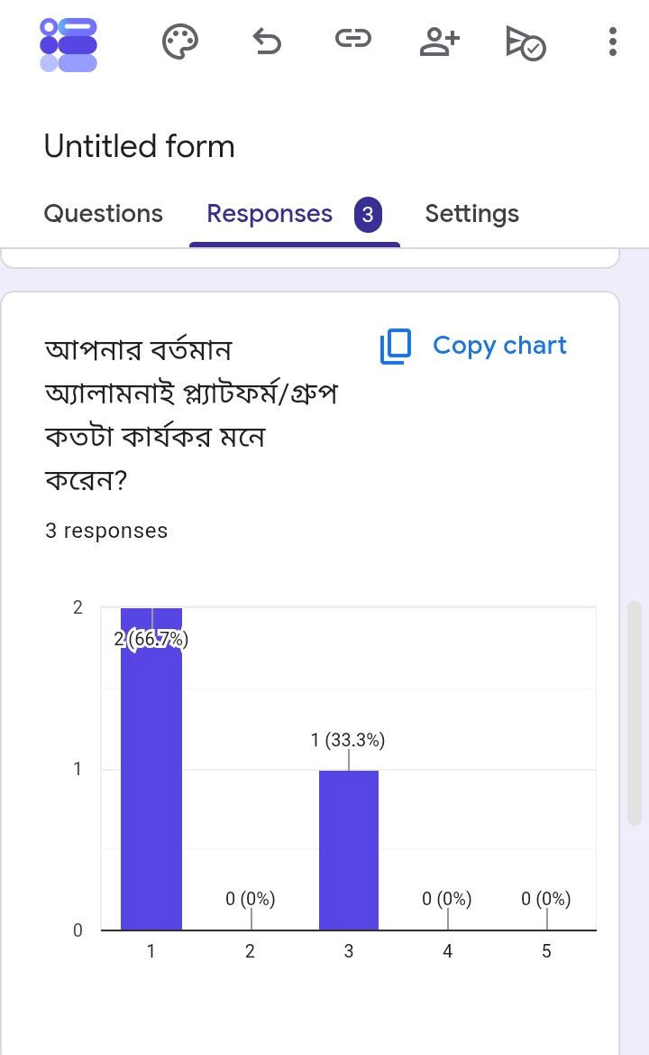
WORKING PROCESS & FEEDBACK EVIDENCE
Google Form feedback collected from alumni to validate system requirements
6

Slide 7
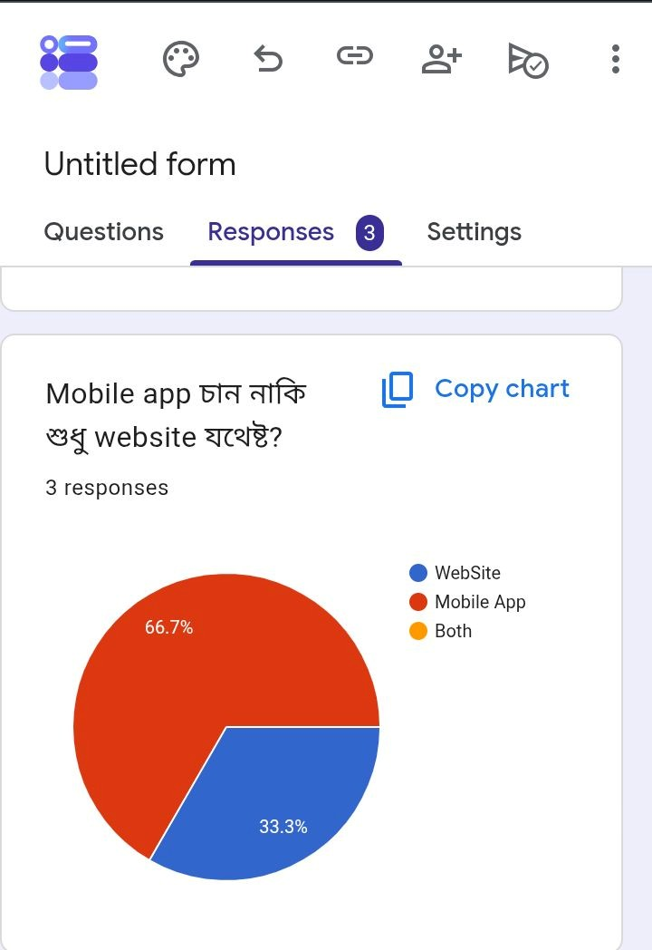
WORKING PROCESS & FEEDBACK EVIDENCE
Feedback Highlights
3 responses collected so far from alumni across multiple batches (6th, 12th, 14th) and roles (Lecturer, Software Engineer).
66.7% rated the current alumni platform/group as poorly effective (score 1/5), confirming the need for a dedicated system.
Discussion Forum was the most requested feature (100%), followed by Job Portal/Networking (66.7%).
66.7% prefer a Website over a Mobile App, supporting the web-based system design.
Open-ended responses are gathering UI/UX suggestions and additional feature requests to refine scope.
Google Form link: https://forms.gle/4JpZ39HfiXLh8PJD9
7

Slide 8





CURRENT STATE
Existing Software / Current System
Assessing what is in place today
Google Forms
Used to collect alumni contact details during reunions and convocation.
No Dedicated Software Exists
Excel Spreadsheets
Alumni data stored locally with no validation or central access.
Most universities, including this one, do not operate a single, integrated Alumni Management Software. Alumni-related work is instead handled through a mix of manual and ad-hoc digital tools.
Facebook / WhatsApp
Informal groups used for updates, with no targeted delivery.
Manual Coordination
Events and donation drives coordinated by phone and email.
8

Slide 9





CURRENT WORKFLOW
Working Process of the Existing Practice
How the current manual process flows end to end
→
→
→
→
Input
Store
Communicate
Coordinate
Output
Alumni submit details via Google Form
Data saved in scattered Excel sheets
Updates via Facebook / email / WhatsApp
Events & donations arranged manually
Ad-hoc reports compiled by staff
No system enforces this sequence today — each step depends on manual follow-up by Alumni Affairs staff.
9

Slide 10

GAP ANALYSIS
Existing System Analysis & Proposed Improvement
Comparing today's manual practice with the proposed system
Existing (Manual) System
Proposed / Improved System
Manual data collection via forms & sheets
Centralized database with online profile submission
No login – open, unsecured records
Role-based secure login (Admin, Alumni, Student)
Communication via informal social groups
Built-in notifications and targeted messaging
Donations & events tracked manually
Dedicated modules for events, jobs, and donations
No analytics or reporting capability
Real-time dashboard with engagement analytics
10

Slide 11


CORE OPERATIONS
Main Activities of the Organization
Core functions carried out by the Alumni Affairs Office
Database Maintenance
Reunions & Events
Career Support
Keeping alumni contact and career records accurate and current.
Organizing get-togethers, seminars, and networking sessions.
Connecting alumni with students for mentorship and referrals.
Fundraising
Newsletters & Updates
Chapter Coordination
Running donation campaigns for scholarships and campus projects.
Publishing regular news about university and alumni achievements.
Managing regional and international alumni chapters.
11

Slide 12


THE PROPOSED SYSTEM
Overall System Workflow
How the proposed system will support the organization's activities
→
→
→
→
→
Users
System
Processing
Database
Output
Organization
A single connected pipeline replaces today's scattered, manual coordination.
12

Slide 13
PROBLEM → SOLUTION
Key Problems & Proposed Solutions
Major organizational problems and how the system addresses each
PROBLEM
PROPOSED SOLUTION
No centralized alumni records
Unified profile database with search & filters
Poor alumni-student interaction
Mentorship & networking module with messaging
Manual, error-prone event planning
Integrated event calendar with RSVP tracking
No visibility into engagement or giving
Analytics dashboard for admin decision-making
13

Slide 14




Expected Benefits
What the organization gains from the proposed system
Improved Efficiency
Reduced Manual Work
Better Data Management
Faster processing of alumni records and requests.
Automation replaces spreadsheet-based upkeep.
Centralized, validated, and searchable records.
Faster Service
Improved Accuracy
Better Monitoring
Instant access to profiles, events, and reports.
Fewer errors from duplicate or outdated entries.
Real-time dashboard for tracking engagement.
14

Slide 15
WRAPPING UP
Conclusion
Bangladesh Army University of Science and Technology(BAUST) currently manages alumni relationships through manual, disconnected tools spreadsheets, forms, and social media groups. This limits engagement, visibility, and the university's ability to support alumni and students alike.
“
A connected alumni network is a stronger university this system turns scattered records into lasting relationships.
The proposed Alumni Management System introduces a centralized, role-based web platform improving data accuracy, communication, and long-term alumni engagement.
Key Takeaway
15

Slide 16

Thank You
Questions & Answers

