Slide 1

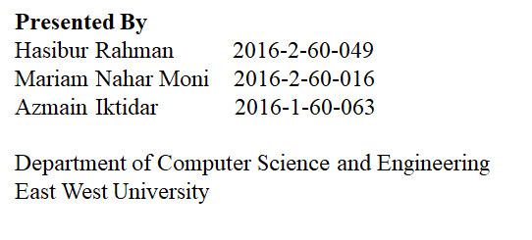
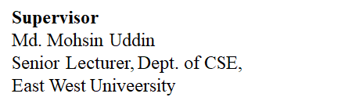

Slide 2
Overview
Introduction
Motivation
Objectives
Related works
Dataset
Proposed work
Implementation
Conclusion
Future works
References

Slide 3
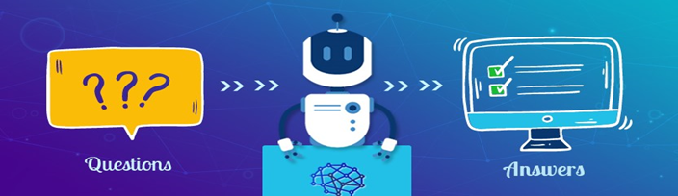
Introduction
What is QA system?
System that automatically answer the question posed by human in natural language processing.

Slide 4
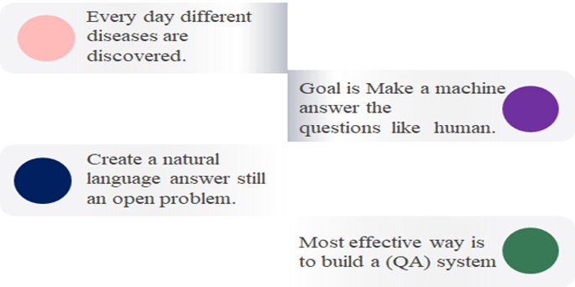
Introduction(Cont.)
Why biomedical question answering?

Slide 5

Introduction (Types of question answering)(Cont.)
Factoid question answering
What is Depression? information
Who is at risk for Depression? susceptibility
What are symptoms of Depression? symptoms

Slide 6

Introduction (Types of question answering)(Cont.)
Complex question answering
What is Depression? Illness that negatively affects how you feel, how you act.
Who is at risk for Depression? The median age of onset for depression is 32 years.
What are symptoms of Depression? Feeling sad ,Loss of interest ,Change in appetite

Slide 7
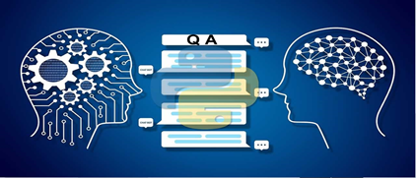
Motivation
● Mass people can get any disease related answer by asking questions anytime,anywhere.
● In pandemic situation like now when people can’t go outside from home,this system can be very much beneficent for them.

Slide 8
Objectives
● To implement the High Performance biomedical question answering system.
● Better understanding of biomedical question answering for experts.
● Allow directly query the data and extract meaningful information.
● Avoid time consuming and extra effort.

Slide 9
Related Works
● The CMU-Live Med QA team (Vasu Sharma*, et al. 2018) designed a speciﬁc system for the medical task. Those system obtained an average score of 0.353.
● The CMU-OAQA system (D. Wang, et al. 2017 )achieved the best performance of 0.637 average score on the medical task by using an attentional encoder-decoder model.
● The PRNA system (V. V. Datla, et al. 2017 ) achieved the second best performance in the medical task with 0.49 average score using Wikipedia as the ﬁrst answer source and Yahoo and Google searches as secondary answer sources.

Slide 10
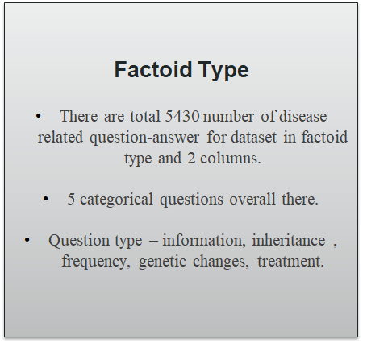
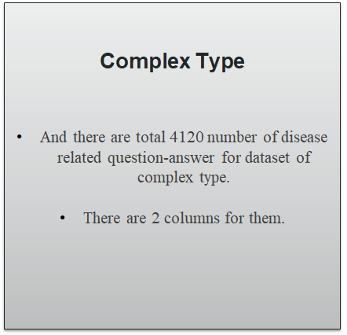
Dataset

Slide 11
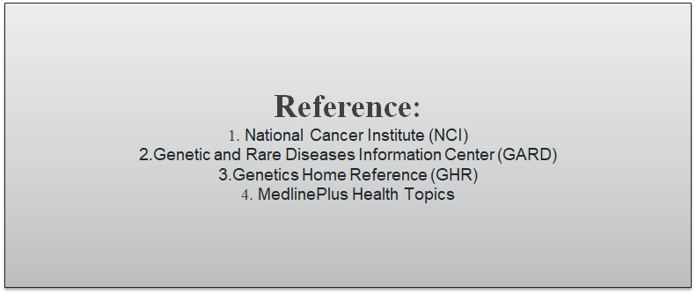
Dataset Collection

Slide 12
Dataset (For factoid type)(Cont.)
Question QType 1.What is acral peeling skin syndrome ? Inheritance 2.How many people are affected by acral peeling syndrome ? Frequency 3.What are the genetic changes related to acral peeling syndrome ? Genetic Changes 4.What are the treatments for acral peeling syndrome ? Treatment

Slide 13
Dataset(For complex type)(Cont.)
Question Answer
An opening in the abdomen through which various abdominal organs can protrude.
What is (are) abdominal wall defect?
Diagnostic Tests-Drug Therapy-Surgery and Rehabilitation-Genetic Counseling-Palliative Care.
What are the treatments for abdominal wall defect?
What is (are) Osteoporosis ?
A Bone Disease that thins and weakens the bones become fragile and break easily.
Who is at risk for Osteoporosis?
Women are at higher risk for osteoporosis than men.
Fractures-A Possible Warning Sign Osteoporosis does not have any symptoms until a fracture occurs.
What are the symptoms of Osteoporosis ?

Slide 14
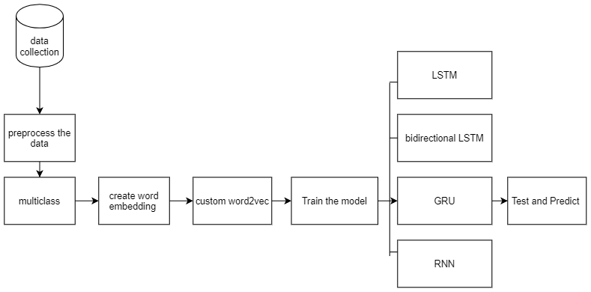
Proposed work (Factoid type Question Answering System)
Figure:multiclass classification(factoid) using Word Embedding keras

Slide 15
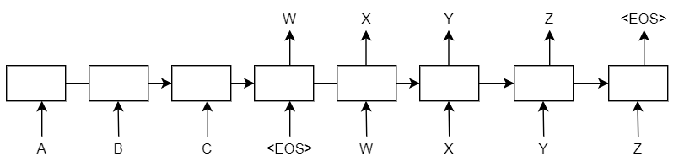
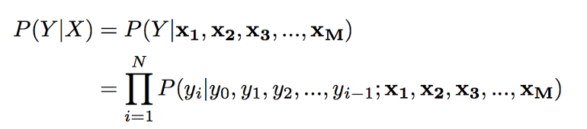
Proposed work (Complex type Question Answering System)
Figure : Encoder Decoder model

Slide 16
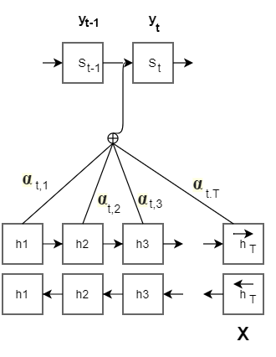

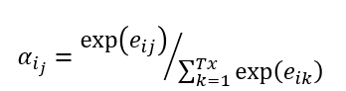
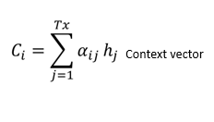
Proposed work(Complex type Question Answering System)
Attention layer consists of
Alignment score
Attention weights
Context vector
Alignment Score:
Attention Weights:
Context Vector:
Figure: Encoder Decoder with attention

Slide 17
Implementation(Factoid type pseudocode)
Start
Input: input sentence {Given a sequence of inputs (x1, . ., xT )}
Output: target class level{level of outputs (y1,.., yT)}
1. Preprocessing:
encode categorical to numerical
clean the data
tokenize the text
apply stopword removal
2.Split the dataset into train and test data

Slide 18
Implementation(Factoid type pseudocode) (Cont.)
3.define Custom word2vec model
model = gensim.models.Word2Vec(
pass the question,
set the dimensionality of word vector,
set the window size,
set number of cpu core as workers size,
define the minimum count words for model
Set sg <- 0 for cbow )
4.Save word2vec model

Slide 19
Implementation(Factoid type pseudocode) (Cont.)
5.Embedding layer
6.define LSTM model
add the fist embedding layer
Add the LSTM layer and set return_sequences as false
Add dense output layer with softmax activation
Compile the model
7.LSTM model training
8.Make predictions from test dataset

Slide 20
Implementation(Complex type Encoder-Decoder pseudocode)
START
Input: input sentence{Given a sequence of inputs(x1, . , xT )}
Output: target sentence {sequence of outputs (y1, . . , yT )}
1. Preprocessing
2.Create the dictionary of unique source and target words to vector and vice-versa
find all the source and target words and sort them
Find maximum sentence length in the source and target data
create a word to index(word2idx) for source and target
create dictionary for index to word for source and target vocabulary
3.Split the dataset into train and test data

Slide 21
Implementation(Complex type Encoder-Decoder pseudocode)(Cont.)
4.Create the data for training the encoder-decoder model
Function generate_batch(X, y, batch_size)
while true
for each j in range(0,,len(x,batch_size)
Initialize encoder input,decoder input,decoder output
For i = 0,(input_text, target_text) in enumerate
For t = 0, word in input_text
encoder_input_data[i, t] <- source_word2idx[word]
if t less than len(target_text.split())-1
decoder_input_data[i, t] <- target_word2idx[word]
If t greater than zero decoder target, data will be ahead by one timestep
decoder_target_data[i, t - 1, target_word2idx[word]] <- 1
yield encoder_input_data, decoder_input_data and decoder_target_data

Slide 22
Implementation(Complex type Encoder-Decoder pseudocode)(Cont.)
5.Build the encoder using Embedding and LSTM layers
pass the input through the input layer.
first hidden layer will be the embedding layer.
Create the LSTM layer and only set return_state to True
discard the encoder_output and preserve the hidden state and cell state only
6.Build the decoder using Embedding and LSTM layers
embedding is again the first hidden layer in the decoder
LSTM layer will return output sequences as well as the internal states.
apply a softmax activation to the Dense layer
generate the decoder outputs

Slide 23
Implementation(Complex type Encoder-Decoder pseudocode)(Cont.)
7. Compile and train the model
Define the model that takes encoder and decoder input to output decoder_outputs
compile the model using “rmsprop” optimizer and categorical_crossentrop
8. Define the inference model
9. Make predictions from on the Test dataset
END

Slide 24
Implementation(Complex type Attention pseudocode)
The steps of attention mechanism is similar with encoder decoder model except the Encoder, Attention layer and Decoder. The attention mechanism is an implementation of ‘Bahdanau Attention’.
1.Build the encoder
pass the input through the input layer.
the first hidden layer will be the embedding layer.
Create the first LSTM layer
Create the second LSTM layer
Create the third LSTM layer
set return_sequences=True and return_state to True for all LSTM layer

Slide 25
Implementation(Complex type Attention pseudocode) (Cont.)
2.Build the decoder
create an input layer for the decoder_inputs
embedding is again the first hidden layer in the decoder
Create LSTM layer
apply a softmax activation to the Dense layer
generate the decoder outputs
3.Build the Attention Layer

Slide 26
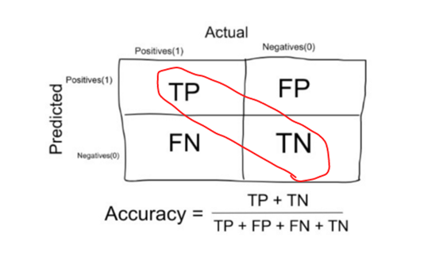
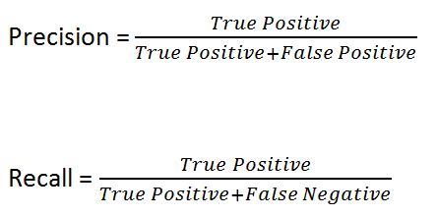
Result Analysis
Performance Analysis for question answering system:
Figure: Formula of Accuracy, Recall, Precession

Slide 27
Result Analysis(Factoid Type)
Comparison of the Factoid type system accuracies, precisions, recalls of all the approaches are mentioned in the following table. Among of them our Proposed bidirectional LSTM reveals better accuracy, precision, recall.
Name of the Algorithm | Depicted Accuracy (%) | Depicted Precision (%) | Depicted Recall (%)
LSTM | 95.19 | 95.50 | 94.84
Bidirectional LSTM | 97.31 | 97.44 | 97.15
GRU | 83.63 | 86.18 | 81.24
Simple RNN | 83.70 | 85.50 | 82.00
CNN | 94.98 | 95.38 | 94.52

Slide 28
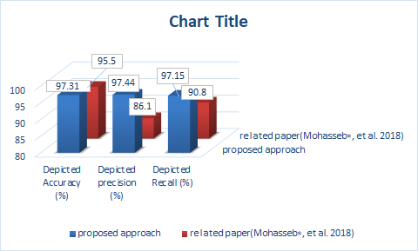
Result Analysis(Factoid Type)
Performance comparison of the proposed work bidirectional LSTM with recent paper(Mohasseb∗, et al. 2018) are shown in the column chart. We can clearly see that our proposed bidirectional LSTM has higher rate of accuracy, precision, recall.

Slide 29
Result Analysis(Complex Type)
For complex type system our proposed work encoder decoder and attention comparison mentioned in the following table .Our proposed encoder decoder reveals better accuracy, precision, recall compared to attention mechanism:
Name of the Algorithm | Depicted Accuracy (%) | Depicted Precision (%) | Depicted Recall (%)
Encoder Decoder 1st approach | 99.67 | 99.68 | 99.67
Attention 2nd approach | 37.25 | 47.57 | 99.49

Slide 30
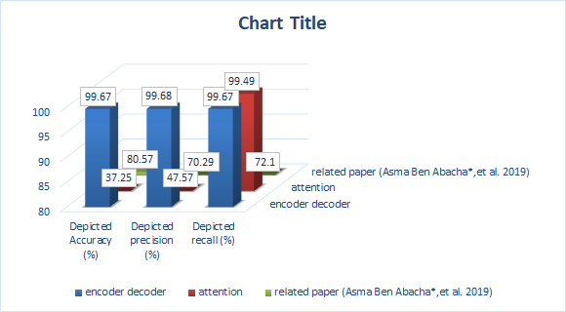
Result Analysis (Complex Type)
Performance comparison of the complex type proposed approach with recent paper(Asma Ben Abacha*,et al. 2019) are shown in the column chart. Here our proposed work encoder decoder has higher rate of accuracy, precision, recall.

Slide 31
Result Analysis(Complex Type)
Encoder-decoder with attention model prediction result from test dataset are shown below
Input Source Question: what are the genetic changes related to x linked thrombocytopenia ?
Actual Target Answer: mutations in the was gene cause x linked thrombocytopenia
Predicted Target Answer: mutations in the alas gene cause x linked sideroblastic anemia
Input Source Question: how many people are affected by ring chromosome syndrome ?
Actual Target Answer: ring chromosome syndrome appears to be a rare condition
Predicted Target Answer: ring chromosome syndrome appears to be a rare condition although its prevalence is unknown
Input Source Question: how many people are affected by hyperlysinemia ?
Actual Target Answer: the incidence of hyperlysinemia is unknown
Predicted Target Answer: the overall prevalence of sialidosis is unknown
Input Source Question: what are the treatments for van der woude syndrome ?
Actual Target Answer: diagnostic tests drug therapy surgery and rehabilitation genetic counseling
Predicted Target Answer: diagnostic tests drug therapy surgery and rehabilitation genetic counseling

Slide 32
Conclusion
Our work has given better result than previous state of paper.
We developed a QA system to answer medical questions using existing question-answer pairs.
We analyzed that better generation of multi-label question not only improved the performance of question but also has a positive impact on the overall QA system.

Slide 33
Future Works
In future we will increase the number of question-answer in our dataset so that it can cover most of the disease occurs in the world.
Also in future recent sequence-to-sequence model transformer,bart can be used to implement for complex question answering system

Slide 34
References
● Asma Ben Abacha* & Dina Demner-Fushman, 2019. A question-entailment approach to question answering. Ben Abacha and Demner-Fushman BMC Bioinformatics, p. 20:511.
● Mohasseb∗, A., Bader-El-Den, M. & Cocea, M., 2018. Classification of factoid questions intent using grammatical features. The Korean institute of communication and information sciences, pp. 239-242.
● Vasu Sharma *, Nitish Kulkarni*, Srividya Pranavi Potharaju*,
Gabriel Bayomi*,Eric Nyberg,Teruko Mitamura , "BioAMA: Towards an End to End BioMedical Question Answering System," Proceedings of the BioNLP 2018 workshop, p. 109–117 , 2018.
● D. Wang and E. Nyberg. CMU OAQA at TREC 2017 LiveQA: A neural dual entailment approach for question paraphrase identiﬁcation. In Proceedings of The Twenty-Sixth Text REtrieval Conference, TREC 2017, Gaithersburg, Maryland, USA, November 15-17, 2017, 2017.
● V. V. Datla, T. R. Arora, J. Liu, V. Adduru, S. A. Hasan, K. Lee, A. Qadir, Y. Ling, A. Prakash, and O. Farri . Open domain real-time question answering based on asynchronous multiperspective context-driven retrieval and neural paraphrasing. In Proceedings of The Twenty-Sixth Text REtrieval Conference, TREC 2017, Gaithersburg, Maryland, USA, November 15-17, 2017.

Slide 35



