Slide 1
8 Queen Problem Solving with Simulated Annealing.
Presented by: Md.Ashikuzzaman
Tayeibah Haque
Anik Islam Khan

Slide 2
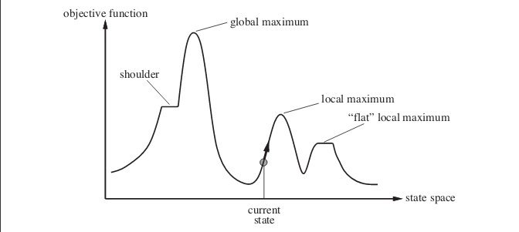
Hill Climbing
Hill Climbing is heuristic search used for mathematical optimization problems in the field of Artificial Intelligence. ‘Heuristic search’ means that this search algorithm may not find the optimal solution to the problem. However, it will give a good solution in reasonable time.
State Space diagram for Hill Climbing

Slide 3
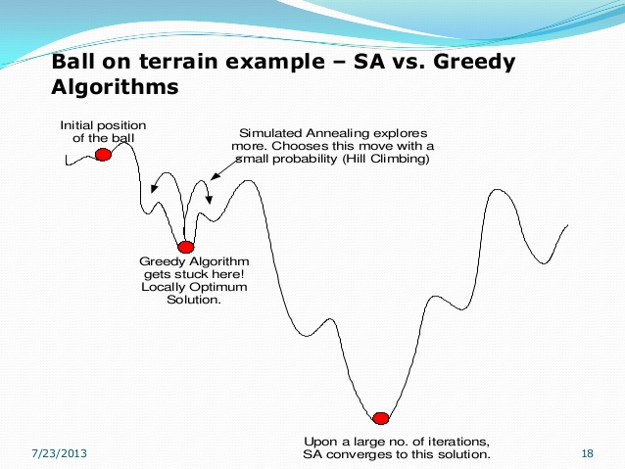
Simulated Annealing
Simulated annealing the procedure is the same there is a probability of accepting a solution that is worst than the previous one. , the idea is to allow the algorithm to “explore” some paths even if they are in principle not very good.
More iterations are run the probability of accepting a solution that is worst than the previous one decreases. So explore a lot at the beginning and just optimize at the end.

Slide 4
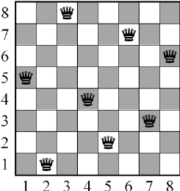
8 Queen Problem
The aim of 8-queens is to place 8 non attacking queens on an 8*8 chess board for finding all the 92 possible solutions.
arrange 8 queens on an 8*8 chessboard in a way that there is no intersection between them at both vertical or horizontal or diagonal directions.
Simulated Annealing algorithm to generate all the possible solutions for eight queens’ problem by using different random initial solutions and calculating the fitness(interaction between queens) for each solution.

