Slide 1
Evaluating the Effectiveness of Prescription Drug Monitoring Programs
Henry Siegler

Slide 2
Research Question: What is the effect of implementing Prescription Drug Monitoring Programs on the opioid overdose death rate?

Slide 3
Literature Review and Background
Prescription Drug Monitoring Programs (PDMPs) are tools used by drug prescribers to track the prescriptions someone is receiving, which helps them avoid overprescribing and see who is at risk for overdose
States must legalize and implement a PDMP
Opioid overdose death counts and rates have been increasing in the US over the past 25 years
States have improved and implemented PDMPs to address this issue

Slide 4
Lit Review Continued
Currently, 49 states and the District of Columbia have PDMP legislation
27 PDMPs were established from 2000-2010
By 2010, there were 44 PDMPs
States are continuously improving their PDMPs, and there is interstate data sharing

Slide 5
Research Question: What is the effect of implementing PDMPs on the opioid overdose death rate?

Slide 6
Lit Review Continued
2017 Patrick et al. – Used an interrupted time-series design with state level data from 1999 to 2013. Concluded that a state newly implementing a PDMP was predicted to have 1.55 fewer opioid-related overdoses per 100,000 per year
2021 Cerda et al. – Used county-level data from 2002 to 2016. Concluded that the adoption of electronic PDMP access was associated with 9% lower rates of fatal prescription overdoses after 3 years

Slide 7
Lit Review Continued
2014 Brady et al. – Used a multivariate analysis design with data from 1999 to 2008 and concluded that implementation of PDMPs was associated with a 3% decrease in the annual morphine milligram equivalents (MMEs) per capita, which may lead to a reduction in the number of opioid overdoses
2017 Nam et al. – Used multivariate regression models with state panel data. Did not find significant results and concluded that PDMPs were not associated with reductions in drug overdose mortality rates and may be related to increased mortality from illicit drugs

Slide 8
Economic Model/Theory
PDMPs provide opioid prescribers with more information on their patients, which regulates the distribution of opioids, which should lead to a lower supply of prescription opioids
The lower supply, in addition to fewer people being exposed to large quantities of opioids in the first place should lead to lower levels of opioid use and overdoses over time
If people have less access to opioids, then fewer people will become addicted to opioids, which lowers the demand for opioids in the long run

Slide 9
Data
Each observation is a state-year pair from 1999 to 2020
Outcome Variable: Overdose death rate in a year and state. Data were collected from the CDC Wonder Database, which collects data on the counts for various causes of death
1,078 observations in total
Variable of Interest: Binary variable equal to 1 if a state-year has a PDMP program implemented
Covariates: Median income, poverty rate, percentage of the population that is white, percentage of the population with a Bachelor’s degree or higher, employment rate, average age, and percentage of the population without any health insurance

Slide 10
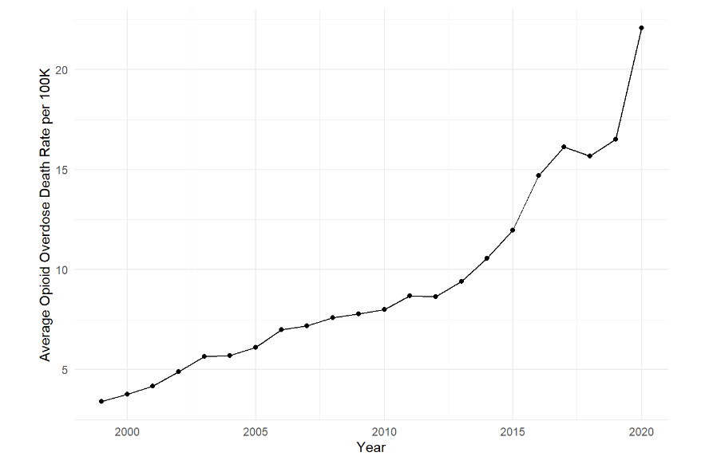

Slide 11
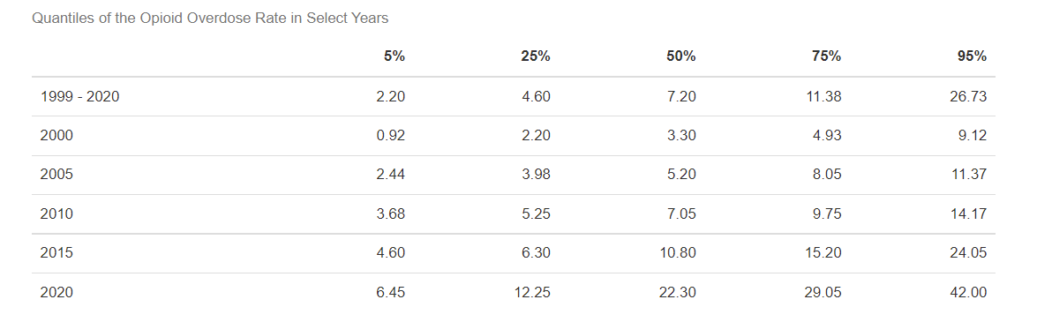

Slide 12
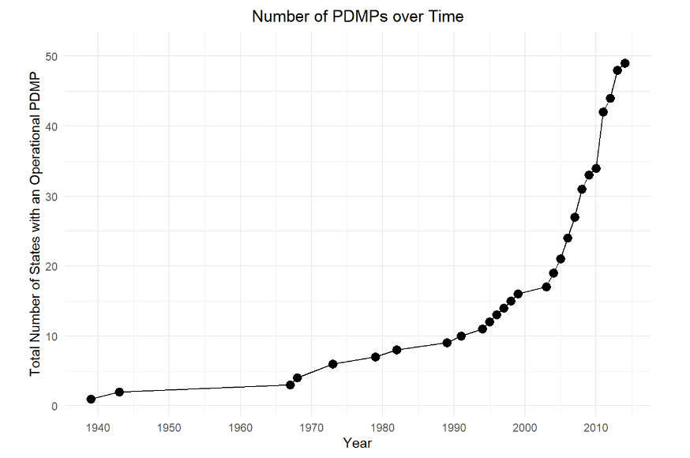

Slide 13


Regression Equation
Y_{s, t} Opioid Death Rate for State s in Time t
α_{s} State fixed effects
γ_{t} Year fixed effects
PDMP_{s, t} – Binary variable equal to 1 for a state in years after PDMP implementation and 0 otherwise
YearsAfterPDMP_{s, t} – Continuous variable indicating the number of years since the PDMP implementation, and 0 for state-year pairs before PDMP implementation
Vector of Covariates

Slide 14
What I Expect to Find
Negative coefficient on PDMP – This would indicate that there is a decrease in the opioid overdose death rate after a PDMP has been implemented
Negative coefficient on YearsAfterPDMP – This would indicate that there is a decrease in the opioid overdose death rate for each year after the PDMP was implemented

Slide 15
Why Results Are Important
Currently, funding for PDMPs is inconsistent and at risk
If there is evidence that PDMPs are effective, policymakers should focus on improving PDMPs and creating a predictable funding source
Data could be updated more frequently, and there could be improved interoperability between states

