Slide 1



We care for everyone

Slide 2
State of the COVID-19 Crisis :
COVID-19 is a humanitarian and societal crisis of unprecedented speed and scale. It has both immediate and long-lasting implications for how people work and participate in society. The top priority is to protect the health and safety of people, including in their workplaces.

Slide 3
Protection against COVID 19 :
With COVID-19, the time to act and protect yourself from getting sick. Ways to protect yourself :
Avoid unprotected contact with people.
Wash your hands frequently.
Cover your cough.
Wear mask.

Slide 4
WeCare
In this pandemic where the whole world is suffering from corona virus disease. The lockdown being imposed by central government people are getting bored in their house. So here come with an all rounder web app which consist of almost all source of entertainment and preventive measures. As the tagline suggests it’s a reason to stay at home and be safe.

Slide 5
Concept :
The main motive behind this web app is to encourage people to stay home. During lockdown people getting bored at home so this is to help them spend there time through gaming and movies. They can also chat with our assistant about their health and preventative measures. It also has section where you can consult a doctor whenever you feel so. And also it reminds you to wash your hands.

Slide 6
Design

Slide 7
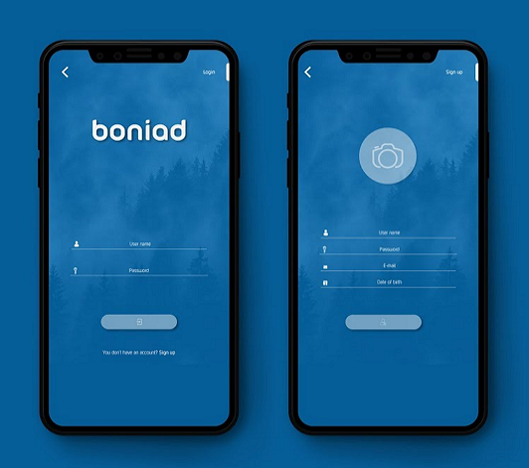
Login page

Slide 8

Chatbot for diagnosis
A REASON TO STAY HOME

Slide 9
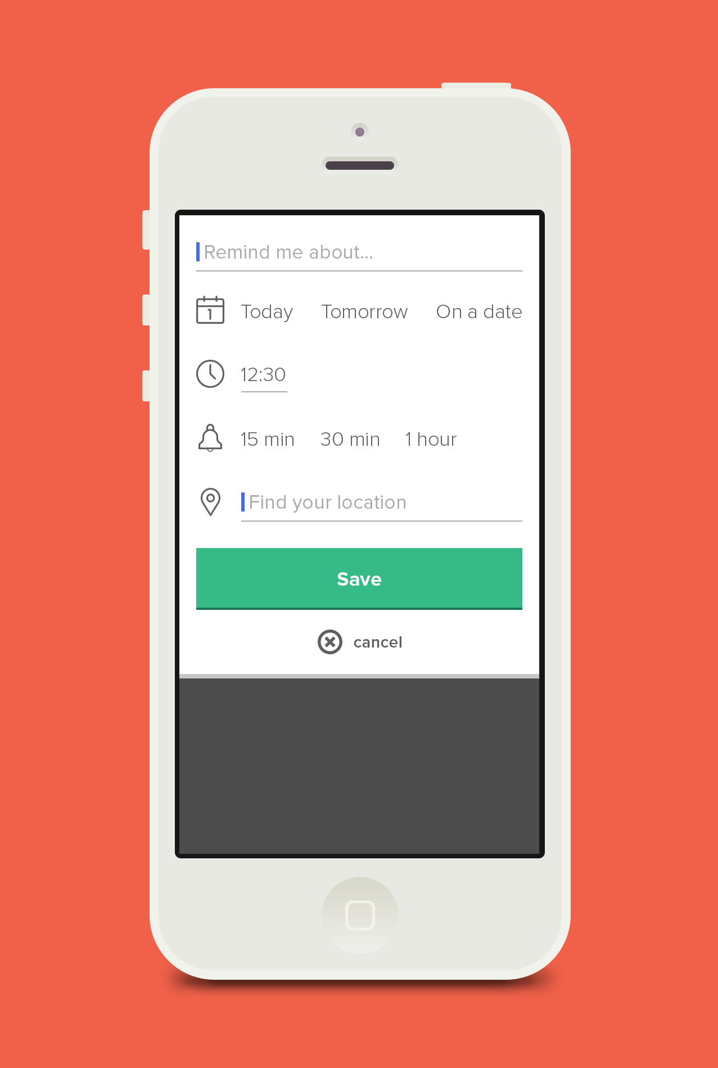
Remainder for washing hands

Slide 10
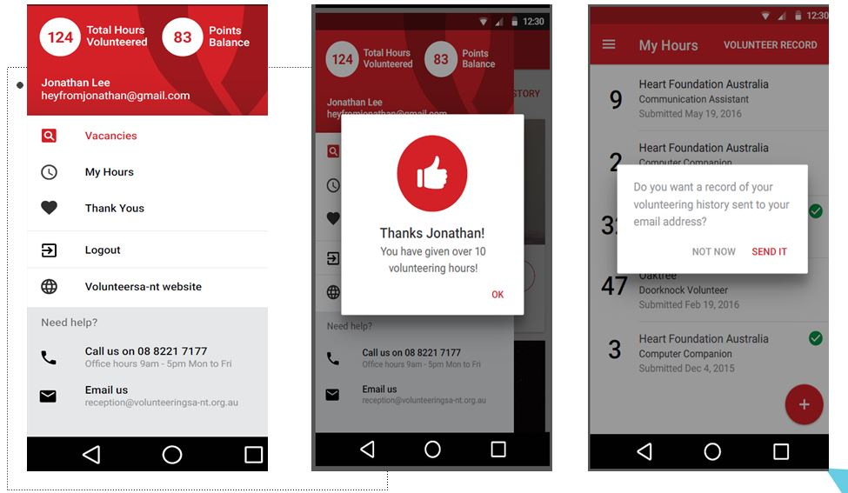
Volunteers

Slide 11
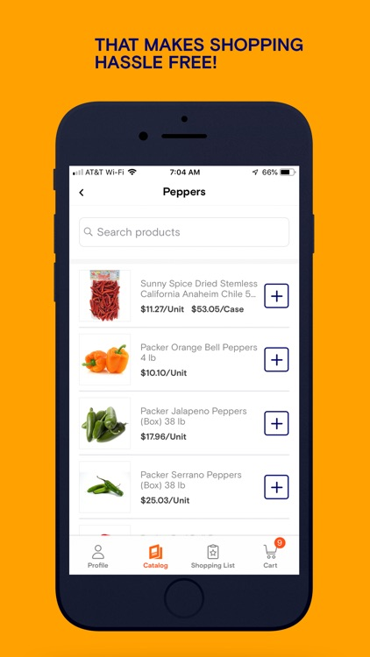
Food Supply

Slide 12
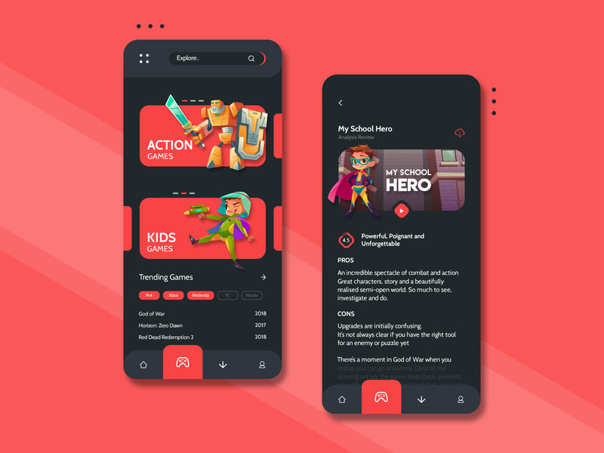
Gaming Zone

Slide 13
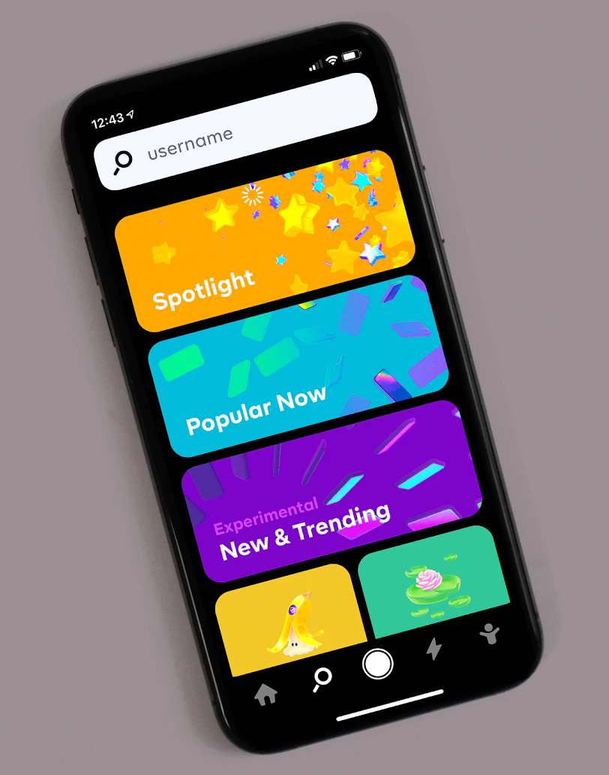
Movies and series

Slide 14
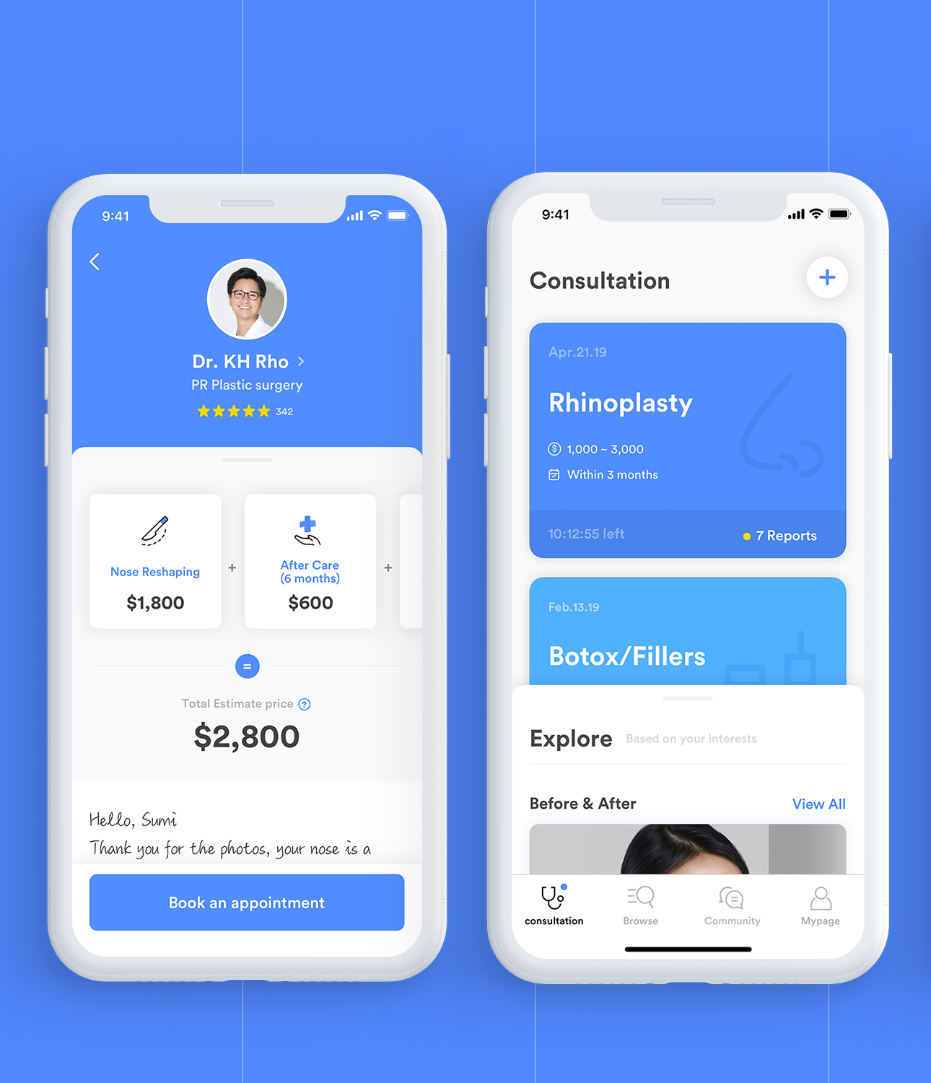
Doctor consultation

Slide 15

Description :
Login page : it allows applicants to register themselves.
Chatbot : it allows users to have a quick health checkup and know whether they are safe or not.
Remainder : it reminds you to wash hands after a fixed period of time.
Food supply : customers can place order for food grains.
Volunteers : customers willing to volunteer can register through the link given.
Gaming and movies : it provides you various types of entertainment.
Doctor’s consult : if necessary users can approach doctors for consultation.

Slide 16


Our fight against COVID-19

Slide 17
…Thank You…

