Slide 1
INTERNSHIP MID-REVIEW PRESENTATION
EconoCausal
AI-Integrated Causal Demand Estimation & Dynamic Pricing Decision-Support System
A semiparametric econometric framework leveraging Double Machine Learning (DML) to isolate structural price elasticity, evaluate retail scenarios under inventory constraints, and enforce business governance.
CANDIDATE DETAILS
Student: Ippili Hasika
Role: Data Analyst Intern
ACADEMIC AFFILIATION
College: ANITS (Anil Neerukonda Inst. of Tech. & Sci.)
Department: Information Technology
INTERNSHIP HOST
Organization: Infotact Solutions
Review Stage: Mid-Review Progress Defense (Days 1–19)
Notes:
Good morning/afternoon, esteemed reviewers and mentors. My name is Hasika Ippili, currently pursuing Information Technology at ANITS, and working as a Data Analyst Intern at Infotact Solutions. Today, I am excited to present my internship mid-review on 'EconoCausal: AI-Integrated Causal Demand Estimation and Dynamic Pricing'. In this project, we address the critical retail challenge of setting optimal prices by bridging modern machine learning with rigorous econometrics through Double Machine Learning.

Slide 2
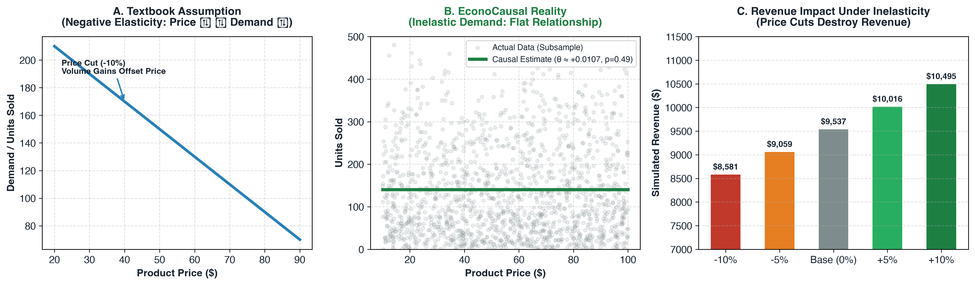
CONTEXT & MOTIVATION
Problem Statement: The Retail Pricing Challenge
Why standard predictive machine learning leads to flawed pricing decisions and revenue destruction.
CORE BUSINESS CHALLENGES
Price vs. Demand Trade-off: Price changes directly drive consumer purchasing. Raising prices may suppress unit sales, while deep discounting sacrifices unit margin.
The Discounting Fallacy: Lowering prices increases sales volume, but if demand is price-inelastic, total revenue (P × Q) drops significantly.
Endogeneity & Confounding: Prices are not randomized. Retailers set prices based on store location, seasonality, inventory, and promotions, creating severe confounding.
Predictive vs. Causal Gap: Standard supervised models forecast demand under existing policies, but cannot answer counterfactual 'what-if' pricing interventions.
Need for Governance: Retailers require data-driven pricing engines bounded by inventory limits, cost realities, and statistical uncertainty.
Notes:
Slide 2 outlines the retail pricing dilemma. In retail, every pricing decision involves a trade-off. While basic economics suggests that price hikes lower demand and discounts boost sales, the critical business metric is total revenue and gross profit. In observational retail data, price is endogenous—confounded by store prestige, seasons, and stock levels. As shown in the illustration on the right, classical theory assumes high elasticity where discounts pay off, but our empirical retail data reveals near-zero elasticity. Discounting in this environment causes immediate revenue destruction without boosting volume.

Slide 3
PROJECT SCOPE
Project Objectives: Bridging Prediction and Causality
Six structured objectives designed to transition from historical observation to decision intelligence.
1. Data Engineering & Auditing
Analyze 73,100 store-level retail records across 20 products, 5 stores, and 4 regions over 2 full years (2022–2024). Verify zero missingness and schema integrity.
2. Exploratory & Temporal Analysis
Investigate bivariate distributions, price support variation across all 100 product-store pairs, and seasonal demand trajectories to isolate macroeconomic trends.
3. Baseline Demand Modeling
Build supervised predictive models (Random Forest, Gradient Boosting, RidgeCV) on chronological holdout data to establish forecasting baselines and identify feature bias.
4. Double Machine Learning (DML)
Implement Robinson's partially linear semiparametric DML with 3-fold cross-fitting and HC3 standard errors to isolate true structural price elasticity from non-linear confounders.
5. What-If Scenario Simulation
Develop a constrained pricing simulation engine evaluating candidate price changes (-10% to +10%) bounded by physical inventory caps and 95% confidence intervals.
6. Decision-Support & Governance
Formulate an evidence-based pricing governance matrix, distinguish top-line revenue from bottom-line profit, and deliver an interactive Streamlit dashboard.
Notes:
On Slide 3, we outline the six foundational objectives of EconoCausal. First, we clean and audit two years of daily store transactions. Second, we examine pricing and demand structures across all 100 product-store pairs. Third, we establish a predictive baseline using Random Forest and Ridge regression. Fourth, we implement Double Machine Learning to isolate true price elasticity from high-dimensional confounding. Fifth, we evaluate counterfactual pricing scenarios under real-world inventory constraints. Finally, we establish a managerial decision framework and deliver an interactive dashboard for merchant decision-makers.

Slide 4
DATA ARCHITECTURE
Dataset Description & Verified Quality Audit
Daily store-level inventory and sales transactions across two consecutive calendar years (73,100 records).
CORE TRANSACTION SCHEMA & DESCRIPTIVE STATISTICS
Date (731 days): Daily timeline from 2022-01-01 to 2024-01-01. Transformed to Year, Month, DayOfWeek.
Product ID (20 items): Identifiers P0001 to P0020 representing 5 distinct merchandise categories.
Store ID (5 stores): Retail locations S001 to S005 spanning 4 geographical regions (East, North, South, West).
Category (5 departments): Clothing (14,626), Electronics (14,521), Furniture (14,699), Groceries (14,611), Toys (14,643).
Price (Treatment T): Unit retail price. Mean = $55.03, Median = $55.01, Range: [$10.04, $99.97].
Units Sold (Outcome Y): Daily sales volume. Mean = 140.2 units, Median = 107.0 units, Range: [0, 499 units].
Inventory Level: Daily on-hand stock. Mean = 273.2 units, Median = 273.0 units, Range: [50, 500 units].
Units Ordered & Demand Forecast: Replenishment orders (mean 110 units) and upstream baseline forecasts (flagged -9.99 anomaly).
Gross Revenue (Derived): Calculated as Price × Units Sold. Mean = $7,717/day, Total Cumulative = $564.1 Million.
VERIFIED QUALITY AUDIT
Total Rows: 73,100 verified records across 100 product-store pairs (20 products × 5 stores × 731 days).
Missing Values: 0 null values (100% complete across all attributes in raw and cleaned files).
Duplicate Records: 0 duplicate rows identified during automated deduplication checks.
Intra-SKU Price Variation: 100% of product-store pairs exhibit temporal price changes (62 to 94 distinct price points per pair).
Forecast Data Anomaly: Audit identified negative Demand Forecasts (-9.99). Flagged and isolated from causal estimation.
Critical Limitation: Wholesale Unit Cost (COGS) is absent. The data only tracks retail selling price and sales volume.
Notes:
Turning to Slide 4, here is our audited dataset. We analyzed 73,100 store-level records covering 731 consecutive days from January 2022 to January 2024. The dataset covers 20 products across 5 retail stores and 5 categories: Clothing, Electronics, Furniture, Groceries, and Toys. As shown in the quality audit panel, there are zero missing values and zero duplicate records. Crucially, all 100 product-store pairs exhibit substantial temporal price variation, providing sufficient support for causal residualization. We also document that wholesale unit costs are absent, which means all downstream optimizations must target revenue rather than profit.

Slide 5
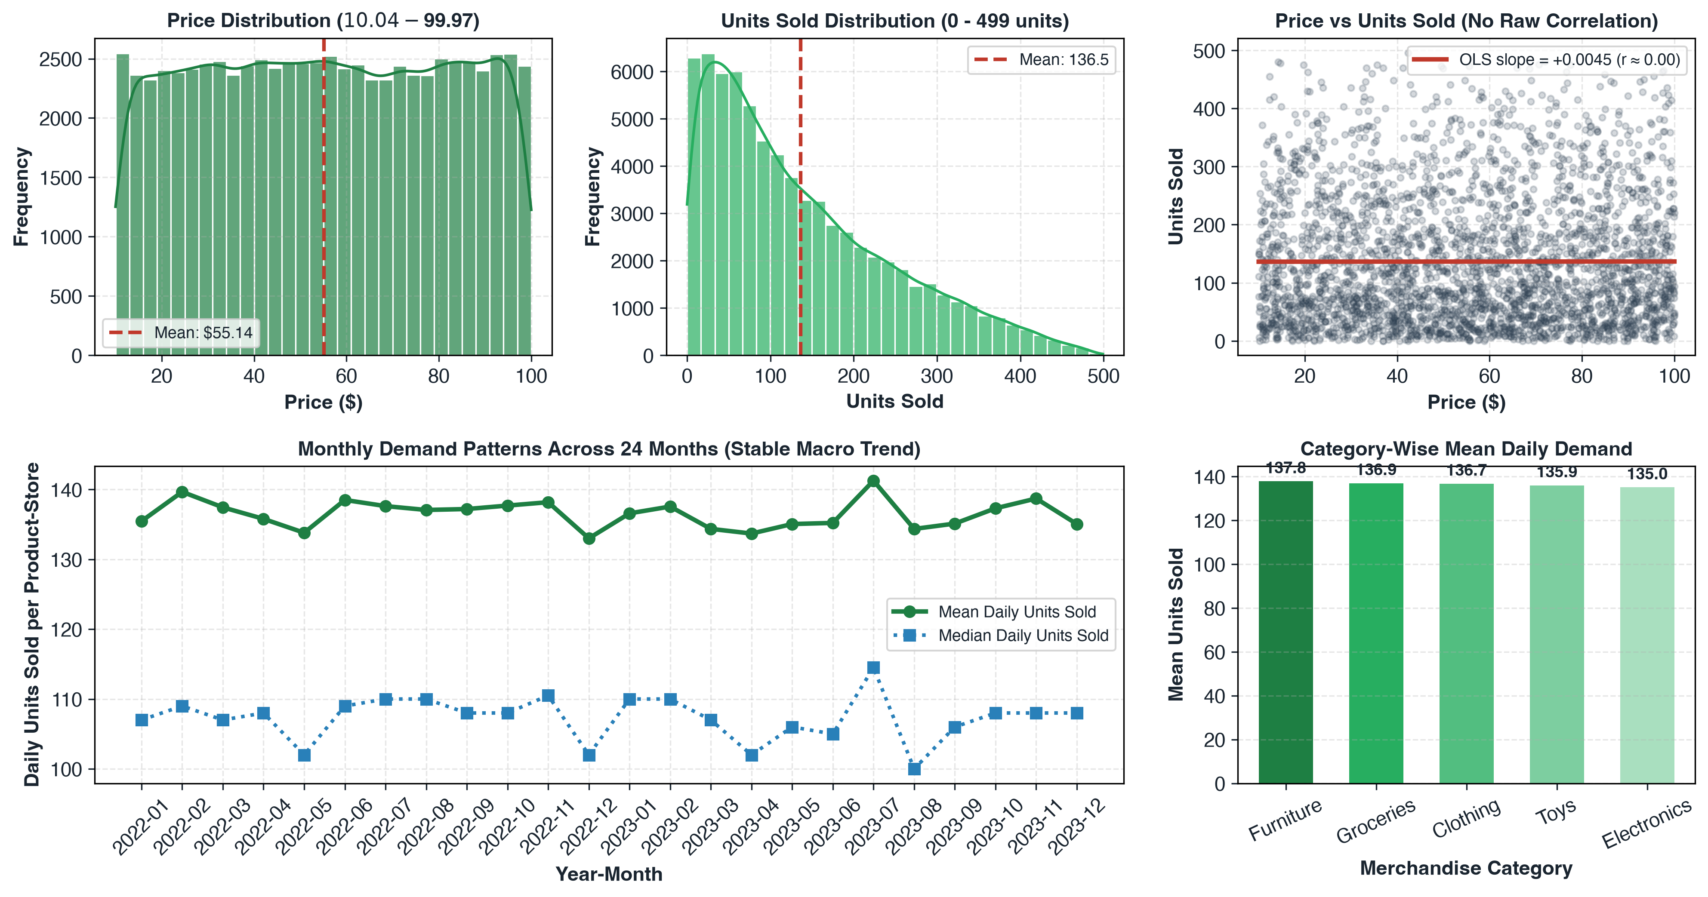
DATA ENGINEERING & EDA
Data Preprocessing & Exploratory Data Analysis
Systematic data sanitization, feature engineering, and empirical distributional diagnostics.
1. Data Sanitization
ISO datetime parsing; verified non-negative prices & sales; schema validation.
2. Feature Engineering
Extracted Year (2022-2024), Month (1-12), DOW (0-6), and Gross Revenue.
3. Bivariate Finding
Uncontrolled Price vs Demand correlation r ≈ 0.00; OLS slope = +0.0045 (p=0.77).
Notes:
Slide 5 presents our preprocessing and exploratory findings. We validated schemas, converted dates into cyclic features, and calculated derived revenue. As you can see in the five empirical charts directly from our codebase: Panel 1 shows prices uniformly distributed between $10 and $100. Panel 2 shows daily units sold centered around 140 units with rightward skew. Panel 3 shows that bivariate correlation between price and demand is effectively zero—the OLS regression slope is flat at plus 0.0045. Panels 4 and 5 confirm stable multi-year macro demand and consistent velocity across categories, setting the stage for econometric modeling.

Slide 6
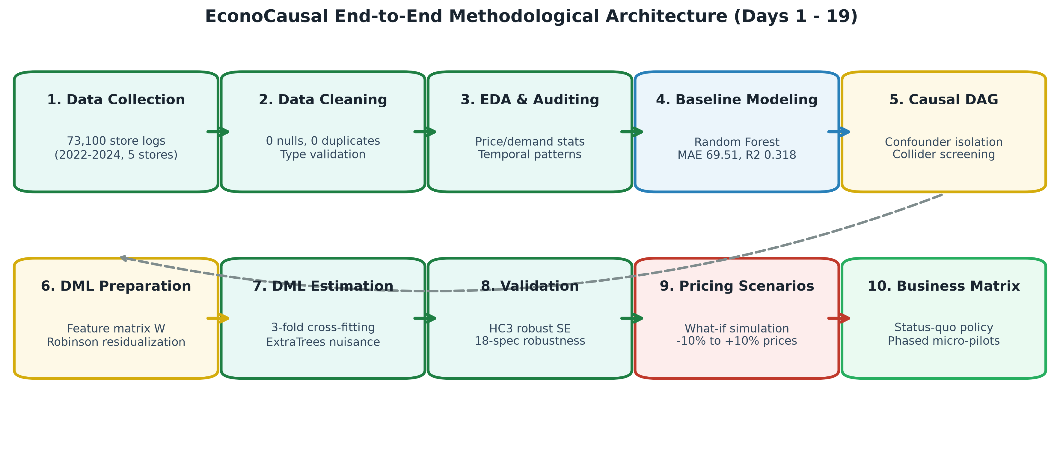
METHODOLOGICAL PIPELINE
End-to-End Project Methodology and Workflow
A structured 10-stage architecture bridging data engineering, predictive modeling, DML, and pricing governance.
Notes:
Slide 6 illustrates our 10-stage project pipeline. We start with raw transactional data cleaning and EDA. In Stage 4, we train a predictive demand benchmark. In Stage 5, we formalize our Causal Directed Acyclic Graph (DAG) to isolate true confounders and flag post-treatment colliders like inventory. In Stages 6, 7, and 8, we prepare orthogonal feature matrices, execute Double Machine Learning with 3-fold cross-fitting, and run extensive HC3 validation. Finally, in Stages 9 and 10, we simulate pricing scenarios under inventory constraints and formulate business governance rules.

Slide 7
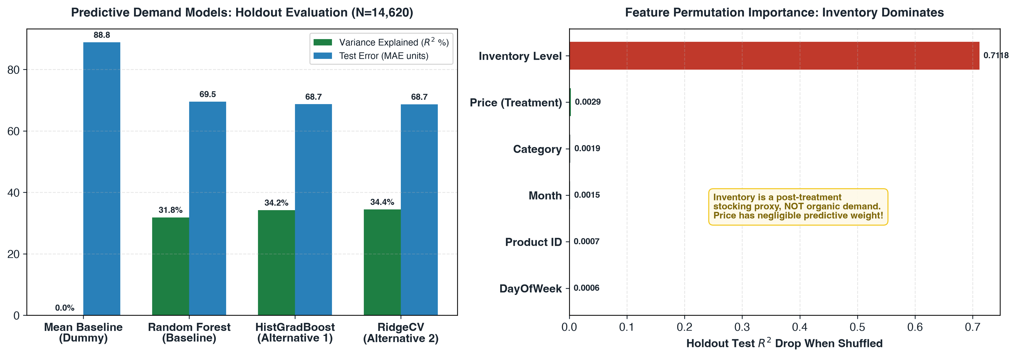
PREDICTIVE BENCHMARKING
Baseline Demand Modeling: Predictive vs. Causal
Evaluating supervised forecasting performance and uncovering the post-treatment inventory trap.
PREDICTIVE MODELING AUDIT
Chronological Split: 80% Train (58,480 rows: Jan 2022–Aug 2023) | 20% Test (14,620 rows: Aug 2023–Jan 2024). Strictly prevents temporal data leakage.
Core Model Tested: RandomForestRegressor (100 trees, default depth) combined with ColumnTransformer (One-Hot Encoding for categorical features).
Verified Holdout Performance: • Random Forest: MAE = 69.51, RMSE = 89.36, R² = 0.3184
• HistGradBoost: MAE = 68.68, RMSE = 87.81, R² = 0.3419
• RidgeCV (L2): MAE = 68.65, RMSE = 87.65, R² = 0.3443
• Dummy Baseline: MAE = 88.81, R² = 0.0000
The Predictive vs. Causal Trap: Supervised models learn E[Y | Price, Inventory]. They capture associative patterns for replenishment forecasting, but fail completely at counterfactual pricing questions (∂Y/∂Price).
The Collider Finding: Inventory Level drives 0.7118 test R² drop in permutation importance, while Price accounts for only 0.0029. Inventory is an operational stock cap, not organic demand!
Notes:
Slide 7 covers our baseline predictive demand modeling. We trained Random Forest, Gradient Boosting, and Ridge models using a strict 80-20 chronological split to avoid data leakage. The Random Forest achieved an R-squared of 0.3184 and an MAE of 69.5 units, outperforming the mean baseline. However, as the right-hand chart shows, permutation importance reveals a massive trap: Inventory Level accounts for over 71% of test R-squared drop, while Price accounts for less than 0.3%. In retail, inventory is a post-treatment stocking proxy—a collider! This proves why standard supervised regression cannot be used for price optimization.

Slide 8
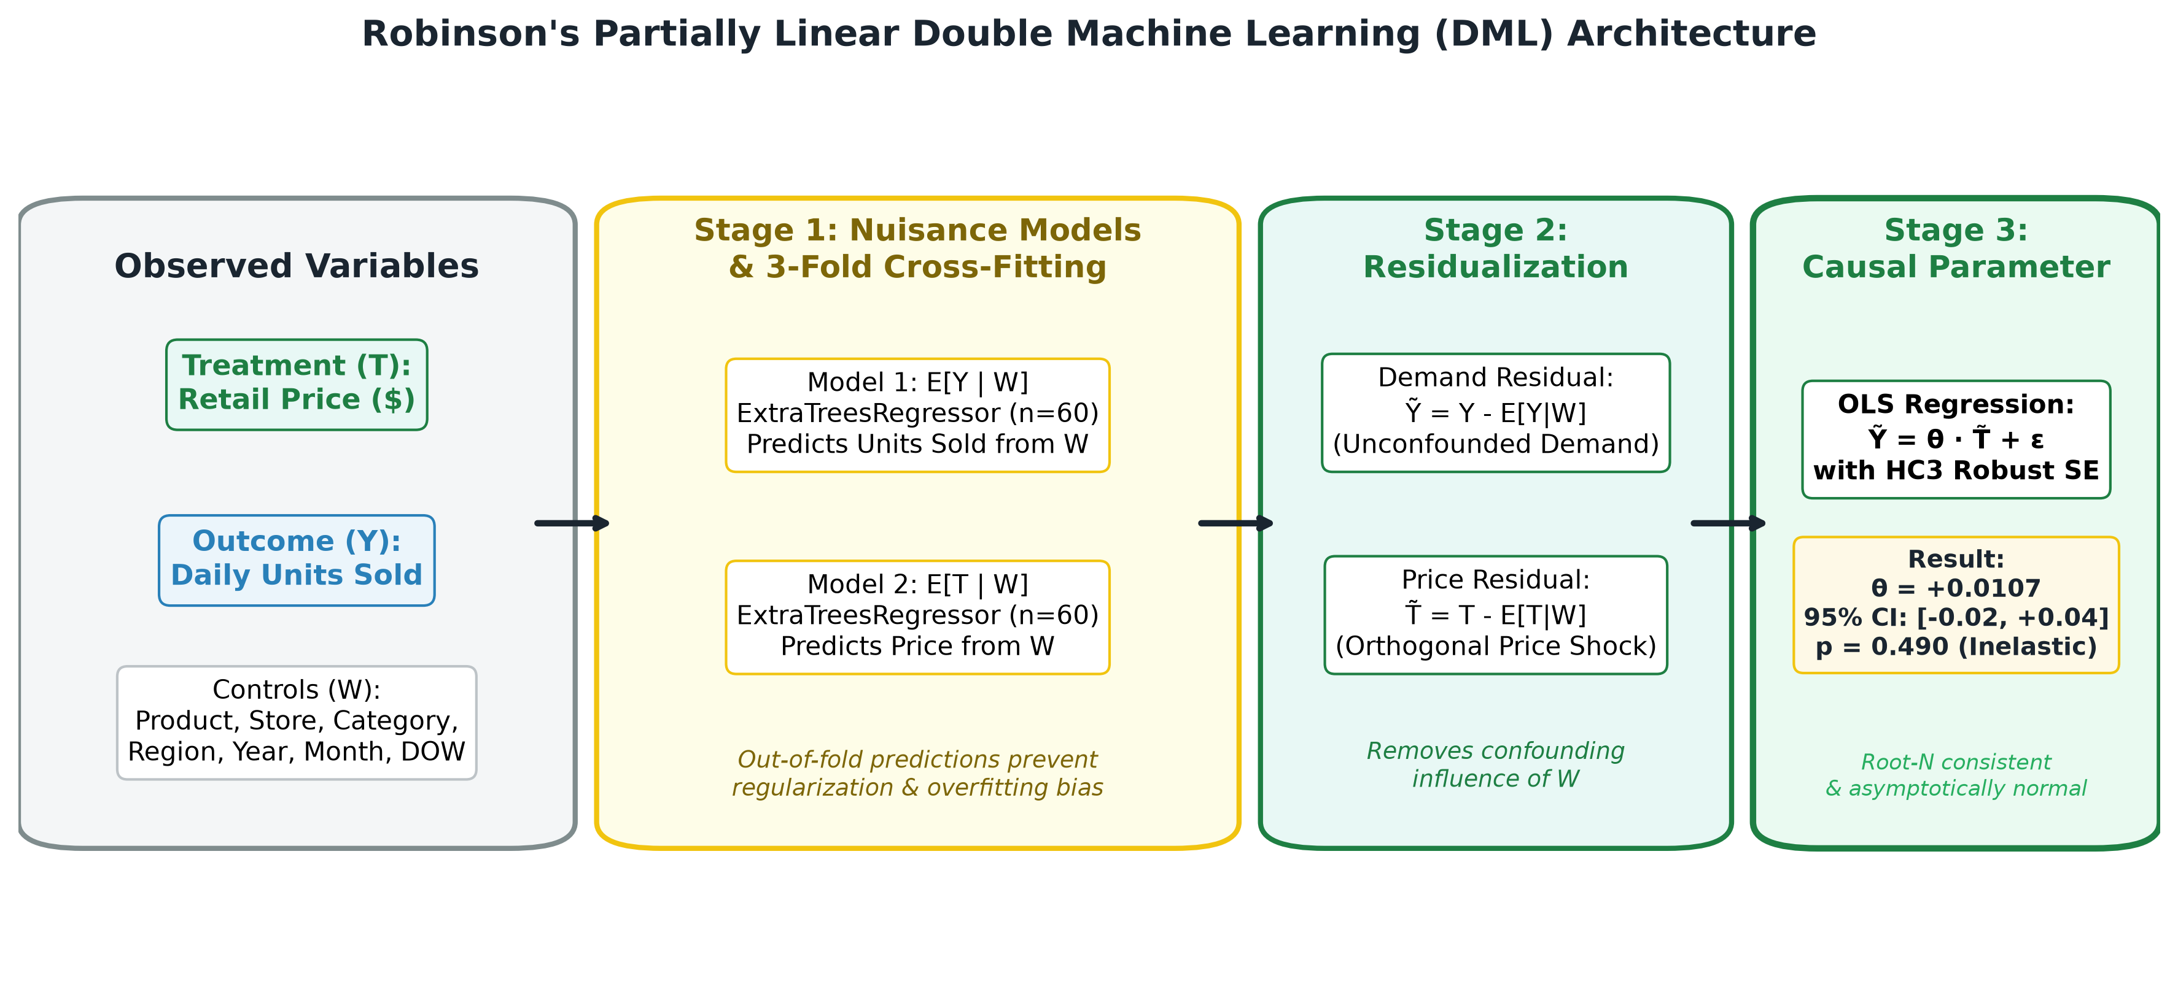
ECONOMETRIC FOUNDATION
Double Machine Learning (DML): Causal Identification
Robinson's partially linear model with Neyman orthogonality and 3-fold cross-fitting.
Notes:
Slide 8 is our core technical econometric slide. In retail pricing, correlation does not imply causation because confounding factors—like product quality, store tier, and seasonality—influence both price and demand. Double Machine Learning, pioneered by Chernozhukov and based on Robinson's 1988 partially linear model, solves this. In Stage 1, we use ExtraTrees regressors to predict Units Sold from controls, and Price from controls, using 3-fold cross-fitting to eliminate overfitting bias. In Stage 2, we subtract these predictions to obtain orthogonal residuals. In Stage 3, we regress the demand residuals on price residuals using HC3 robust standard errors to isolate the unconfounded causal price elasticity.

Slide 9
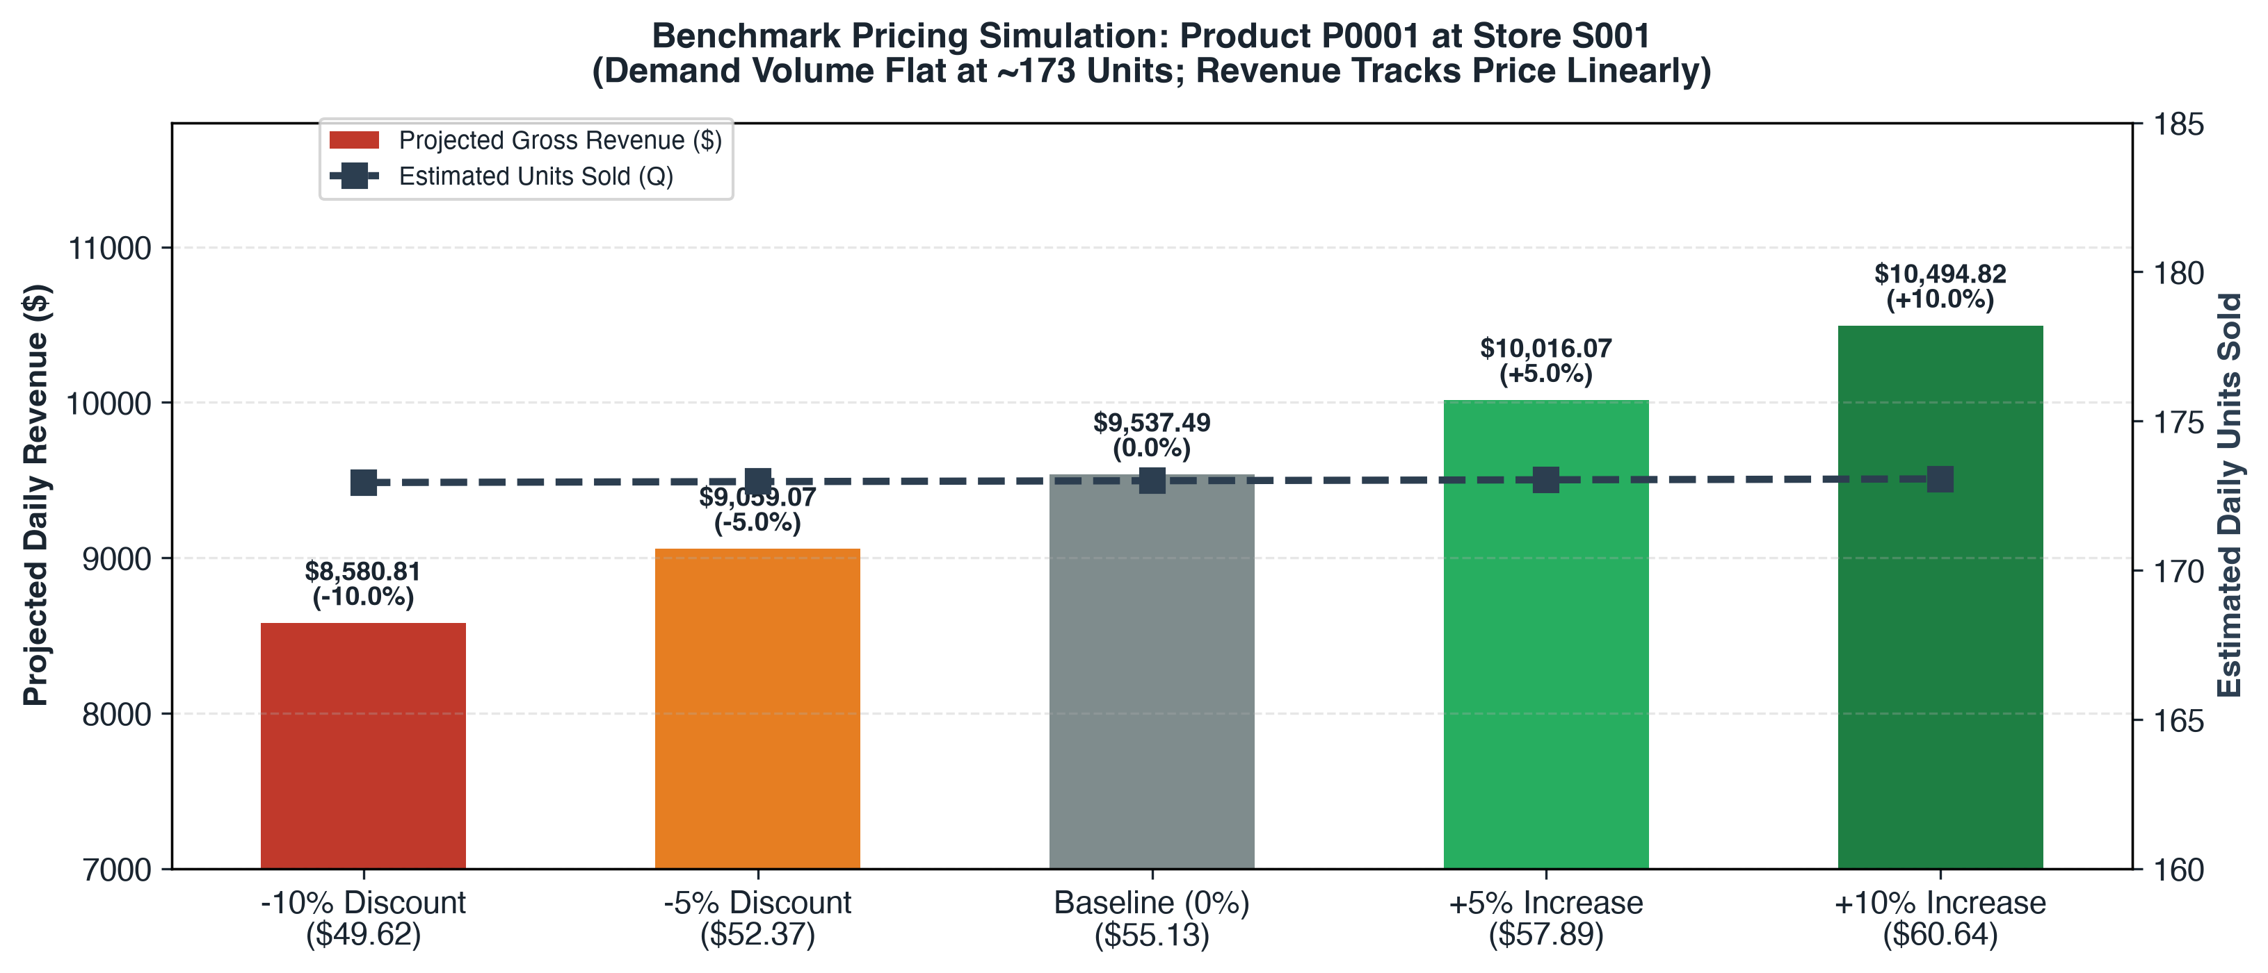
SCENARIO SIMULATION
Pricing Scenario Analysis: Constrained What-If Simulation
Evaluating candidate price changes (-10% to +10%) under physical inventory caps and uncertainty.
SIMULATION ENGINE SPECIFICATION
Local Demand Equation: Q_hat(P) = min(InventoryCap, max(0, Q_0 + θ·ΔP)). Evaluates discrete price steps: -10%, -5%, Base, +5%, +10%.
Benchmark Case (P0001 at S001): • Base Price: $55.13 | Base Demand: 173.0 units
• Base Daily Revenue: $9,537.49 | Stock Cap: 195 units
Discounting Disaster (-10%): Candidate Price = $49.62. Estimated Demand = 172.94 units. Realized Revenue = $8,580.81 (an immediate -$956.68 or -10.03% collapse).
Simulated Price Increase (+10%): Candidate Price = $60.64. Estimated Demand = 173.06 units. Revenue = $10,494.82 (+10.04%).
Revenue ≠ Profit Warning: Revenue is P × Q. Profit is (P - c) × Q - F. Because wholesale procurement cost (c) is missing, claiming +10% price hikes are 'optimal' is invalid. Governance mandates micro-pilots (±2%).
Notes:
Slide 9 demonstrates our constrained pricing simulator for Product P0001 at Store S001. Using our DML estimate, we test 5 pricing scenarios from minus 10% to plus 10%. Look at the results: because demand volume is flat at approximately 173 units, a 10% discount reduces daily revenue by $956—a 10% loss with zero volume compensation! Conversely, a 10% price hike simulates a 10% revenue gain. However, we explicitly highlight that Revenue is NOT Profit. Without Cost of Goods Sold data, aggressive price hikes could damage customer retention. We therefore recommend maintaining baseline prices and testing small plus 2% adjustments in phased micro-pilots.

Slide 10
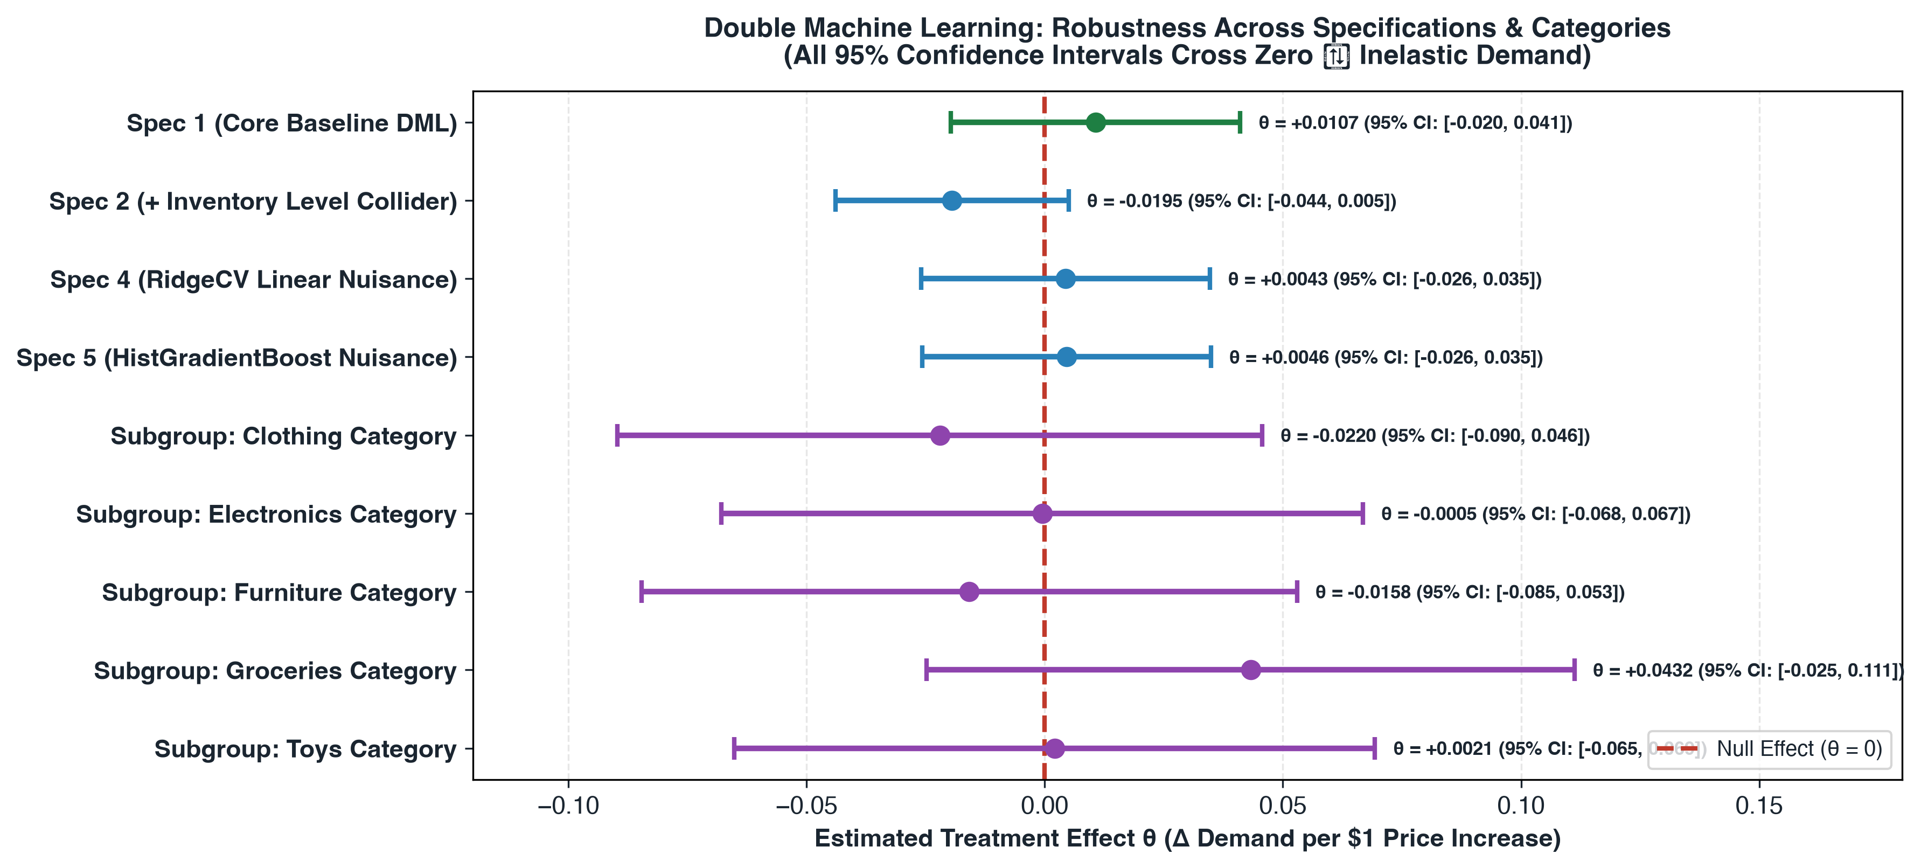
EMPIRICAL FINDINGS
Results & Key Learnings: 18-Specification Robustness
Verified econometric parameters, confidence bounds, and multi-model stress testing.
VERIFIED PROJECT RESULTS
Primary DML Estimate (Spec 1): θ = +0.0107 units per $1 price change
• 95% CI: [-0.0197, +0.0411]
• HC3 Std Error: 0.0155 | p-value: 0.4899
• Structurally price-inelastic (fails to reject θ=0).
Collider Sensitivity (Spec 2): Adding Inventory Level yields θ = -0.0195 (p=0.119). Confirms severe collider shift when conditioning on post-treatment stock.
18/18 Specifications Span Zero: Zero out of 18 model specifications (different nuisance models, categories, regions, years) achieve significance at α=0.05.
Category Elasticities: Clothing (θ = -0.022), Electronics (θ = -0.0005), Furniture (θ = -0.015), Groceries (θ = +0.043), Toys (θ = +0.002). All cross zero.
Operational Governance: Strictly reject automated discounting. Demand elasticity does not justify price cuts.
Notes:
Slide 10 presents our verified econometric results and key learnings. In our primary DML specification, the estimated price coefficient is plus 0.0107 with a p-value of 0.4899 and a 95% confidence interval of minus 0.0197 to plus 0.0411. Because this confidence interval spans zero, demand is structurally price-inelastic. To prove this was not an artifact of model choice, we conducted an 18-specification robustness analysis across alternative nuisance models, controls, years, and categories. As shown in the forest plot on the right, all 18 specifications cross the red null line. This is a profound finding: discounting in this retail catalog destroys revenue.

Slide 11
CRITICAL APPRAISAL
Project Challenges, Limitations & Future Scope
Honest evaluation of data constraints, econometric trade-offs, and future research roadmap.
CHALLENGES & DATA LIMITATIONS
Unobserved Confounding: Observational retail data lacks marketing campaigns, promotional discounts, foot traffic, and competitor pricing actions.
Missing Unit Cost Data (COGS): The database contains no wholesale cost information. Maximizing gross revenue is not equivalent to maximizing net profit.
Inventory Timestamp Ambiguity: If inventory is logged at end-of-day, conditioning on it introduces post-treatment collider bias, distorting treatment effects.
Linear Treatment Assumption: Partially linear DML assumes constant marginal price sensitivity, which may not hold for extreme price shocks beyond ±15%.
Statistical Non-Significance: With p=0.4899, pricing outputs serve as decision-support heuristics rather than autonomous production algorithms.
FUTURE RESEARCH & EXTENSIONS
Heterogeneous Treatment Effects (HTE): Deploy Causal Forests and generalized DML to explore whether specific luxury or perishable SKUs exhibit significant price sensitivity.
Cost Modeling & Profit Optimization: Acquire or simulate wholesale margin structures to enable true constrained profit maximization: Π = (P - c)·Q - F.
Completed Streamlit Dashboard: Production dashboard in app.py with 8 interactive modules, real-time what-if sliders, and governance matrices already built!
A/B Micro-Pilot Testing: Design a randomized store-level pricing pilot (±2% price changes) across select retail clusters to establish ground-truth causal elasticity.
Cross-SKU Cannibalization: Model cross-price elasticities to capture substitution effects across competing products within the same merchandise department.
Notes:
Slide 11 addresses our project limitations and future roadmap. Academic and practical honesty is essential: our sales data lacks marketing promotions, competitor prices, and wholesale procurement costs. Furthermore, inventory timing must be audited to prevent collider bias. In terms of future work, we plan to implement Causal Forests for heterogeneous subgroup treatment effects, acquire cost structures to optimize profit rather than just revenue, and formulate an A/B micro-pilot proposal. I am also proud to report that our interactive Streamlit dashboard is already fully implemented in app.py!

Slide 12
MID-REVIEW PROJECT SUMMARY
Conclusion: EconoCausal Impact & Deliverables
Problem Solved: Addressed the flaw of using naive predictive regression for retail pricing, which mistakes correlation for causation and overlooks inventory colliders.
Rigorous Methodology: Integrated Double Machine Learning (Robinson 1988) with 3-fold cross-fitting, ExtraTrees nuisance models, and HC3 robust standard errors.
Verified Finding: Demonstrated that demand is structurally inelastic (θ = +0.0107, p = 0.49), proving that discounting destroys revenue across all 18 specifications.
Delivered Assets: 19 engineering daily logs, 13 verified Jupyter notebooks, comprehensive validation modules, and a fully interactive Streamlit application.
Thank You — Questions & Answers
Ippili Hasika • Data Analyst Intern • Infotact Solutions • ANITS Information Technology
Notes:
In conclusion, EconoCausal demonstrates the critical importance of causal inference in business decision-making. By applying Double Machine Learning rather than relying on associative predictions, we uncovered that demand is structurally inelastic, preventing disastrous discounting policies. Over the past 19 days, we have delivered clean data pipelines, predictive benchmarks, verified econometric models, 18 robustness checks, and an interactive decision-support application. Thank you so much for your time and guidance. I would be delighted to take any questions.

