Slide 1

AquaMind AI: Agentic Smart Water Supply & Leakage Management System using SOA
SOA Project Review-1
Date& Time
 | Under the Guidance of Dr.T.Mahesh XXXXXX Professor, Department of Computer Science and Engineering, KLH CSE Bowrampet Campus
Team Members NAME:P.HASIKA (2420030227) NAME:K.VASAVI (2420030785)

Slide 2

Outline of Project Work
Focus
Introduction
Literature Survey
Challenges
Research Objectives
Conclusion & Future Work
References
Publications Details

Slide 3
Problem Statement
Citizens have no reliable way of knowing exact water supply timings, and schedules often change without prior notice, leaving households unable to plan their day around water availability.
Pipeline leakages in underground and overhead networks remain unnoticed for long periods, causing significant water wastage and financial loss to municipal authorities.
Complaints regarding leakages or supply issues are still registered and processed manually, which delays repair and resolution times.
Citizens struggle to locate alternative water sources such as tankers or public water points during sudden shortages or emergencies.
Municipal authorities lack predictive insights into demand and distribution patterns, resulting in inefficient and reactive water management rather than proactive planning.

Slide 4
Objectives
To design an Agentic AI platform, AquaMind AI, that proactively predicts water supply timing, delays, and demand instead of showing only fixed schedules.
To build a Leakage Detection Agent that uses computer vision on citizen-uploaded photos or videos to classify leakage severity and automatically raise a prioritized complaint.
To automate complaint registration through a Complaint Automation Agent that converts a citizen's spoken description into a tracked complaint with minimal manual effort.
To develop a Water Conservation Agent that studies household usage trends and delivers personalized, quantified saving recommendations.
To provide an Emergency Water Agent that guides citizens to nearby tankers and public water points during supply failures.
To implement the entire platform on a Service-Oriented Architecture (SOA), with independent, REST-API-driven microservices for scalability and maintainability.

Slide 5
Literature Survey
Authors | Title of the Paper | Methodology | Inferences | Limitation/Future work
Ambika et al. [1] | IoT-Based Water Leakage Detection Using Machine Learning, IJNRD, 2024 | IoT water-level and rain sensors feed real-time flow data to a central unit Supervised ML model classifies normal vs. abnormal flow to flag leaks | Demonstrates that continuous sensor data combined with an ML classifier can reliably distinguish leak from non-leak flow patterns in near real time. | Relies on physically installed flow/level sensors across the network, which is costly to scale city-wide — motivates AquaMind AI's camera/photo-based, sensor-free leakage detection.
Nazarenko et al. [2] | LLM Agents for Smart City Management: Enhancing Decision Support Through Multi-Agent AI Systems, MDPI Smart Cities, 2025 | Multi-agent architecture orchestrates diverse urban data sources using LLMs Compares GPT-4, Mistral and Llama on urban-specific decision tasks | Shows LLM-based multi-agent systems outperform single-model chatbots for coordinated, context-aware urban decision-making across departments. | Focused on school placement and park planning use cases; does not address utility-specific domains such as water supply, leakage, or conservation — the gap AquaMind AI's agents target.
Karthikeyan, C. [3] | Service-Oriented Architecture for Big Data Analytics in Smart Cities, Journal for Future Society and Education, 2025 | SOA-based framework benchmarked against monolithic architectures Evaluated on mobility, energy and urban-index datasets | Reports substantially lower latency and resource usage and higher data-integration accuracy for SOA over monolithic designs in smart-city analytics. | Evaluates SOA purely for backend data integration and scalability; does not couple it with citizen-facing agentic AI features — the combination AquaMind AI proposes.

Slide 6
Problem Gap Identification
Existing IoT and ML-based leakage detection systems rely on physical sensors installed across pipelines, which are costly to deploy and maintain at city scale; AquaMind AI instead uses citizen-submitted photos and videos, removing the sensor dependency.
Most smart-city AI research applies a single-purpose model or chatbot for one task; there is limited work on coordinated, agentic multi-agent systems that jointly handle prediction, detection, complaints, conservation, and emergencies for water utilities.
Current municipal complaint systems remain form-based and reactive, responding only after a citizen manually reports an issue, rather than proactively predicting and preventing it.
SOA-based smart-city studies focus mainly on data integration and scalability, but rarely couple the architecture with citizen-facing agentic AI features such as personalized conservation coaching.
Consequently, there is a clear gap for a low-cost, sensor-independent, agentic AI platform that unifies prediction, detection, complaint handling, and conservation on a single scalable SOA backbone.

Slide 7
Innovation, Creativity, and Novelty
1. Proactive AI Water Supply Prediction
Instead of a fixed schedule, the Water Prediction Agent forecasts delays, supply duration, and demand, explaining the reason behind each deviation.
2. Smart Leakage Severity Analysis
A single citizen-uploaded photo is enough for computer vision to detect a leak, estimate its severity, and assign repair priority automatically — no dedicated sensor hardware required.
3. Personalized Water Conservation Coach
The Water Conservation Agent learns individual usage trends and delivers daily tips and monthly reports with concrete, quantified saving estimates — a feature most student dashboards omit entirely.
Together, these agents shift the platform from a passive monitoring dashboard to an active, agentic assistant that anticipates problems before citizens report them.

Slide 8
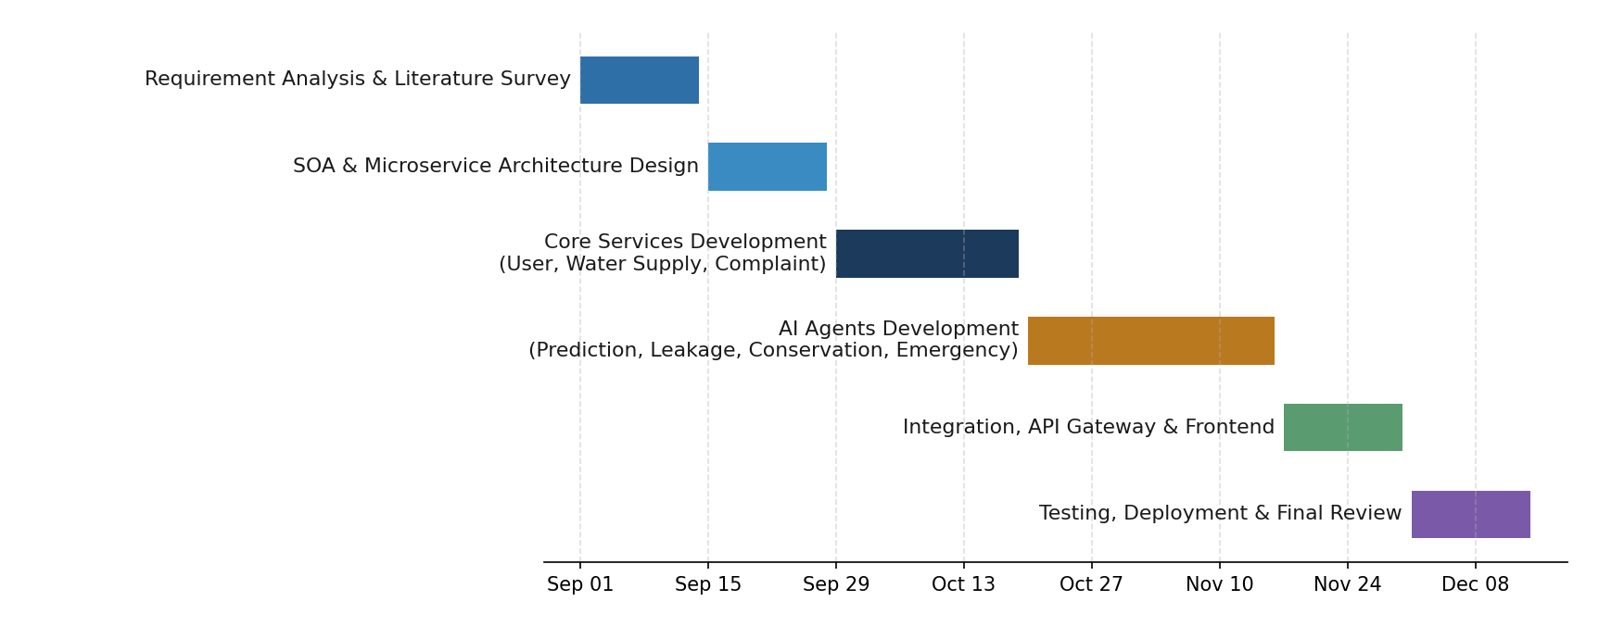
Feasibility and Project Plan
The project is feasible within the course timeline: each microservice and AI agent is independently deployable using open-source frameworks (React, REST APIs, MySQL, and open ML/CV libraries), so development can proceed in parallel across services. The phased plan below sequences architecture design, core services, AI agent development, integration, and testing over a 15-week schedule.

