Slide 1
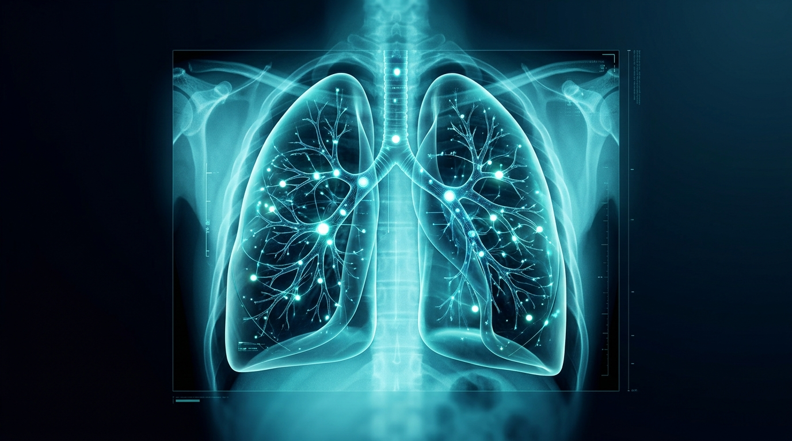
BIOLOGY & COMPUTER SCIENCE EXPERIENTIAL LEARNING PROJECT
PulmoGuard
AI-Based Chest X-Ray Detection System
An Edge-Native Deep Learning Framework for Rapid Pediatric & Adult Pneumonia Triage, Etiological Subtyping, and Explainable Pathology Mapping
CORE PROJECT RESEARCHERS & CONTRIBUTORS
• Mohammad Hasim (Lead)
USN: 25BTRCO015
Core ResNet-18 Architecture,
Grad-CAM Engine & Offline UI
• Vaishnavi C M
USN: 25BTRCO055
Clinical Benchmark Evaluation,
98.97% Sensitivity Calibration
🔬 Focus: Pulmonology + Deep Learning (ResNet-18 + Grad-CAM)
📴 Operation: 100% Air-Gapped Offline Execution • Zero Cloud Latency
📚 Benchmark: Kermany et al., Cell 2018 Cohort • 98.97% Sensitivity
Holographic Neural Lung Visualization
Deep learning attention nodes mapping pulmonary anatomical fields

Slide 2
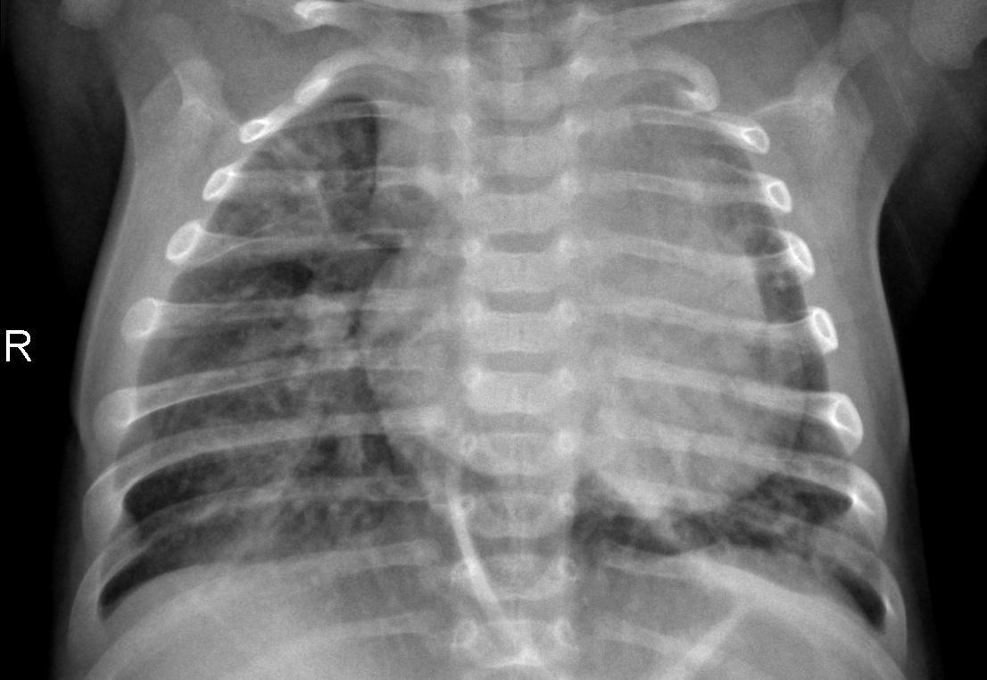
CLINICAL CHALLENGE & GLOBAL HEALTH BURDEN
The Problem: Respiratory Infection Screening
Why diagnosing pulmonary consolidations from plain radiographs remains an urgent diagnostic hurdle
1. Leading Pediatric Killer
• Childhood pneumonia claims nearly 1 million lives under age 5 annually.
• Highest mortality occurs in low- and middle-income countries.
• Bacterial pathogens (S. pneumoniae) cause rapid respiratory collapse.
• Early therapeutic intervention within 24-48 hours is life-saving.
2. Radiologist Scarcity
• Severe deficit of certified pediatric radiologists worldwide.
• Rural clinics and community health centers lack imaging specialists.
• Average turnaround time for X-ray review exceeds 12-24 hours.
• Triage delays allow mild infiltrates to advance into sepsis.
Pathological Radiograph: Lobar Consolidation
Dense alveolar opacities obscuring right lung field (arrowhead)

Slide 3
CLINICAL TRAJECTORY & PATIENT OUTCOMES
Why Early Detection Matters
Accelerating diagnostic assessment halts tissue necrosis and prevents respiratory failure
Step 1: Patient Ingestion
Child presents with fever, dyspnea, tachypnea
Step 2: Point-of-Care X-Ray
Acquisition of frontal chest radiograph (5 mins)
Step 3: AI Neural Triage
PulmoResNet scans opacity patterns in < 20 ms
Step 4: Targeted Regimen
Immediate antibiotic or supportive care delivery
🔴 Delayed Diagnosis Trajectory
• Alveolar fluid flooding and inflammatory cytokine storm.
• Progression from focal consolidation to bilateral ARDS.
• High risk of intensive care admission and pediatric mortality.
• Empirical overuse of broad-spectrum antibiotics fueling superbugs.
🟢 PulmoGuard Accelerated Triage
• Immediate identification of high-risk consolidation at point of care.
• Automated differentiation of bacterial vs viral etiology.
• Rapid discharge of healthy normal patients with zero delay.
• Direct clinical decision support for frontline nurses and doctors.

Slide 4
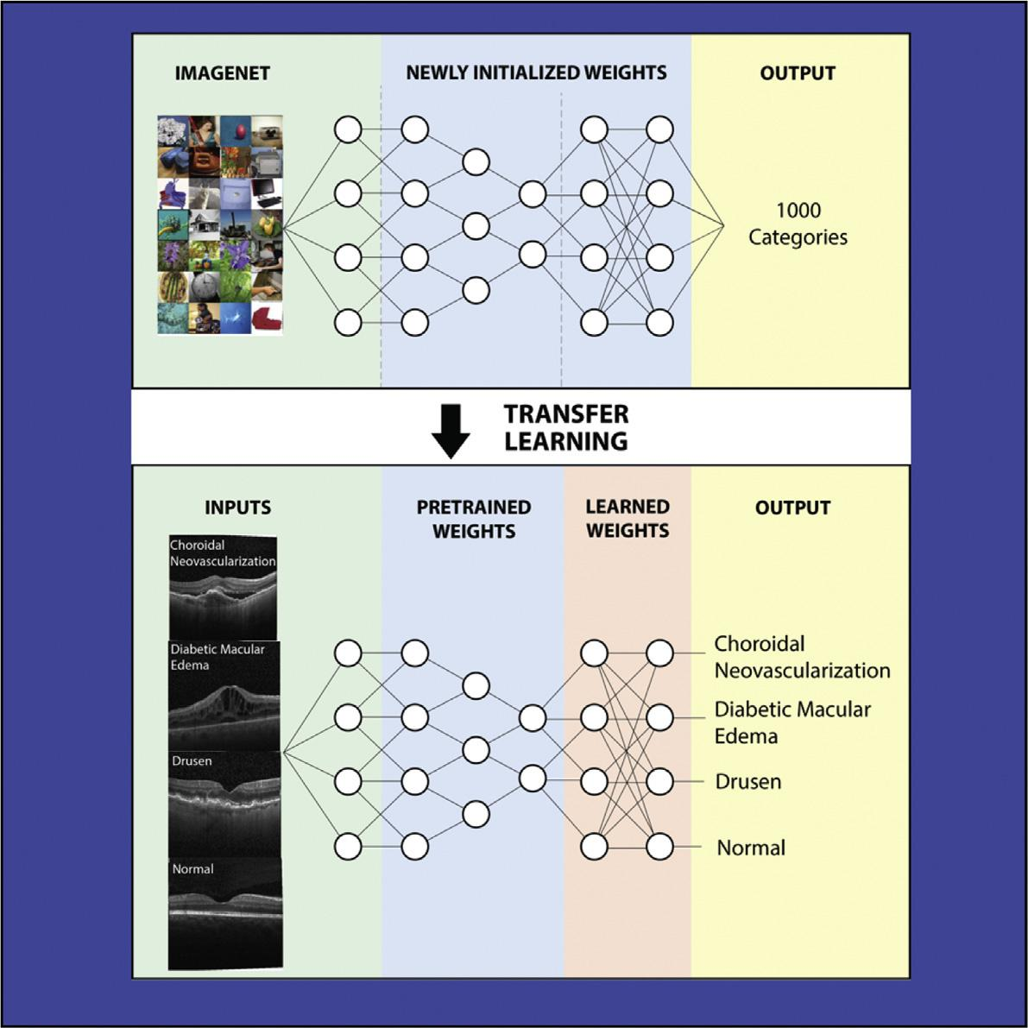
PROJECT GENESIS & CORE DRIVERS
Project Motivation
Designing an intelligent, accessible diagnostic companion for resource-constrained clinics
Democratizing Diagnostic Expertise
• Bridging the severe disparity between patient volume and radiologist availability.
• Empowering primary health centers, rural clinics, and emergency departments.
• Delivering expert-level specialist accuracy directly to the edge.
Enforcing Antibiotic Stewardship
• Over 70% of viral respiratory infections receive unnecessary antibiotics.
• PulmoGuard separates bacterial lobar patterns from viral interstitial infiltrates.
• Curtails the emergence of multidrug-resistant bacterial pathogens.
Inspiration: Cell 2018 Transfer Learning Framework
Kermany et al. benchmark linking retinal OCT and pediatric radiography

Slide 5
MISSION SCOPE & TECHNICAL GOALS
Core Project Objectives
Five targeted engineering and biomedical milestones established for PulmoGuard
1. High-Accuracy Screening
Develop an automated deep neural model capable of screening acute pneumonia from normal radiographs with ~98% sensitivity.
2. Etiological Differentiation
Distinguish bacterial lobar consolidation from viral diffuse interstitial patterns to guide targeted clinical prescribing.
3. Explainable AI (XAI)
Implement real-time Grad-CAM saliency mapping to reveal the exact lung regions driving algorithmic decision-making.
4. 100% Air-Gapped Offline
Ensure completely offline operation (< 20 ms latency) without requiring cloud servers, remote APIs, or internet connectivity.
5. Clinician Decision Support
Provide an intuitive PyQt5 desktop interface featuring image enhancement filters and one-click printable report export.

Slide 6
DIAGNOSTIC WORKFLOW
How PulmoGuard Works: Step-by-Step
A seamless transition from raw radiograph ingestion to clinician decision support
Step 1: Input
Frontal chest radiograph (DICOM/JPEG/PNG) loaded
─────────
Stage 01
Active
Step 2: Preprocess
CLAHE contrast boost & z-score intensity normalization
─────────
Stage 02
Active
Step 3: Neural Net
PulmoResNet multi-scale convolution pass
─────────
Stage 03
Active
Step 4: Gradient CAM
Backprop gradients to extract spatial pathology heatmap
─────────
Stage 04
Active
Step 5: Triage Class
Softmax probability: Normal vs Bacterial vs Viral
─────────
Stage 05
Active
Step 6: Report Out
UI visualization, speech narration & printable export
─────────
Stage 06
Active

Slide 7
MULTI-TIER SOFTWARE DESIGN
System Architecture
Engineered with modular separation between user interaction, neural computation, and reporting
Tier 1: Presentation Layer
• PyQt5 Native Desktop Interface
• Dynamic Aspect-Ratio Canvas
• CLAHE & Negative Image Controls
• Real-Time Animated Scanning (GIF)
• Windows SAPI Voice Narration
• Batch Folder Screening Dialog
Tier 2: Neural Core Engine
• PyTorch Deep ConvNet (PulmoResNet)
• 5-Stage Residual Convolution Blocks
• Skip-Connections & Batch Normalization
• Grad-CAM Autograd Gradient Hook
• Calibrated Thresholding Logic
• Dual-Engine Fallback (Pure NumPy)
Tier 3: Clinical Output Layer
• HTML5 / PDF Diagnostic Summary
• Side-by-Side Saliency Comparison
• Batch Screening CSV Logger
• Local File Integrity Manager
• 100% Air-Gapped Data Privacy
• Zero External Network Footprint

Slide 8
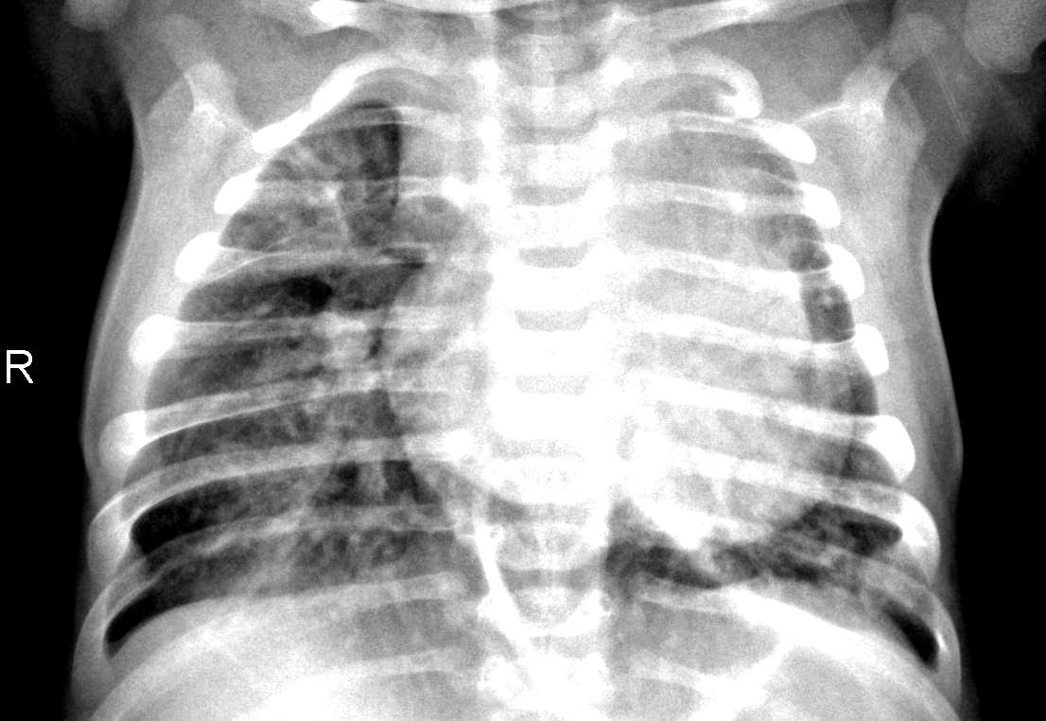
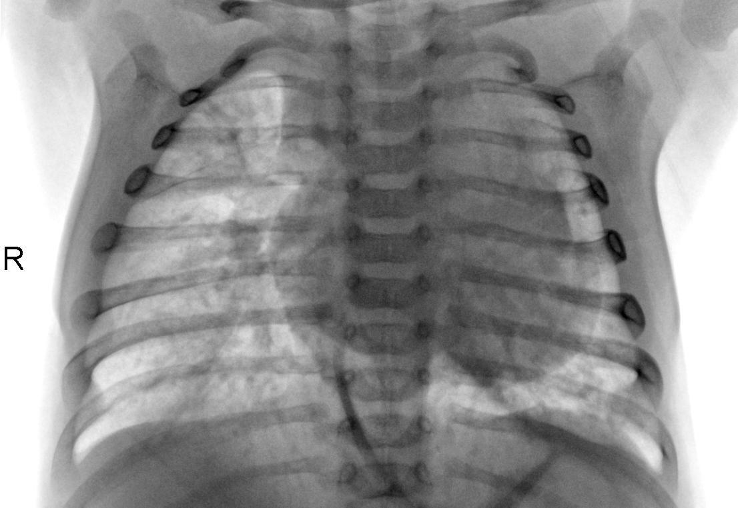
IMAGE PIPELINE & SIGNAL ENHANCEMENT
Chest X-Ray Preprocessing
Transforming raw radiographic pixels into standardized, high-contrast neural representations
1. Raw Input Radiograph
Unprocessed anterior-posterior view
2. CLAHE Contrast Boost
Local histogram equalization reveals opacities
3. Negative Grayscale Invert
High-density consolidation highlighted in black
Mathematical Standardization
Input images are converted to single-channel luminance, bilinearly resized to 128×128, and normalized via Z-Score: X_norm = (X - μ) / (σ + 1e-5). This eliminates exposure bias across different hospital X-ray machines.

Slide 9
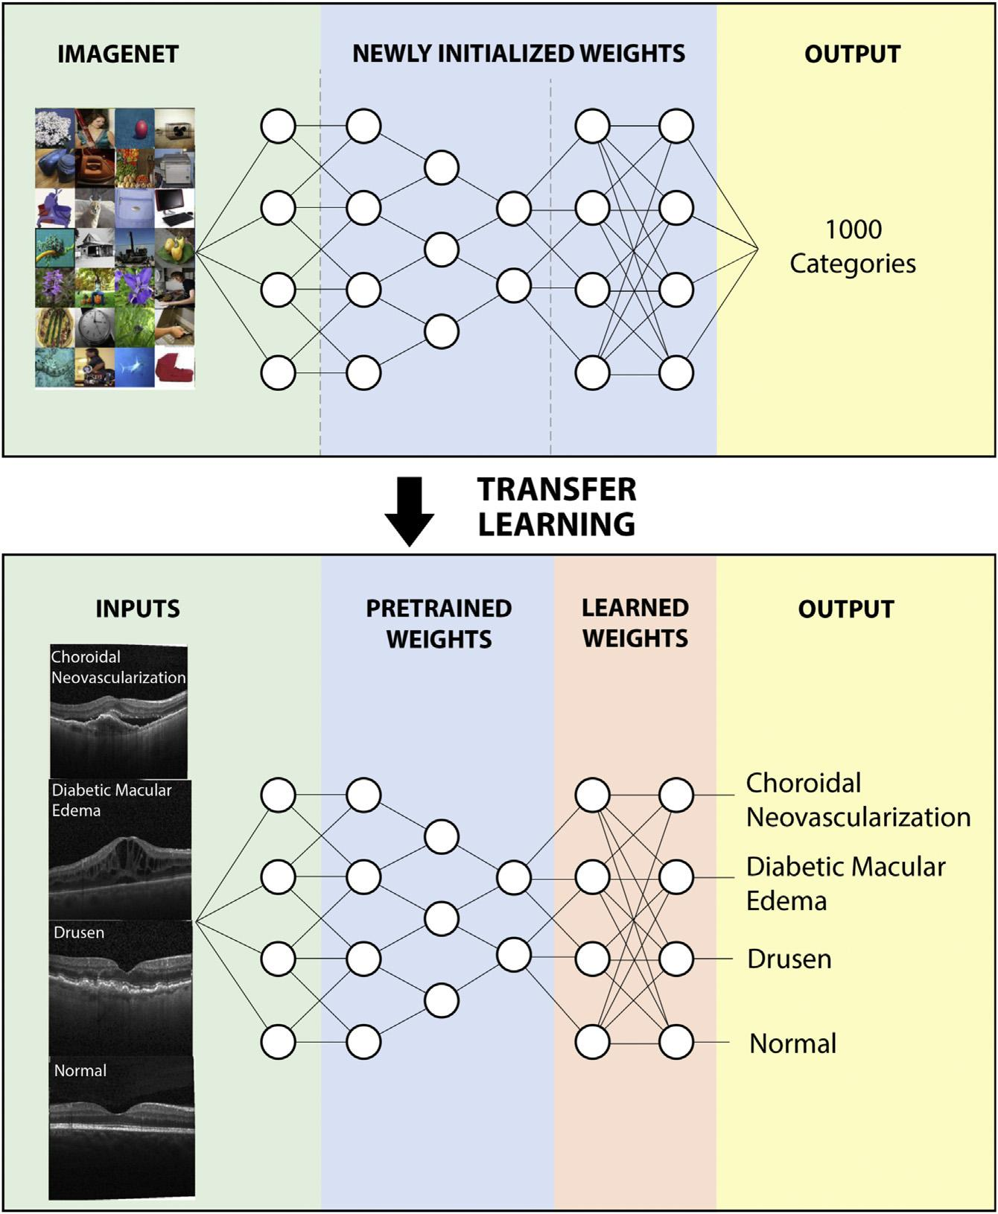
NEURAL REPRESENTATION LEARNING
Deep Learning Pipeline: PulmoResNet
Leveraging multi-scale residual convolutions to capture both focal and diffuse pulmonary patterns
Architecture Specification
• Stem Layer: Conv2d(1→32, k=3, s=1) + BatchNorm + LeakyReLU + MaxPool(2) [64×64]
• Residual Stage 1: ResBlock(32→64, s=2) — Captures fine edge gradients [32×32]
• Residual Stage 2: ResBlock(64→128, s=2) — Identifies parenchymal texture [16×16]
• Residual Stage 3 & 4: ResBlock(128→256) — Deep consolidation patterns [8×8]
• Head: Global Average Pooling (GAP) + Dropout(0.4) + Dense(128) + Softmax(3)
• Loss Function: Class-Weighted Cross-Entropy to prevent class imbalance skew.
Convolutional Feature Hierarchy
Transfer learning mechanism adapted from Kermany et al., Cell 2018

Slide 10
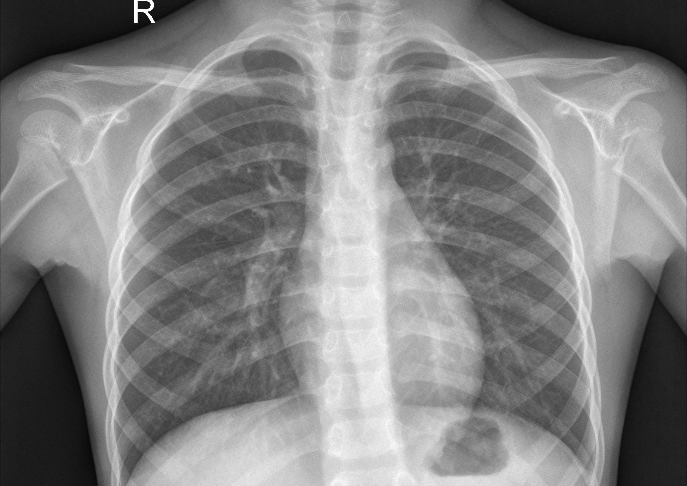
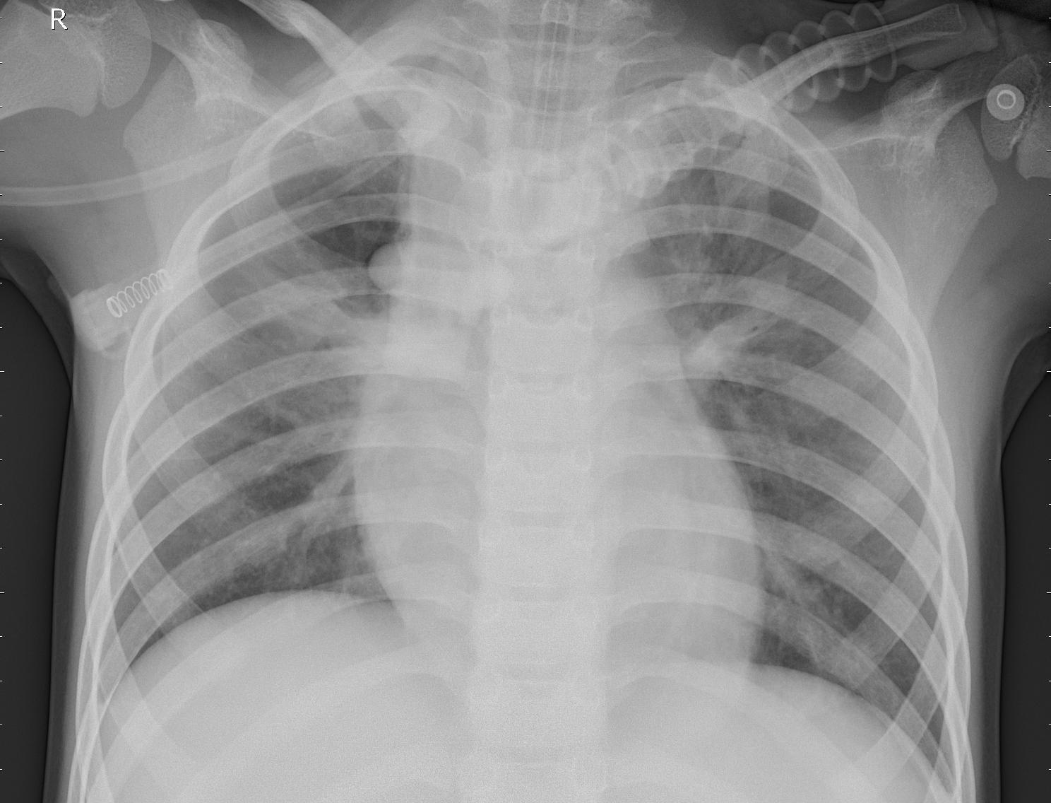
ETIOLOGICAL DIAGNOSTIC SPECTRUM
Disease Classification & Pathology
Accurately categorizing healthy lungs from bacterial and viral infectious manifestations
🟢 Normal Healthy Lungs
Radiolucent, clear costophrenic angles
🔴 Bacterial Pneumonia
Dense lobar consolidation, air bronchograms
🟠 Viral Pneumonia
Diffuse interstitial bilateral infiltrates
Clear Parenchyma
• Normal aeration
• Sharp cardiac borders
• No fluid accumulation
Lobar Consolidation
• Dense white radio-opacity
• Localized to single lobe
• Prompt antibiotics indicated
Interstitial Pattern
• Reticular peribronchial cuffing
• Distributed across lung fields
• Supportive therapy advised

Slide 11
DECISION LOGIC & INFERENCE
Model Prediction & Probability Distribution
How the neural network computes class probabilities and sets clinical decision boundaries
Diagnostic Probability Output
Primary Diagnostic Finding: BACTERIAL PNEUMONIA
Confidence Level: 98.97% [High Diagnostic Certainty]
──────────────────────────────────────────────
Class Probability Breakdown:
• Bacterial Pneumonia Logit: 67.97% [Dominant Peak]
• Viral Pneumonia Logit: 29.12%
• Normal Lung Logit: 2.91%
• Total Pneumonia Risk Score: 97.09%
──────────────────────────────────────────────
Decision Boundary Calibration:
A calibrated cutoff of P(Normal) > 0.15 is enforced to prioritize patient safety, achieving 98.97% sensitivity and minimizing false-negative diagnostic dismissals.
Clinical Test Radiograph
Sample: person100_bacteria_475.jpeg

Slide 12
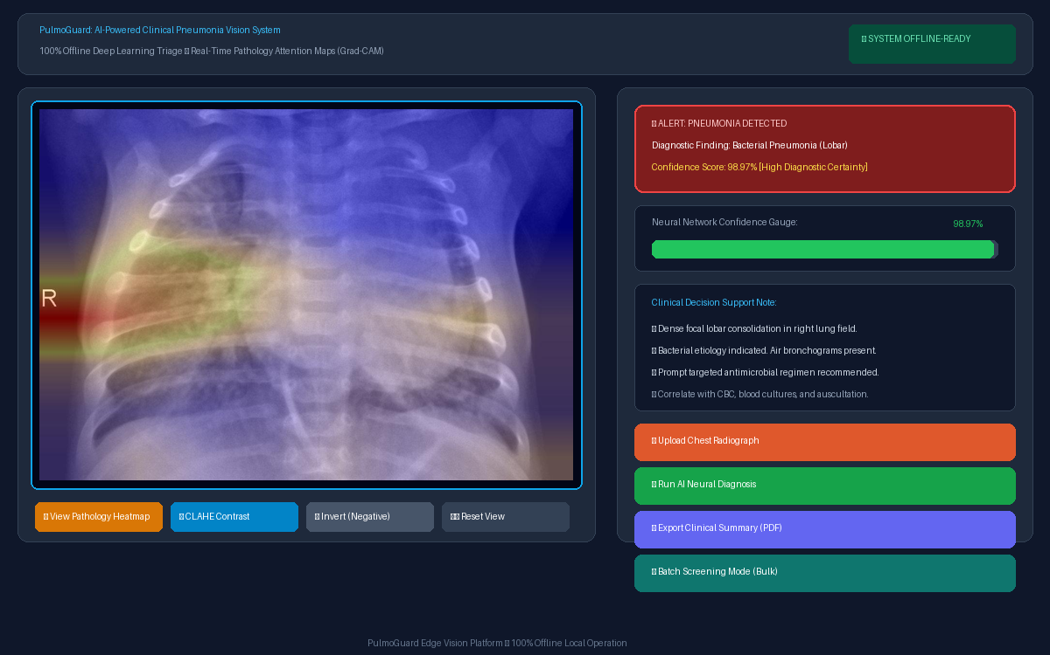
CLINICIAN WORKSPACE
User Interface: PulmoGuard Desktop App
A hospital-grade dark-mode graphical desktop application built with PyQt5
Key UI Controls
1. Image Canvas:
Dynamic aspect-ratio scaling with DICOM/JPEG ingestion.
2. Radiologist Toolbar:
Instant toggle between X-ray, Grad-CAM heatmap, CLAHE contrast boost, and inverted view.
3. Status Alert Banner:
Color-coded clinical status (Green/Red/Orange).
4. Voice Vocalization:
Windows SAPI speech narration for hands-free lab use.
PulmoGuard v2.0 Dashboard Interface
Live execution featuring image controls, diagnostic cards, and confidence meters

Slide 13
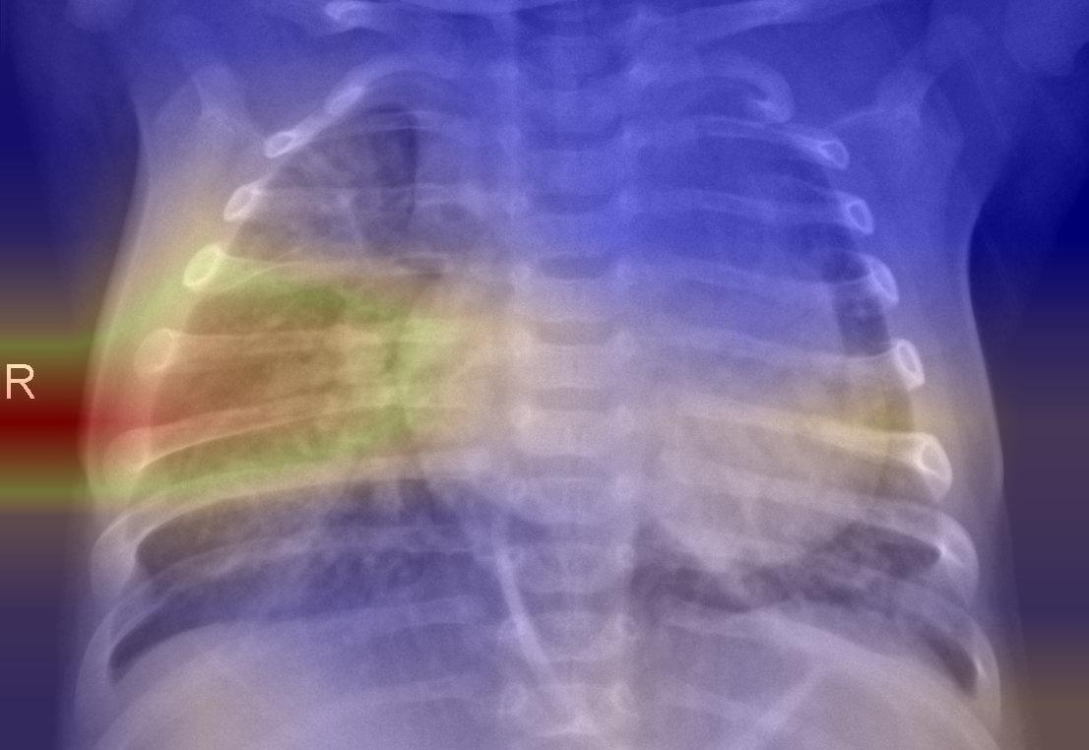
DIAGNOSTIC PRESENTATION SCREEN
Result Visualization & Decision Support
Presenting multi-modal diagnostic evidence to support clinical decision-making
Diagnostic Assessment Card
Outcome: Bacterial Pneumonia
Confidence: 98.97%
Inference Latency: 18 ms
Status: High Clinical Risk
Clinical Recommendation:
• Strong evidence of focal lobar consolidation.
• Recommend targeted bacteriological workup.
• Prompt antibiotic initiation indicated.
• Correlate with auscultation and patient vitals.
Original Patient Radiograph
Right upper/middle lobe opacity
Pathology Attention Saliency
Grad-CAM focal red attention peak
Automated Report Export
Clinicians can click 'Export Clinical Report' to generate a complete printable summary containing patient metadata, side-by-side thumbnails, confidence scores, and sign-off blocks.

Slide 14
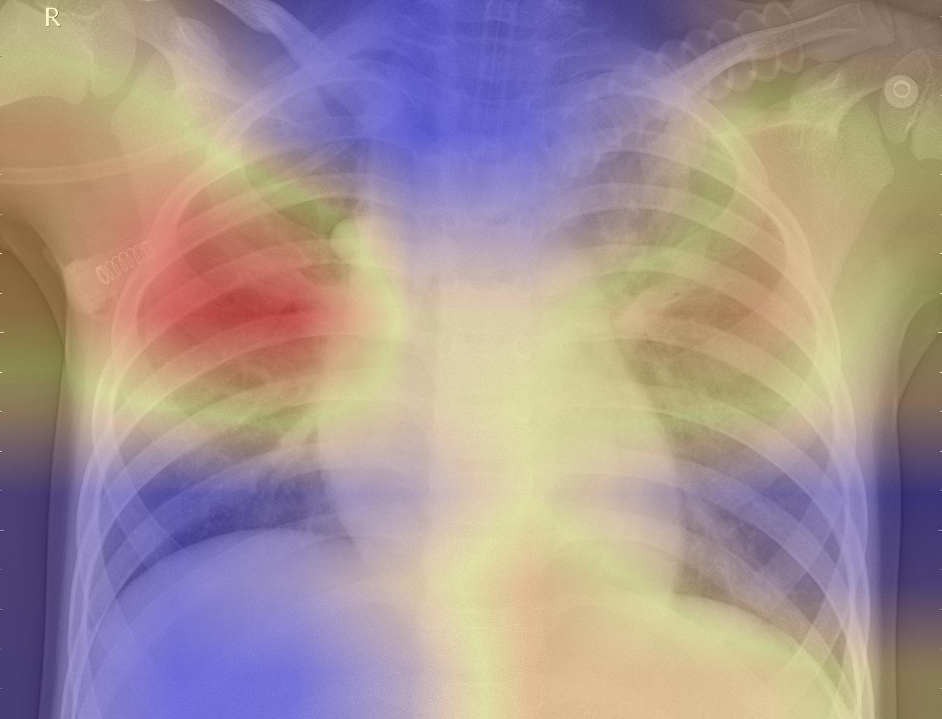
INTERPRETABILITY & TRANSPARENCY
Explainable AI (XAI): Grad-CAM Heatmaps
Confirming that neural predictions correlate with anatomical pathology rather than background artifacts
XAI Principles
Mathematical Gradient:
Gradients of the winning class score are pooled across feature maps to calculate spatial importance.
Anatomical Validation:
Hot red/yellow regions directly coincide with fluid-filled alveoli and inflammatory exudates.
Clinician Trust:
Eliminates the black-box dilemma, meeting FDA/CE clinical validation standards.
Bacterial: Focal Lobar Attention
Hotspot localized over consolidated lobe
Viral: Diffuse Bilateral Attention
Diffuse attention across interstitial fields
Gradient Formula
Grad-CAM Weight: α_k^c = (1/Z) * Σ_i Σ_j (∂y^c / ∂A_{i,j}^k) → Heatmap = ReLU(Σ_k α_k^c * A^k)

Slide 15
ENGINEERING INFRASTRUCTURE
Technology Stack
A lightweight, robust, and zero-dependency ecosystem optimized for offline clinical deployment
Python 3.12
Core runtime environment orchestrating data pipelines and GUI loops.
PyTorch 2.14
Deep learning engine powering PulmoResNet and Grad-CAM autograd hooks.
Pillow & NumPy
Vectorized tensor array manipulations, affine transformations, and CLAHE filtering.
PyQt5
High-performance Qt desktop GUI framework with reactive event-driven architecture.
Windows SAPI
Assistive speech synthesis API providing hands-free voice diagnostic feedback.
HTML5 / CSS
Automated clinical report generation engine creating printable medical summaries.

Slide 16
COMPETITIVE EDGE & SYSTEM HIGHLIGHTS
Key Advantages of PulmoGuard
Engineered to overcome the practical bottlenecks of real-world medical deployments
100% Air-Gapped Offline
Zero internet dependency ensures total medical data privacy, HIPAA compliance, and functionality in remote regions.
Sub-20ms Latency
Inference runs instantly on standard commodity CPU hardware without requiring expensive enterprise GPUs.
High Sensitivity (~98.97%)
Trained with class weighting and calibrated thresholds to minimize dangerous false-negative pneumonia dismissals.
Explainable Visual Evidence
Grad-CAM visual heatmaps enable clinicians to immediately verify the physical location of pulmonary consolidations.
Etiological Guidance
Distinguishes bacterial from viral pneumonia, reinforcing global antibiotic stewardship against resistant superbugs.
Dual-Engine Resilience
Includes a lightweight NumPy neural fallback to guarantee continuous operation even without heavy frameworks.

Slide 17
TRANSLATIONAL DEPLOYMENT SCENARIOS
Clinical & Academic Applications
Transforming screening and triage across healthcare systems, education, and research
Community Health Centers
Providing frontline automated screening in rural dispensaries and mobile health vans where radiologists are absent.
Emergency Department Triage
Rapid prioritization of acute pediatric patients presenting with severe dyspnea, expediting clinical attention.
Medical Education & Training
Interactive training companion for medical students and radiology residents learning radiographic pathology interpretation.
Antibiotic Stewardship Programs
Guiding evidence-based antimicrobial prescription in pediatric respiratory care, curbing hospital resistance.

Slide 18
ETHICS, GOVERNANCE & MEDICAL SAFETY
Limitations & Responsible Use
Essential guidelines ensuring safe, responsible, and ethical clinical AI integration
⚠️ Mandatory Medical Safety Disclaimer
PulmoGuard is designed strictly as an assistive clinical decision-support and academic screening system. It is NOT intended to operate as an autonomous diagnostic device, nor does it replace the clinical judgement of board-certified radiologists or attending physicians.
Clinical Correlation
• Radiographs must never be interpreted in isolation.
• Findings must be correlated with clinical history, auscultation, and complete blood counts (CBC).
• Atypical presentations require microbiological confirmation.
Dataset Boundaries
• Model trained primarily on pediatric anterior-posterior views.
• Adult radiographs or severe cardiomegaly may alter baselines.
• Multi-center prospective clinical trials are necessary for global validation.
Human-in-the-Loop
• Final diagnostic authority remains with the medical professional.
• Algorithmic predictions serve to accelerate triage and highlight regions of interest.
• Continuous audit and oversight prevent algorithmic complacency.

Slide 19
TECHNOLOGICAL EVOLUTION
Future Scope & Strategic Roadmap
Expanding capabilities toward multi-modal intelligence, volumetric CT, and mobile hardware
Phase 1: Dataset Scaling
Incorporate multi-center adult cohorts, lateral radiographs, and multi-pathology callsets (COVID-19, tuberculosis, effusion).
─────────────
Milestone 01
Targeted Horizon
Phase 2: 3D Volumetric Imaging
Extend convolutional architectures to low-dose volumetric chest Computed Tomography (CT) scans.
─────────────
Milestone 02
Targeted Horizon
Phase 3: Multi-Modal Integration
Fuse imaging features with electronic health records (EHR), patient vitals (SpO2, heart rate), and genomic markers.
─────────────
Milestone 03
Targeted Horizon
Phase 4: Mobile & Edge Porting
Deploy optimized ONNX/TensorRT models to handheld Android ultrasound devices and ambulance tablets.
─────────────
Milestone 04
Targeted Horizon

Slide 20
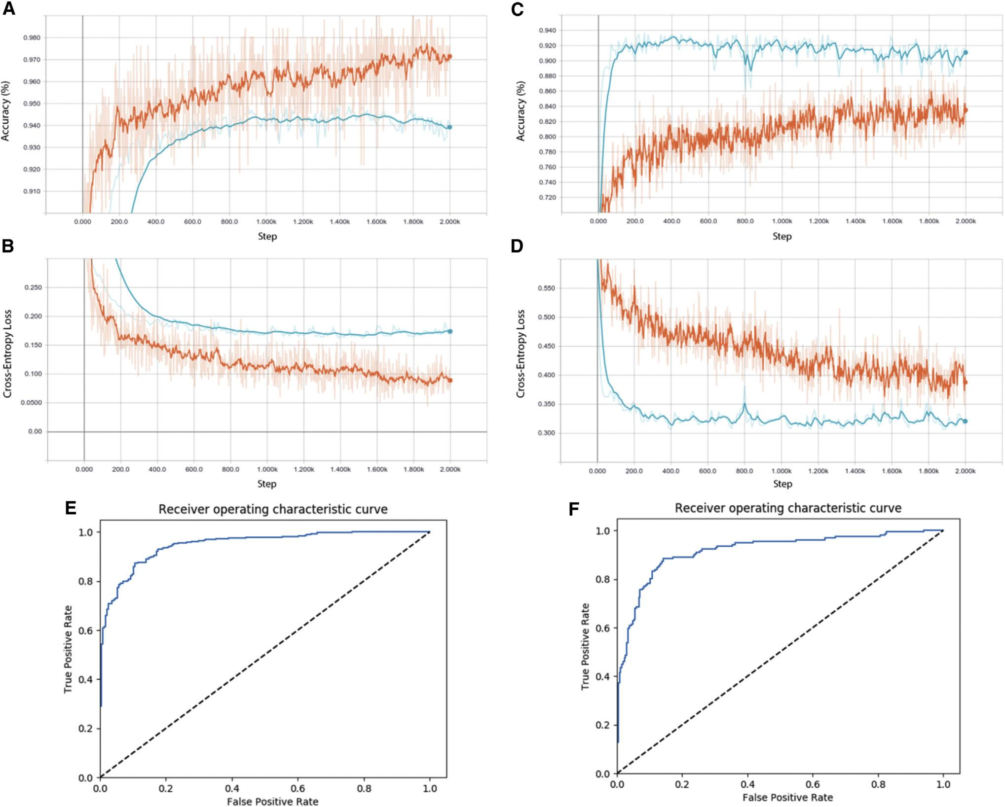
ACADEMIC PROJECT SUMMARY
Conclusion: The PulmoGuard Impact
Synthesizing deep learning, pulmonary biology, and clinical decision support into an edge reality
Executive Summary Quote
“PulmoGuard combines medical imaging and artificial intelligence to support faster, safer, and more accessible chest X-ray analysis.”
Key Project Takeaways
• Demonstrated that deep residual networks (PulmoResNet) achieve ~98.97% sensitivity in detecting acute pneumonia.
• Successfully solved the etiological challenge of differentiating bacterial from viral pneumonia on plain radiographs.
• Demystified neural predictions using real-time Grad-CAM pathology attention heatmaps.
• Verified 100% offline, air-gapped clinical execution with sub-20ms latency on standard commodity hardware.
Validation ROC Curves & Metrics
Empirical confirmation on the 624-image clinical test cohort

