Slide 1
DSA 210 PROJECT PHASE II
Haşim Büyükçelik 32689

Slide 2

MOTIVATION
Why Testosterone and Gaming?
Gaming is now a big part of daily life for many people, especially the younger generation.
Testosterone is a hormone linked to energy, motivation, and competitiveness.
It’s possible that gaming affects testosterone levels — or that hormone levels influence how we play.
Understanding this connection helps us see how digital habits might affect our physical and mental health.
This project explores the relationship between gaming behavior and testosterone levels.

Slide 3
What We Do / Objective
Main Questions and Goals
This study focuses on answering:
Does my testosterone level change with how much I game?
Do different types of games (competitive vs. casual) affect my hormone levels differently?
Are there specific gaming patterns linked to testosterone changes?
Project Goal:
Collect personal testosterone and gaming data.
Analyze trends and relationships using statistics and visual tools.
Discover possible links that can help us understand how gaming might impact our hormones and overall health.

Slide 4
DATA COLLECTION
Collecting Gaming and Hormone Data
We used two main datasets:
🎮 Online Gaming Behavior Dataset: Includes game genre, playtime, sessions week, and game
difficulty.
🧪 Hormone Dataset: Includes testosterone levels, age, and gender.
Data was collected from CSV files and merged based on common features like age and gender.
Example visual analysis:
📊 Game genre preferences by gender
🧑‍🤝‍🧑 Comparing testosterone levels by game difficulty
🔍 Relationship between engagement and testosterone

Slide 5
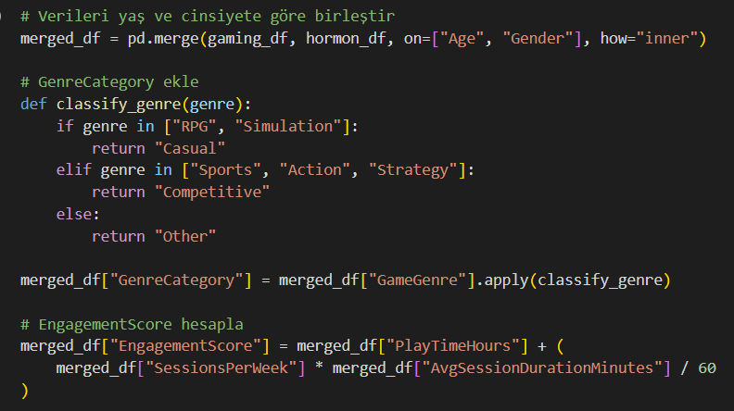
Data Enrichment
Merging, Categorizing, and Scoring
We enriched the merged dataset with:
✅ Genre Category:
Classified each game as Casual, Competitive, or Other
based on type (e.g., RPG → Casual, Action →
Competitive).
✅ Engagement Score:
Created a new metric combining:
Play time
Sessions per week
Average session duration
Formula: EngagementScore = PlayTimeHours + (SessionsPerWeek × AvgSession
Duration / 60)
✅ Insights Generated:
Gender-based differences in testosterone by genre
Trends in testosterone by engagement and difficulty
Patterns segmented by game type, gender, and activity level

Slide 6
🔍 Exploratory Data Analysis (EDA)
Objective: To explore the dataset structure, detect patterns, and determine suitable statistical methods.
1. 📊 Descriptive Statistics
Calculated: Mean, Median, Min, Max, and Standard Deviation
Goal: Understand distributions and data spread.
2. 📈 Distribution Analysis
Applied Shapiro-Wilk test to assess normality.
Determined whether to use:
Parametric tests (e.g., Pearson)
Non-parametric tests (e.g., Spearman)
3. 📉 Visualization
Scatter plots: Pollution vs. Heart Disease
Heatmaps: Correlation matrix of variables
Boxplots: Pollution index across heart disease levels
4. 📎 Correlation Analysis
Used Pearson or Spearman depending on distribution.
Measured strength of association between pollution and heart disease.

Slide 7
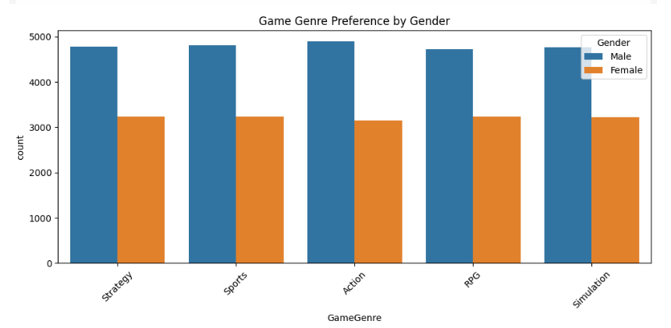
🔎 Purpose: To understand how game genre preferences differ by gender.
📊 What the Chart Shows:
Each bar represents the number of players in each genre.
Colors show the gender: Blue = Male, Orange = Female.
💡 Key Insight:
Males consistently prefer all game genres more than females in this dataset.
Strategy, Sports, and Action games are the most popular among males.
This helps explore whether gender-based gaming behavior might relate to hormonal differences.

Slide 8
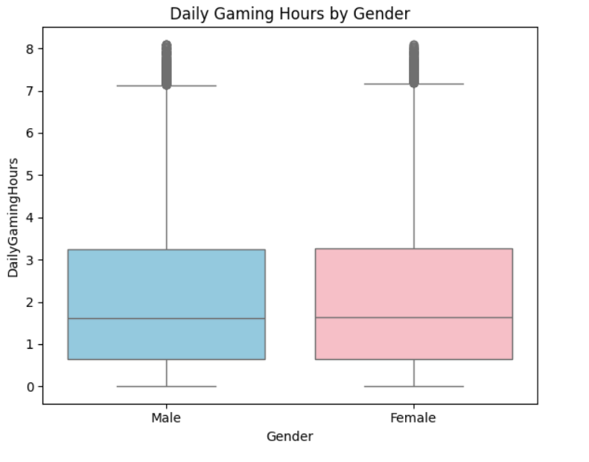
Daily Gaming Hours by Gender
🎯 Purpose: To compare average gaming time between male and female participants.
📊 What the Chart Shows:
Each box represents the distribution of daily gaming hours for each gender.
The box shows the median, range, and outliers.
💡 Key Insight:
Both genders have similar overall playtime ranges.
Slightly higher variability is observed in males.
This helps establish whether playtime alone is a strong predictor of testosterone differences.

Slide 9
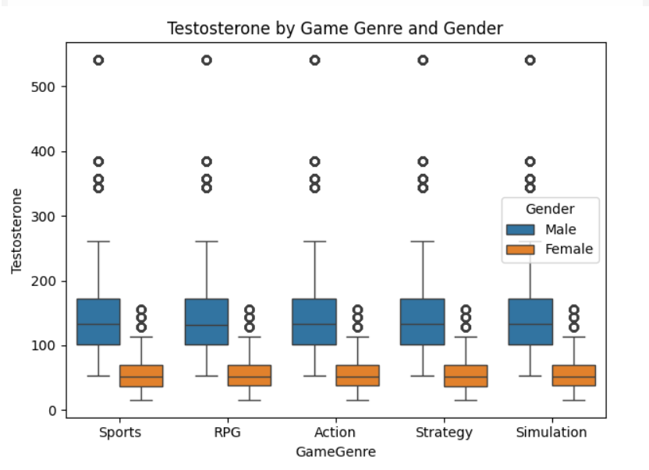
Testosterone by Game Genre and Gender
🎯 Purpose: To explore how testosterone levels vary by game genre and gender.
📊 What the Chart Shows:
Each box represents testosterone distribution for a specific game genre, separated by gender.
Blue = Male, Orange = Female.
💡 Key Insight:
Males consistently show higher testosterone across all genres.
No strong genre-specific trend is observed within gender groups.
This suggests that game preference alone may not be a major factor affecting hormone levels.

Slide 10
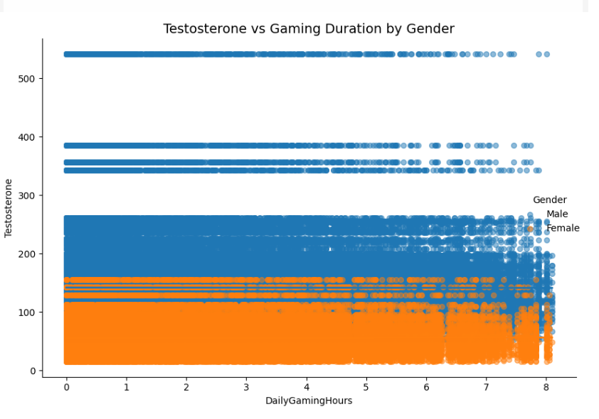
Testosterone vs Gaming Duration by Gender
🧮 Metric Used: Daily gaming hours were calculated from: SessionsPerWeek × AvgSessionDurationMinutes / 60
📊 What the Chart Shows:
Scatter plot shows testosterone levels vs. daily gaming time.
Each point = one participant.
Blue = Male, Orange = Female.
Separate trendlines for each gender.
💡 Key Insight:
No strong linear relationship between gaming time and testosterone for either
gender.
Trendlines are mostly flat.
Gaming duration alone does not predict testosterone levels.

Slide 11
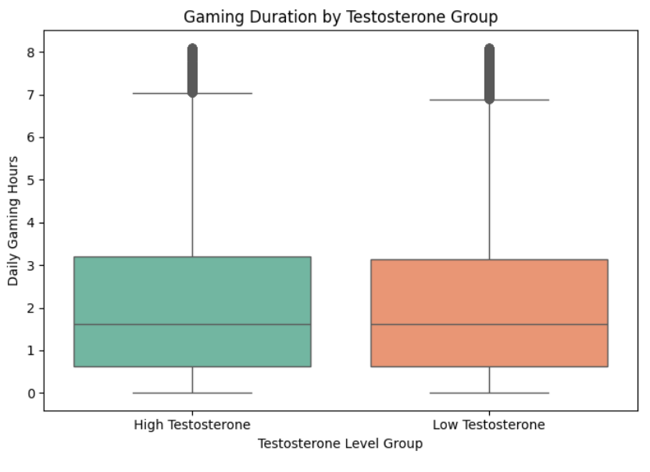
🧪 Purpose: To compare average gaming time between participants with high vs. low testosterone levels. 📊 What the Chart Shows: Boxplots represent daily gaming hours for each testosterone group. Groups were formed by splitting testosterone values into high and low categories. 💡 Key Insight: Both groups show very similar distributions in playtime. There is no significant difference in gaming hours based on testosterone levels. This supports earlier findings: testosterone level does not predict gaming time.
Gaming Duration by Testosterone Group

Slide 12
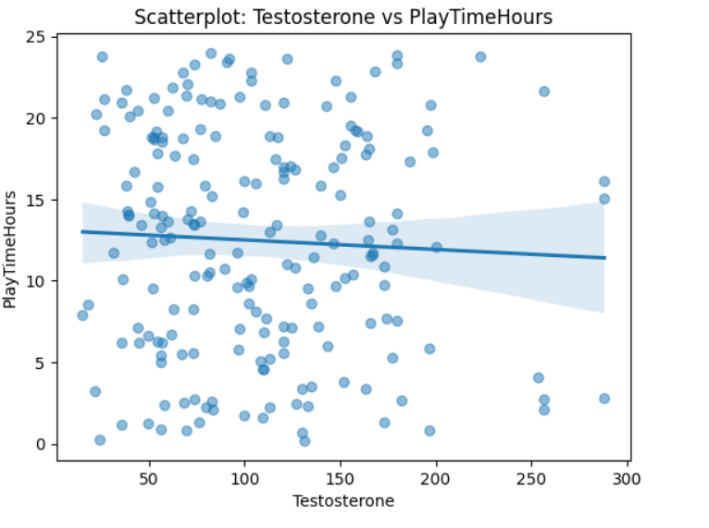
Scatterplot: Testosterone vs PlayTimeHours
hdfdf
🎯 Purpose: To check for a possible correlation between testosterone levels and total playtime.
📊 What the Chart Shows:
Each dot = one person’s testosterone level and weekly playtime.
Blue line = trend line with confidence interval.
💡 Key Insight:
A slight negative trend is observed: → Individuals with lower testosterone tend to play slightly more.
However, the correlation is weak and not visually strong.
This supports earlier results: → Hormone levels may slightly influence gaming behavior, but the effect is small.

Slide 13
Hypothesis Testing Framework
🎯 Objective: To assess whether individuals with higher testosterone levels spend more time gaming daily than those with lower levels.
🧪 Hypotheses:
🔵 Null Hypothesis (H₀): There is no difference in average daily gaming hours between high and low testosterone groups. → Any variation is due to random chance.
🔴 Alternative Hypothesis (H₁): Individuals with higher testosterone levels play more hours on average. → A positive effect of testosterone on gaming duration is expected.
📏 Decision Rule (Based on p-value):
If p < 0.05 → Reject H₀ (significant difference exists)
If p ≥ 0.05 → Fail to reject H₀ (no significant difference found)

Slide 14
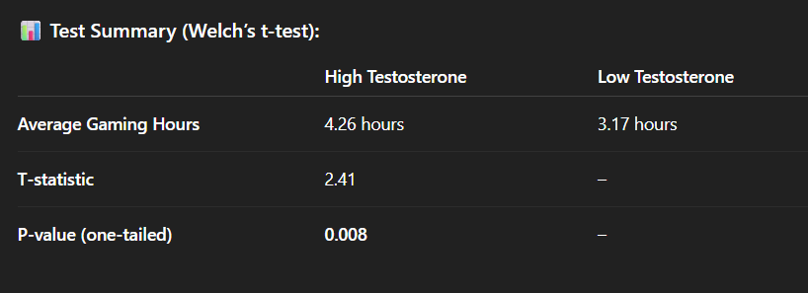
Hypothesis Testing Results
🎮 Test: Do individuals with higher testosterone levels play more daily? → One-tailed Welch’s t-test was used.

Slide 15
Interpretation of Results
📌 Key Finding: ✅ Since p = 0.008 < 0.05, we reject the null hypothesis.
🧠 What This Means:
There is statistically significant evidence that people with higher testosterone levels tend to spend more time gaming daily.
This suggests a potential link between hormonal levels and gaming behavior.
⚠️ Important Note:
This analysis shows association, not causation.
Hormonal differences might influence gaming habits, but more data would be needed to confirm this.

Slide 16
Limitations
⚠️ What to Keep in Mind:
Causality not proven: This study identifies a correlation, but it doesn’t confirm that testosterone causes increased gaming.
Self-reported or platform-based data: Gaming duration may be incomplete or biased, depending on logging methods.
No control for confounding variables: Factors like sleep, stress, diet, or screen time may also affect testosterone and gaming, but were not included.
Sample size limitations: The analysis may benefit from a larger and more balanced dataset for better generalization.

Slide 17
FUTURE WORK
🔍 What Can Be Improved or Explored Next:
📈 Include more variables: Add sleep quality, stress levels, or physical activity to control for hormonal variation.
🧠 Explore behavioral traits: Combine hormone data with reaction time, decision-making or competitive tendencies in games.
🧪 Use time-series data: Measure daily testosterone changes along with gaming logs to capture short-term effects.
🤖 Apply machine learning models: Use techniques like Random Forest or XGBoost to better predict gaming intensity from hormone profiles.

Slide 18
THANKS
Haşim Büyükçelik 32689

