Slide 1
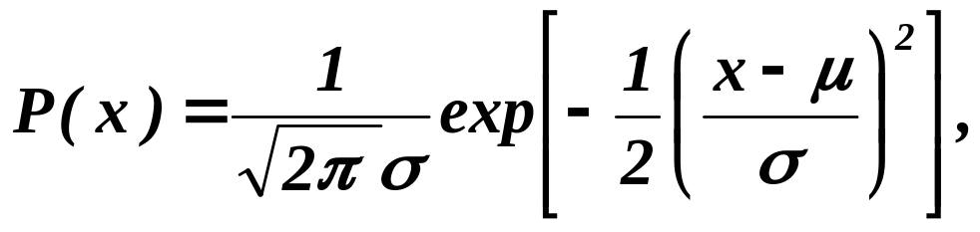
The Normal Density
Univariate density
Where:
μ = mean (or expected value) of x
σ² = expected squared deviation or variance

