Slide 1
LT#5
Owais Ali-23053

Slide 2


Slide 3
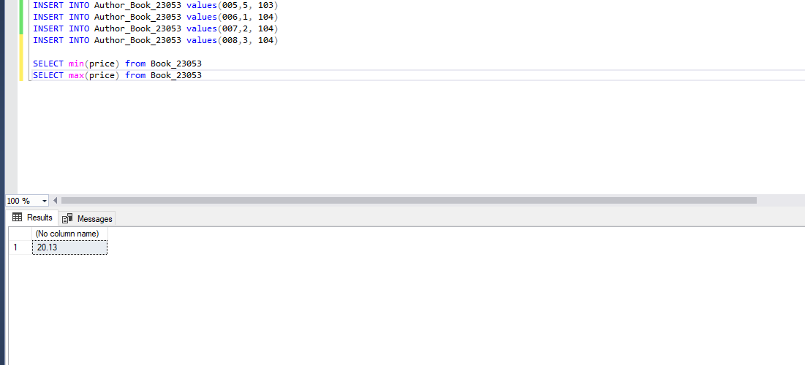

Slide 4
