Slide 1
Lab Task # 2
Hasin Zaman -- 23010

Slide 2
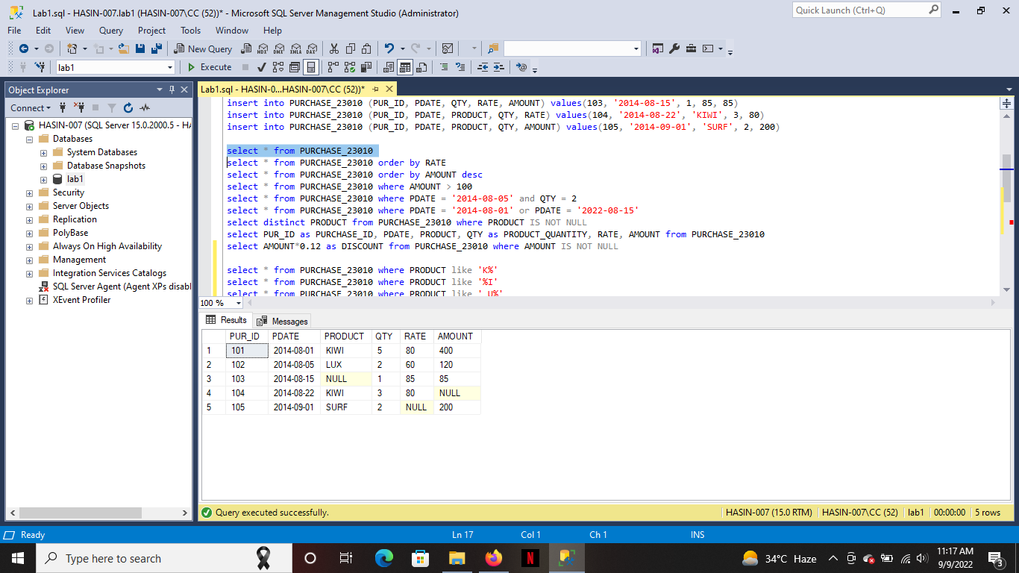

Slide 3
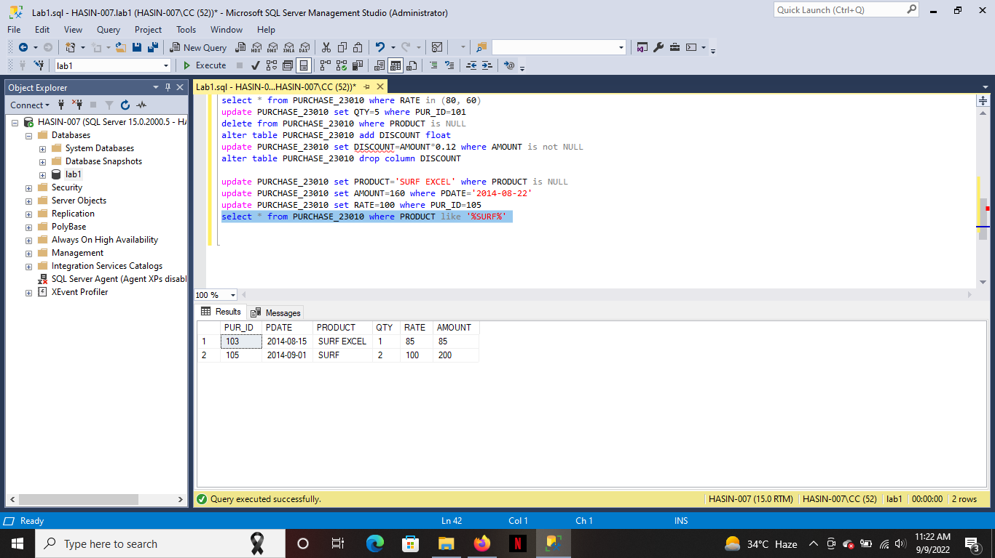

Slide 4
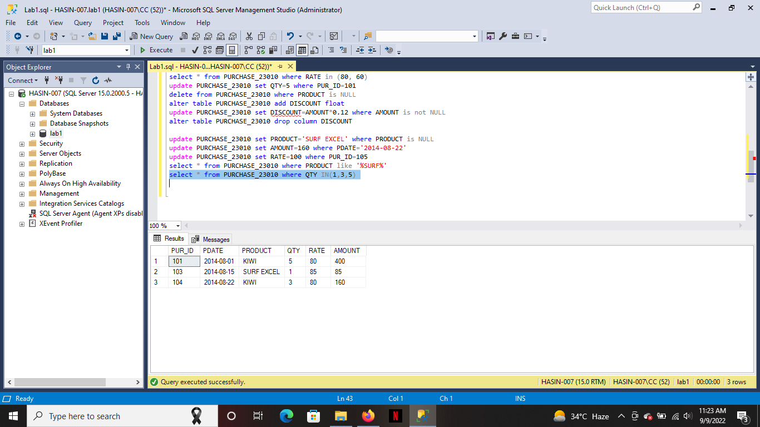

Slide 5
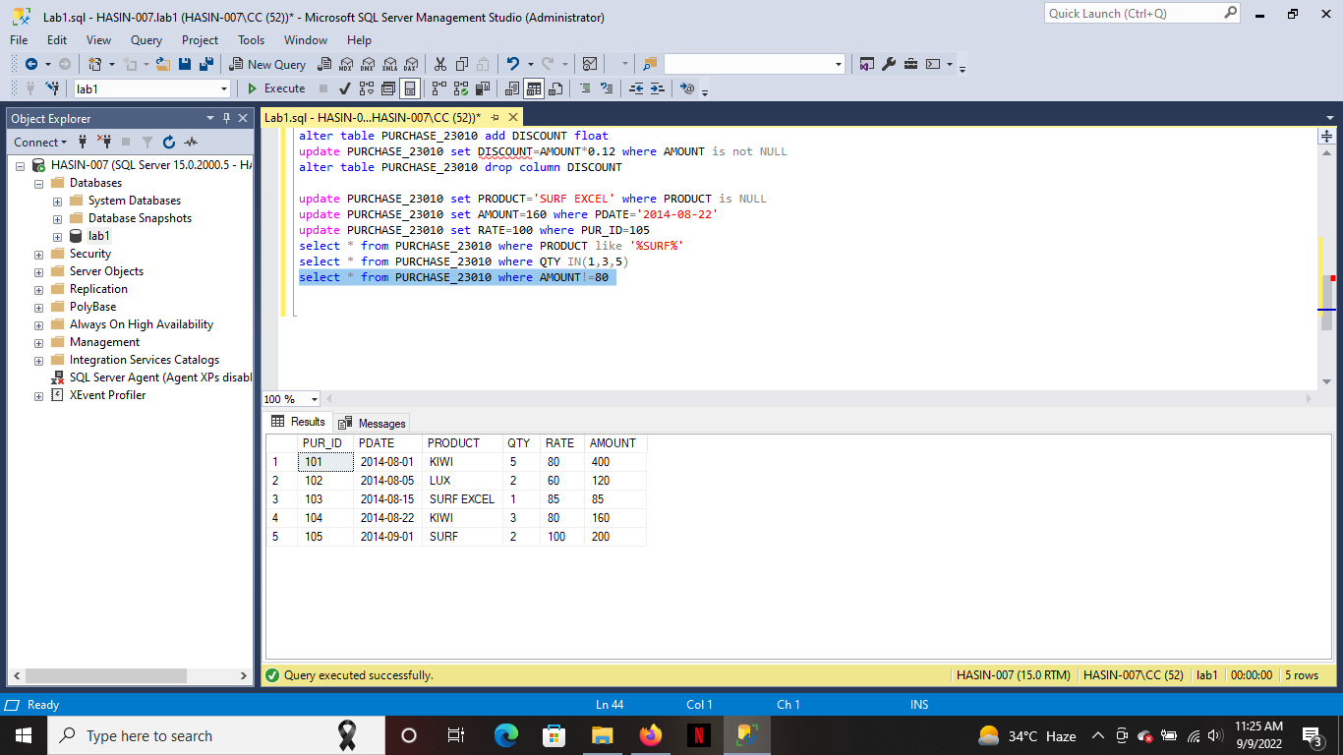

Slide 6


Slide 7
