Slide 1
Object Oriented Concepts

Slide 2
OOP
A principle of design and development of programs using modular approach
A computer programming model that organizes software design around data, or objects, rather than functions and logic.
well-suited for programs that are large, complex and actively updated or maintained.

Slide 3
Object
Objects are basic building blocks for designing programs
Has unique attributes and behavior
A collection of data members and associated member functions that manipulate that data members
An object is active, not passive; it does things
An object is responsible for its own data
But: it can expose that data to other objects

Slide 4
Class
Objects can be made with the help of a class.
A class is a collection of objects that have identical properties, common behavior and shared relationship
Hold both data and methods

Slide 5

Classes and Objects
Class
<CAR>

Slide 6
Example of a class
class Employee {
// Fields
private String name; //Can get but not change
private double salary; // Cannot get or set // Constructor
Employee(String n, double s) { name = n; salary = s; } // Methods
void pay () {
System.out.println("Pay to the order of " +
name + " $" + salary);
} public String getName() { return name; } // getter
}

Slide 7
Concept: Objects must be created
int n; does two things:
It declares that n is an integer variable
It allocates space to hold a value for n
For a primitive, this is all that is needed
Employee secretary; also does two things
It declares that secretary is type Employee
It allocates space to hold a reference to an Employee
For an object, this is not all that is needed
secretary = new Employee ( );
This allocate space to hold a value for the Employee
Until you do this, the Employee is null

Slide 8
Notation: How to declare and create objects
Employee secretary; // declares secretary
secretary = new Employee (); // allocates space
Employee secretary = new Employee(); // does both
But the secretary is still "blank" (null)
secretary.name = "Adele"; // dot notation
secretary.birthday (); // sends a message

Slide 9
Notation: How to reference a field or method
Inside a class, no dots are necessary
class Person { ... age = age + 1; ...}
Outside a class, you need to say which object you are talking to
if (john.age < 75) john.birthday ();
If you don't have an object, you cannot use its fields or methods!

Slide 10
Concept: this object
Inside a class, no dots are necessary, because
you are working on this object
If you wish, you can make it explicit:
class Person { ... this.age = this.age + 1; ...}
this is like an extra parameter to the method
You usually don't need to use this

Slide 11



Classes and Objects
Object
<7_series_BMW>
Object
<VW_Beetle>
Object
<Ford_Mustang>

Slide 12

Messages to Objects
Object
<7_series_BMW>
“Start the engine of the BMW”
Start_Engine

Slide 13
Method of a Class
Class
<CAR>
Start_Engine

Slide 14
Types of Methods
There are 4 basic types of methods:
Modifier (sometimes called a mutator)
Changes the value associated with an attribute of the object
E.g. A method like Change_Car_Color
Accessor
Returns the value associated with an attribute of the object
E.g. A method like Price_of_Car
Constructor
Called once when the object is created (before any other method will be invoked)
E.g. Car(Mustang)
Destructor
Called when the object is destroyed
E.g.~Car( )

Slide 15
Constructors
Constructors are used to initialize the object’s state.
Like methods, a constructor also contains collection of statements(i.e. instructions) that are executed at time of Object creation.
Each time an object is created using new keyword at least one constructor (it could be default constructor) is invoked to assign initial values to the data members of the same class.
Constructor is invoked at the time of object or instance creation.

Slide 16
Regulation
A constructor doesn’t have a return types
The name of the constructor must be the same as the name of the class.
Unlike methods, constructors are not considered members of a class.
A constructor is called automatically when a new instance of an object is created.

Slide 17
Types of Constructor
There are two types of constructors in java
Default constructor (no-argument constructor)
Parameterized constructor

Slide 18
Default Constructor
A constructor is called "Default Constructor" when it doesn't have any parameter.
If we don’t define a constructor in a class, then compiler creates default constructor(with no arguments) for the class.
If we write a constructor with arguments or no-argument then compiler does not create default constructor.
Default constructor provides the default values to the object like 0, null etc. depending on the type.

Slide 19
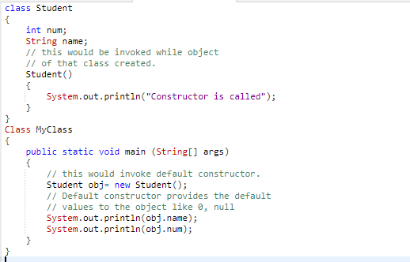
Default Constructor Example

Slide 20
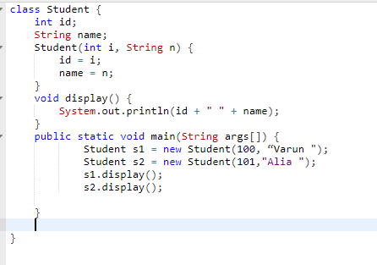
Parameterized Constructor Example

Slide 21
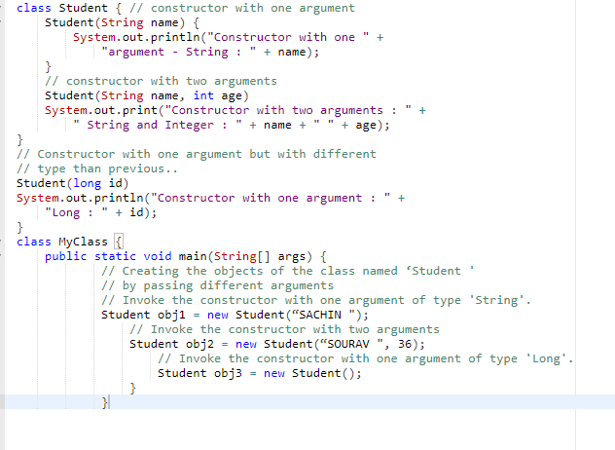
Constructor Overloading Example

Slide 22
Access
Most classes provide three levels of access to their members (state and behavior):
Public
The part of the class of the class that is visible to all clients of the class
Protected
The part of the class that is only visible to subclasses of the class
Private
A part of the class that is not visible to any other classes

Slide 23
Components of OOP
Inheritance
OOP
Polymorphism
Encapsulation
Abstraction

Slide 24
Inheritance
Inheritance is a relationship where one class shares the structure or behavior defined in one class (single inheritance) or more (multiple inheritance)
Superclass
Sub class
Sub class

Slide 25
Benefits of Inheritance
One view of inheritance is that it provides a way to specify some properties/behaviors that all subclasses must exhibit
Inheritance can be used to re-use code
Inheritance also provides the ability to generalize
A method can be written to work with the super-class but subclasses can be passed as arguments

Slide 26
Example: Assignment of subclasses
class Dog { ... }
class Poodle extends Dog { ... }
Dog myDog; Dog rover = new Dog ();
Poodle yourPoodle; Poodle fifi = new Poodle ();
myDog = rover; // ok
yourPoodle = fifi; // ok
myDog = fifi; //ok
yourPoodle = rover; // illegal
yourPoodle = (Poodle) rover; //runtime check

Slide 27
Example of inheritance
class Person {
String name;
int age;
void birthday () {
age = age + 1;
}
}
class Employee
extends Person {
double salary;
void pay () { ...}
}
Every Employee has name and age fields and birthday method as well as a salary field and a pay method.

Slide 28
Polymorphism
Ability of a function to take multiple forms
Polymorphism
Method Overloading
Method Overriding

Slide 29
Methods can be overridden
class Bird extends Animal {
void fly (String destination) {
location = destination;
}
}
class Penguin extends Bird {
void fly (String whatever) { }
}
So birds can fly. Except penguins.

Slide 30
How to use overridden methods
class FamilyMember extends Person {
void birthday () { // override birthday() in Person
super.birthday (); // call overridden method
givePresent (); // and add your new stuff
}
}

Slide 31
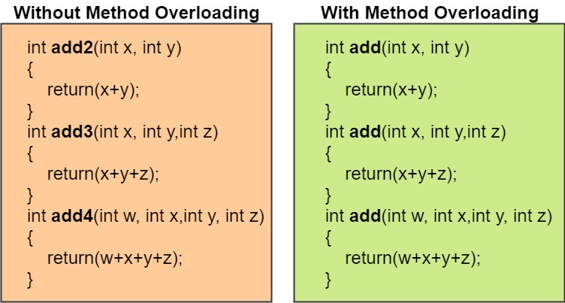
Overloading
Allows object to have different meaning depending upon context
Operator overloading: when an existing operator operates on new data type is called operator overloading
Function overloading: means two or more function have same name, but differ in the number of arguments or data type of arguments.

Slide 32
Encapsulation
class Employee extends Person {
private double salary; private boolean male;
public void setSalary (double newSalary) {
salary = newSalary;
}
public double getSalary () { return salary; } public boolean isMale() { return male; }
}
This way the object maintains control
Setters and getters have conventional names: setDataName, getDataName, isDataName (booleans only)

Slide 33
Abstraction and Interface

