Slide 1
LinguaL – A Language learning application
Object Oriented Concepts II
SWE 4302
Hasin Mahtab Alvee
210042174

Slide 2
Table of contents
01
04
02
05
03
06
Project Overview
Violations of SOLID
Key Features
Code & Design Smells
Previous Desing
SOLID Implementations

Slide 3
Project Overview
LinguaL is a comprehensive language learning application based on what language a user wants to learn.
We have study materials for different languages for lessons and exams.
The application can handle multiple users and can track the progress of all the users via utilizing text files as the primary database

Slide 4
Key Features
User Authentication
Activity History
Multiple users can be handled
User activity history is saved
Quiz Exams
Lessons
Track Progress
Quiz based exams can be taken by users
Lessons are available for languages
User can track their progress

Slide 5
Previous Design
Core implementation of previous design:
Using static class & variables to navigate around the text files.
Business logic were coupled with the UI
Most standalone functional classes
Most of these characteristics go against the concepts of OOP, thus we need to be worked on.

Slide 6
Implementation of SOLID
Jonathan Swift
Alexander Pope
Mars is actually a very cold place
Venus has extremely high temperatures
Samuel Richardson
Charlotte Lennox
Jupiter is the biggest planet of them all
Saturn is a gas giant and has several rings

Slide 7
Significance
Literary innovations & evolution
Reflection of social & cultural changes
Mercury is the closest planet to the Sun and the smallest one in the Solar System—it’s only a bit larger than the Moon
Venus has a beautiful name and is the second planet from the Sun. It’s hot and has a poisonous atmosphere

Slide 8
Implementation of SOLID
Rationalism & reason
Individualism & human rights
Scientific progress
Mercury is the closest planet to the Sun and the smallest of them all
Venus has a beautiful name and is the second planet from the Sun
Despite being red, Mars is actually a cold place. It’s full of iron oxide dust

Slide 9
Awesome words

Slide 10
—Someone Famous
“This is a quote, words full of wisdom that someone important said and can make the reader get inspired”

Slide 11
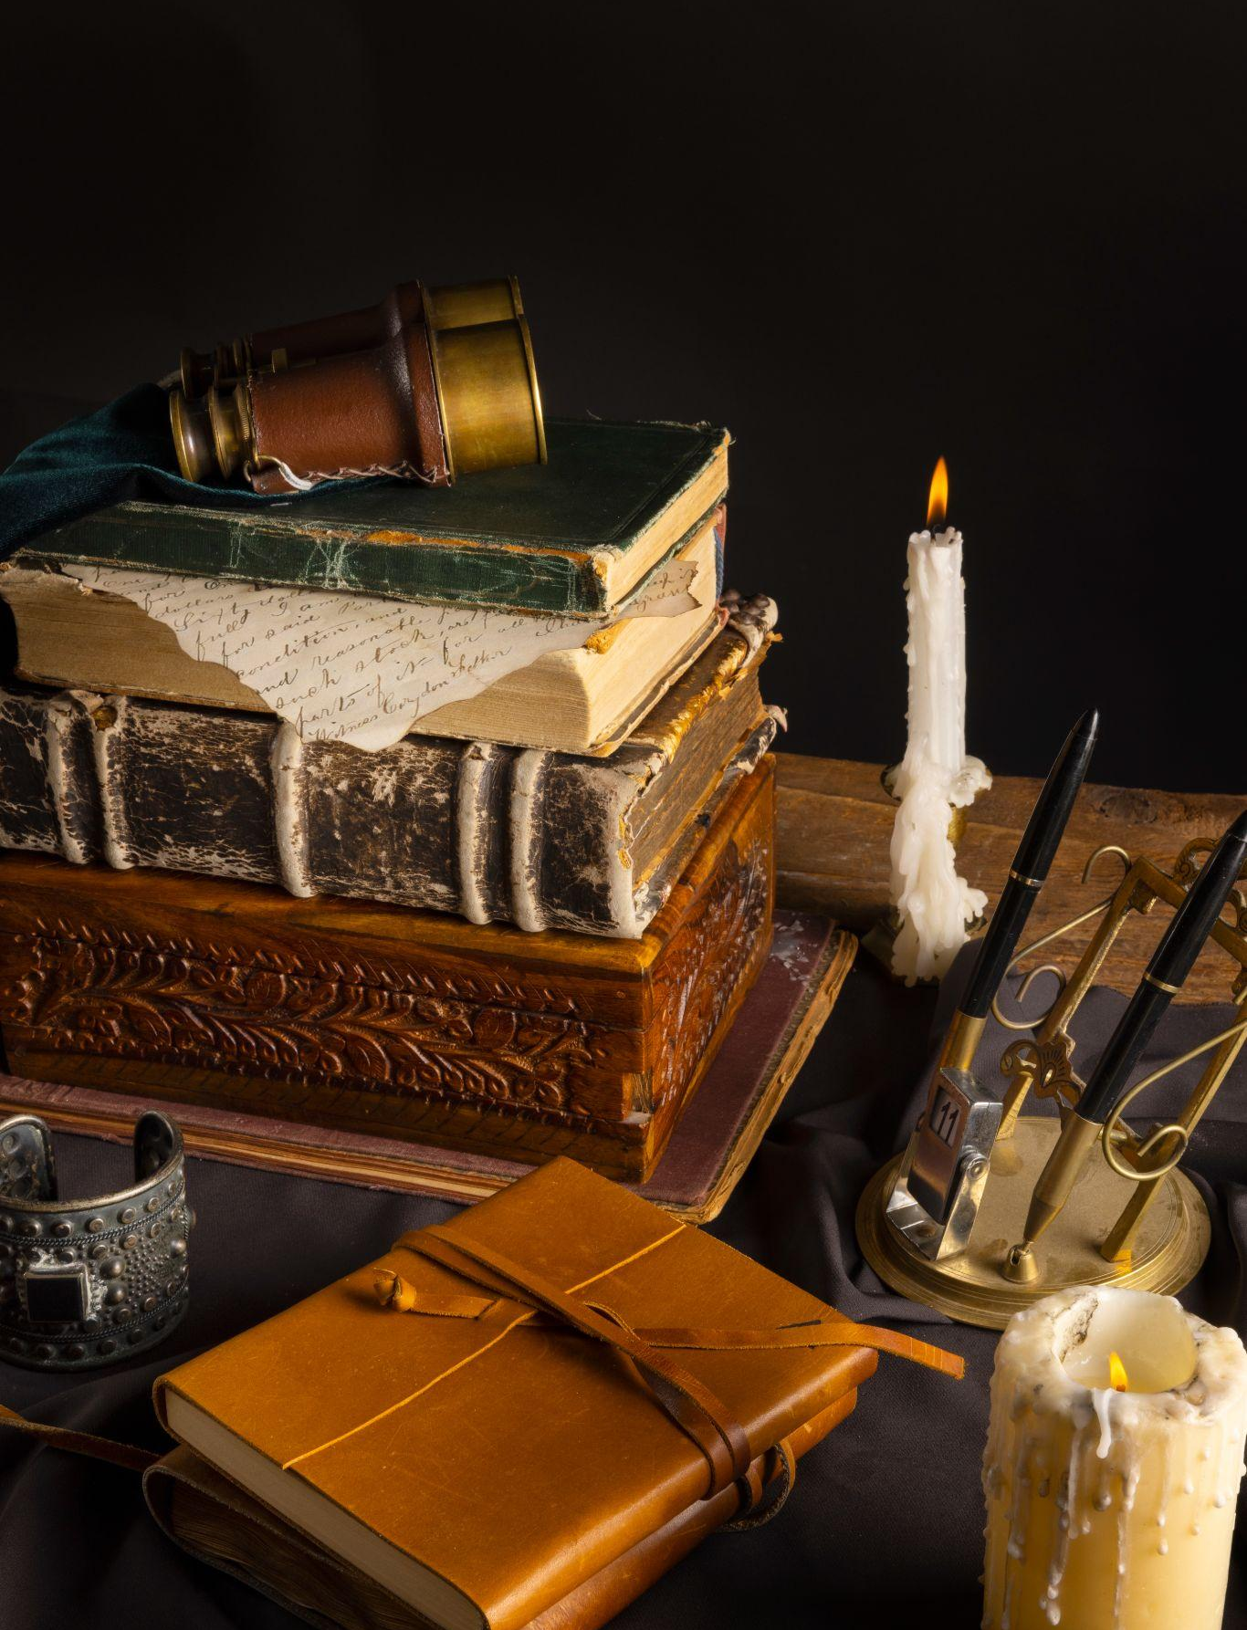
A picture always reinforces
the concept
Images reveal large amounts of data, so remember: use an image instead of a long text. Your audience will appreciate it

Slide 12
9h 55m 23s
333,000
386,000 km
Jupiter’s rotation period
The Sun’s mass compared to Earth’s
Distance between Earth and the Moon

Slide 13
Let’s use some percentages
Mercury
15%
Venus
Mercury is quite a small planet
Venus has a beautiful name
40%
25%
Jupiter
Saturn
Jupiter is a very big planet
20%
Saturn is a gas giant with rings

Slide 14
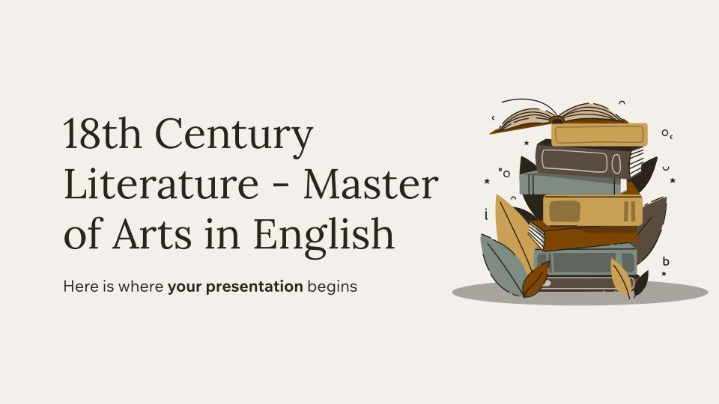
Computer mockup
You can replace the image on the screen with your own work. Just right-click on it and select “Replace image”

Slide 15
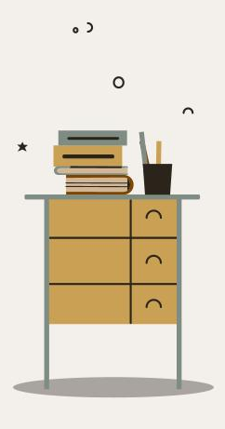
Phone mockup
You can replace the image on the screen with your own work. Just right-click on it and select “Replace image”

Slide 16
A linguistic revolution
Mercury
Saturn
Mercury is very close to the sun
Saturn is a gas giant and has rings
Jupiter
Jupiter is a gas giant and is a big planet
Neptune
Venus
Neptune is far away from the sun
Venus has a beautiful name

Slide 17
Use this diagram
Venus
Venus is the second planet from the sun
Jupiter
Mercury
Jupiter is a very big planet
Mercury is a very small planet
Mars
Despite being red, Mars is cold
Neptune
Saturn
Neptune is far away from us
Saturn has several rings

