Slide 1
Research Mapping
Kolkata Cluster + NCBS Bangalore
DPCN Course Project 2026 · Group 23 · Statistics Report
Institutions: SN Bose National Centre, Bose Institute Kolkata, SINP Kolkata, NCBS Bangalore
10,801 papers · 255,613 citations · 1,423 faculty/authors
Data source: OpenAlex · Period: 2016–2026
Instructor: Chittaranjan Hens
10,801
Papers
255,613
Citations
1,423
Faculty
61.4%
Q1 Fraction
12.0
Median h-index
DPCN Course 2026 · Group 23 · Kolkata Cluster + NCBS
1 / 10

Slide 2
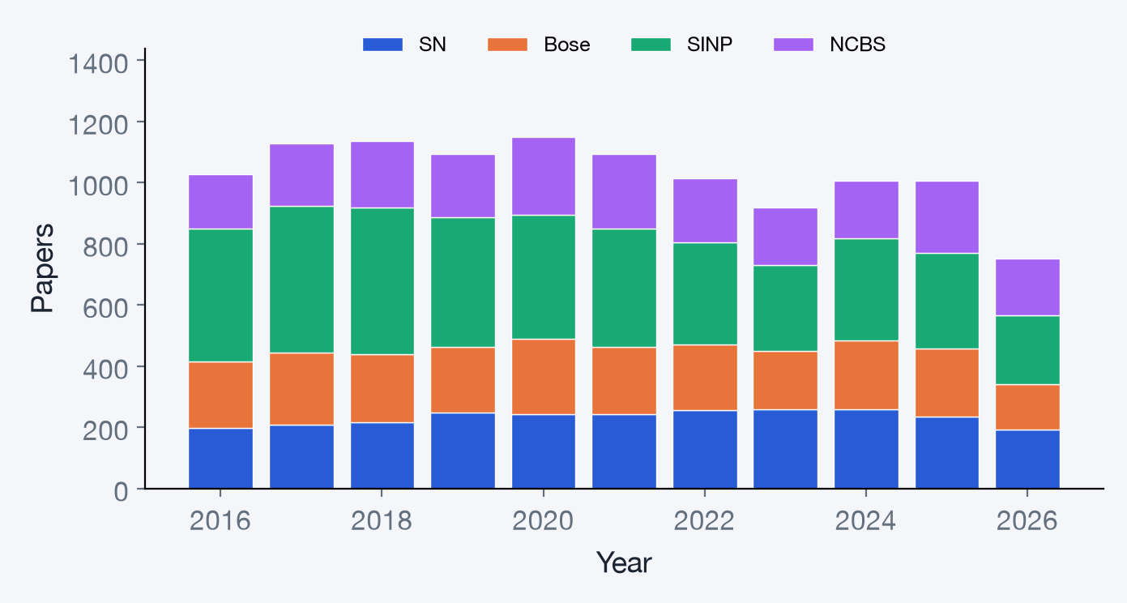
Publication Trend 2016–2026
10,801 papers total · SINP Kolkata leads with 4,094 papers
▸ SN Bose National Centre: 2,553 papers, 42,081 citations
▸ Bose Institute Kolkata: 2,362 papers, 54,325 citations
▸ SINP Kolkata: 4,094 papers, 102,935 citations
▸ NCBS Bangalore: 2,315 papers, 71,017 citations
Note: 2025–26 counts may be
incomplete (indexing lag).
DPCN Course 2026 · Group 23 · Kolkata Cluster + NCBS
2 / 10

Slide 3
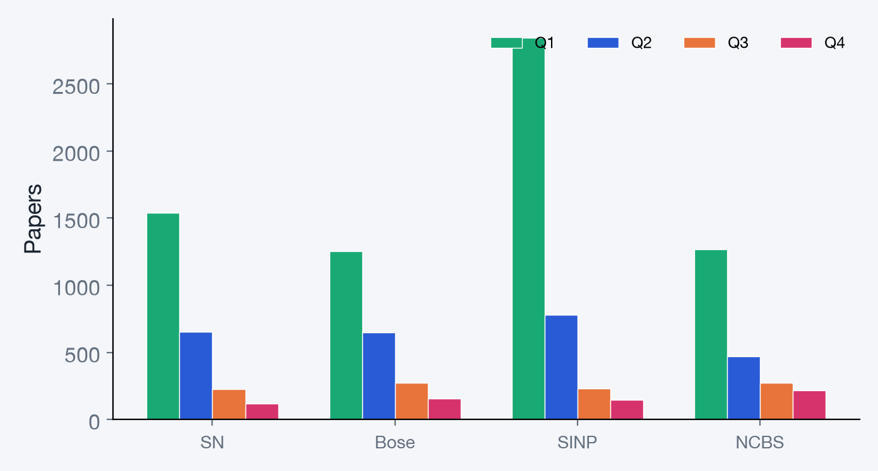
Journal Quartile Distribution
Q1 fraction = Q1 papers / journal papers with a known quartile · Overall Q1 = 61.4%
▸ SN Bose National Centre: Q1 = 60.7%
▸ Bose Institute Kolkata: Q1 = 53.7%
▸ SINP Kolkata: Q1 = 71.1%
▸ NCBS Bangalore: Q1 = 56.9%
Source: Scimago Journal Rankings
(curated ISSN → quartile mapping)
DPCN Course 2026 · Group 23 · Kolkata Cluster + NCBS
3 / 10

Slide 4
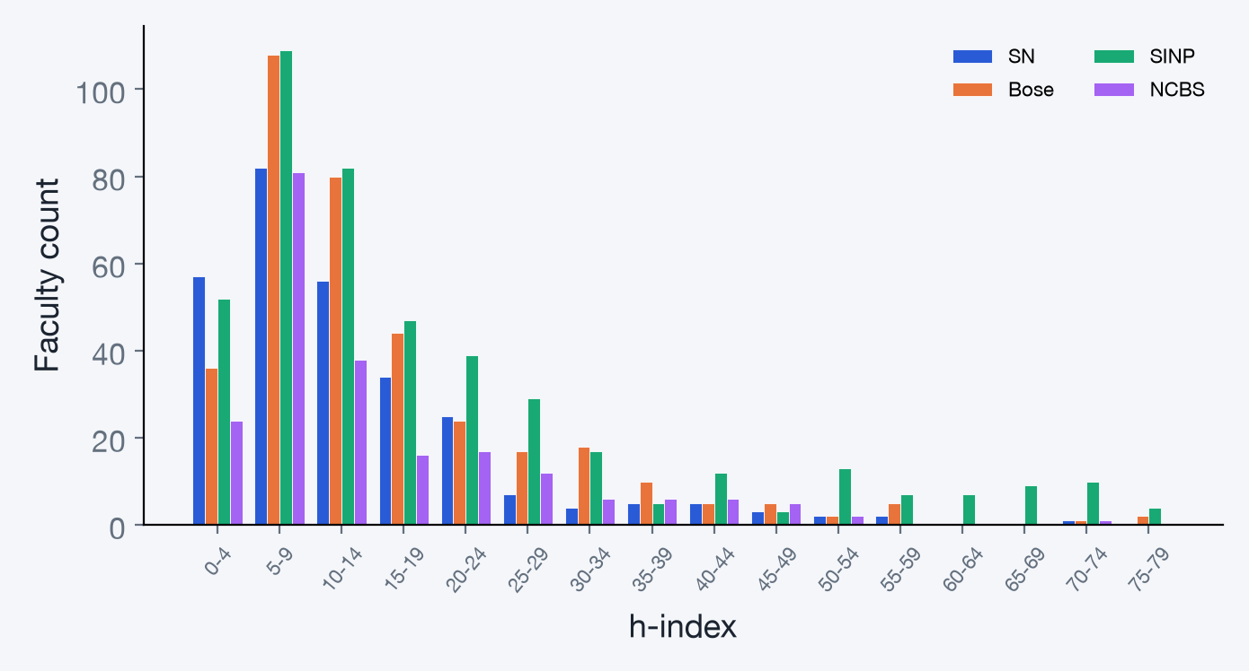
h-index Distribution of Faculty
Median h-index: 12.0 · Faculty = authors with 5+ papers · h-index is career-wide (OpenAlex)
▸ SN Bose National Centre: median h = 10.0, 301 faculty
▸ Bose Institute Kolkata: median h = 12.0, 386 faculty
▸ SINP Kolkata: median h = 15.0, 528 faculty
▸ NCBS Bangalore: median h = 10.0, 214 faculty
Top 3 by h-index:
Arun Kumar (157)
D. Dutta (147)
Subir Sarkar (146)
Note: OpenAlex may merge authors with similar names (e.g. "S. Das"), inflating some h-index values.
DPCN Course 2026 · Group 23 · Kolkata Cluster + NCBS
4 / 10

Slide 5
Top Journals & Most-Cited Papers
Where each institution publishes most · Highest citation counts across all four institutions
Inst | Top Journal | #
SN | Physical Review B | 162
 | Physical Review A | 93
 | Monthly Notices of the Royal Astronomi | 68
 | Physical Review E | 62
 | Physical Review D | 62
Bose | Journal of High Energy Physics | 100
 | The European Physical Journal C | 70
 | Physical Review C | 64
 | Physical Review Letters | 51
 | Physical Review A | 44
Inst | Top Journal | #
SINP | Journal of High Energy Physics | 541
 | Physical Review D | 289
 | The European Physical Journal C | 204
 | Physical Review C | 189
 | Physical Review Letters | 182
NCBS | eLife | 66
 | Zootaxa | 63
 | Nature Communications | 56
 | Scientific Reports | 52
 | Proceedings of the National Academy of | 47
Title | Journal | Year | Cites
The repertoire of mutational signatures in human cancer | Nature | 2020 | 3,861
Pan-cancer analysis of whole genomes | Nature | 2020 | 3,363
Guidelines for the use and interpretation of assays for moni | Autophagy | 2021 | 2,742
‘Green’ synthesis of metals and their oxide nanoparticles: a | Journal of Nanobiotechno | 2018 | 2,713
The mystery of membrane organization: composition, regulatio | Nature Reviews Molecular | 2017 | 2,244
Full top-10 list available in the interactive dashboard.
DPCN Course 2026 · Group 23 · Kolkata Cluster + NCBS
5 / 10

Slide 6
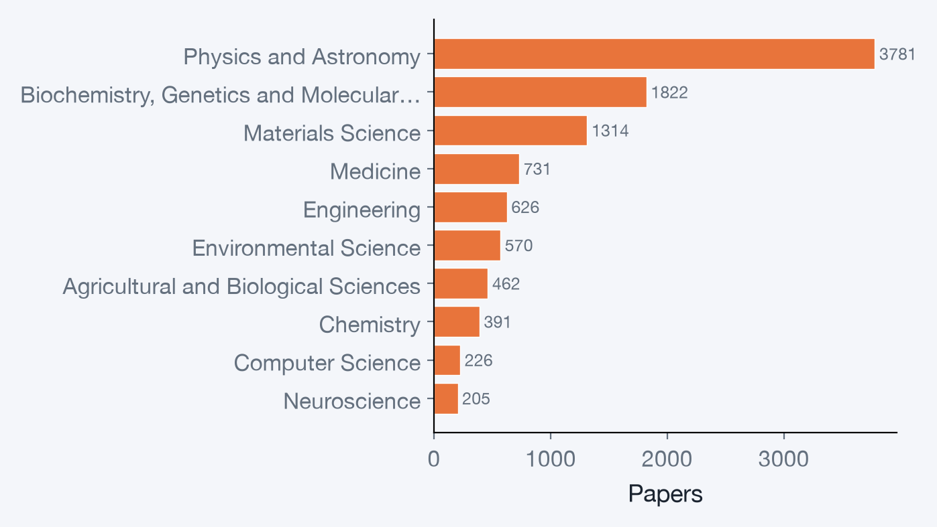
Research Area Breakdown
Primary OpenAlex field of each paper · Physics dominates across all four institutions
▸ Physics and Astronomy: 3781 (35%)
▸ Biochemistry, Genetics and Molecular Biology: 1822 (16%)
▸ Materials Science: 1314 (12%)
▸ Medicine: 731 (6%)
▸ Engineering: 626 (5%)
▸ Environmental Science: 570 (5%)
▸ Agricultural and Biological Sciences: 462 (4%)
▸ Chemistry: 391 (3%)
DPCN Course 2026 · Group 23 · Kolkata Cluster + NCBS
6 / 10

Slide 7
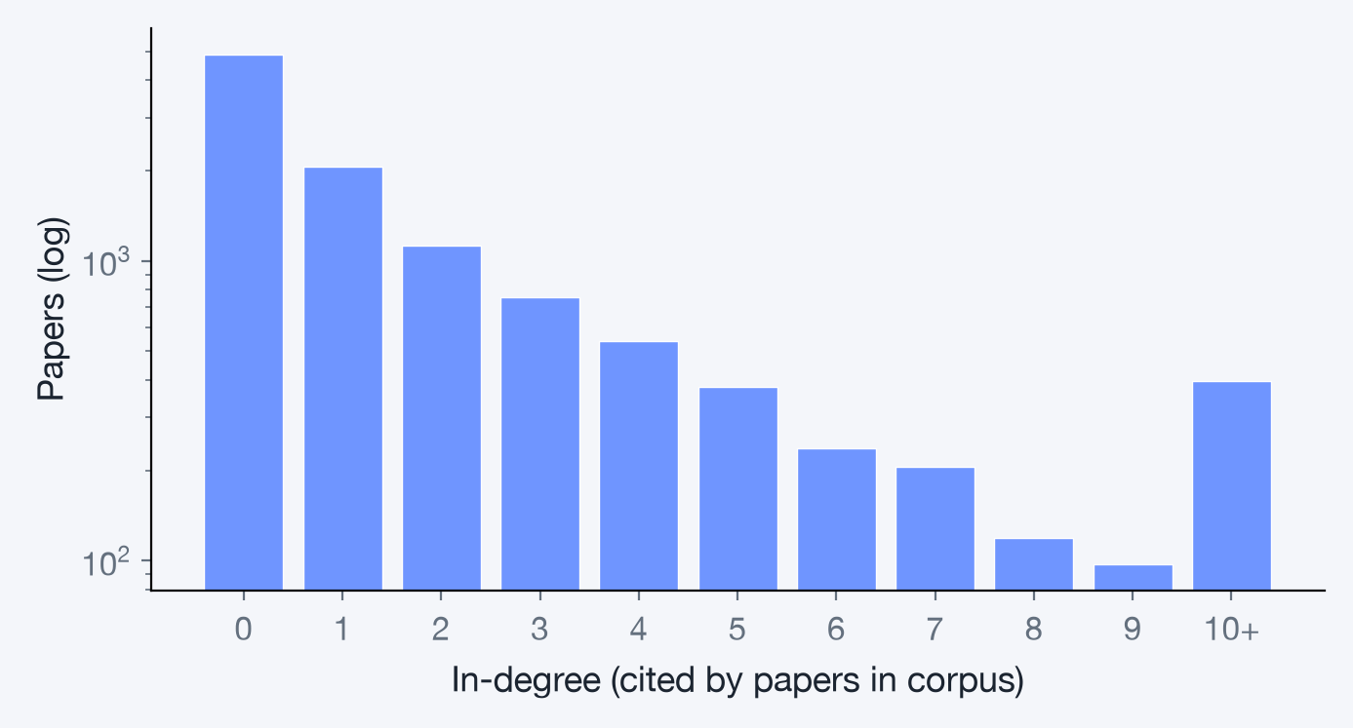
Citation Network Summary
10,801 papers · 24,410 citation edges inside the group's corpus
PageRank Top Papers | Inst | PR | In-deg
Event generator tunes obtained from underlyi | SINP | 0.00966 | 428
The CMS trigger system | SINP | 0.00627 | 500
Structural anomaly and dynamic heterogeneity | SN | 0.00459 | 15
Jet energy scale and resolution in the CMS e | SINP | 0.00411 | 375
Particle-flow reconstruction and global even | SINP | 0.00383 | 472
Acridine‐Functionalized Covalent Organic Fra | SN | 0.00282 | 10
Dielectric relaxation in ionic liquid/dipola | SN | 0.00259 | 6
Quantum Scars from Zero Modes in an Abelian | SINP | 0.00214 | 14
Institution | Papers | Internal edges | Isolated
SN Bose National Centre | 2553 | 5,014 | 547
Bose Institute Kolkata | 2362 | 4,340 | 605
SINP Kolkata | 4094 | 12,980 | 834
NCBS Bangalore | 2315 | 2,863 | 785
DPCN Course 2026 · Group 23 · Kolkata Cluster + NCBS
7 / 10

Slide 8
Authorship Network Summary
4,874 authors · 18,547 co-author links · 186 Louvain communities (modularity 0.896)
Most Collaborative (Degree) | Inst | Collab.
Biswarup Satpati | SINP | 156
Kuladip Jana | Bose | 138
Samir Kumar Pal | SN | 108
Ramanathan Sowdhamini | NCBS | 100
Dulal Senapati | SINP | 100
Uma Ramakrishnan | NCBS | 93
H. Weick | SINP | 89
Subhrangsu Chatterjee | Bose | 84
Key Brokers (Betweenness) | Inst | Score
Dimple Notani | NCBS | 0.1850
Dulal Senapati | SINP | 0.1652
Biswarup Satpati | SINP | 0.0963
Samir Kumar Pal | SN | 0.0745
Kuladip Jana | Bose | 0.0502
Awadhesh Pandit | NCBS | 0.0491
Ramanathan Sowdhamini | NCBS | 0.0476
Uma Ramakrishnan | NCBS | 0.0409
Institution | Authors | Co-author links | Communities | Modularity | Largest group
SN Bose National Centre | 983 | 2,748 | 39 | 0.82 | 803
Bose Institute Kolkata | 1140 | 4,612 | 51 | 0.827 | 979
SINP Kolkata | 1280 | 5,994 | 66 | 0.822 | 987
NCBS Bangalore | 1560 | 4,674 | 88 | 0.882 | 1092
Cross-institution links: 1,026 · Papers with >100 authors excluded from co-author pairs (1450 papers)
DPCN Course 2026 · Group 23 · Kolkata Cluster + NCBS
8 / 10

Slide 9
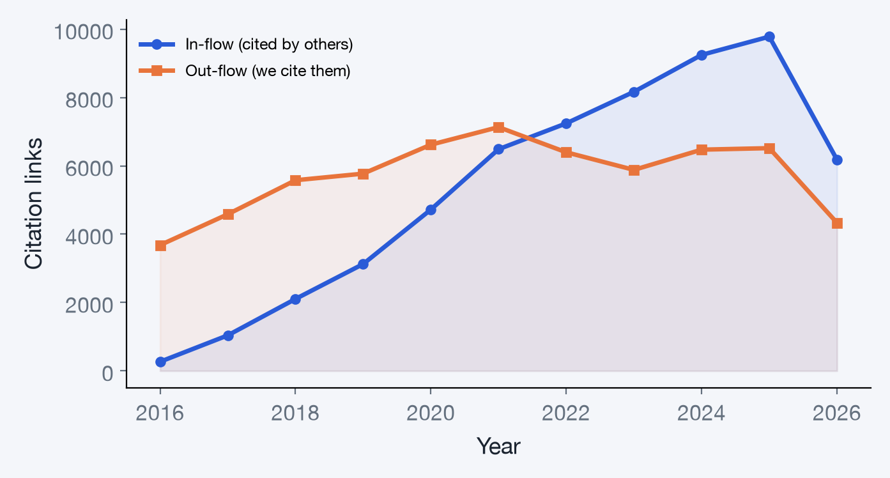
Indian Connectivity & Citation Flow
How the group sits in the wider Indian research network · in-flow vs out-flow of citations
Institution | In-flow | Out-flow | Ratio
SN | 13,328 | 13,932 | 0.96
Bose | 15,510 | 17,112 | 0.91
SINP | 22,642 | 28,704 | 0.79
NCBS | 11,693 | 9,640 | 1.21
Top Indian Institutes Citing Us | Cites
Homi Bhabha National Institute | 7,340
Tata Institute of Fundamental Research | 5,073
Variable Energy Cyclotron Centre | 3,159
Indian Institute of Technology Bombay | 2,591
Aligarh Muslim University | 2,462
Indian Institute of Science Bangalore | 2,294
Total in-flow: 58,396 · Total out-flow: 62,972 · In/Out ratio: 0.93
DPCN Course 2026 · Group 23 · Kolkata Cluster + NCBS
9 / 10

Slide 10
Key Takeaways
1
10,801 papers across 4 institutions (2016–2026), totalling 255,613 citations.
2
SINP Kolkata is the largest contributor (4,094 papers, 102,935 citations).
3
Overall Q1 fraction: 61.4% — SINP leads at 71.1.
4
Top journal: Journal of High Energy Physics (574 papers) — reflecting the strong HEP presence at SINP and Bose Institute.
5
Citation network: 24,410 internal citation links; highest PageRank paper is "Event generator tunes obtained from underlying event an…"
6
Authorship network: 186 collaboration communities (modularity 0.896), with 1,026 cross-institution links.
7
NCBS Bangalore has the highest citation in-flow ratio (1.21), indicating strong external impact.
8
Most-cited paper: "The repertoire of mutational signatures in human cancer…" (3,861 citations).
DPCN Course 2026 · Group 23 · Kolkata Cluster + NCBS
10 / 10

