Slide 1
Does Repeated Drought Reduce Ecosystem Recovery?
Mid-Evaluation Report · Team Earth 404
Pavani · Raviteja · Vandana · Akshitha · Gayatri · Hasini

Slide 2
Problem statement
Drought changes ecosystem productivity, and its effects can outlast the dry spell
These drought legacies (physiological, hydrological, ecological) can last months or years
Droughts are getting more frequent, intense and longer, so a new one may hit before recovery from the last
Key risk: repeated exposure could compound damage over time
Rain-fed farming and groundwater-dependent livelihoods in Anantapur and Kurnool.
Whether repeated drought erodes resilience changes how water, afforestation and relief are prioritised.
Do ecosystems remember past stress in a way that weakens later responses?
Team Earth 404 · Mid-Evaluation

Slide 3
Research question
Does repeated exposure to drought reduce the resistance and recovery capacity of ecosystems?
1 · Resistance
Does a drought that hits before recovery from a prior one (successive) cause a bigger productivity drop than an isolated drought?
2 · Recovery
Does the ecosystem take longer to return to normal productivity after a successive drought than after an isolated one?
3 · Spatial variation
Is the effect uniform, or does it depend on baseline climate? Liu et al. (2026) found legacies only in some regions, hence six districts.
Team Earth 404 · Mid-Evaluation

Slide 4
Data used
Six districts in Andhra Pradesh across an aridity gradient · Jan 2001 to Dec 2022 · 264 months each · extracted via Google Earth Engine (FAO GAUL 2015, Level 2)
District | Climate profile | Role in study
Anantapur | Semi-arid, chronically drought-hit | Primary focus
Kurnool | Semi-arid, moderately dry | Within-region comparison
Kadapa | Semi-arid, Rayalaseema dry belt | Within-region (added)
Chittoor | Partly hilly, drier than coast | Intermediate (added)
Prakasam | Coastal-influenced, drought-prone | Coastal contrast (added)
East Godavari | Coastal, tropical-wet, monsoon | Wet contrast case
Dataset | Resolution | Used for
SPEI-03 (SPEIbase v2.10) | ~55 km, monthly | Timing and severity of droughts
MODIS GPP (MOD17A2H) | 500 m, 8-day | Main outcome: resistance, recovery
MODIS NDVI (MOD13Q1) | 250 m, 16-day | Cross-check of GPP resistance
ERA5-Land temperature | ~11 km, monthly | Computed per event, not analysed yet
CHIRPS rainfall | ~5.5 km, daily | Extracted, not used (SPEI covers it)
GPP is the single outcome indicator; NDVI is only a validation check. Soil moisture was dropped when the Random Forest step was replaced by direct statistical tests.
Team Earth 404 · Mid-Evaluation

Slide 5
Methodology: six steps
1 · Find drought events
SPEI-03 below -1.0; merge runs 2 months apart or less; drop runs under 2 months
2 · Successive or isolated
Successive only if it starts before recovery from a previous drought that caused a GPP loss
3 · Resistance
Minimum GPP in the event (plus 1-month lag) divided by the seasonal baseline; loss if below 0.90
4 · Recovery time
Months until GPP is at least 90% of baseline for two months in a row, within 24 months
5 · Statistical tests
Mann-Whitney, Cliff's delta, bootstrap CI, district-stratified permutation, clustered OLS, Spearman
6 · Cross-verification
NDVI vs GPP resistance, plus a Kruskal-Wallis check for seasonal artefacts
Team Earth 404 · Mid-Evaluation

Slide 6
Results: drought events identified
58
93%
District | Events | With loss | Repeat
Anantapur | 10 | 10 | 1
Kurnool | 10 | 10 | 0
East Godavari | 11 | 10 | 1
Kadapa | 8 | 8 | 0
Chittoor | 8 | 8 | 0
Prakasam | 11 | 8 | 0
Total | 58 | 54 | 2
drought events across 6 districts
54 events caused a GPP loss
54 / 54
2 of 58
loss events recovered within 24 months
successive events (3.4%)
Median recovery 2 months, mean 2.9; 48% recovered in a single month
Longest recovery: 18 months (Kurnool, Jan 2018)
Successive: Anantapur (Jan 2004) and East Godavari (May 2003)
Team Earth 404 · Mid-Evaluation

Slide 7
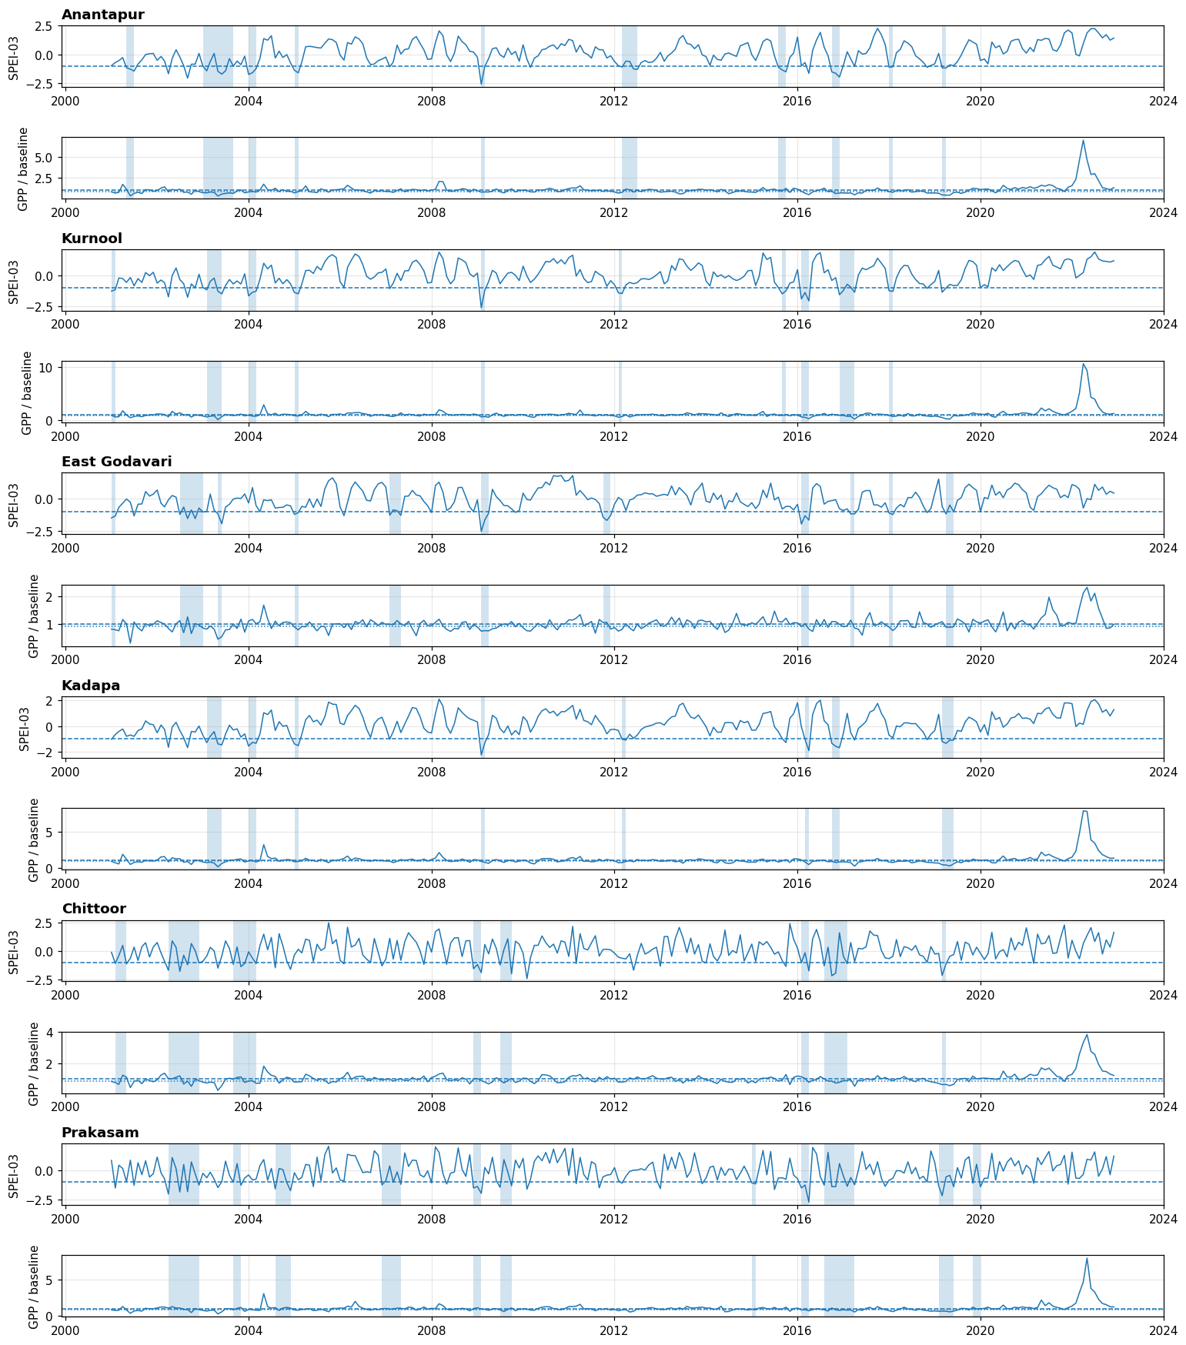
SPEI-03 and GPP across the six districts
Shaded bands are detected drought events (SPEI-03 below -1.0)
Droughts cluster in the same years across districts (2003-05, 2009, 2016-17, 2019), so events are not fully independent
Every district shows a very large GPP spike in 2022, flagged for checking before the final submission
Team Earth 404 · Mid-Evaluation

Slide 8
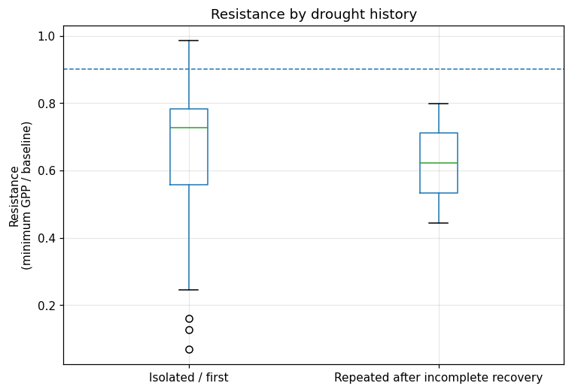
Resistance: repeated vs isolated droughts
0.622
0.651
mean resistance, repeated (n = 2)
mean resistance, isolated (n = 56)
Difference -0.030, bootstrap 95% CI [-0.242, +0.183]
Stratified permutation p = 0.920
Clustered OLS repeat coefficient -0.113 (p = 0.581)
Repeat events fall inside the isolated range: no detectable effect
Team Earth 404 · Mid-Evaluation

Slide 9
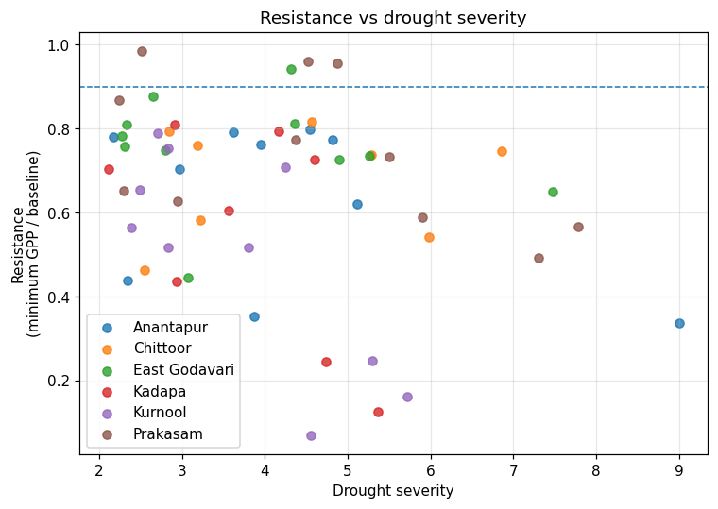
Resistance vs drought severity
No clear relationship: similar severity gives the whole range of resistance
Lowest values sit at moderate severity (about 4-5) in Kurnool and Kadapa
Severity is not significant in the regression (p = 0.718); duration neither (p = 0.109)
Team Earth 404 · Mid-Evaluation

Slide 10
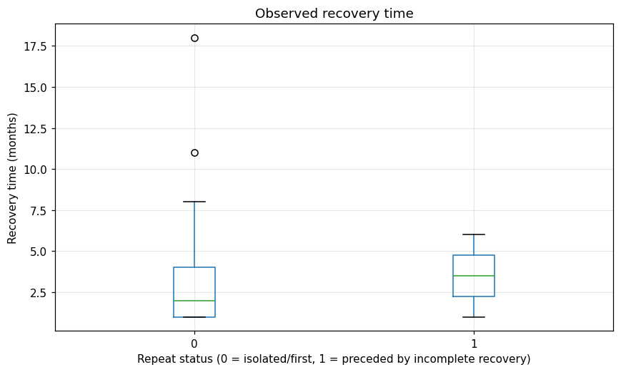
Recovery: repeated vs isolated droughts
3.5 mo
2.85 mo
repeated (n = 2)
isolated (n = 52)
Difference +0.65 months, CI -2.42 to +3.64, p = 0.751
Direction fits slower recovery, but two events cannot be separated from natural spread
Recovery gain was larger for repeat events (0.781 vs 0.318, perm. p = 0.139): inconclusive
Team Earth 404 · Mid-Evaluation

Slide 11
Statistical tests and regional comparison
Outcome (rep. / iso.) | Mean rep. | Mean iso. | Diff. | MW p
Resistance (2/56) | 0.622 | 0.651 | -0.030 | 0.982
Recovery time (2/52) | 3.50 | 2.85 | +0.654 | 0.751
Post-drought residual (2/56) | -0.117 | -0.271 | +0.154 | 0.612
Recovery gain (2/56) | 0.781 | 0.318 | +0.463 | 0.068
District | Median res. | Mean res. | Median rec. (mo)
East Godavari | 0.758 | 0.753 | 2.0
Chittoor | 0.743 | 0.680 | 2.5
Anantapur | 0.734 | 0.636 | 1.5
Prakasam | 0.732 | 0.746 | 1.5
Kadapa | 0.654 | 0.556 | 1.0
Kurnool | 0.541 | 0.499 | 1.0
Kurnool has the lowest resistance (coefficient -0.177 vs Anantapur, p = 0.065); Kadapa next
Prakasam is higher than Anantapur (+0.153, p = 0.030)
Anantapur, the most drought-prone, is not the lowest, so there is no simple wet = resistant ordering
Team Earth 404 · Mid-Evaluation

Slide 12
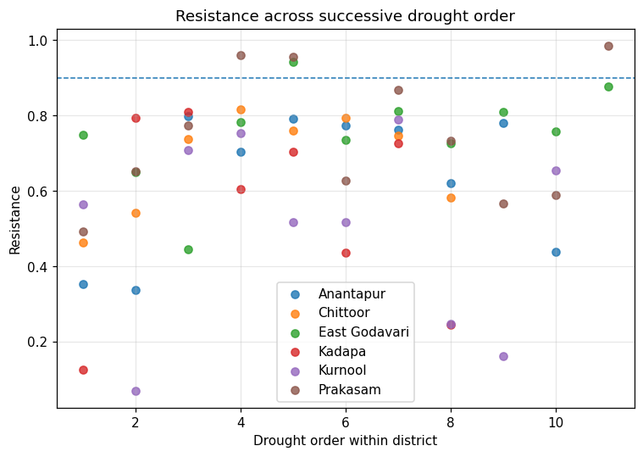
Legacy checks and cross-verification
Resistance does not fall with event order; later events sit slightly higher
No predictor was linked to lower resistance or longer recovery
Higher pre-drought GPP went with higher resistance (rho = 0.325, p = 0.015), one of 12 exploratory tests
GPP vs NDVI resistance: rho = 0.514, p < 0.001
Season of onset: Kruskal-Wallis p = 0.190, so no seasonal artefact
Team Earth 404 · Mid-Evaluation

Slide 13
Observations
No detectable effect of repeated drought on resistance or recovery, but with only 2 successive events the test is weak. This is insufficient evidence, not evidence of no effect.
What the data show
93% of events had a GPP loss, yet all recovered within 24 months (median 2). Pre-drought condition may matter.
Link to literature
Differs from Xu et al. (2021), who used back-to-back experimental droughts. Closer to Liu et al. (2026) and Gliesch et al. (2025).
Regional pattern
Kurnool and Kadapa are least resistant; regional gaps look larger than the repeat effect, but not a clean wet-to-dry gradient.
Team Earth 404 · Mid-Evaluation

Slide 14
Honest limitations
Very few repeat events
2 of 58, so low power; only very large effects detectable
Events not independent
Same-year droughts across districts; effective sample is below 58
Definition-dependent
Recovery threshold and SPEI cutoff change the repeat count
Scope of data
Analysis stops at 2022; rainfall, soil moisture, temperature not analysed
Team Earth 404 · Mid-Evaluation

