Slide 1
Integration of DAC and rbac policies

Slide 2
INtroduction
DAC stands for Discretionary Access Control. It allows the data owner to determine who has access to specific resources and what actions they can perform.
The DAC policy specifies the rules and permissions associated with accessing and manipulating data within a database. They are crucial for maintaining the confidentiality and integrity of data within a database.
RBAC stands for Role-Based Access Control. It is an access control mechanism that restricts system access to authorized users and assigns permissions based on the roles those users have.
A RBAC policy is a set of rules and guidelines that govern the access permissions granted to users or systems based on their roles within an organization or system.
It enhances security, helps with compliance, and provides a structured approach to managing access within an organization or system.

Slide 3
Methodology
Creating the users, groups and assigning the users to groups using DAC policies.
Setting user and group permissions
Showing how April created a required document Reqs.pdf
Allowing the developers to review Reqs.pdf created by April
Implementing RBAC policies on users
Deleting the user ‘Steven’ from developer group by the administrator

Slide 4
STEP 1: Creating users
Creating the users by using ‘adduser’ command and protecting them with password
List of users: Susan
April
Carla
Steven

Slide 5


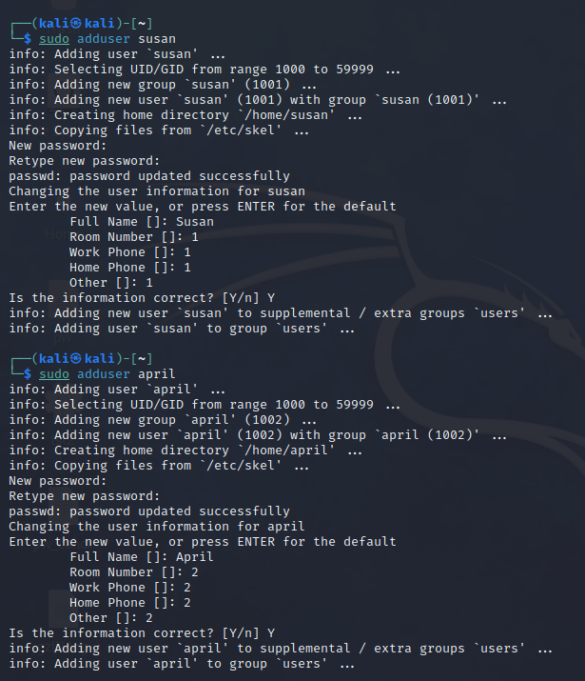
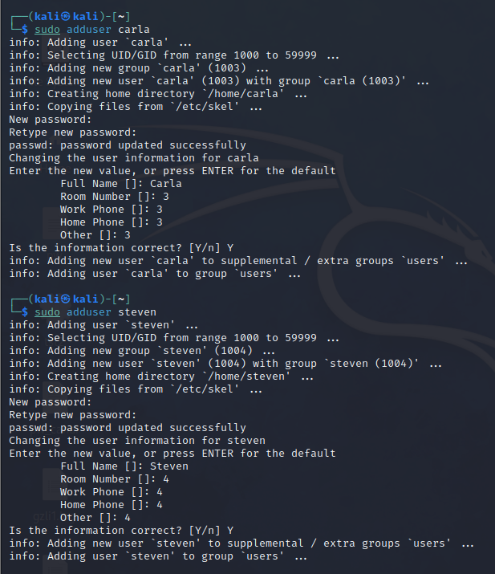

Slide 6

STEP 2: Creating GROUPS
Creating the groups for different roles by using ‘addgroup’ command
List of groups: Administrator
Architect
Developer

Slide 7

STEP 3: assigning users to GROUPS
Assigning users to their respective groups using ’usermod’ command.
Users and their groups: Susan: Administrator
April: Architect
Carla: Developer
Steven: Developer

Slide 8
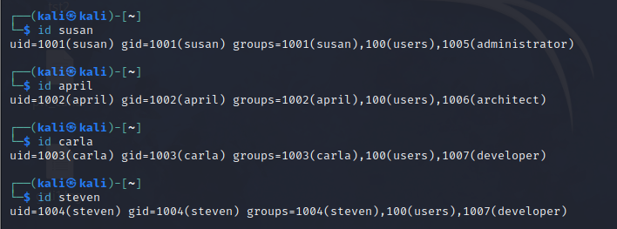
STEP 4: verifying user group memberships
Checking the group memberships using ‘id’ command.

Slide 9

STEP 5: setting user and group permissions
Assigning the architect group to april in its home directory and giving read, write and execute permissions using ‘chown’ and ‘chmod’ command respectively.

Slide 10
STEP 6: creating the required file
Creating Documents directory in the April user account and creating Reqs.pdf file in the April’s document directory.

Slide 11

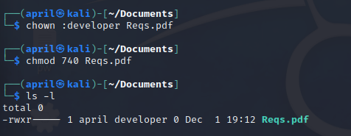

As April would like all developers to review the Reqs.pdf file we need to restrict the access permission to other groups

Slide 12
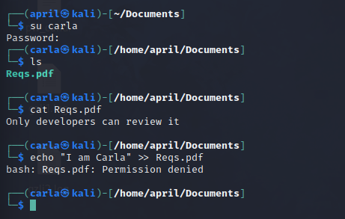
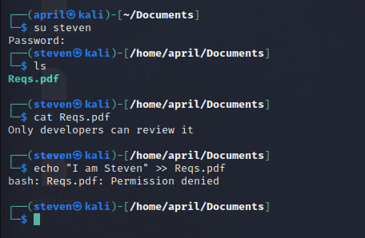
STEP 7: reviewing the required file by developers

Slide 13
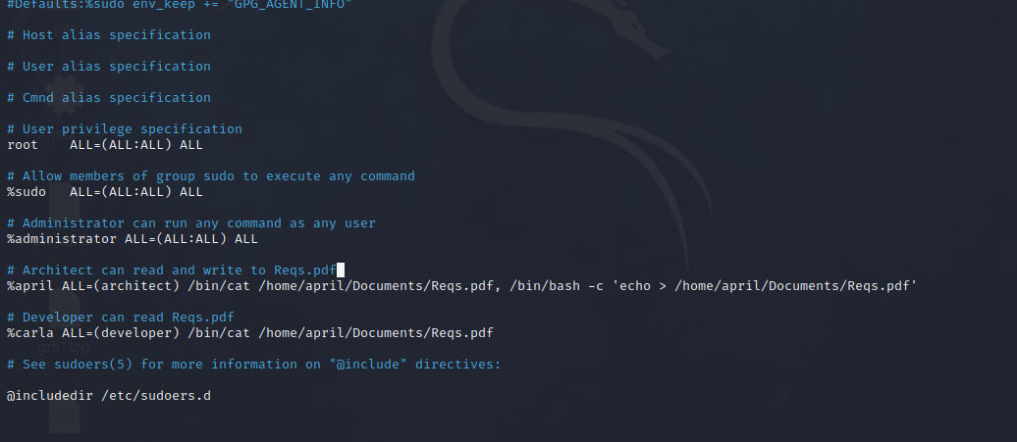
STEP 8: implementing rbac policies on users

Slide 14
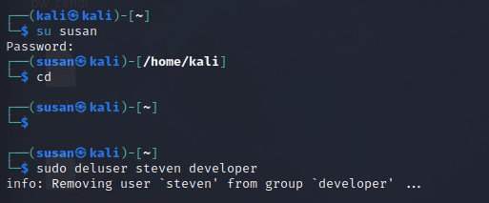
STEP 9: deleting the user
Deleting the user ‘steven’ from developer group by the administrator

Slide 15
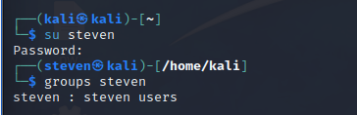
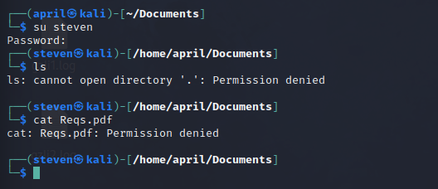
STEP 10: checking for the account and access in developers

Slide 16
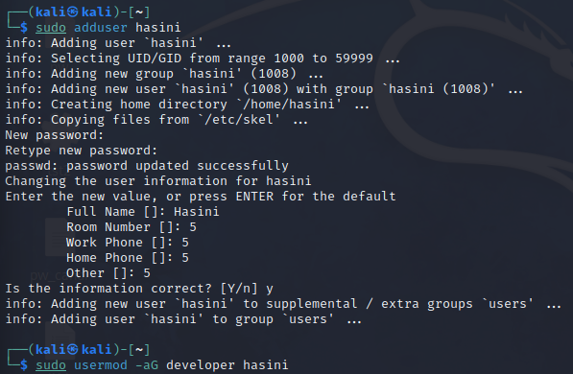
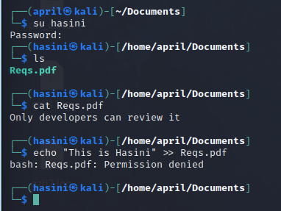
STEP 11: checking whether new users added to developers group can review the file.

Slide 17
Thank You…

