Slide 1

MOVIE RECOMMENDATION SYSTEM
Final Project Review | Department of Computer Science & Engineering | KLH University
FINAL PROJECT REVIEW
TEAM MEMBERS
2420030517 – Tejaswi Chowdary
2420030606 – Harshith Reddy
2420030613 – Hasini Reddy
Guide: Dr. Sunanda N
Department of Computer Science and Engineering
Koneru Lakshmaiah Education Foundation | Academic Year: 2026–27
Notes:
Title slide. Replace all bracketed text. Use the full project title, list every team member with registration number, and name your guide. Insert the institution logo in the dashed box.

Slide 2
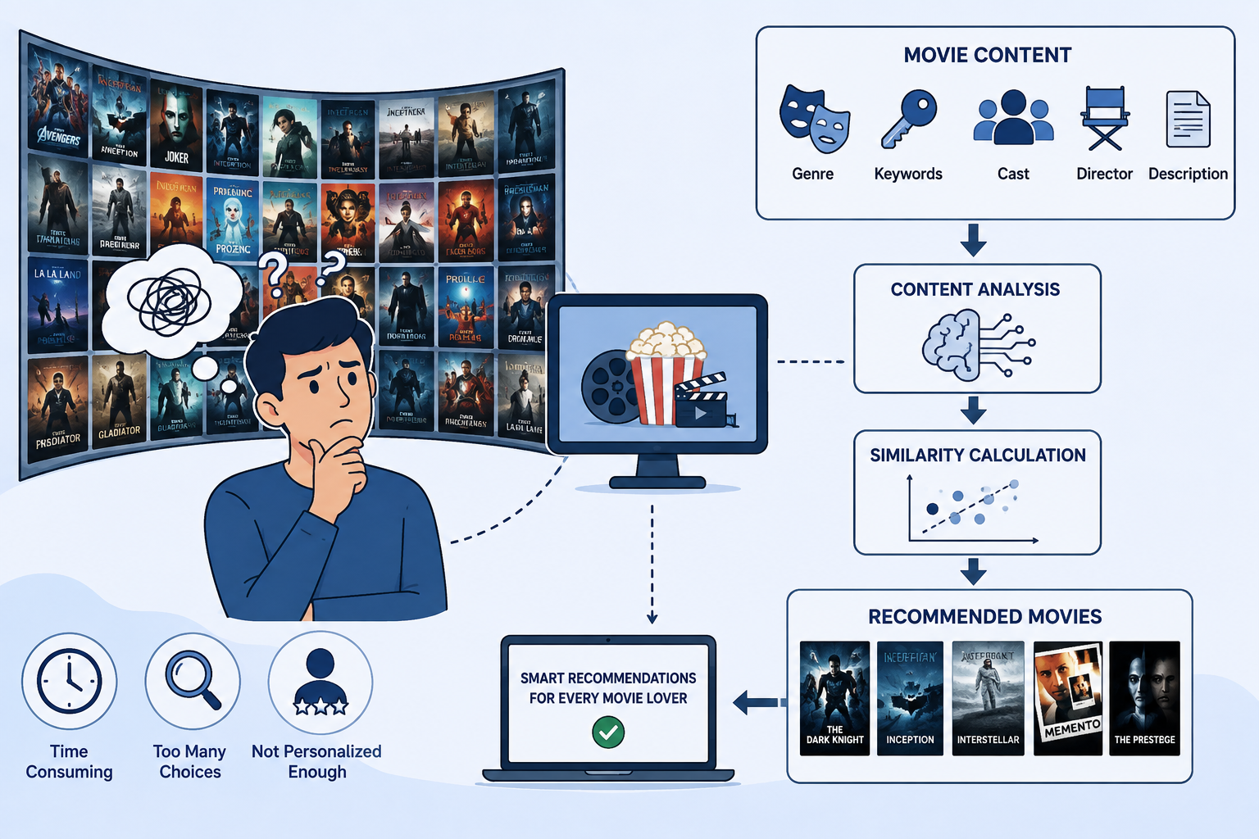



Introduction & Problem Statement
Background
The Movie Recommendation System applies Data Science, Natural Language Processing and Machine Learning to analyse movie characteristics and recommend similar movies.
Problem Statement
With thousands of movies available, users may struggle to find films matching their interests. Manual searching is time-consuming. The system recommends movies similar to a movie selected by the user.
Motivation / Need
Helps users discover relevant movies faster, reduces browsing effort and demonstrates practical use of content-based recommendation without depending on other users’ ratings.
Notes:
State the domain, the exact problem and why it matters. Keep it to about 2 minutes. Add one real-world statistic if you can, with a citation.

Slide 3


Objectives & Scope
Objectives
1
Collect and preprocess the TMDB 5000 movie dataset.
2
Select genre, keywords, cast, director and description features.
3
Apply TF-IDF and Cosine Similarity to identify similar movies.
4
Display ranked recommendations through a Streamlit dashboard.
Notes:
Objectives should be measurable and start with action verbs. The scope slide tells the panel what you did and did not attempt.

Slide 4
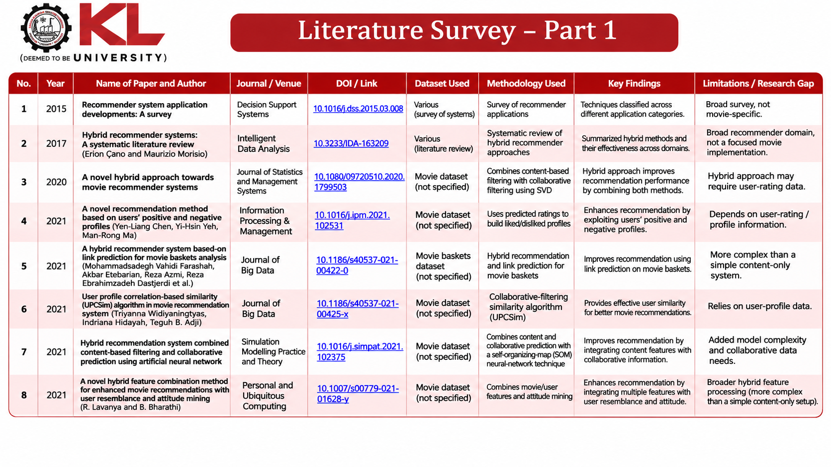

Research Gap
Existing systems use popularity-based, content-based, collaborative and hybrid recommendation. This project focuses on combining multiple movie attributes—genre, keywords, cast, director and description—then representing them with TF-IDF and ranking similarity using Cosine Similarity. It does not require user-rating history.
Notes:
Summarise four to six relevant papers or existing systems. End with the research gap, because that gap justifies your project.

Slide 5





Proposed System & Methodology
STEP 1
STEP 2
STEP 3
STEP 4
STEP 5
Define Problem
Collect Data
Design
Implement
Test & Evaluate
Define the movie discovery problem and recommendation objective.
TMDB 5000 dataset; about 5,000 movie records from Kaggle.
Select metadata features and combine them into one text representation.
Apply TF-IDF, compute cosine similarity and connect to Streamlit.
Show a ranked list of similar movies for the selected title.
Key Novelty / Contribution
The system combines multiple movie metadata fields in one content representation and recommends similar films using TF-IDF and Cosine Similarity, without requiring other users’ ratings.
Notes:
Walk through the five steps left to right. Rename the steps to match your project (for example, Requirement Analysis, Design, Coding, Testing, Deployment). End with your novelty.

Slide 6
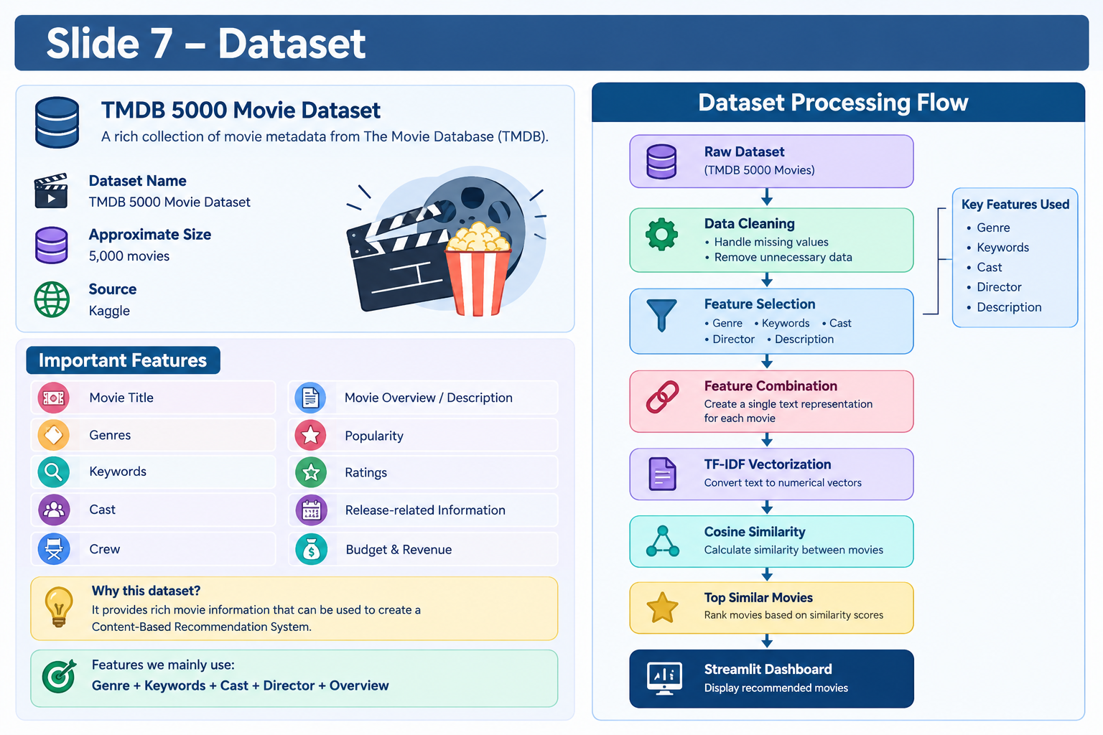
System Architecture
Components
1
Dataset & Input
TMDB 5000 movie metadata.
2
Preprocessing
Handle missing and unnecessary data.
3
Feature Processing
Genre, keywords, cast, director and description.
4
Recommendation & UI
TF-IDF, cosine ranking and Streamlit display.
Notes:
Insert a clear block diagram: input, processing, storage, output. Number each block and explain them on the right. Redraw the figure yourself rather than copying it.

Slide 7


Hardware & Software Requirements
Hardware details are not specified in the project PPT.
A computer capable of running the Python environment is required.
Python-based project
Streamlit dashboard
Kaggle dataset
Development environment not specified in source.
TF-IDF
Cosine Similarity
Data Science / NLP
Machine Learning
[Processor / RAM / GPU]
[Storage]
[Sensors / boards / devices]
[Network / peripherals]
[Operating system]
[Language and version]
[IDE / notebook environment]
[Version control, e.g. GitHub]
[Library 1 and version]
[Library 2 and version]
[Framework / API]
[Database / cloud service]
Deployment / Platform: Streamlit interactive dashboard. Dataset source: Kaggle TMDB 5000 Movie Dataset.
Notes:
List only what you actually used, with versions. For a pure software project, shorten the hardware list and add cloud or deployment resources.

Slide 8
Dataset / Data Understanding
~5,000
Metadata
Movie records
Movie features
Not stated
Not applicable
Missing-value count
Target classes
Source: Kaggle – TMDB 5000 Movie Dataset.
Features used: genre, keywords, cast, director and movie overview/description.
The PPT does not specify exact missing-value counts or feature-column totals.
Notes:
Explain where the data came from and what it contains. Show a screenshot of the first rows or the info summary. For non-data projects, replace this slide with “Requirement Analysis” or “Input Specification”.

Slide 9
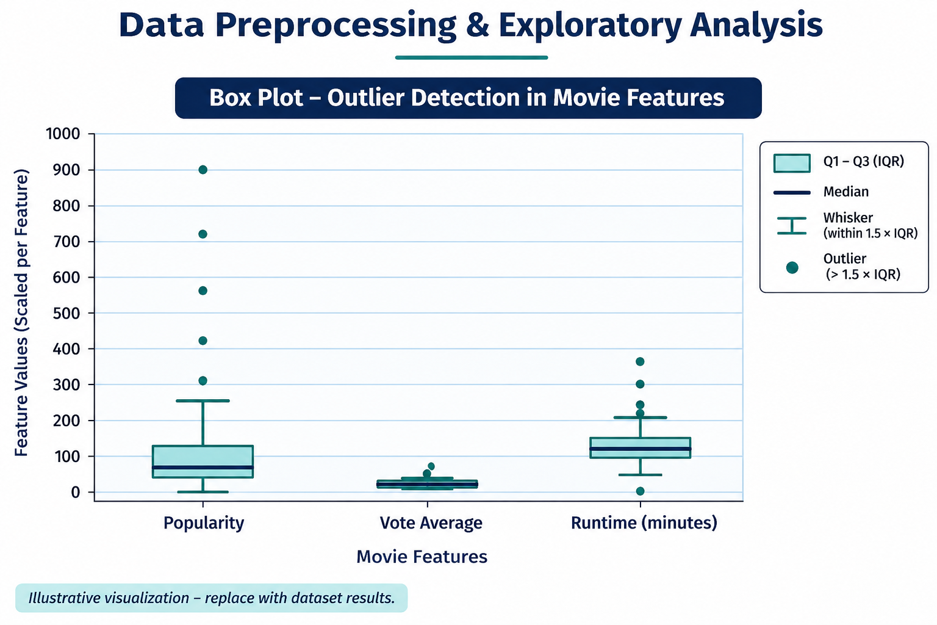



Data Preprocessing & Exploratory Analysis
Cleaning
Transformation
Feature Selection
Handle missing values and remove unnecessary data before recommendation processing.
Combine selected movie attributes into one text field and convert text using TF-IDF.
Use genre, keywords, cast, director and description as the main recommendation features.
Notes:
Show two or three plots that tell a story: distributions, correlations, outliers. Explain what each plot told you and what you did about it.

Slide 10
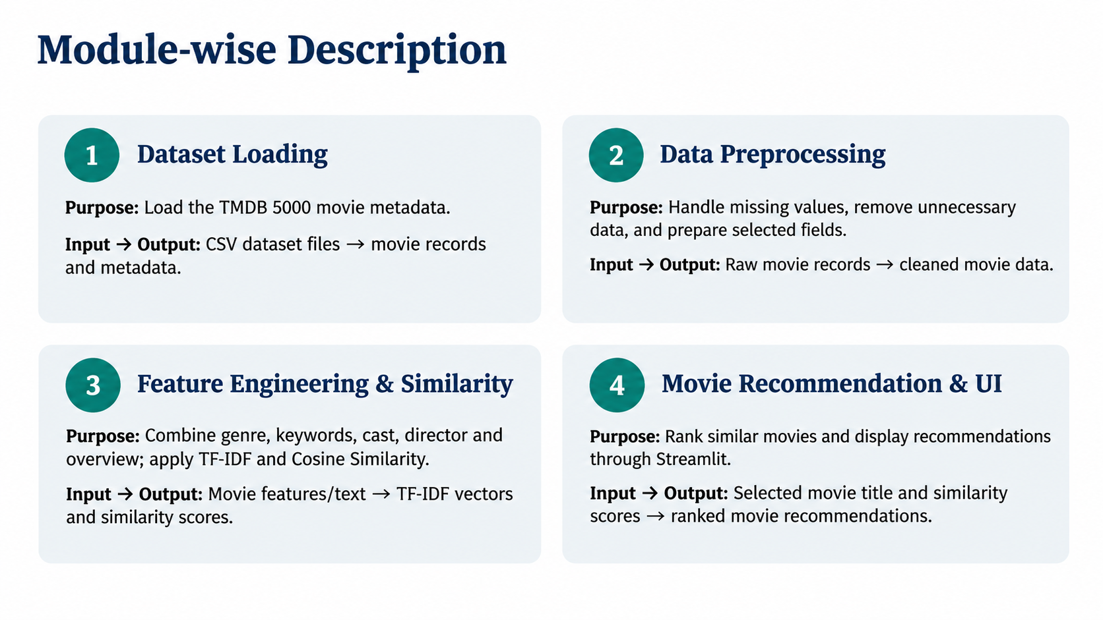

Slide 11

Algorithms & Technologies Used
Content-Based Filtering
TF-IDF
Cosine Similarity
Why chosen: Recommends movies from their own characteristics without user-rating history.
Key inputs: genre, keywords, cast, director and description.
Why chosen: Converts combined movie text into numerical feature vectors.
Role: Gives importance to informative terms in movie metadata.
Why chosen: Measures similarity between movie feature vectors.
Role: Ranks movies most similar to the selected title.
Selection criteria: Content relevance, simplicity and suitability for metadata-based movie recommendations.
Notes:
Name each model, algorithm or technology, say why you chose it, and list the key settings. Then explain how you picked the final one.

Slide 12
Implementation / Model Building
Code snippet / pseudocode
import pandas as pd
from sklearn.feature_extraction.text import TfidfVectorizer
from sklearn.metrics.pairwise import cosine_similarity
movies = pd.read_csv("movies.csv")
movies["combined"] = (
movies["genres"] + " " +
movies["keywords"] + " " +
movies["overview"]
)
tfidf = TfidfVectorizer(stop_words="english")
matrix = tfidf.fit_transform(movies["combined"])
similarity = cosine_similarity(matrix)
def recommend(movie):
idx = movies[movies["title"] == movie].index[0]
scores = similarity[idx]
top = scores.argsort()[-6:-1][::-1]
return movies.iloc[top]["title"]
Feature Selection
Genre, keywords, cast, director and movie overview/description are selected to represent each movie.
Preprocessing Pipeline
Clean data → select features → combine text fields → TF-IDF vectorization → cosine similarity.
Data Splitting
A train/test split is not described in the project PPT. The approach is based on item-to-item similarity.
Configuration
Dataset: TMDB 5000. Similarity method: Cosine Similarity. Interface: Streamlit. Other parameter values are not specified.
Notes:
Describe the build in the order you did it. Paste only the most important code or pseudocode, not entire files. For hardware projects, show the circuit or wiring summary instead.

Slide 13
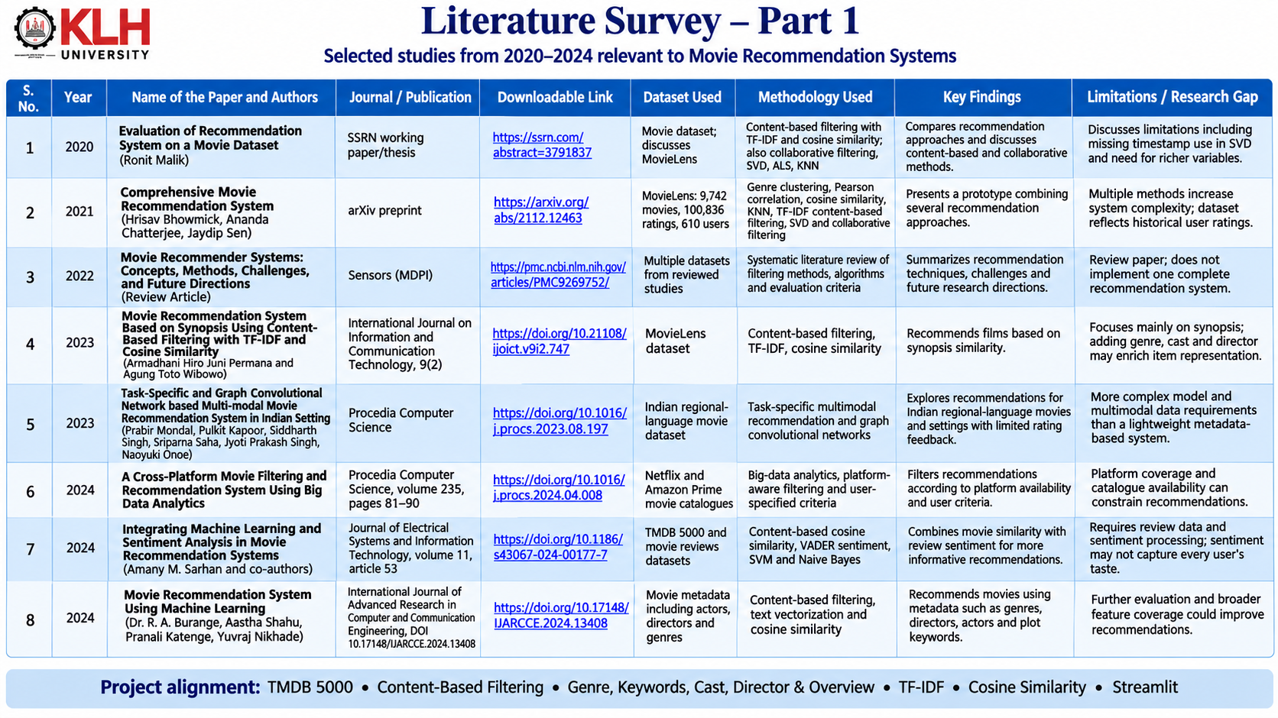
Working Prototype / Output Screens
Problem illustration
Shows why movie discovery needs relevant recommendations.
Dataset processing flow
Shows TMDB 5000 data preparation and recommendation pipeline.
Literature survey
Summarizes related movie recommendation studies.
Notes:
Show real screenshots, photos of the hardware or a short demo video link. Caption each one with what the viewer should notice.

Slide 14
Results & Performance Comparison
Performance metrics were not reported in the source PPT.
The project describes a content-based recommendation workflow; no measured accuracy, precision, recall or F1-score is provided.
Metric | Project result | Status
Accuracy | Not reported | Not evaluated in source
Precision | Not reported | Not evaluated in source
Recall | Not reported | Not evaluated in source
F1-score | Not reported | Not evaluated in source
ROC-AUC | Not reported | Not specified
No measured best-model score is reported.
The source presentation does not include quantitative evaluation results. Do not treat template example values as project results.
Notes:
Right-click the chart and choose Edit Data to enter your real numbers. Replace the metrics with the ones that fit your project (accuracy, latency, power, throughput, user rating). State clearly which option performed best.

Slide 15
Analysis & Key Findings
Interpretation: The system represents movie metadata using TF-IDF and ranks similar movies with cosine similarity.
Key features: Genre, keywords, cast, director and description.
Error analysis and measured feature importance are not provided in the source presentation.
Notes:
Explain what the numbers mean. Use a confusion matrix, ROC curve, feature-importance chart or output comparison. Be honest about weak results; panels value that.

Slide 16

Testing & Validation
Test ID | Test Description | Expected Result | Actual Result | Status
TC-01 | Select a movie title | Selected title is accepted | Not specified in source | Not reported
TC-02 | Process movie metadata | Feature text is prepared | Not specified in source | Not reported
TC-03 | Calculate similarity | Similar movies are ranked | Not specified in source | Not reported
TC-04 | Display recommendations | Results appear in Streamlit | Not specified in source | Not reported
Functional Testing
Validation Method
Performance Testing
Test scenarios are derived from the stated workflow; actual test execution results were not included.
Validation approach: verify selected movie input, feature processing, similarity ranking and displayed recommendations.
No speed, load or accuracy measurements are provided in the source PPT.
Notes:
List representative test cases with expected and actual outcomes. Name the validation methods you used. Delete rows you do not need.

Slide 17


Challenges & Limitations
Challenges Faced
Limitations
• Large movie collections make manual discovery difficult.
• Movie metadata must be cleaned and combined.
• Relevant features must be selected to produce useful similarity scores.
• Content-based recommendations focus on movie metadata.
• Recommendations depend on the quality and completeness of available features.
• No quantitative evaluation results are provided in the source PPT.
Notes:
Be candid. Pair every challenge with how you solved it, and list limitations that the panel would otherwise spot themselves.

Slide 18

Conclusion
A content-based Movie Recommendation System is designed using the TMDB 5000 dataset and a Streamlit dashboard.
1
Final Outcome
The source PPT does not report measured accuracy or comparative performance values.
Content-based recommendations
2
Outcome: ranked similar-movie suggestions
Interface: Streamlit dashboard
Objectives: workflow described in project PPT
The workflow combines movie metadata, TF-IDF and Cosine Similarity to recommend movies similar to a title selected by the user.
3
Notes:
Revisit each objective and say whether you met it. Quote your headline result with numbers. Do not introduce new material here.

Slide 19



Future Scope & Applications
Improve recommendation quality by evaluating similarity results and refining feature weights.
Applications
• Movie discovery platforms
• Streaming service interfaces
• Personal movie exploration
• Users seeking films similar to a selected title
Expand metadata coverage and include additional movie attributes where available.
Enhance the Streamlit dashboard with richer movie details and poster previews.
Explore hybrid recommendations that combine content features with user ratings, if suitable data becomes available.
Notes:
Give concrete next steps, ideally tied to the limitations. Then name two or three real-world uses.

Slide 20
Team Contribution
Reg. No. | Name | Contribution / Modules Handled
2420030517 | Tejaswi Chowdary | Dataset Collection, Loading and Data Preprocessing
2420030606 | Harshith Reddy | Feature Selection, TF-IDF Vectorization and Cosine Similarity
2420030613 | Hasini Reddy | Movie Recommendation , Streamlit, UI and testing
Notes:
Show that work was planned and shared. Every member should be able to explain their own module.

Slide 21

References
[1] R. Malik, “Evaluation of Recommendation System on a Movie Dataset,” SSRN, 2020. [Online]. Available: https://ssrn.com/abstract=3791837
[2] H. Bhowmick, A. Chatterjee, and J. Sen, “Comprehensive Movie Recommendation System,” arXiv preprint arXiv:2112.12463, 2021. [Online]. Available: https://arxiv.org/abs/2112.12463
[3] S. Jayalakshmi, N. Ganesh, R. Čep, and J. S. Murugan, “Movie Recommender Systems: Concepts, Methods, Challenges, and Future Directions,” Sensors, vol. 22, no. 13, Art. no. 4904, 2022. DOI: 10.3390/s22134904.
[4] A. H. J. Permana and A. T. Wibowo, “Movie Recommendation System Based on Synopsis Using Content-Based Filtering with TF-IDF and Cosine Similarity,” International Journal on Information and Communication Technology, vol. 9, no. 2, pp. 1–14, 2023. DOI: 10.21108/ijoict.v9i2.747.
[5] P. Mondal, P. Kapoor, S. Singh, S. Saha, J. P. Singh, and N. Onoe, “Task-Specific and Graph Convolutional Network Based Multi-modal Movie Recommendation System in Indian Setting,” Procedia Computer Science, vol. 218, pp. 591–600, 2023. DOI: 10.1016/j.procs.2023.08.197.
Project Links
GitHub: Not provided
Dataset: TMDB 5000 Movie Dataset (Kaggle)
Demo video: Not provided
Notes:
Use IEEE style, numbered in order of first citation in the deck. Include datasets, documentation and code repositories.

Slide 22
THANK YOU
Questions & Discussion
Movie Recommendation System
Guide: Dr. Sunanda N
Department of Computer Science and Engineering
Notes:
Leave this slide up during questions. Make sure every team member can answer questions about their own module.

