Slide 1
Bank Marketing Campaign Analysis
EDA PROJECT · PYTHON, PANDAS, SEABORN, SCIKIT-LEARN
Which customers say yes to a term deposit, and how can calls be better targeted?
[Your name] · Bleep EDA Assignment · UCI Bank Marketing dataset, 45,211 customers
Notes:
Introduce the problem: a bank phoned customers to sell term deposits and only 11.7% said yes. The goal is to find patterns that help target calls.

Slide 2
Data and cleaning
45,211
16
11.7%
customers (one row each)
features plus the yes/no target
subscribed, so classes are imbalanced
Key cleaning decisions
"unknown" values (poutcome 81.7%)
Kept as their own category instead of dropping rows
pdays = -1
Replaced by a previously_contacted flag (-1 is a code, not days)
balance outliers (10.5%)
Kept as real customers; compared with medians and a log scale
duration
Excluded from the model because it is only known after the call
Bank Marketing Campaign Analysis · 2
Notes:
Dataset facts and the four cleaning decisions that matter most. Duplicates: none found.

Slide 3
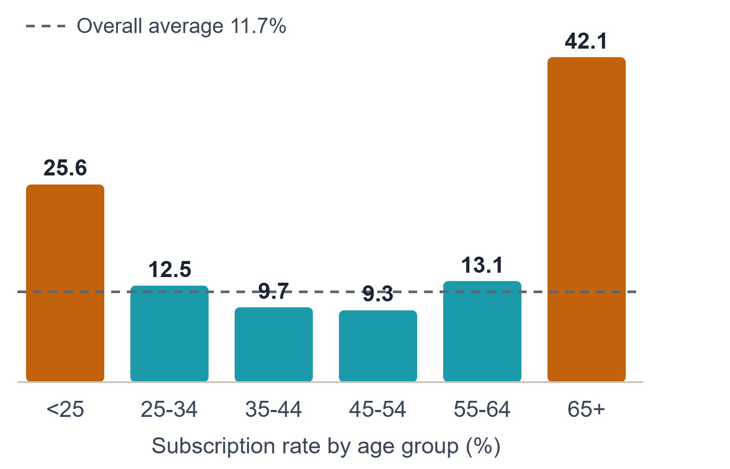
Age and job shape who subscribes
U-shape by age: under-25 (25.6%) and 65+ (42.1%) subscribe far above the 11.7% average.
Job: students (28.7%) and retirees (22.8%) lead; blue-collar is lowest at about 7%.
Caution: the under-25 and 65+ groups have only about 810 customers each.
Bank Marketing Campaign Analysis · 3
Notes:
Age follows a U-shape, and the job chart tells the same story: students are young, retirees are old. The extreme groups are small, so treat them as promising signals.

Slide 4
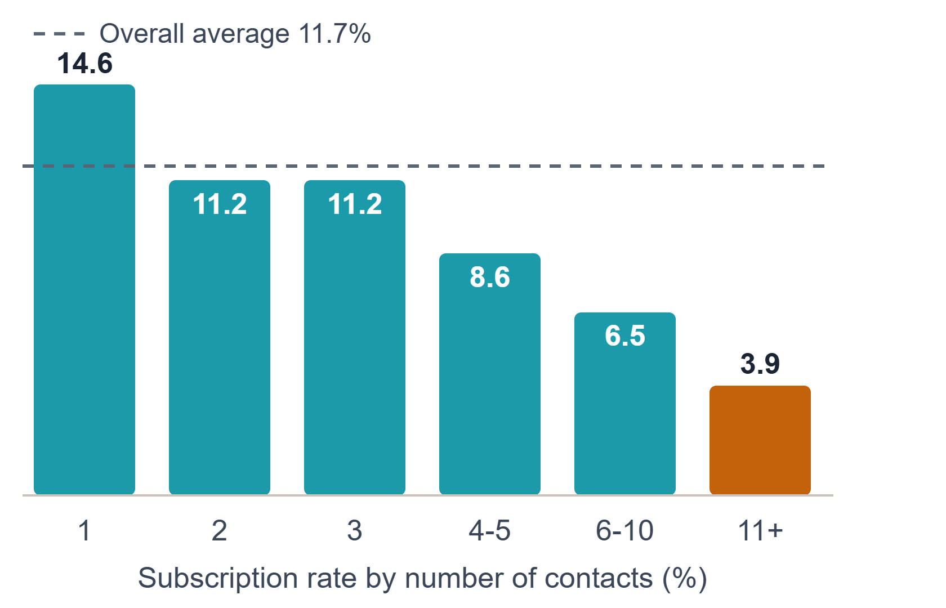
Past success and call frequency
64.7%
of previous-campaign successes subscribed again, about 5.5x the average
14.9%
cellular contacts subscribed, vs 13.4% telephone and only 4.1% unknown
Bank Marketing Campaign Analysis · 4
Notes:
Returns diminish after about three contacts. This is an association: hard-to-convert customers may simply be called more often. The unknown contact group is 28.8% of customers, so read its low rate carefully.

Slide 5
Seasonality: effort and results do not match
~7%
52.0%
~44-47%
May
March
Sep, Oct, Dec
About 13,700 calls (roughly 30% of all calls) but one of the lowest rates
Only about 400 calls, but the highest rate of the year
Few calls each (a few hundred), very high rates
High-rate months have small samples and may reflect who was called, not the month itself. The data has no year column, so this is a seasonal pattern, not a true time series.
Bank Marketing Campaign Analysis · 5
Notes:
Values marked with a tilde are read from the monthly chart; March (52.0%) is the printed value. Replace with exact numbers from the notebook printout.

Slide 6
Baseline model: Logistic Regression
Test set results (class "yes")
Confusion matrix (9,043 customers)
Accuracy
0.756
6,175
1,810
Precision
0.27
Correct "no"
Wasted calls
Recall
0.62
399
659
Missed subscribers
Subscribers found
F1-score
0.37
Flagged customers subscribe at about 27%, roughly 2.3x the 11.7% baseline. duration was excluded to avoid data leakage.
Bank Marketing Campaign Analysis · 6
Notes:
Accuracy is lower than an always-no model (about 88%), but that model finds zero subscribers. Class weights were balanced, so precision is traded for recall. The model's top features agree with the EDA: previous success, unknown contact, number of contacts, retired status.

Slide 7
Recommendations and limitations
Recommendations
Limitations
1. Re-contact previous successes first (64.7%).
One bank, 2008-2010 data.
2. Prioritise students, retirees and tertiary-educated customers.
Association, not causation.
Some segments and months have small samples.
3. Cap follow-up calls at about 3 per customer.
No year column, so months are a seasonal pattern.
4. Prefer cellular and record contact method properly.
Logistic Regression is linear and misses the age U-shape.
5. Test moving call volume away from May.
Bank Marketing Campaign Analysis · 7
Notes:
Close with the five actions and be upfront about what the analysis cannot prove.

